Slide 2








Reading
Speaking
Before you read, look at the pictures below. Make predictions about the reading. Then read and check your ideas.
Work in pairs. Make notes about one of the places in the reading. You can add your own ideas.
Some foreign visitors are visiting your city / town / area. You are their tour guide. Tell them some interesting things about the place as well as what they must and mustn’t do there.
Complete the sentences, using the words from the box.
Read the text again. Answer the following questions.

Slide 3


Date : 08/12/2025 - Class : 6D
Monday,December 8th , 2025
P 39 : UNIT 5 : Natural Wonders of Viet Nam
Lesson 5: Skills 1
I- Reading
1-Before reading

Slide 4


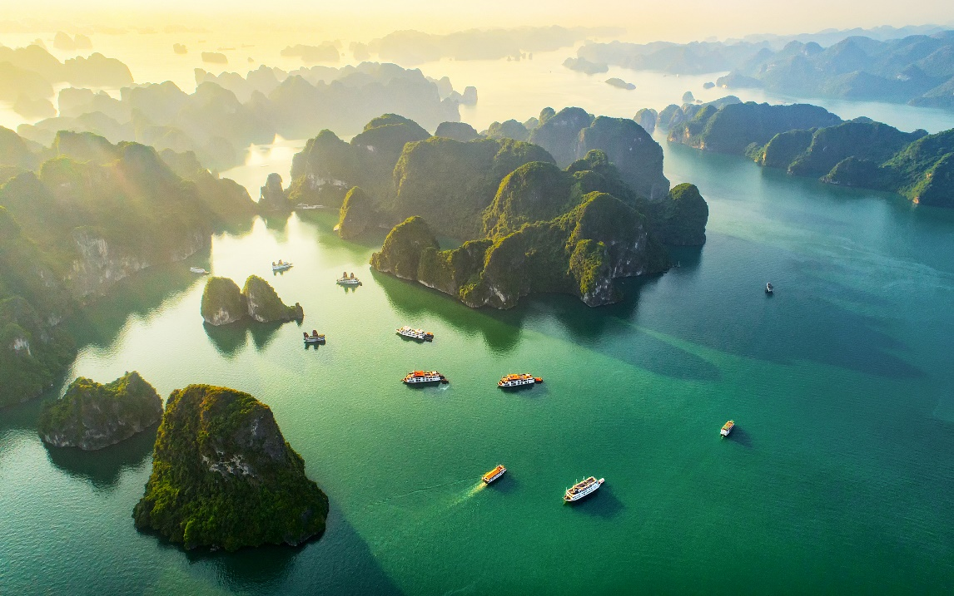
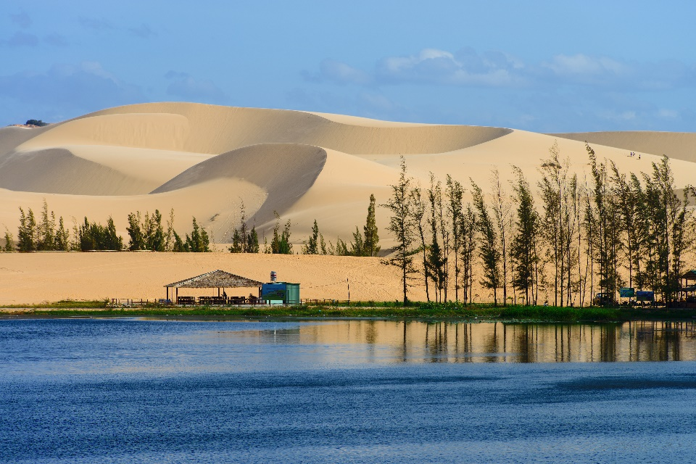
Before you read, look at the pictures below. Make predictions about the reading. Then read and check your ideas.
1.
What is the reading about?
2.
What do you know about these places?

Slide 5
Period 39: UNIT 5 . Natural Wonders of Viet Nam
Skills 1
2. Vocabulary
popular (adj)
phổ biến
attraction (n)
Sự hấp dẫn/sự thu hút
enjoy (v)
thích
seafood(n):
hải sản
landscape(n)
phong cảnh
different
khác/khác biệt
early > < late
Sớm >< muộn

Slide 6
Friday,December 2nd 2023
Period 39: UNIT 5 . Natural Wonders of Viet Nam
Lesson 5: Skills 1
- - tourist (n) khách du lịch
- - slope (n) độ dốc (- sườn núi)….

Slide 7

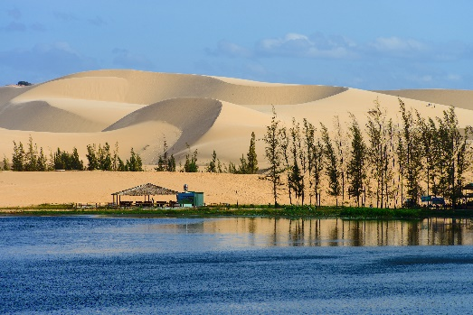
Ha Long Bay is in Quang Ninh. It has many islands and caves. Tuan Chau, with its beautiful beaches, is a popular tourist attraction in Ha Long Bay. There you can enjoy great seafood. And you can join in exciting activities. Ha Long Bay is Viet Nam’s best natural wonder.
Mui Ne is popular for its amazing landscapes. The sand has different colours: white, yellow, red ... It’s like a desert here. You can ride a bike down the slopes. You can also fly kites, or have a picnic by the beach. The best time to visit the Mui Ne Sand Dunes is early morning or late afternoon. Remember to wear suncream and bring water.

Slide 8
Before you read, look at the pictures below. Make predictions about the reading. Then read and check your ideas.
1.The reading is about HaLong Bay and Mui Ne 2. I know a bout Tuan Chau: a large island in Ha Long Bay, a popular tourist destination
Mui Ne: a tourist attraction in Binh Thuan Province

Slide 9

Complete the sentences, using the words from the box.
desert
visit
wonder
islands
remember
islands
1.
Ha Long Bay is the famous for its beautiful .
wonder
2.
Ha long Bay is the number one natural in Viet Nam.
desert
3.
A is a large area of land with very little water.
Remember to bring an umbrella, as it often rains there.
4.
to bring an umbrella, as it often rains there.
5.
A lot of people Ly Son Island in the summer.
visit

Slide 10

Read the text again. Answer the following questions.
1.
Where is Ha Long Bay?
It is in Quang Ninh.
2.
What can you do at Ha Long Bay?
We can enjoy (great) seafood and join in exciting activities.
3.
Is there a desert in Mui Ne?
No, there isn’t.
4.
Where can you have a picnic in Mui Ne?
By the beach.
5.
What is the best time to visit the Mui Ne Sand Dunes?
Early morning or late afternoon.

Slide 11
II. Speaking

Slide 12

Work in pairs. Make notes about one of the places in the reading. You can add your own ideas.
Ha Long Bay | Mui Ne
interesting islands
a beautiful place
Beautiful beaches
caves
amazing landscapes
……beaches
Then tell your partner about the place.
Example:
Ha Long Bay has a lot of interesting islands. It also has a lot beautiful beaches…
Mui Ne is a beautiful place. It has many amazing landscapes ,

Slide 13

Some foreign visitors are visiting your city / town / area. You are their tour guide. Tell them some interesting things about the place as well as what they must and mustn’t do there.
Example:
You must follow all the rules.
You mustn’t take photos when you are in the City Museum.
Litter = xả rác/ make noisy = làm ồn
Wear shorts/…..

Slide 14
Period 39: UNIT 5 . Natural Wonders of Viet Nam
Skills 1
Homework:
Learn by heart Vocabulary.
Do exercise Part D at page 36- 38.
Prepare Unit 5: Skills 2

Slide 15







