Slide 1


Slide 2
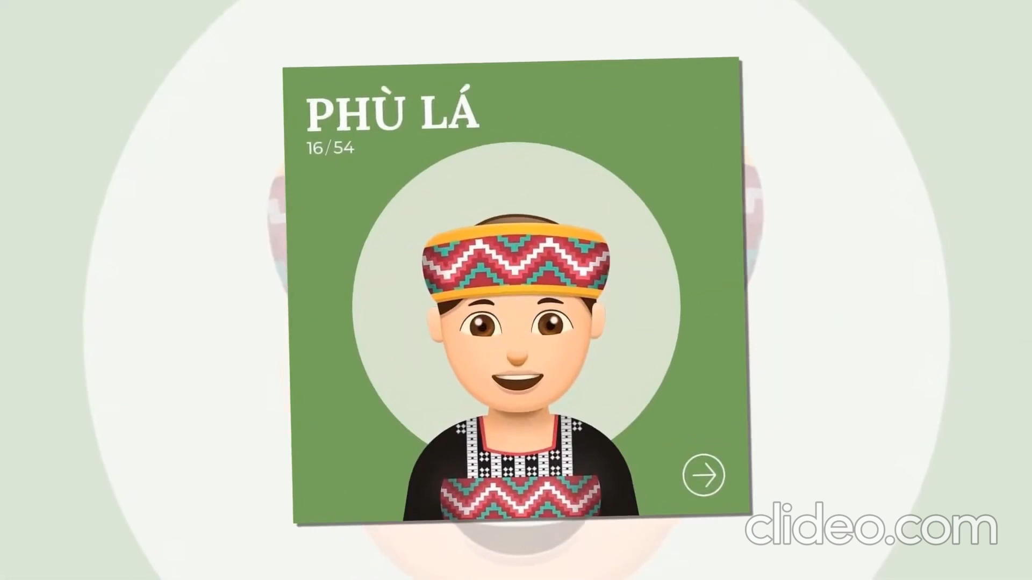

Slide 3


Slide 4

Unit
4
ETHNIC GROUPS OF VIET NAM
Unit
ETHNIC GROUPS OF VIET NAM
LESSON 7: LOOKING BACK & PROJECT
LESSON 3: A CLOSER LOOK 2
Vocabulary
Grammar
Project: Making a poster
Unit
HOBBIES

Slide 5


Slide 6
VOCABULARY
1
Match the words and phrases with the pictures.
1. weaving
2. folk dance
3. open fire
4. fishing
5. minority group
___________
___________
___________
___________
___________

Slide 7
VOCABULARY
2
Complete the sentences with the word and phrases from the box.
folk songs
staircase
sticky rice
communal house
musical instruments
1. Minority groups have their own _________________ like the dan tinh, gong, t’rung.
2. The Kinh use __________ to make banh chung and banh tet.
3. For most minority groups like the Bahnar and Ede, the ________________, usually known as Rong house, is the heart of the village.
4. My grandmother taught me to sing many ___________.
5. The __________of a Muong’s stilt house has an odd number of steps: 5, 7, or 9.

Slide 8
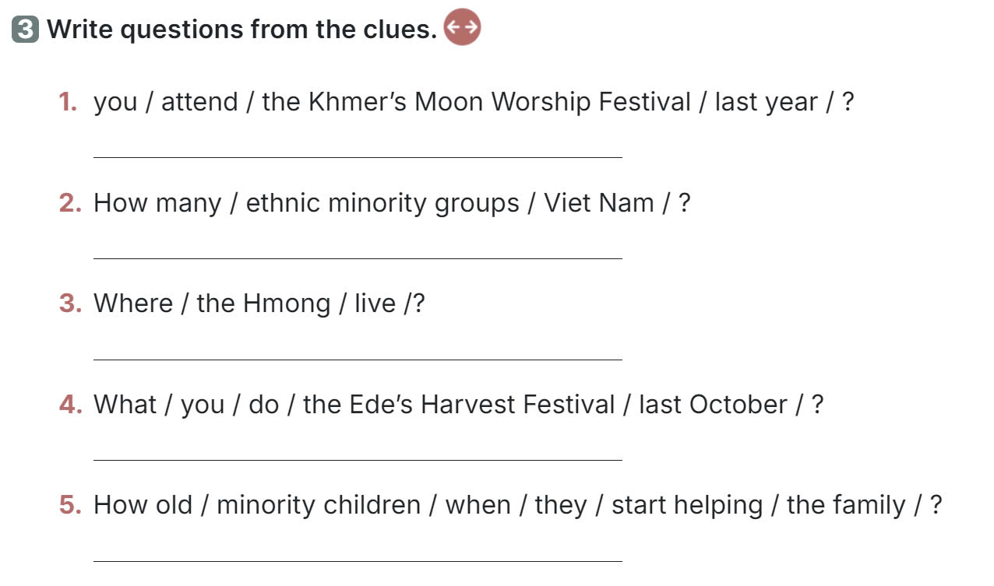
GRAMMAR

Slide 9
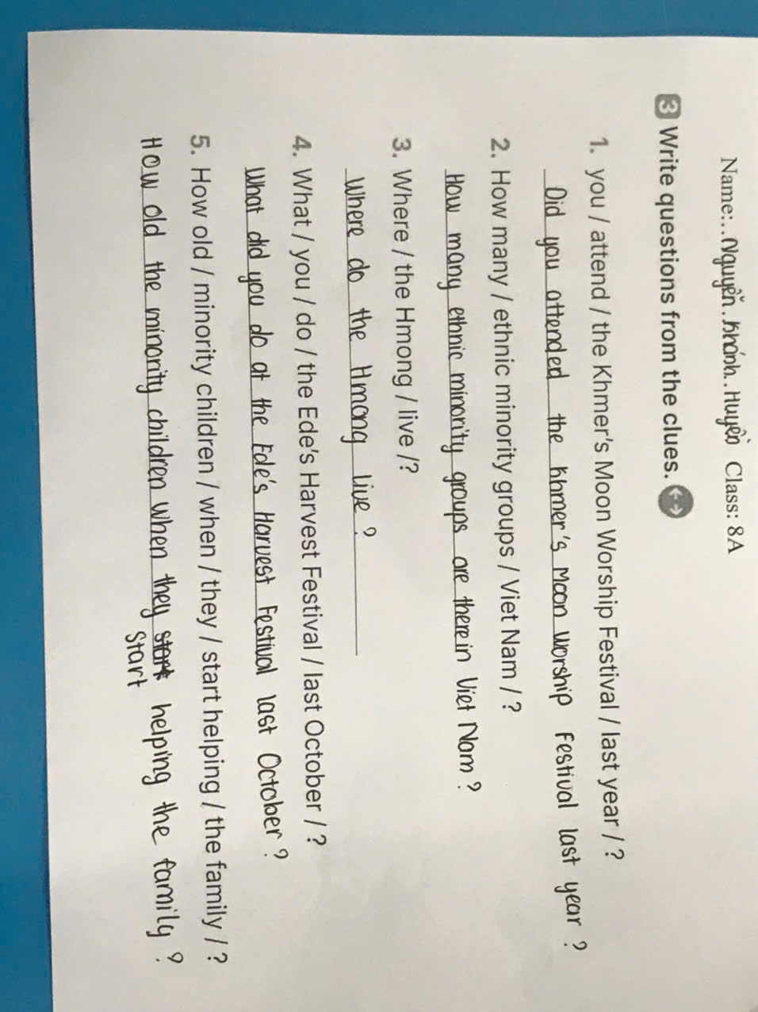

Slide 10
GRAMMAR
3
Write questions from the clues.
3. → Where do the Hmong live?
4. → What did you do at the Ede’s Harvest Festival last October?
5. → How old are the minority children when they start helping the family?

Slide 11
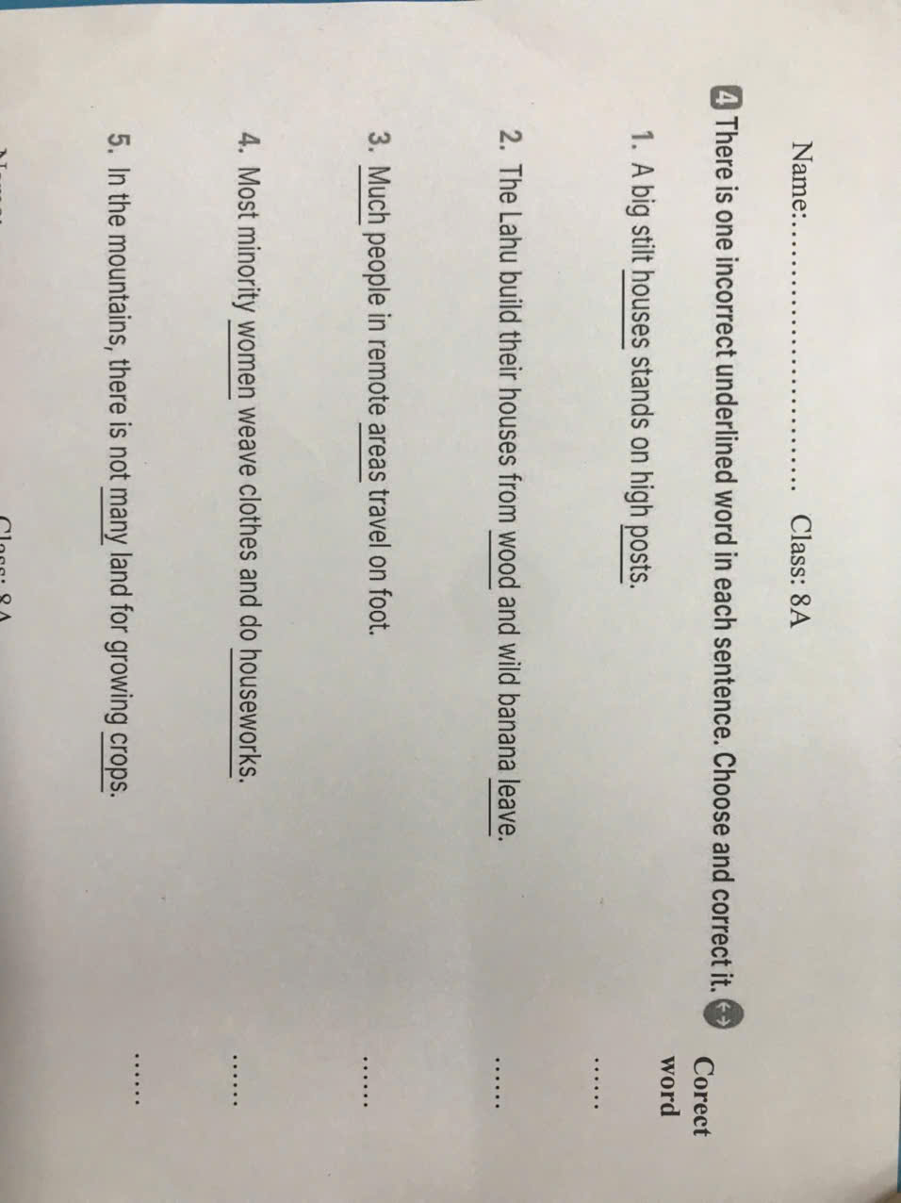

Slide 12
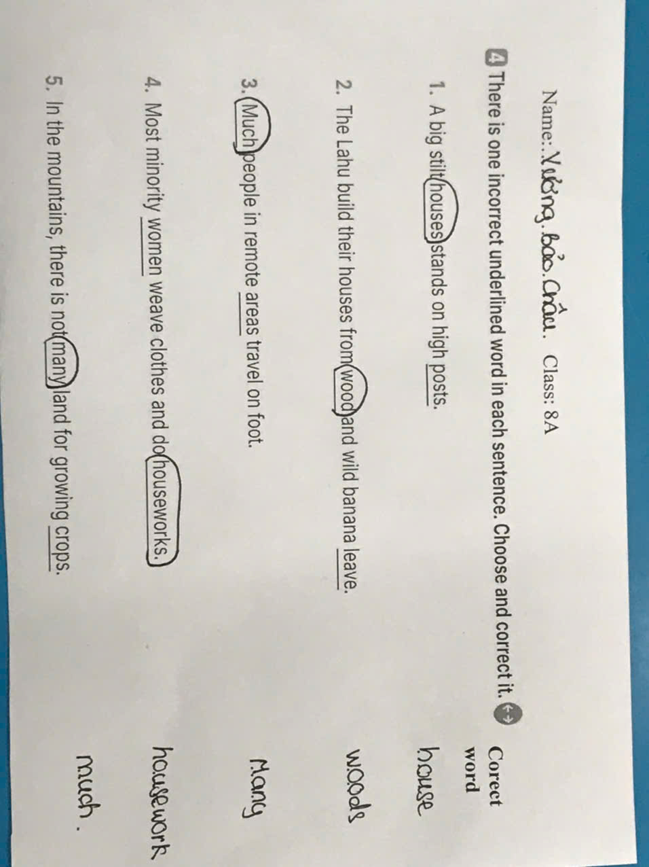

Slide 13
GRAMMAR
4
There is one incorrect underlined word in each sentence. Circle and correct it.
 | Correct word
1. A big stilt houses stands on high posts.
2. The Lahu build their houses from wood and wild banana leave.
3. Much people in remote areas travel on foot.
4. Most minority women weave clothes and do houseworks.
5. In the mountains, there is not many land for growing crops.
→ house
→ leaves
→ Many
→ housework
→ much

Slide 14
PROJECT
OUR ETHNIC GROUPS

Slide 15

CONSOLIDATION
1
Wrap-up
In this lesson, you have:
revised more vocabulary items in the unit in different context.
revised Yes / No questions and Wh-questions.
revised the use of countable and uncountable nouns.
had an opportunity to research more deeply into an ethnic group you are interested in.

Slide 16

CONSOLIDATION
2
Homework
Do exercises in the workbook.
Prepare for Unit 5 – Getting started.

Slide 17





THANKS FOR YOUR ATTENTION!

