Slide 1
P62-Unit 8:
Sports and games
Part 1: Getting started

Slide 2
Objectives
By the end of the lesson, students will be able to:
- have an overview about the topic Sports and games;
- use the vocabulary and talk about sports and games.

Slide 3
Name of sport
TENNIS

Slide 4
Name of sport
BASKETBALL

Slide 5
Name of sport
BASEBALL

Slide 6
Name of sport
HOCKEY

Slide 7
Name of sport
BADMINTON

Slide 8
Name of sport
SOCCER/ FOOTBALL

Slide 9
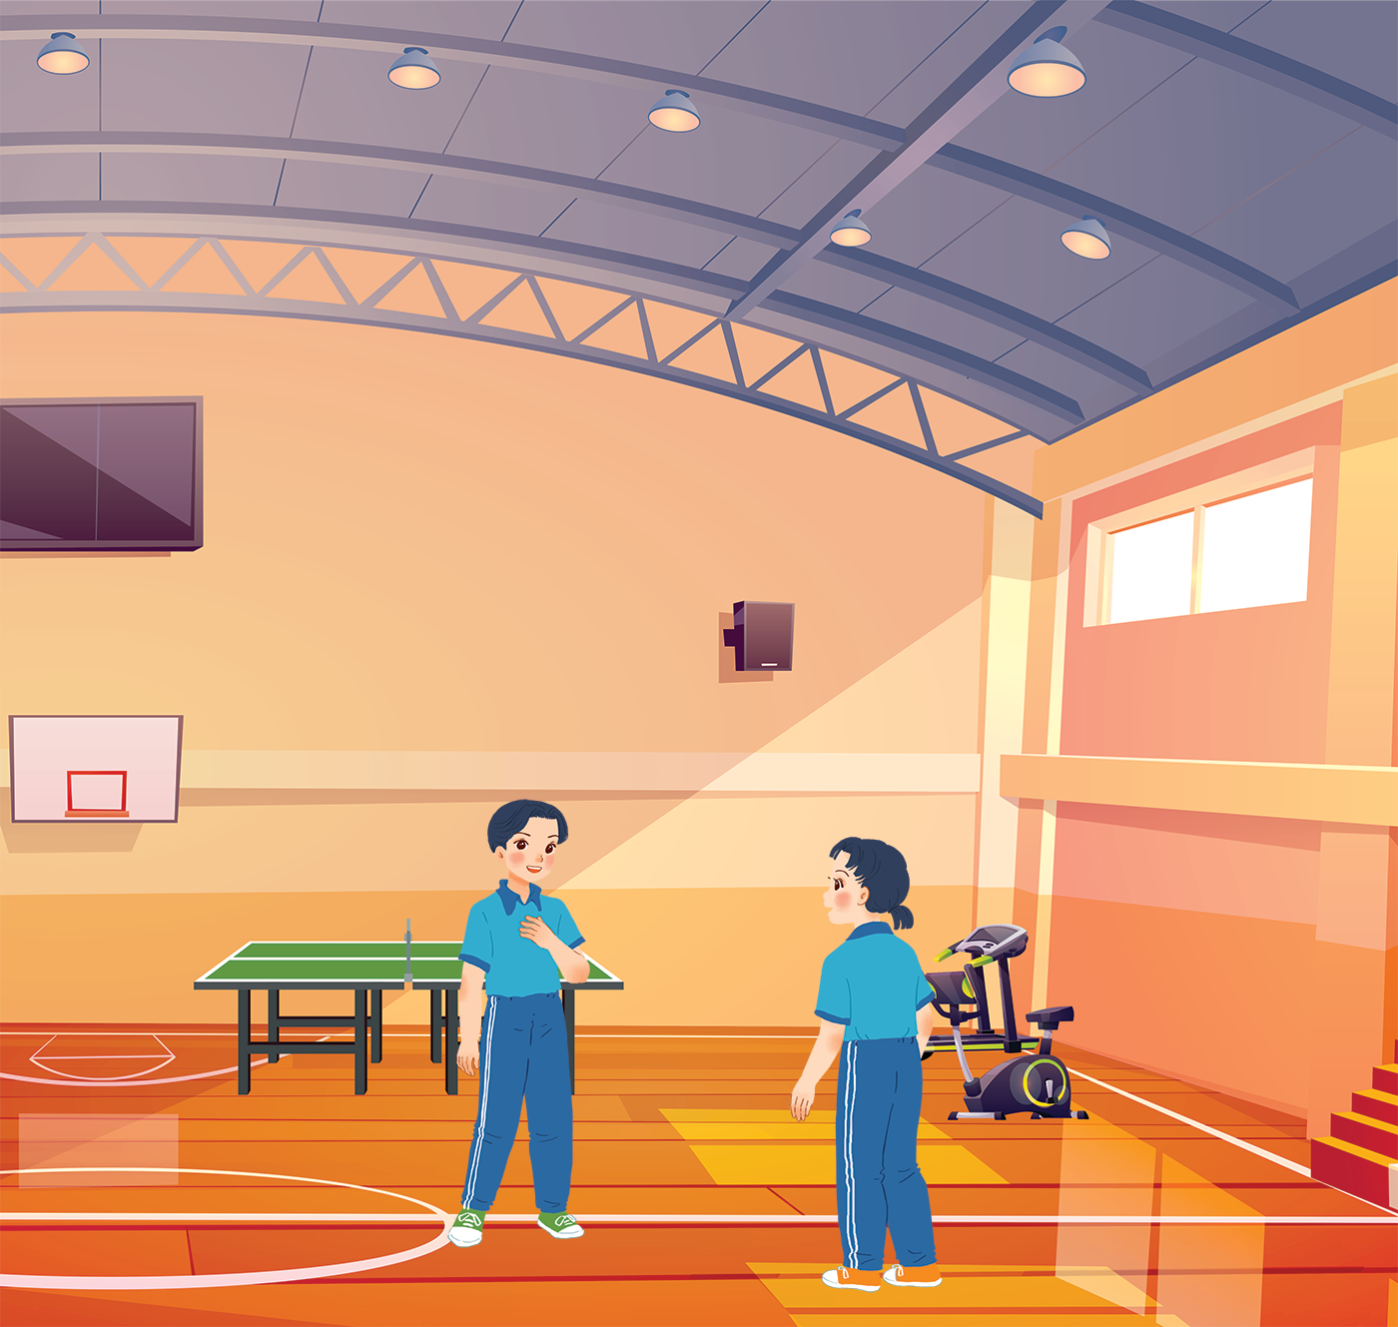
BEFORE YOU READ
What do you see in the picture?
Where are they?
Do you usually go to the gym?

Slide 10
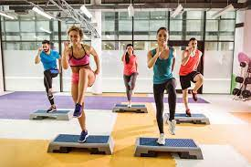
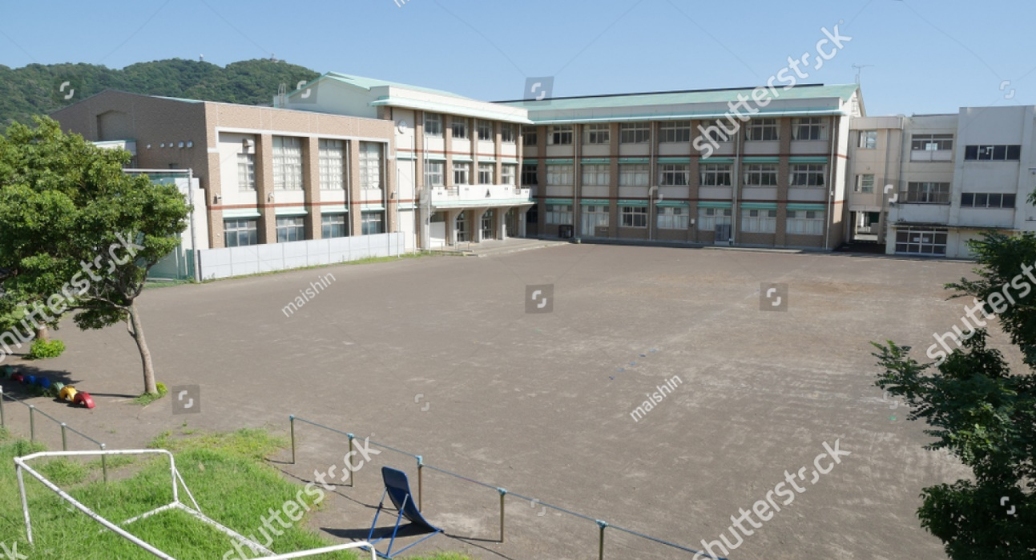
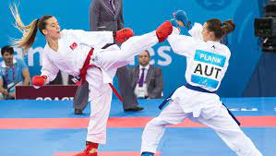
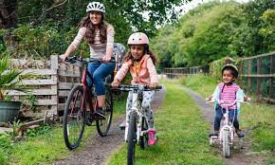
Vocabulary
Equipment (n) /ɪˈkwɪp.mənt/
Karate(n) /kəˈrɑː.ti/
Congratulations: (ex,n) /kənˌɡrætʃ·əˈleɪ·ʃənz/
Cycle (v) /ˈsaɪ.kəl/
Aerobics(n): /eəˈrəʊ.bɪks/
Schoolyard:(n) /ˈskuːl.jɑːd/
Trang thiết bị
Môn võ karate
Chúc mừng
Đạp xe
Thể dục nhịp điệu
Sân trường

Slide 11
Checking Vocabulary
Equipment
Karate
Congratulations:
Cycle:
Aerobics:
School yard:
Trang thiết bị
Môn võ karate
Chúc mừng
Đạp xe
Thể dục nhịp điệu
Sân trường

Slide 12
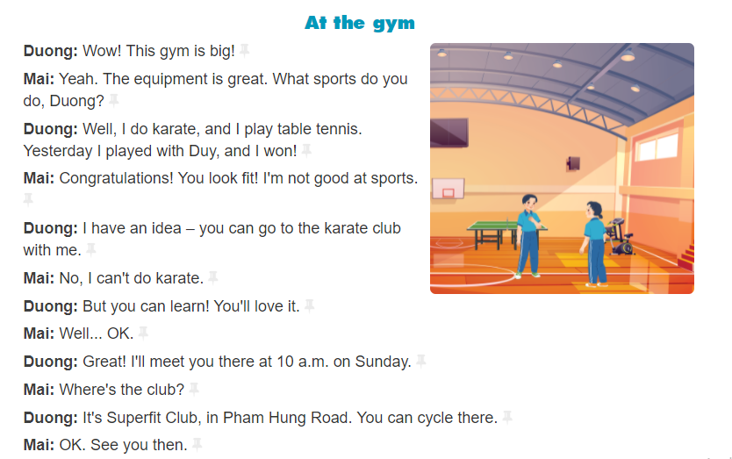

Slide 13
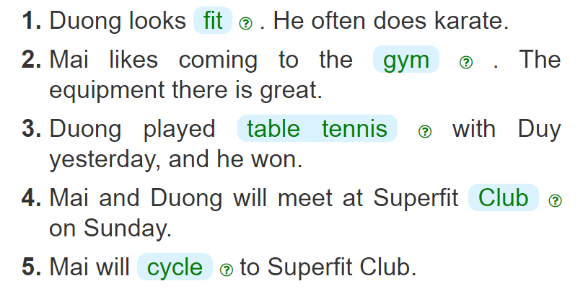
Duong: Well, I do karate, and I play table tennis. Yesterday I played with Duy, and I won! Mai: Congratulations! You look fit!
Duong: Wow! This gym is big! Mai: Yeah. The equipment is great.
Duong: Well, I do karate, and I play table tennis. Yesterday I played with Duy, and I won!
Duong: Great! I’ll meet you there at 10 a.m. on Sunday. Mai: Where’s the club? Duong: It’s Superfit Club, in Pham Hung Road.
Duong: It’s Superfit Club, in Pham Hung Road. You can cycle there. Mai: OK.

Slide 14
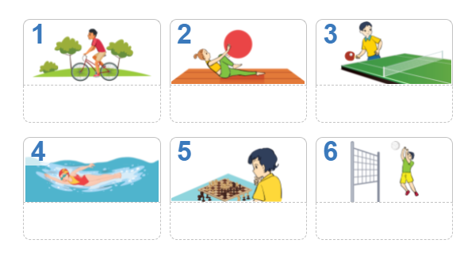
Chess
aerobics
Table tennis
cycling
swimming
volleyball

Slide 15
- A sport is a physical activity carried out under an agreed set of rules, with a recreational purpose: for competition or self-enjoyment or a combination of these.
- A game is a recreational activity involving one or more players, defined by a goal that the players try to reach, and some set of rules to play it.

Slide 16
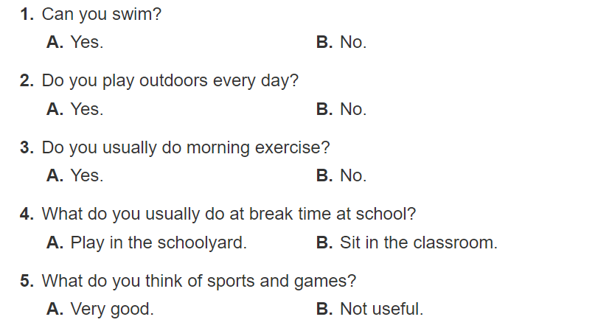

Slide 17
Sum up
By the end of the lesson, students will be able to:
- have an overview about the topic Sports and games;
- use the vocabulary and talk about sports and games.
- Do homework page…
- Prepare “ A closer look 1” part.

