Slide 1
Good morning class!!!

Slide 2
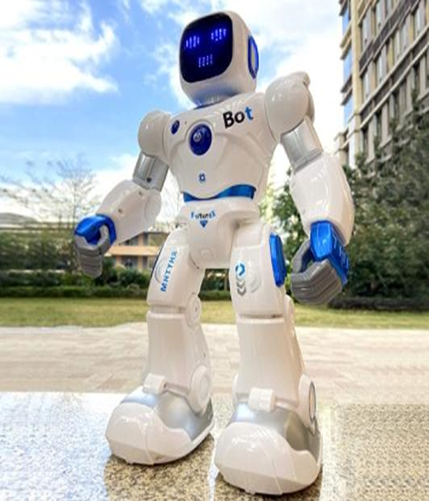
Game:
* Guessing word
R | O | B | O | T | S

Slide 3
UNIT 12. ROBOTS
P95-Lesson 1: GETTING STARTED

Slide 4
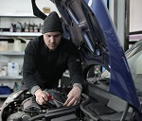
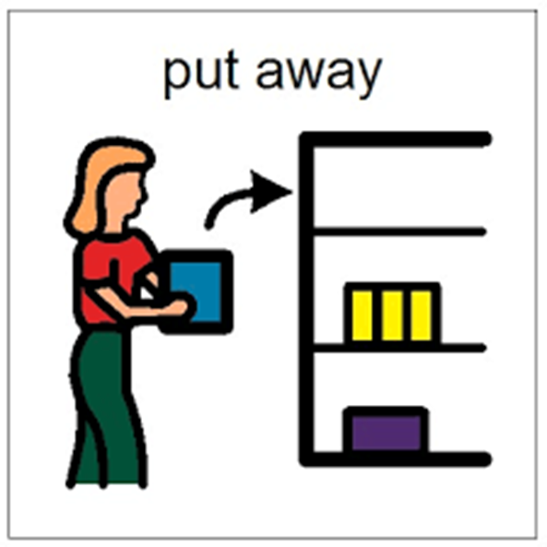
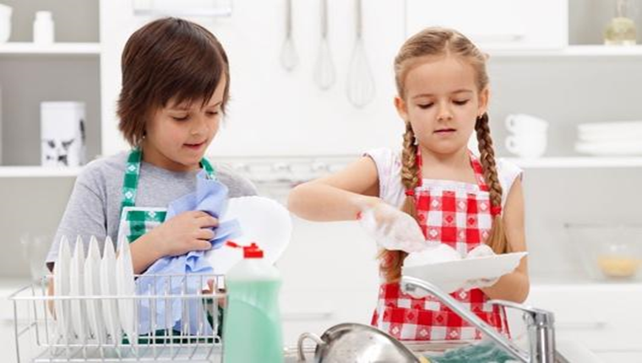
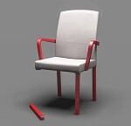
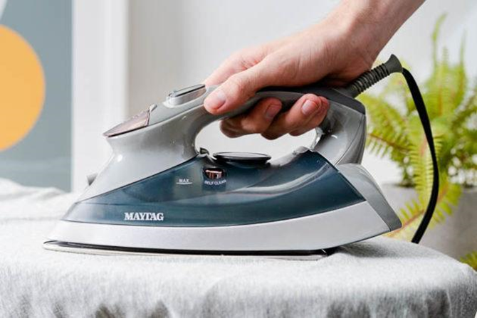
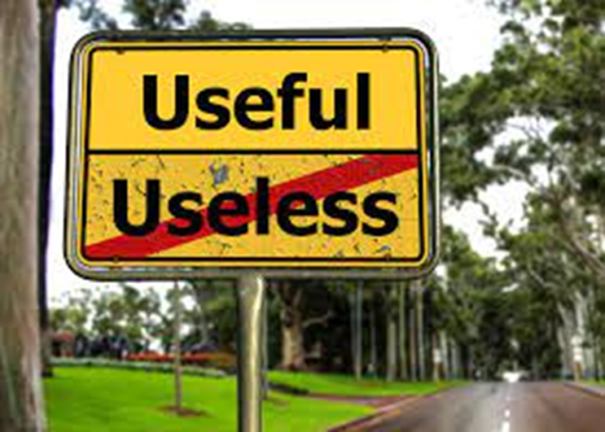
* Vocabulary
- robot (n) /ˈrəʊbɒt/:
- do the dishes (vph) / dɪʃiz/:
- iron (v) /ˈaɪən/:
- useful (adj) /ˈjuːsfl/:
- put sth away (vph) /pʊt əˈweɪ/:
- repair (v) /rɪˈpeə(r)/:
- broken (adj) /ˈbrəʊkən/:
người máy
rửa bát đĩa
là phẳng (quần áo)
có ích, hữu dụng
cất đi
sửa chữa
vỡ, nát, hỏng

Slide 5
* Checking vocabulary
- robot (n) /ˈrəʊbɒt/:
- do the dishes (vph) / dɪʃiz/:
- iron (v) /ˈaɪən/:
- useful (adj) /ˈjuːsfl/:
- put sth away (vph) /pʊt əˈweɪ/:
- repair (v) /rɪˈpeə(r)/:
- broken (adj) /ˈbrəʊkən/:
người máy
rửa bát đĩa
là phẳng (quần áo)
có ích, hữu dụng
cất đi
sửa chữa
vỡ, nát, hỏng

Slide 6
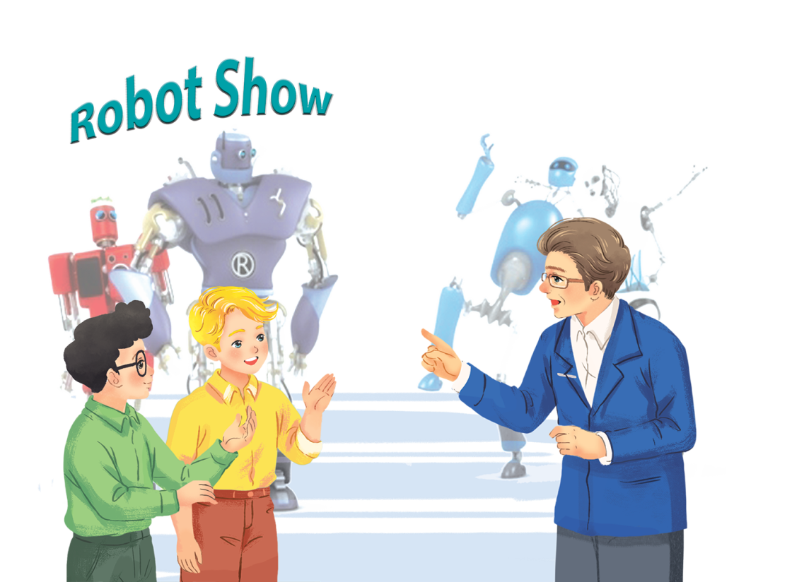
Listen and read.
At an International Robot Show
1. Who are they in the picture?
→They are Nick, phong and
Dr Adams.
2. Where are they?
→They are in a robot show.
3. What types of robot do you know?
→ Doctor robot, teacher robot, worker robot, home robot, space robot

Slide 7
At an International Robot Show
Nick: Dr Adams! Can you tell us about the robots in the show, please?
Dr Adams: Sure. This is H8, a home robot. It can do the dishes, iron clothes, put toys away …
Nick: It looks very useful!
Dr Adams: Yes, it can even make meals.
Phong: Look! That’s the biggest robot in the show.
Dr Adams: Right, it’s WB2, a worker robot. It’s the strongest and fastest robot here.
Nick: What can it do?
Dr Adams: It can move heavy things or repair broken machines.
Nick: And what is this?
Dr Adams: It’s Shifa, a doctor robot. It’s the smartest robot. It can help sick people and do many things like humans.

Slide 8
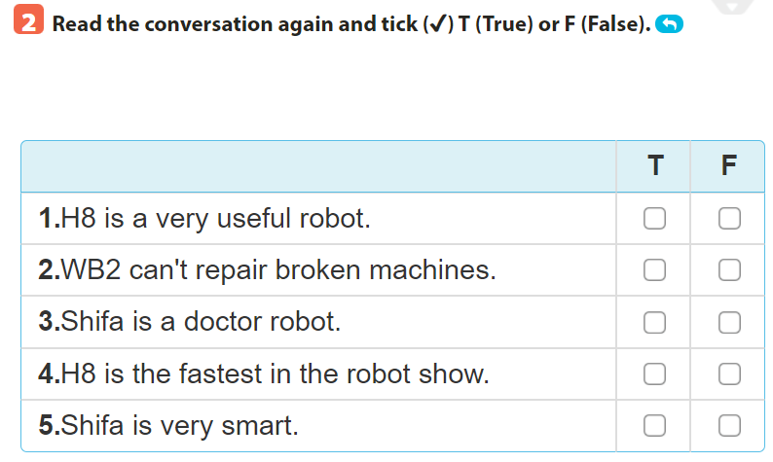
Read the conversation again and tick () T (True) or F (False).
✓
✓
✓
✓
✓
Dr Adams: Sure. This is H8, a home robot. It can do the dishes, iron clothes, put toys away …
Nick: It looks very useful!
Nick: And what is this? Dr Adams: It's Shifa, a doctor robot. It's the smartest robot. It can help sick people and do many things like humans.
Dr Adams: Yes, it can even make meals.] Phong: Look! That's the biggest robot in the show.
Dr Adams: It's Shifa, a doctor robot. It's the smartest robot. It can help sick people and do many things like humans.
Nick: What can it do? Dr Adams: It can move heavy things or repair broken machines.

Slide 9
Complete the following sentences, using the adjectives in the box.
fast
smart
useful
heavy
strong
1. My dad bought me a very.............. home robot last week.
It helps me to do many household chores.
2. This is a very ........... .car. It can travel at a speed of 300 km per hour.
3. He's very ................... He can move a big car!
4. They're making a very ............ robot. It can understand 30 languages.
5. The table is too .............. for me to move on my own.

Slide 10
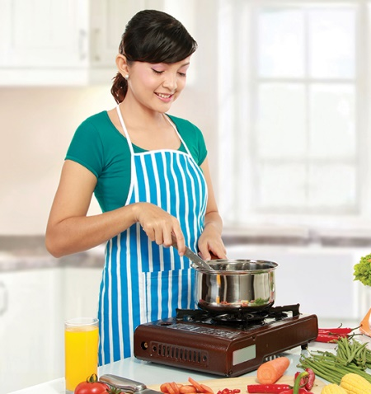
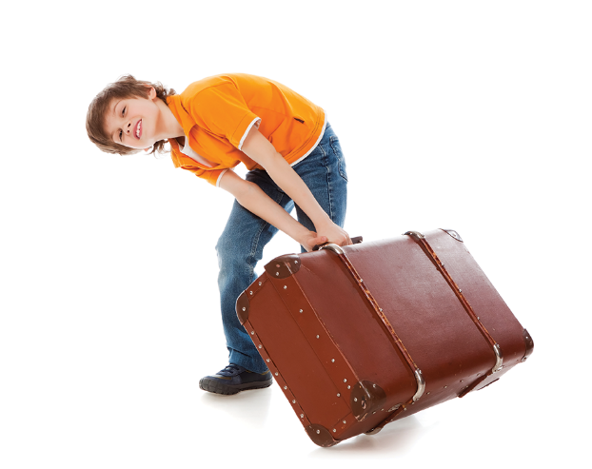
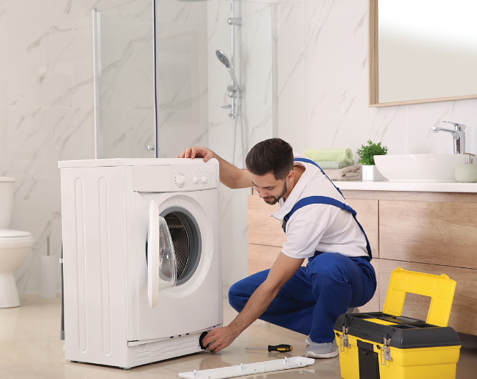
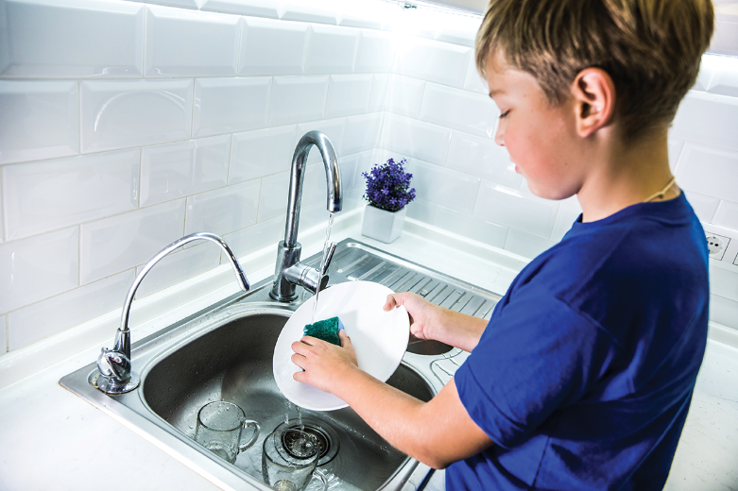
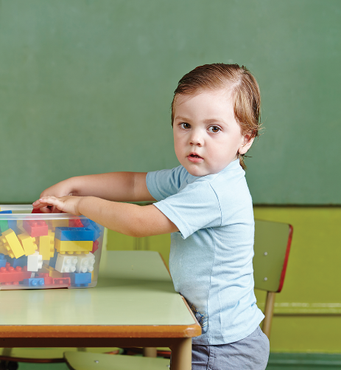
Match the following activities with the pictures.
a.
iron clothes
c.
move heavy things
e.
repair a broken machine
b.
make meals
d.
do the dishes
f.
put toys away
1
2
3
4
5
6

Slide 11
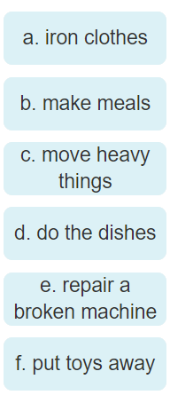
Match the activities with the pictures.

Slide 12
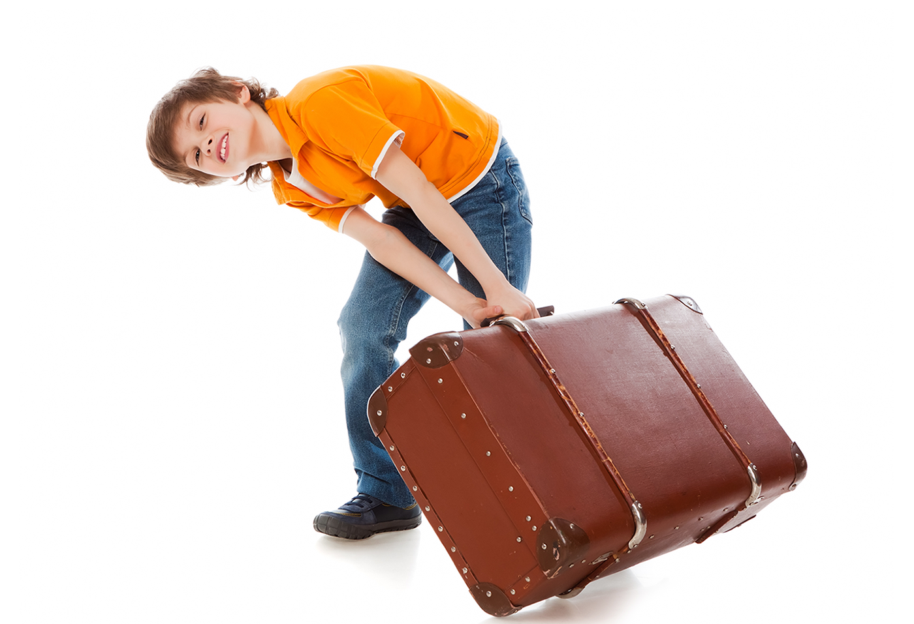
Match the activities with the pictures.

Slide 13
Match the activities with the pictures.

Slide 14
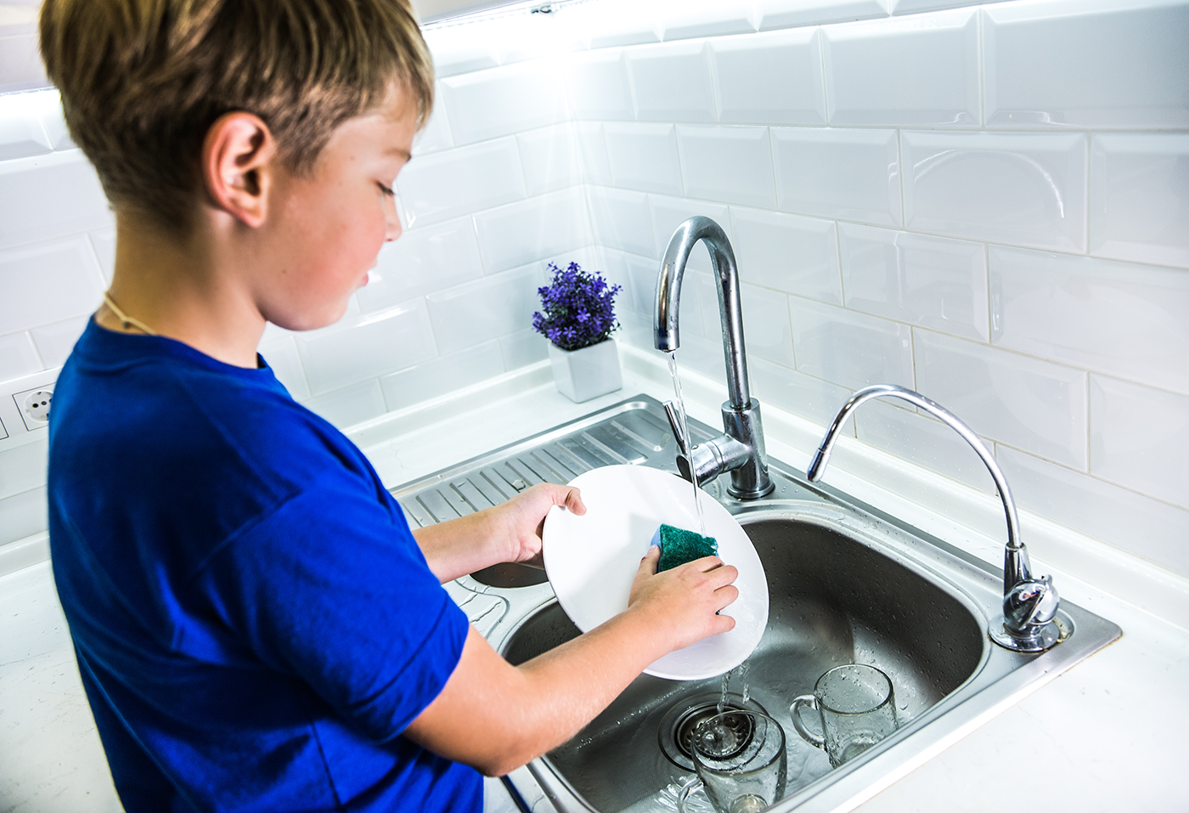
Match the activities with the pictures.

Slide 15
Match the activities with the pictures.

Slide 16
Match the activities with the pictures.

Slide 17
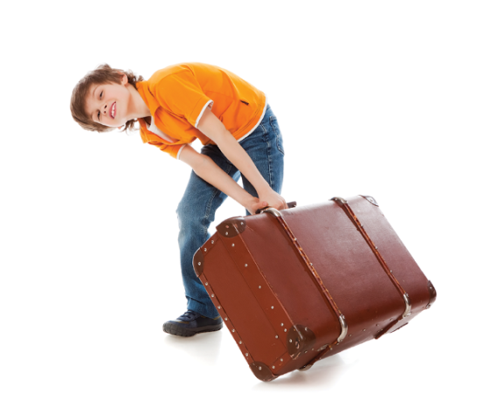
a.
Match the activities with the pictures.
iron clothes
c.
move heavy things
e.
repair a broken machine
b.
make meals
d.
do the dishes
f.
put toys away
1
2
3
b.
make meals
c.
move heavy things
e.
repair a broken machine
4
5
6
d.
do the dishes
f.
put toys away
a.
iron clothes

Slide 18
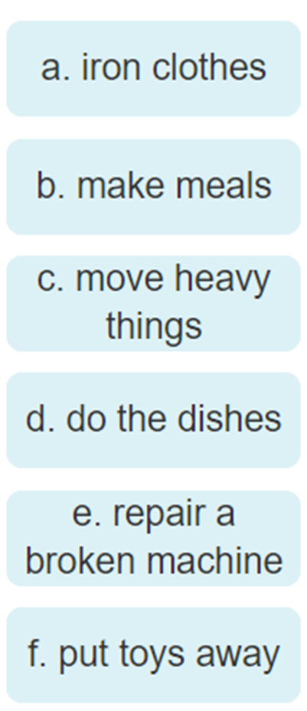
Miming
Work in groups. A student mimes one of the activities in 4 and the others try to guess. Then swap.
Example:
A: What am I doing?
B: You’re doing the dishes.
A: Yes, that’s right. / No, try again.

Slide 19
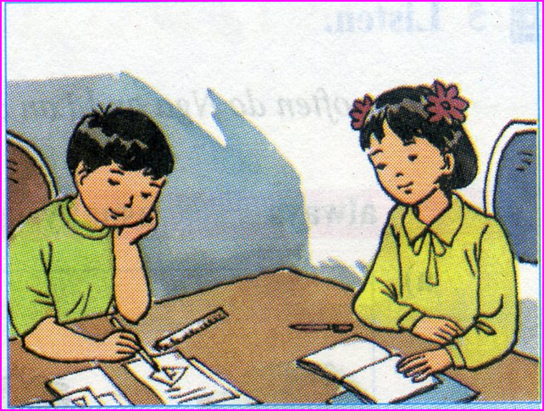
homework
- Learn all the new words by heart .
- Read the dialogue again.
- Prepare lesson 2 ( A closer look 1).

