Slide 1
Thusday November 31st 2024
Good morning class !!!
Welcome the teachers to attend our lesson to day - Class 9A

Slide 2
* Warm up: KIM’S GAME

Slide 3
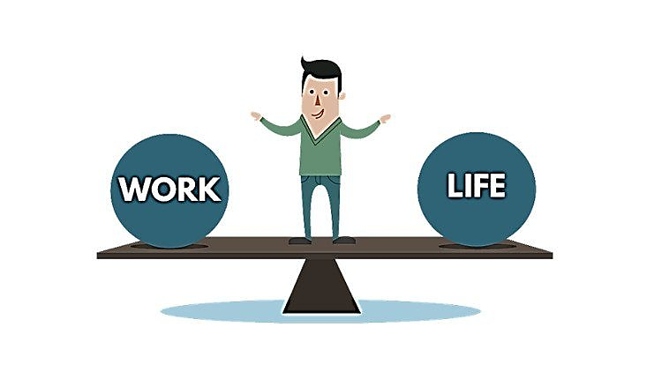
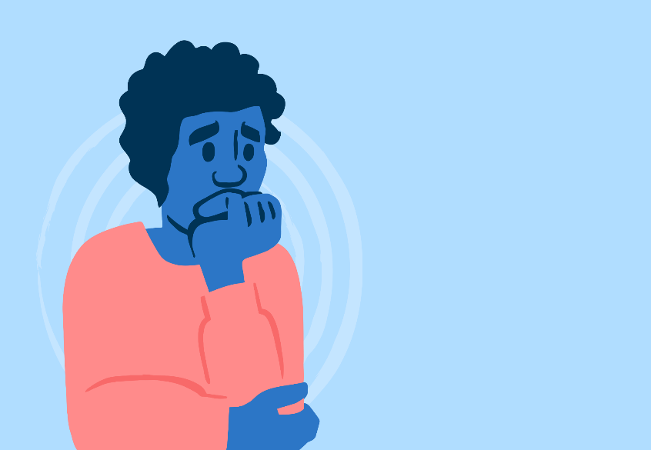
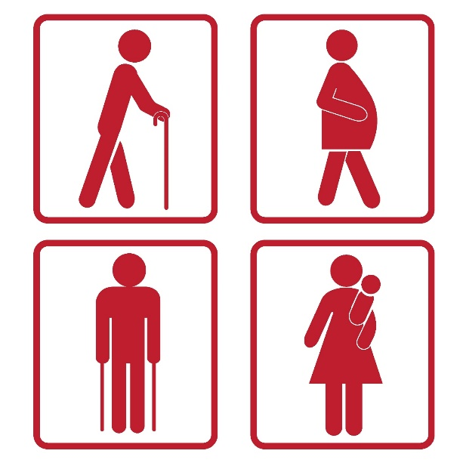
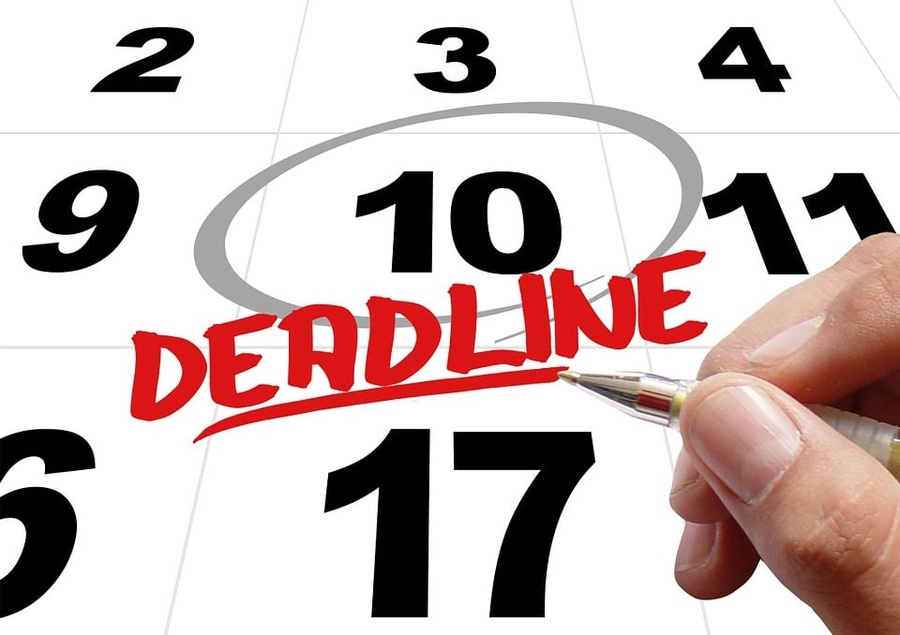
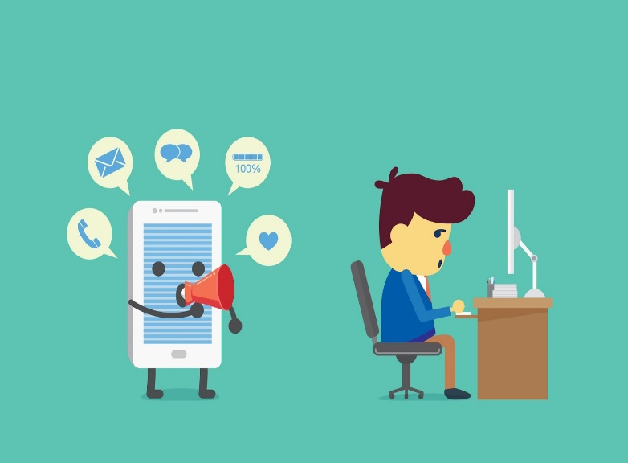
REMEMBER AND WRITE DOWN THE WORDS

Slide 4
CHECK YOUR ANSWER
well-balanced / balance
anxiety
priority
distraction
advice
deadline / due date

Slide 5
P22. UNIT 3: HEALTHY LIVING FOR TEENS
Lesson 7: Looking back and project
Lesson 7: Looking back + project

Slide 6
OBJECTIVES
In this lesson, you will review:
- Vocabulary, pronunciation and grammar of Unit 3.
- Apply what you have learnt to do exercises and apply voc , grammar, pronunciation into practice through a project

Slide 7
LOOKING BACK
I.VOCABULARY
‘Physical, ‘mental, well-’balanced, pri’ority, ‘counsellor, ad’vice, main’tain, ‘manage, ‘balance, a’chieve, a’ccomplish, ‘due date, dis’traction, de’lay, opti’mistic, stressed out….

Slide 8
II. PRONUNCIATION
/h/: ‘healthy, ‘happiness, ‘habit, a’head, Per’haps, ‘homework, her, ‘health
/r/: re’gularly, ‘really, ‘ready, ‘worrying, ‘several, ‘worry, ‘read, ring

Slide 9
* Fill in each blank with given words.
eat
will have
Ex1: If you ....... (eat) an ice-cream, I .............. (have) a hot chocolate.
don’t have
Ex2: If we .................... (not have) time this afternoon, we .................... (meet) this tomorrow.
will meet

Slide 10
III.GRAMMAR
- If + S + present simple tense, S + will + bare inf.
- Instead of will, we can use modal verbs: can, must, may, might, should…

Slide 11
Ex1. Complete the sentences with the correct words and phrases in the box. (Groups work)
stressed out priority delay well-balanced due date
well-balanced
1. A ________________meal or diet contains all the different things you need to keep you healthy.
2. The ________________ for the project is next Friday.
3. I’ve got too much to do, and I’m completely ________________.
4. Nick gave ________________ to tasks at his job because he couldn’t do everything he wanted today.
5. You may not feel better if you _________ going to the doctor.
due date
stressed out
priority
delay
Notes:
1. well-balanced 2. due date 3. stressed out 4. priority 5. delay

Slide 12
Ex2. Choose the correct answer A, B, C, or D. (Plicker)
1. To most people, ______ living means both physical and mental health are functioning well together.
A. healthy B. unhealthy C. health D. healthily
2. When we ______ our task, we headed home.
A. succeeded B. won C. accomplished D. managed
3. She’s in poor health, but she’s ______ about her future.
A. optimistic B. negative C. pleased D. unhappy
4. There are too many ____ in this classroom – it’s hard for me to pay attention to the lesson.
A. difficulties B. distractions C. obstacles D. omissions
5. He was in a good ______ when he got home from school.
A. mind B. feeling C. attitude D. mood
Notes:
1. A 2. C 3. A 4. B 5. D

Slide 13
Ex3. Complete the sentences with the correct modal verbs in the box. A modal verb can be used twice. (Pairs work)
can must should might
must
1. If you don’t want to get in an accident, you _________ follow these safety instructions.
2. If you take these pills, you _________ feel better soon.
3. You _________ come and join us if you like.
4. If you feel unwell, you _________ consult a doctor.
5. If she tries hard, she _________ speak English better than you.
might
can
should
can
Notes:
1. must 2. might 3. can 4. should 5. Can

Slide 14
Ex4. Circle the most suitable modal verbs to complete the sentences. (Game)
1. He shouldn’t / may not / cannot stay up late tonight if he wants to feel awake and alert tomorrow morning.
2. Nick should / can’t / might be very excited if we invite him to our home.
3. Mai can / must / should be good at time management if she takes a training course at school.
4. If you want to save on your electricity bills, you must / can / might turn off all the electric equipment before going out.
5. If you help me tidy our flat this morning, you must / can / can’t go out this afternoon.
Notes:
1. shouldn’t 2. might 3. can 4. must 5. can

Slide 15
BOMB GAME
START!

Slide 16
BOMB GAME
1
2
3
4
5
6
7
8

Slide 17
Check your answer
1. He shouldn’t / may not / cannot stay up late tonight if he wants to feel awake and alert tomorrow morning.
C. shouldn’t
1
+ 10 points
Notes:
Ấn vào số đề quay về trang chủ

Slide 18
2. Nick should / can’t / might be very excited if we invite him to our home.
A. might
2
+ 20 points
Notes:
Ấn vào số đề quay về trang chủ

Slide 19
LUCKY NUMBER: + 100 points
3
Notes:
Ấn vào số đề quay về trang chủ

Slide 20
3. Mai can / must / should be good at time management if she takes a training course at school.
A. can
4
+ 20 points
Notes:
Ấn vào số đề quay về trang chủ

Slide 21
5
LOSE ½ POINTS
Notes:
Ấn vào số đề quay về trang chủ

Slide 22
4. If you want to save on your electricity bills, you must / can / might turn off all the electric equipment before going out.
A. must
6
+ 20 points
Notes:
Ấn vào số đề quay về trang chủ

Slide 23
GIVE YOUR FRIENDS ALL YOUR POINTS. YOU ARE VERY NICE!
7
Notes:
Ấn vào số đề quay về trang chủ

Slide 24
5. If you help me tidy our flat this morning, you must / can / can’t go out this afternoon.
B. can
8
+ 30 points
Notes:
Ấn vào số đề quay về trang chủ

Slide 25
* Look at and check the answers again.
1. He shouldn’t stay up late tonight if he wants to feel awake and alert tomorrow morning.
2. Nick might be very excited if we invite him to our home.
3. Mai can be good at time management if she takes a training course at school.
4. If you want to save on your electricity bills, you must turn off all the electric equipment before going out.
5. If you help me tidy our flat this morning, you can go out this afternoon.
Notes:
1. shouldn’t 2. might 3. can 4. must 5. can

Slide 26
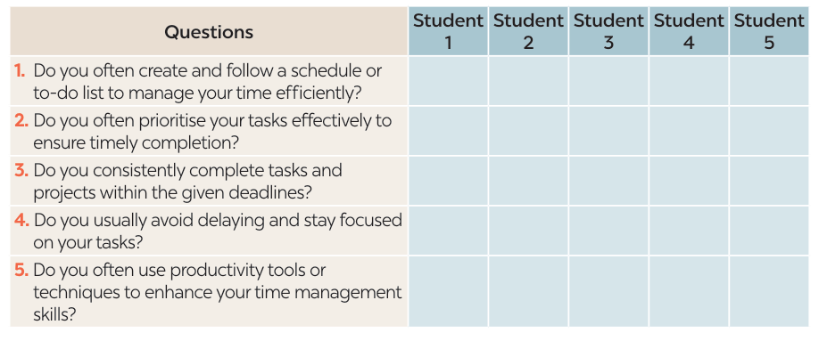
B. PROJECT

Slide 28
WRAP-UP
What have we learnt in this lesson?
Revise the vocabulary items learnt in the unit.
Revise the forms and uses of comparative adverbs.
Develop research and collaboration skills and practise giving an oral presentation.

Slide 29
HOMEWORK
Review the vocabulary and grammar points in Unit 3
Do exercises in the workbook
Prepare: Unit 4: Getting Started

Slide 30
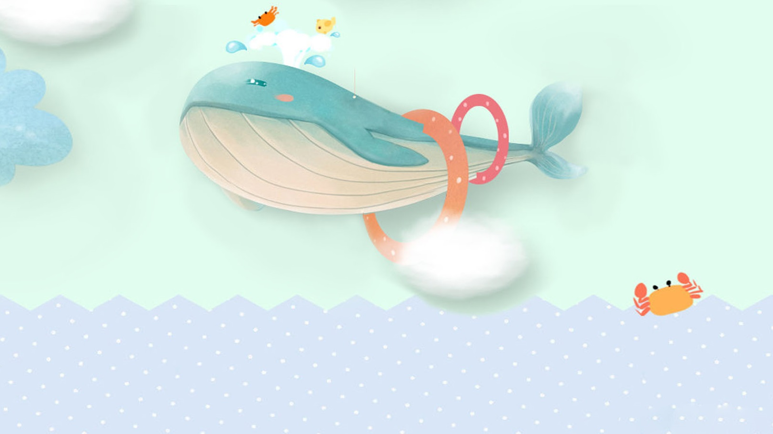
THANKS FOR ATTENDING THIS LESSON

