Slide 1
Unit 1: Local Community
Lesson 7: Looking back & Project

Slide 2

Objectives
By the end of the lesson, students will be able to:
- Review the vocabulary and grammar of Unit 1.
- Apply what they have learnt (vocabulary and grammar) into practice through a project.

Slide 3
I. Looking backs:
1. Vocabulary
Review the vocabulary and grammar of Unit 1.

Slide 4
WORD | PRONUNCIATION | MEANING
artisan (n) | /ˌɑːtɪˈzən/ | thợ làm nghề thủ công
community (n) | /kəˈmjuːnəti/ | cộng đồng
community helper | /kəˈmjuːnəti ˈhelpə/ | người phục vụ cộng đồng
craft village | /ˌkrɑːft ˈvɪlɪdʒ/ | làng nghề thủ công
cut down on | /kʌt daʊn ɒn/ | cắt giảm
delivery person | /dɪˈlɪvəri ˈpɜːsn/ | nhân viên giao hàng

Slide 5
WORD | PRONUNCIATION | MEANING
electrician (n) | /ɪˌlekˈtrɪʃn/ | thợ điện
facilities (n, plural) | /fəˈsɪlətiz/ | cơ sở vật chất
firefighter (n) | /ˈfaɪəfaɪtə/ | lính cứu hoả
fragrance (n) | /ˈfreɪɡrəns/ | hương thơm
function (n) | /ˈfʌŋkʃn/ | chức năng
garbage collector (n) | /ˈɡɑːbɪdʒ kəlektə/ | nhân viên dọn vệ sinh

Slide 6
WORD | PRONUNCIATION | MEANING
get on with | /ɡet ɒn wɪð/ | có quan hệ tốt với
hand down | /hænd daʊn/ | truyền lại
handicraft (n) | /ˈhændikrɑːft/ | sản phẩm thủ công
look around | /lʊk əˈraʊnd/ | ngắm nghía xung quanh
original (adj) | /əˈrɪdʒənl/ | nguyên bản
pass down | /pɑːs daʊn/ | truyền lại

Slide 7
police officer (n) | /pəˈliːs ɒfɪsə/ | công an
pottery (n) | /ˈpɒtəri/ | đồ gốm
preserve (v) | /prɪˈzɜːv/ | bảo tồn
run out of | /rʌn aʊt əv/ | hết, cạn kiệt
speciality (n) | /ˌspeʃiˈæləti/ | đặc sản
suburb (n) | /ˈsʌbɜːb/ | vùng ngoại ô
tourist attraction | /ˈtʊərɪst əˈtrækʃn/ | điểm du lịch

Slide 8
Ex 1: Write a word or phrase for each description below.
delivery
person
1. This person delivers goods to your house.
2. This person stops fires from burning.
3. People visit this place for pleasure usually while they are on holiday.
4. People make these objects out of clay.
5. This person makes things with his / her hands.
người giao hàng
firefighter
lính cứu hỏa
tourist
attraction
địa điểm du lịch
pottery
đồ gốm
artisan
thợ thủ công

Slide 9
Ex 2: Circle the correct word or phrase to complete each sentence.
1. The villagers (preserve / shorten) their traditional weaving techniques.
2. Com Lang Vong has a special (fragrance / function), so it is very popular.
3. Our (firefighters / police officers) help keep law and order in our community.
4. Bun Cha is the (speciality food / fast food) I like best.
5. My home town is famous for (handicrafts / objects), such as paper fans and lanterns.

Slide 10
2. Grammar:
Question words before to-infinitives
– We use a question word such as who, what, where, when, or how before a to-infinitive to express an indirect question about what we should do.
– We often use a verb such as ask, wonder, (not) decide, (not) tell, or (not) know before the question word + to-infinitive.
Example:
We don’t know what to do to help the community.
She asked how to get to the nearest shopping mall.

Slide 11
2. Grammar:
Phrasal verbs
– A phrasal verb consists of a verb and one or two particles, such as up, down, back, on, round, ...
– A phrasal verb usually has a special meaning.
Example:
go out = leave your house to go to a social event
pass down = give or teach something to your children
cut down on = reduce the amount or number of something
run out of = have no more of

Slide 12
Ex 3: Choose the correct answer A, B, C, or D.
1. You should decide ______ to move to the new house.
A. while B. when C. where D. who
2. Do you know ______ to sort rubbish?
A. who B. which C. how D. what

Slide 13
Ex 3: Choose the correct answer A, B, C, or D.
3. She didn’t tell me ______ to meet, in the library or in the lab.
A. how B. when C. what D. where
4. Could you tell me ______ to do in this situation?
A. what B. when C. where D. who

Slide 14
Ex 3: Choose the correct answer A, B, C, or D.
5. I wonder ______ to ask for advice, my teacher or my parents.
A. where B. when C. who D. what

Slide 15
Ex 4: Rewrite each sentence so that it contains the phrasal verb in brackets. You may have to change the form of the verb.
1. In some villages, people reduce the number of steps to make the handicraft. (cut down on)
2. My grandparents gave the skills to my parents. (hand down)
3. In their community, the eldest child is usually responsible for his or her parents. (take care of)
4. Before we go to a new place, we always get information about it. (find out)
5. They have a good relationship with all neighbours. (get on with)

Slide 16
Ex 4: Rewrite each sentence so that it contains the phrasal verb in brackets. You may have to change the form of the verb.
1. In some villages, people reduce the number of steps to make the handicraft. (cut down on)
2. My grandparents gave the skills to my parents. (hand down)
reduce
In some villages, people cut down on the number of steps to make the handicraft.
gave the skills
My grandparents handed down the skills to my parents.

Slide 17
Ex 4: Rewrite each sentence so that it contains the phrasal verb in brackets. You may have to change the form of the verb.
3. In their community, the eldest child is usually responsible for his or her parents. (take care of)
4. Before we go to a new place, we always get information about it. (find out)
responsible
In their community, the eldest child usually takes care of his or her parents.
get information
Before we go to a new place, we always find out about it.
They get on with all neighbours.

Slide 18
Ex 4: Rewrite each sentence so that it contains the phrasal verb in brackets. You may have to change the form of the verb.
5. They have a good relationship with all neighbours. (get on with)
have a good relationship
They get on with all neighbours.

Slide 19
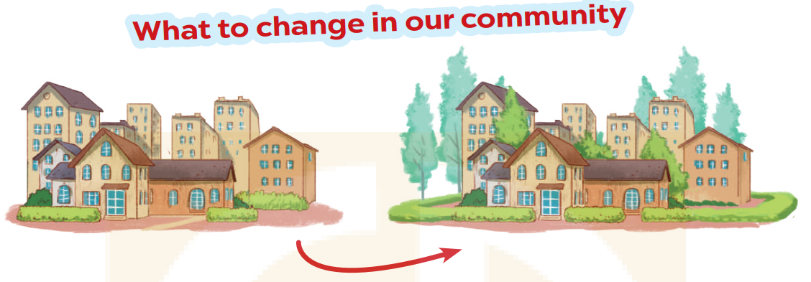
II. PROJECT

Slide 20
1. Interview some students from your class or from other classes about the changes they want to make in their community. Use the questions below.
Where do you live?
2. What is good about your community?
3. What is not good about your community?
4. What changes do you want to make to improve your community?

Slide 21
1. Interview some students from your class or from other classes about the changes they want to make in their community. Use the questions below.
1. I live in the countryside/ suburb of Hanoi.
2. People in my community are friendly and supportive of each other.
3. One drawback is the limited availability of public spaces and recreational facilities.
4. I would like to see improvements in creating more public spaces, parks, cinemas and entertainment centres.

Slide 22
2. Collect the answers. Use the table below.
Student | Question 1 | Question 2 | Question 3 | Question 4
A | Small town | friendly neighbors | lack of public parks and and outdoor space. | More green space and recreational area
B | urban area | many entertainment places and shopping centers | traffic congestion | implementing traffic management measure.
C | quiet neibourhood | local markets filled with fresh products | limited public transportation options | better public transportation services.
D | Suburb area in Ha Noi | low cost of living, many green places | limited access to quality healthcare facilities | more accessible healthcare options.

Slide 23
3. Report your group's findings to your class. Use the following questions to guide your report. (may be at home)
1. How many students did you interview?
2. What is good about their community?
3. What is not good about their community
4. What changes do they want to make?

Slide 24
WRAP-UP
What have you learnt in this lesson?
1
Review the vocabulary and grammar of Unit 1.
2
Apply what they have learnt (vocabulary and grammar) into practice through a project.

Slide 25
Thanks!
Do you have any questions?

