Slide 1
Unit 1: LOCAL COMMUNITY
Lesson 6: Skills 2

Slide 2
Objectives
I. Listening
- Listen for specific information about a community helper.
II. Writing
- Write a paragraph about a community helper.
By the end of this lesson, Ss will be able to:

Slide 3
I. Listening

Slide 4
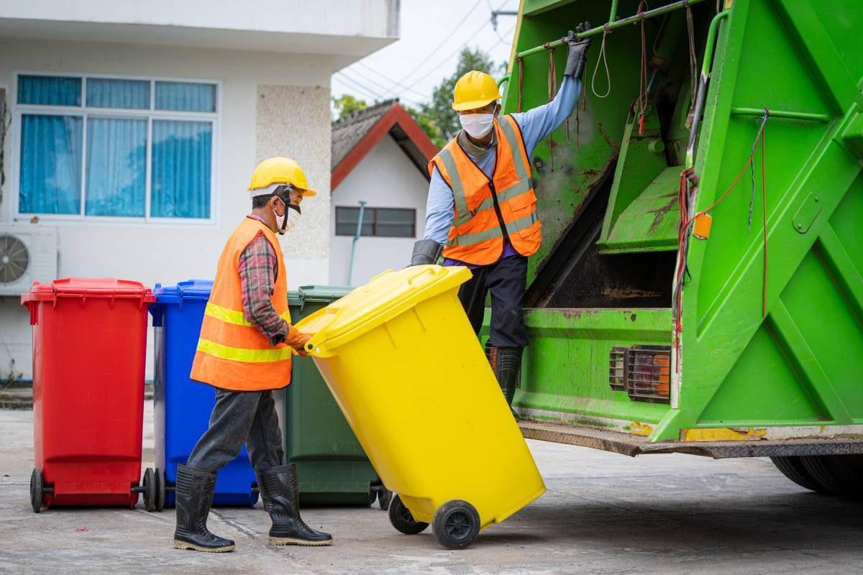
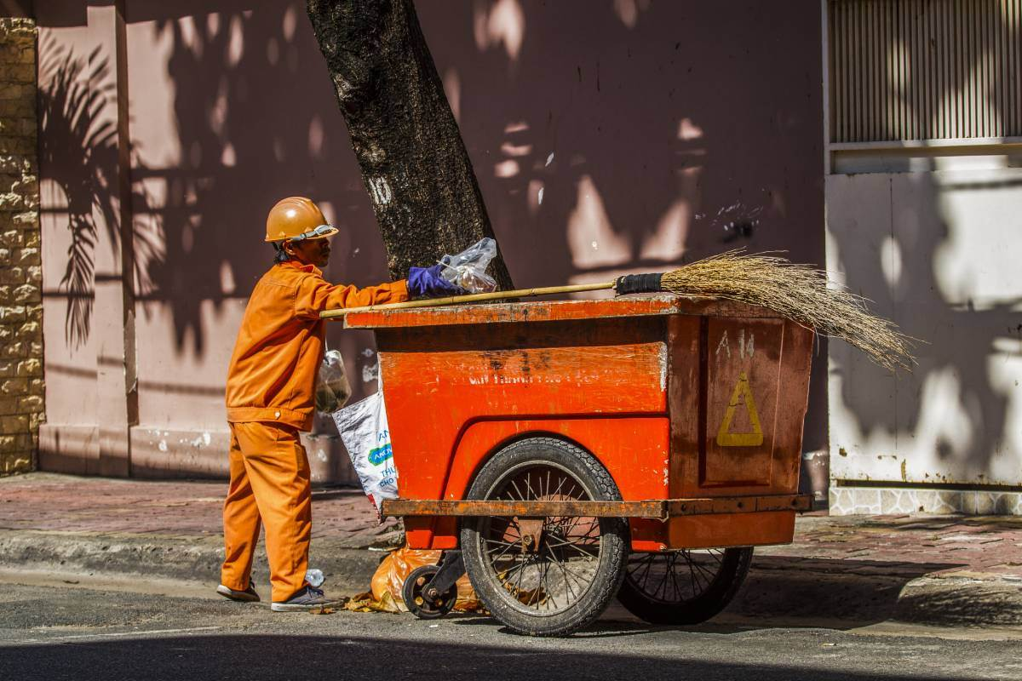
Ex 1: Work in pairs. Discuss the questions.
collecting garbage
garbage
man
1. Who can you see in the pictures?
2. What are they doing?
We can see garbage collectors.
They are taking the garbage away.

Slide 5
Ex 2: Listen and fill in each blank with no more than two words.
1. The name of the writing contest is “My Favourite ___________”.
2. Mr Vinh is a __________________.
3. He is tall and __________________.
4. He is hard-working, responsible, and _______________.

Slide 6
Ex 2: Listen and fill in each blank with no more than two words.
name of the writing contest
Community Helper
1. The name of the writing contest is “My Favourite ___________”.
In today’s special programme, we will share with you a piece of writing which won first prize in our writing contest called “My Favourite Community Helper”.
Mr Vinh
garbage collector
2. Mr Vinh is a ______________.
There are many great community helpers in our neigbourhood but my favourite one is Mr Vinh, the garbage collector.

Slide 7
Ex 2: Listen and fill in each blank with no more than two words.
tall and
slim man
3. He is tall and _______.
Mr Vinh is a tall and slim man.
hard-working, responsible, and
4. He is hard-working, responsible, and ______.
friendly
Mr Vinh is also friendly. He usually keeps a smile on his face. He talks with the people in our community cheerfully about his work…

Slide 8
Audio Script
This is An Binh Commune Radio Station. In today’s special programme, we will share with you a piece of writing which won first prize in our writing contest called “My Favourite Community Helper”. This was written by Mi, a grade 9 student. There are many great community helpers in our neigbourhood but my favourite one is Mr Vinh, the garbage collector. Mr Vinh is a tall and slim man. He usually wears a green uniform with reflective stripes. He is hard-working and responsible. Every day he goes to our neighbourhood at 6 p.m. with a garbage cart. He instructs everyone to put garbage in the correct bin: recyclable and non-recyclable, and then goes to the next neighbourhood. At about 9 p.m. he comes back and empties all the bins carefully. Mr Vinh is also friendly. He usually keeps a smile on his face. He talks with the people in our community cheerfully about his work and the importance of sorting rubbish. We all love him.

Slide 9
Ex 3: Listen again and tick T (True) or F (False).
 | T | F
1. Mr Vinh wears an orange uniform.
2. He arrives at Mi’s neighbourhood at 9 p.m. every day.
3. He instructs people to put rubbish in two types of bins.
4. He shares information about his work and the importance of sorting rubbish.

Slide 10
Ex 3: Listen again and tick T (True) or F (False).
 | T | F
1. Mr Vinh wears an orange uniform.
2. He arrives at Mi’s neighbourhood at 9 p.m. every day.
3. He instructs people to put rubbish in two types of bins.
4. He shares information about his work and the importance of sorting rubbish.
He usually wears a green uniform with reflective stripes.

Slide 11
Ex 3: Listen again and tick T (True) or F (False).
 | T | F
1. Mr Vinh wears an orange uniform.
2. He arrives at Mi’s neighbourhood at 9 p.m. every day.
3. He instructs people to put rubbish in two types of bins.
4. He shares information about his work and the importance of sorting rubbish.
Every day he goes to our neighbourhood at 6 p.m. with a garbage cart.

Slide 12
Ex 3: Listen again and tick T (True) or F (False).
 | T | F
1. Mr Vinh wears an orange uniform.
2. He arrives at Mi’s neighbourhood at 9 p.m. every day.
3. He instructs people to put rubbish in two types of bins.
4. He shares information about his work and the importance of sorting rubbish.
He instructs everyone to put garbage in the correct bin: recyclable and non-recyclable

Slide 13
Ex 3: Listen again and tick T (True) or F (False).
 | T | F
1. Mr Vinh wears an orange uniform.
2. He arrives at Mi’s neighbourhood at 9 p.m. every day.
3. He instructs people to put rubbish in two types of bins.
4. He shares information about his work and the importance of sorting rubbish.
He talks with the people in our community cheerfully about his work and the importance of sorting rubbish

Slide 14
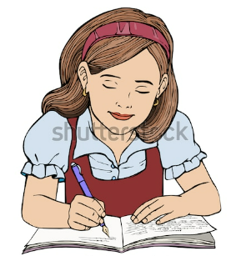
II. Writing

Slide 15
Ex 4: Work in pairs. Choose a community helper you like and answer the following questions.
1. What is his / her job?
2. What does he / she look like?
3. What is he / she like?
4. What does he / she do for the community?
5. How do you feel about him / her?

Slide 16
Ex 4: Work in pairs. Choose a community helper you like and answer the following questions.
1. What is his / her job? - delivery person
2. What does he / she look like? - tall/big
3. What is he / she like? – friendly/ hardworking/ responsible
4. What does he / she do for the community? - delivers goods
5. How do you feel about him / her?- dedicated community helper / makes our life easy and comfortable.

Slide 17
Ex 5: Write a paragraph (about 100 words) about your favourite community helper.
Use the answers to the questions in 4 to help you.
Example
My favourite community helper is ……. He is ….. and …... He is a ….. in my neighbourhood. He is a …… person. Whenever he delivers something to us, he smiles happily. He sometimes asks me about my study. In addition, he is ….. And…... He …… to my family and other families in the neighbourhood despite the weather. Sometimes he has to return twice to deliver us a parcel because we are not at home. I really appreciate his manner. In general, Mr Nam is a very …..who……

Slide 18
Ex 5: Write a paragraph (about 100 words) about your favourite community helper.
Use the answers to the questions in 4 to help you.
Example
My favourite community helper is a firefighter. He typically wears specialized uniforms that include protective gear. He is a dedicated, brave, and quick-thinking individual. He can handle various emergency situations, often risking his lives to ensure the safety of others. He responds to fire incidents, accidents, and natural disasters to protect lives and property for communities. Beyond extinguishing flames, he engages in rescue operations, administering emergency medical aid. He also engages in public programs, educating people on fire safety and prevention. I have immense respect and gratitude for him. His selfless, tireless dedication to serving the community is admirable. He is a true hero in real life.

Slide 19
SWAP AND CHECK
Check for spelling
Do the words spell correctly?
Check for ideas
Does your friend write about your favourite community helper?
Check for comprehension
Does the writing make sense?
Check for grammar
Does the writing use the correct tenses and structures?

Slide 20
WRAP-UP
What have you learnt in this lesson?
Listen for specific information about a community helper.
1
2
Write a paragraph about a community helper.

Slide 21
Homework
1. Do exercises in workbook (B,C)
2. Prepare Skill 2 in Studentbook

Slide 22
Thanks!
Do you have any questions?

