Slide 1

* Matching.

Slide 2
Match the question words with the information it needs.
What
choices
Where
person/people
When
manner/process
Why
things
Which
places
Who
time
How
reasons

Slide 3

Unit 1: Local Community
Lesson 4: Communication

Slide 4
Objectives
By the end of the lesson, students will be able to:
1. Know how to seek for help and respond
2. Know some places of interest.

Slide 5
1
EVERYDAY ENGLISH
Seeking for help and responding.

Slide 6

Ex 1. Listen and read the conversations. Pay attention to the highlighted parts.
1
2
- Mai: Do you mind carrying this suitcase for me?
- Tom: Not at all.
- Ann: Could you show me how to open this gate, please?
- Mr Nam: Sure.
Example of Seeking(tìm kiếm) for help. | Example of Responding for help.
Do you mind + V-ing?
Do you mind + V-ing?
Not at all
Sure
Would you ... please?
Would you ... please?
Could you help me…?
Could you help me…?
Could you give me a hand with ...?
Could you give me a hand with ...?
Could you…?

Slide 7

1. You want your friend to lend you her pen.
2. You want your neighbour to tell you the name of the new garbage collector.
3. You want to ask your neighbour where to buy the best fruits and vegetables.
Ex 2. Work in pairs.
Ask for help and respond in the following situations.

Slide 8
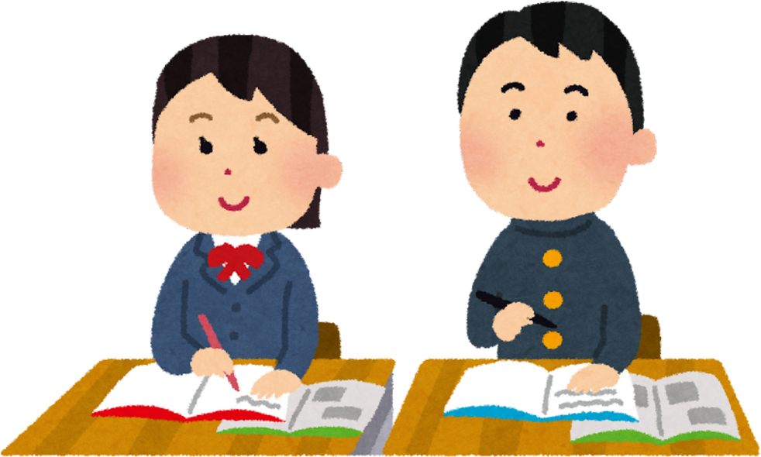
1. You want your friend to lend you her pen.
Ex 2. Work in pairs. Ask for help and respond in the following situations.
Example:
Do you mind lending me your pen?
Not at all. Here you are

Slide 9
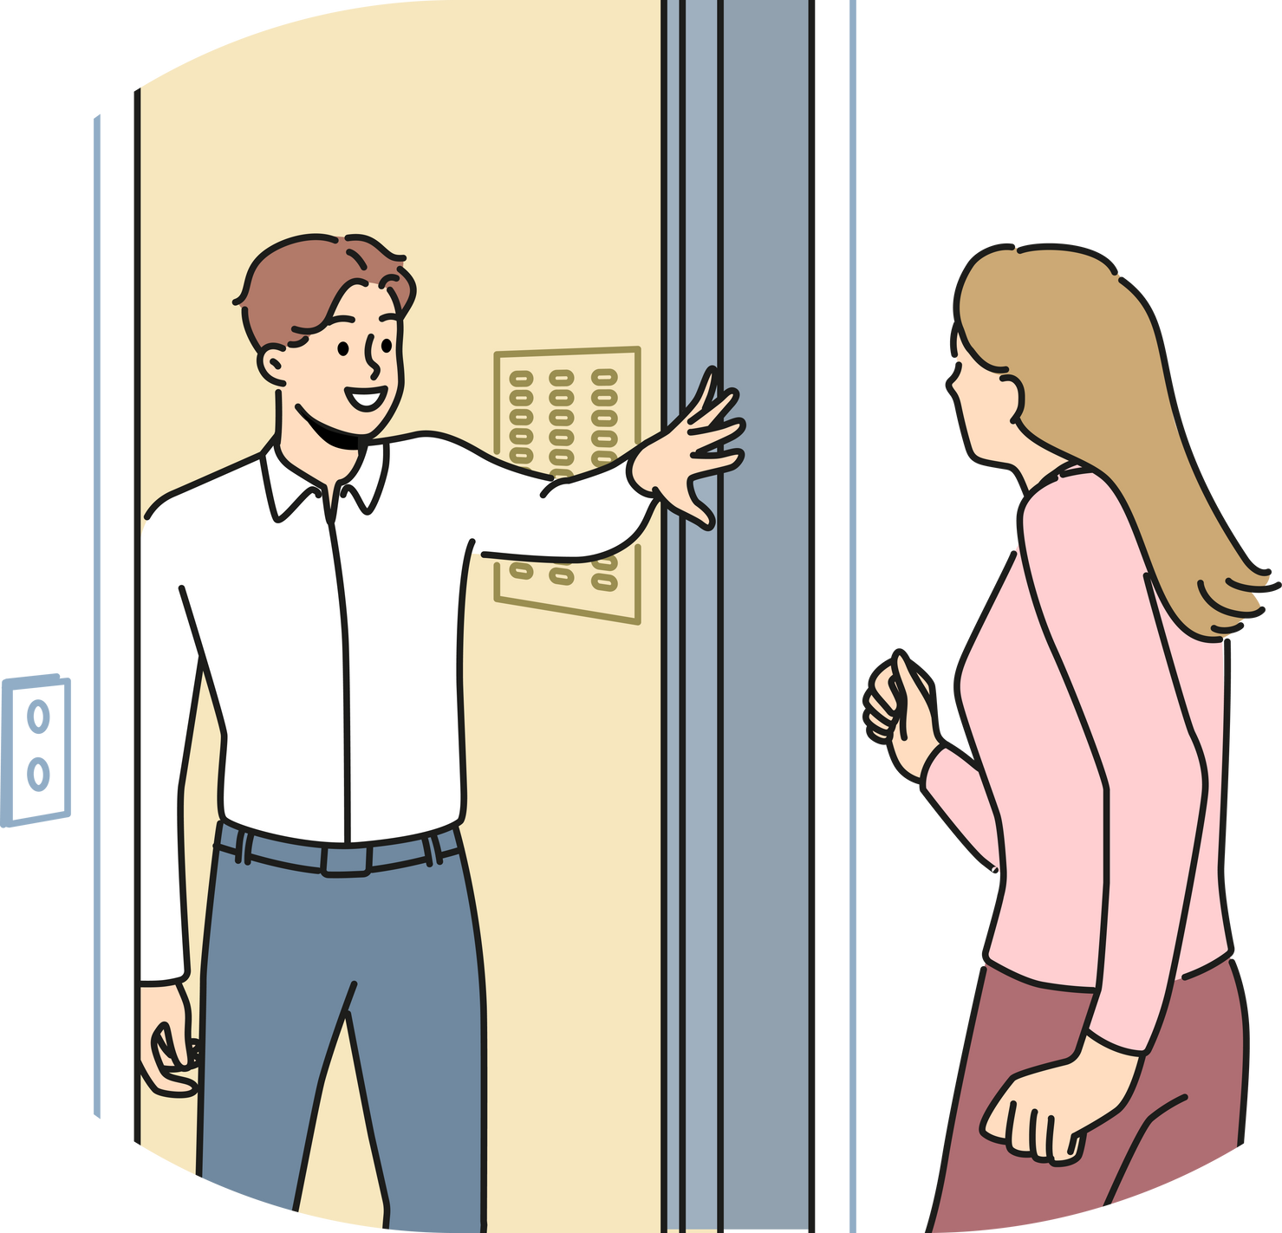
2. You want your neighbour to tell you the name of the new garbage collector.
Ex 2. Work in pairs. Ask for help and respond in the following situations.
Example:
Could you tell me the name of the new garbage collector?
Sure. His name’s Nam.

Slide 10
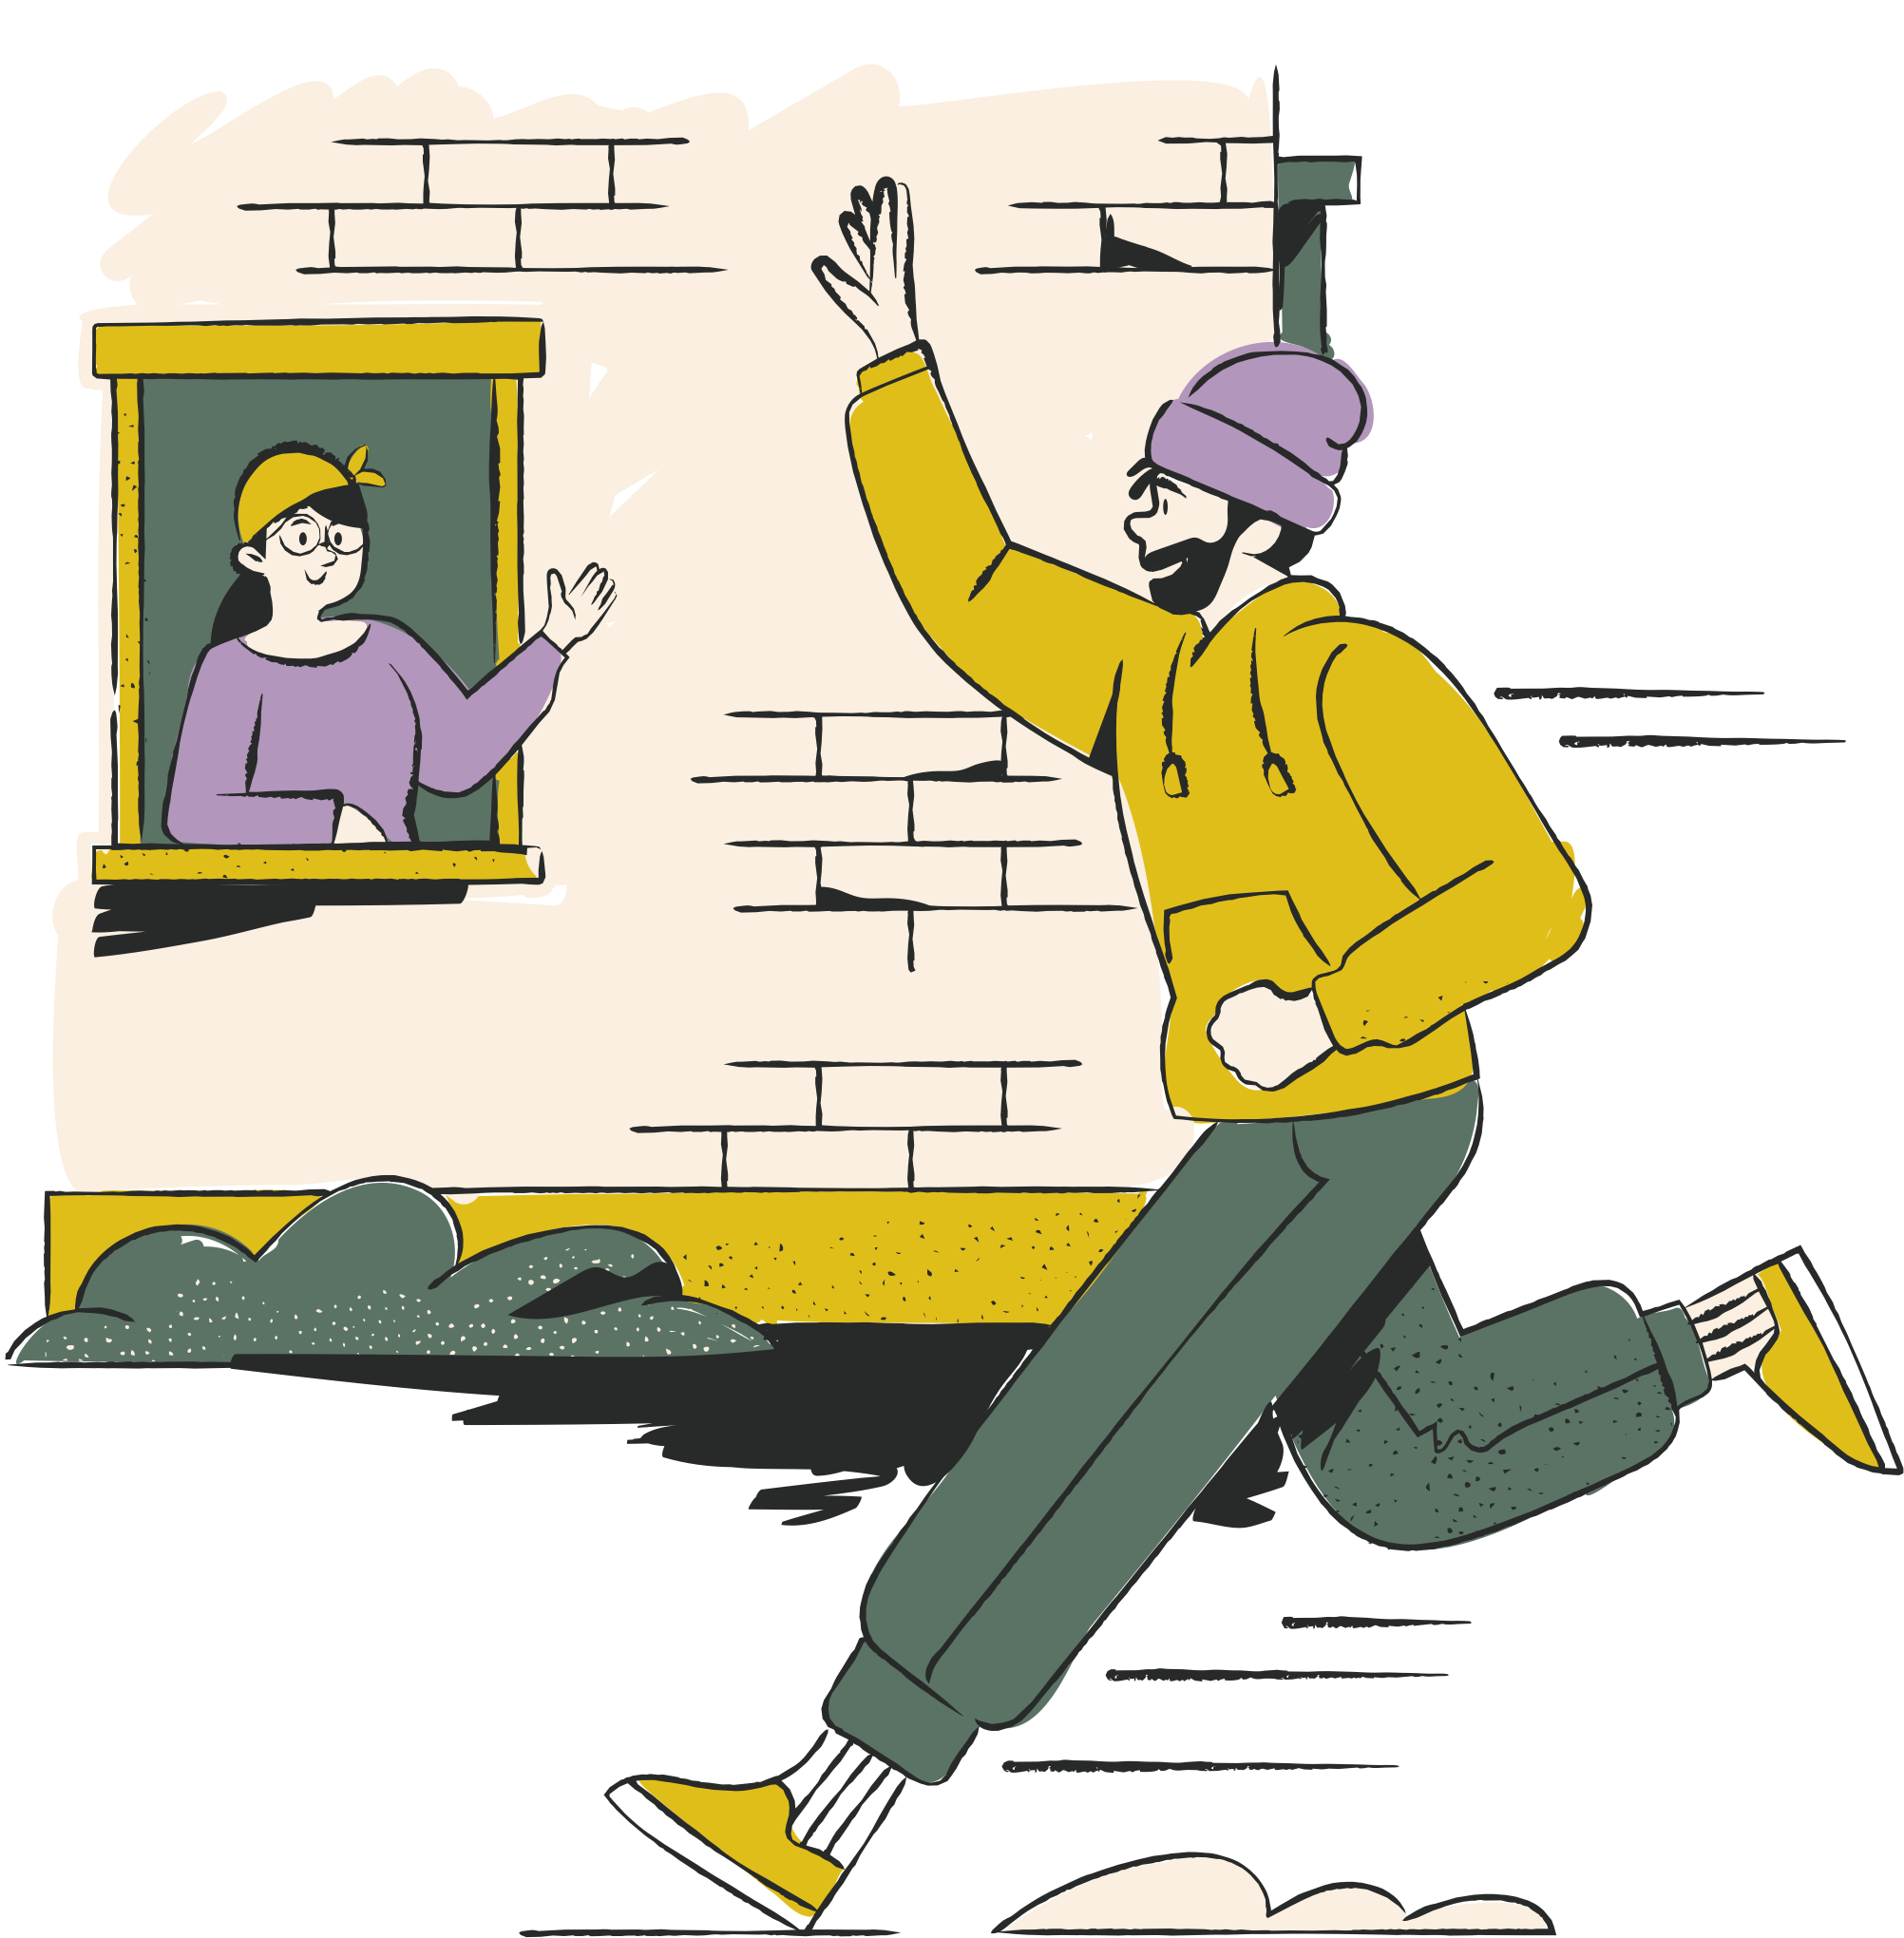
3. Could you tell me where to buy the best fruits and vegetables in our area?
Ex 2. Work in pairs. Ask for help and respond in the following situations.
Sure. There’s a shop in Le Lai Street.
Could you tell me where to buy the best fruits and vegetables in our area?

Slide 11
02
PLACES OF INTEREST

Slide 12
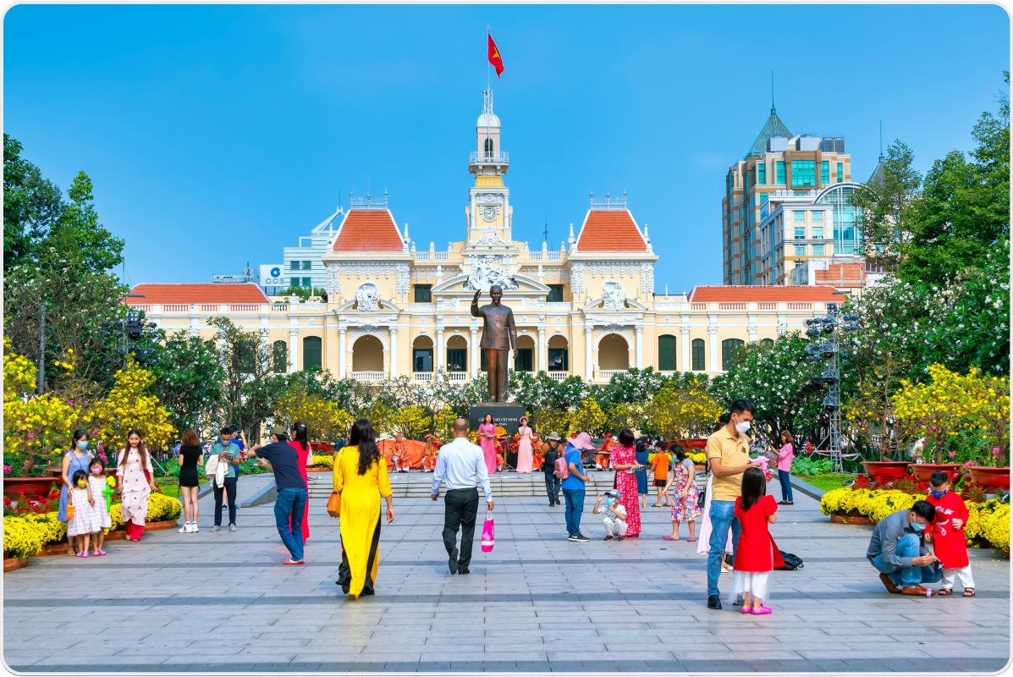
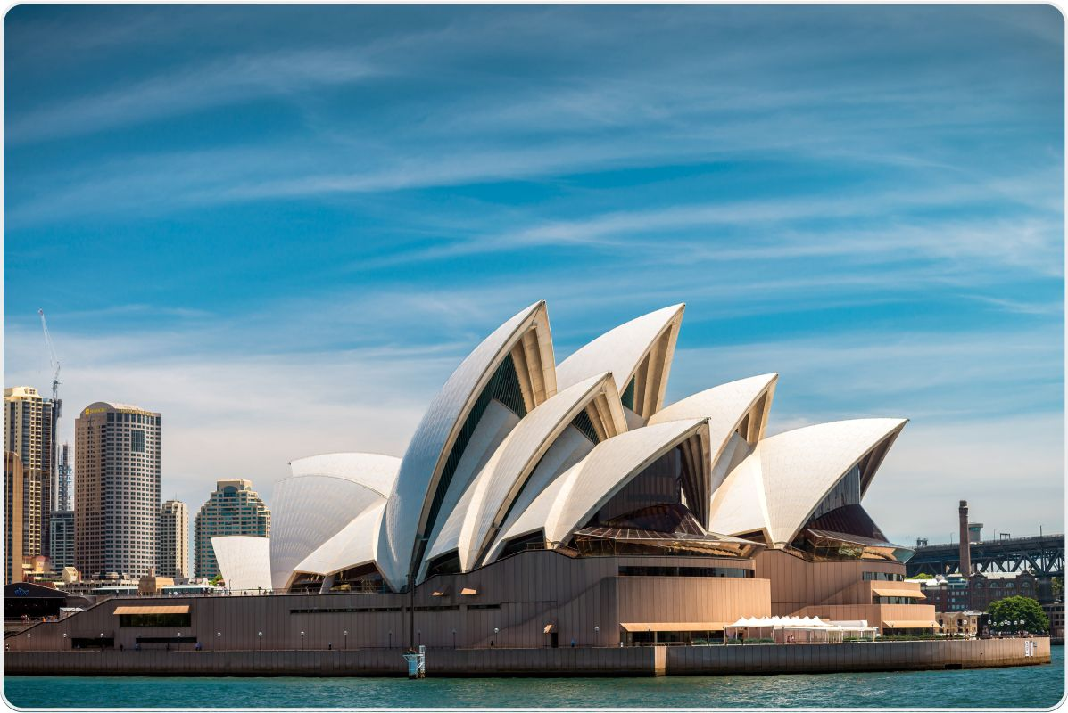
Nguyen Hue Pedestrian Street in Ho Chi Minh City.
Ex 3. Do you know the place in each picture?
Sydney Opera House in Sydney, Australia.

Slide 13

Ex 4. Listen to Binh and Mira talking about a place of interest in their community. Fill in each blank with no more than TWO words and / or a number.
 | Place | Distance | Frequency | Activities
Binh Ho Chi Minh City, Viet Nam | Nguyen Hue Pedestrian Street | (1) ______ km | Every (2) ______ | Children: enjoying music, looking for (3) ______ Parents: looking around
Mira Sydney, Australia | Sydney Opera House | (4) ______ km | Twice a month | Children: running up and down the stairs, (5) ______ seagulls Parents: having (6) ______, talking

Slide 14
 | Place | Distance | Frequency | Activities
Binh Ho Chi Minh City, Viet Nam | Nguyen Hue Pedestrian Street | (1) ______ km | Every (2) ______ | Children: enjoying music, looking for (3) ______ Parents: looking around
Mira Sydney, Australia | Sydney Opera House | (4) ______ km | Twice a month | Children: running up and down the stairs, (5) ______ seagulls Parents: having (6) ______, talking
one / 1
“It's in the centre of this city and only a kilometre from our house, so we walk there every weekend.”

Slide 15
 | Place | Distance | Frequency | Activities
Binh Ho Chi Minh City, Viet Nam | Nguyen Hue Pedestrian Street | (1) ______ km | Every (2) ______ | Children: enjoying music, looking for (3) ______ Parents: looking around
Mira Sydney, Australia | Sydney Opera House | (4) ______ km | Twice a month | Children: running up and down the stairs, (5) ______ seagulls Parents: having (6) ______, talking
one / 1
weekend
“It's in the centre of this city and only a kilometre from our house, so we walk there every weekend.”

Slide 16
 | Place | Distance | Frequency | Activities
Binh Ho Chi Minh City, Viet Nam | Nguyen Hue Pedestrian Street | (1) ______ km | Every (2) ______ | Children: enjoying music, looking for (3) ______ Parents: looking around
Mira Sydney, Australia | Sydney Opera House | (4) ______ km | Twice a month | Children: running up and down the stairs, (5) ______ seagulls Parents: having (6) ______, talking
one / 1
weekend
favourite books
“My sister and I enjoy the music that street bands play and look for our favourite books while our parents look around.”

Slide 17
 | Place | Distance | Frequency | Activities
Binh Ho Chi Minh City, Viet Nam | Nguyen Hue Pedestrian Street | (1) ______ km | Every (2) ______ | Children: enjoying music, looking for (3) ______ Parents: looking around
Mira Sydney, Australia | Sydney Opera House | (4) ______ km | Twice a month | Children: running up and down the stairs, (5) ______ seagulls Parents: having (6) ______, talking
one / 1
weekend
favourite books
five / 5
“Our family goes there twice a month because it's about five kilometres from our house.”

Slide 18
 | Place | Distance | Frequency | Activities
Binh Ho Chi Minh City, Viet Nam | Nguyen Hue Pedestrian Street | (1) ______ km | Every (2) ______ | Children: enjoying music, looking for (3) ______ Parents: looking around
Mira Sydney, Australia | Sydney Opera House | (4) ______ km | Twice a month | Children: running up and down the stairs, (5) ______ seagulls Parents: having (6) ______, talking
one / 1
weekend
favourite books
five / 5
feeding
a drink
“My brother and I are fond of running up and down the stairs and feeding the seagulls. Our parents love having a drink and talking to each other.”

Slide 19
Listening Script Ex 4.
Binh from Ho Chi Minh City, Vietnam.
My Favourite place of interest is Nguyen Du pedestrian street. It's in the centre of this city and only a kilometre from our house, so we walk there every weekend. It's used for pedestrians only and is very popular, especially at weekends and during tet. My sister and I enjoy the music that street bands play and look for our favourite books while our parents look around.
Mira from Sydney, Australia.
Of all the attractions in Sydney, I love the opera house the most. It's one of the most famous performing arts centre in the world. Our family goes there twice a month because it's about five kilometres from our house. My brother and I are fond of running up and down the stairs and feeding the seagulls. Our parents love having a drink and talking to each other.

Slide 20
– What is your favourite place of interest?
– How far is it from your house?
– How often do you go to that place?
– What do you do there?
Then tell the class about your partner’s favourite place of interest.
Example: Lan’s favourite place of interest is Tao Dan Park. It’s only one kilometre from her house
Ex 5. Work in pairs.
Ask and answer about your favourite places of interest. Use the questions below.
– What is your favourite place of interest?
– How far is it from your house?
– How often do you go to that place?
– What do you do there?
Then tell the class about your partner’s favourite place of interest.
Example: Lan’s favourite place of interest is Tao Dan Park. It’s only one kilometre from her house
so she goes there every weekend with her mother and sister. There they walk, do some exercises and enjoy the fresh air. Sometimes they also cycle around the park.

Slide 21
WRAP-UP
What have you learnt in this lesson?
1
How to seek for help and respond
2
Some famous places of interest

Slide 22
Homework
01
02
03

Slide 23
Thank you!
Do you have any questions?

