Slide 1
Good morning class !!!

Slide 2
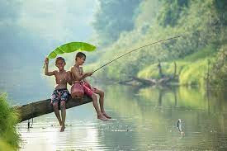
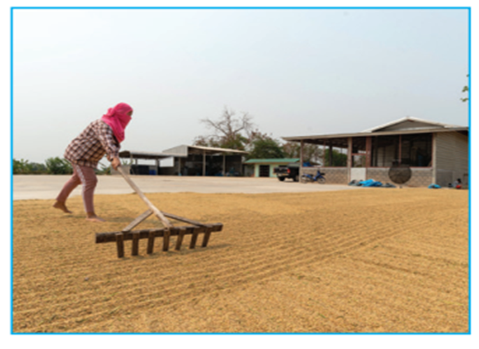
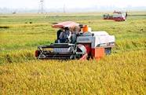
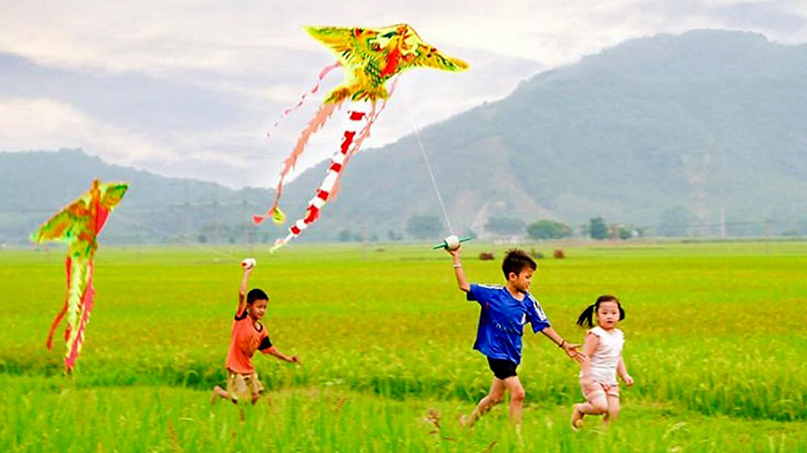
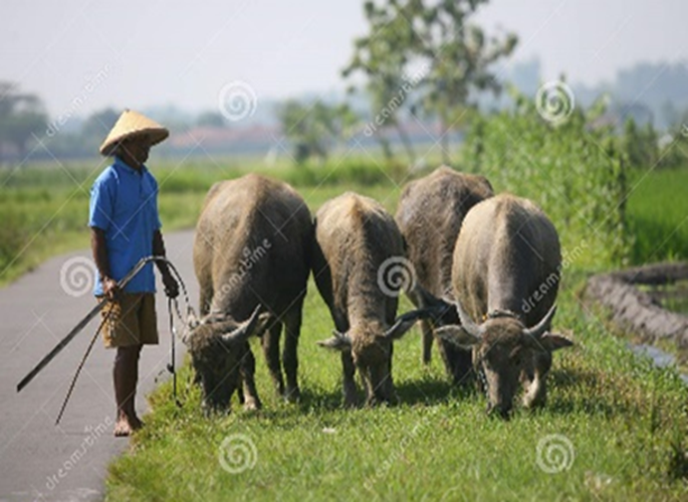
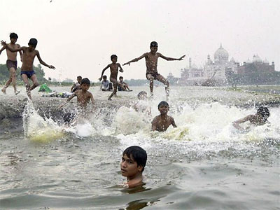
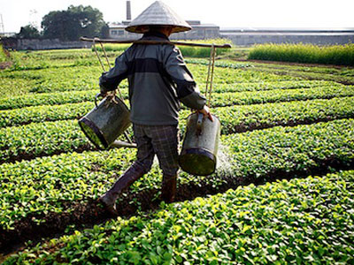
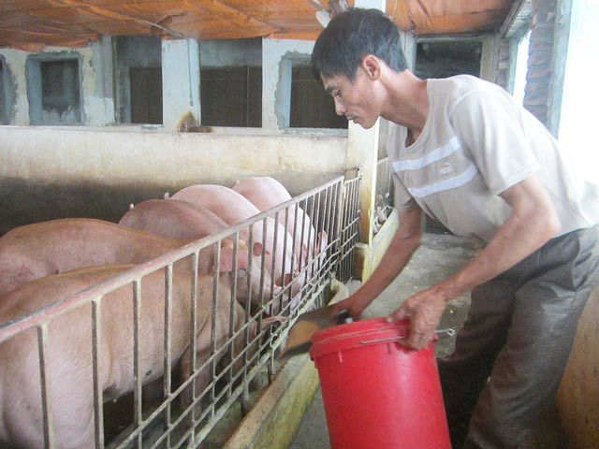
Going fishing
harvesting rice
drying rice
Kim’s Game
flying kites
herding buffaloes
Swimming in the river
feeding pigs
watering vegetables

Slide 3
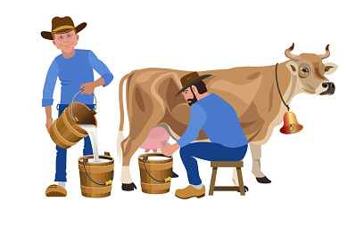
Unit
2
LIFE IN THE COUNTRYSIDE
LESSON 7: LOOKING BACK & PROJECT

Slide 4
I. LOOKING BACK: * VOCABULARY
Ex 1. Write a phrase from the box under the correct picture.
unloading rice milking cows catching fish ploughing fields feeding pigs drying rice
ploughing fields
catching fish
1. _________________
2. _________________

Slide 5
unloading rice milking cows catching fish ploughing fields feeding pigs drying rice
drying rice
unloading rice
3. _________________
4. _________________

Slide 6
unloading rice milking cows catching fish ploughing fields feeding pigs drying rice
feeding pigs
milking cows
5. _________________
6. _________________

Slide 7
* VOCABULARY
Ex2: Choose the correct answer A, B, or C.
1. There is a huge cloud ______ as far as the eye can see. A. surrounded B. stretching C. vast
2. People in my village are really ______; they are always generous and friendly to visitors. A. well-trained B. funny C. hospitable

Slide 8
3. The development of cities destroys ______ areas of countryside. A. vast B. much C. stretching
4. The workers in our factory are very ______ because they took a lot of good training courses. A. hospitable B. kind C. well-trained
5. The area around the village is famous for its ______ landscape. A. picturesque B. boring C. dull

Slide 9
2. GRAMMAR
Ex3: Complete the sentences with suitable comparative forms of the adverbs from the box.
1. Every morning nick gets up ten minutes (early) ______ than his sister.
2. I speak French (fluently) ____________ now than I did last year.
3. You’ll find your way around the village (easily) __________ if you have a good map.
4. It rained (heavily) ____________ today than it did yesterday.
5. If you work (hard) _________, you will do (well) ________ in your exam.
Game

Slide 10
LUCKY NUMBERS
1
2
3
4
5
6
7
8
GA
2
4
6
8
10
12
14
GB
2
4
6
8
10
12
14

Slide 11
3
earlier
1. Every morning nick gets up ten minutes (early) ______ than his sister.

Slide 12
more fluently
2. I speak French (fluently) ______________ now than I did last year.

Slide 13
3. You’ll find your way around the village (easily) ______________ if you have a good map.
more easily

Slide 14
more heavily
4. It rained (heavily) _______________ today than it did yesterday.

Slide 15
harder
better
5. If you work (hard) _________, you will do (well) ________ in your exam.

Slide 19
Ex3: Complete the sentences with suitable comparative forms of the adverbs from the box.
earlier
1. Every morning nick gets up ten minutes (early) ______ than his sister.
2. I speak French (fluently) ______________ now than I did last year.
3. You’ll find your way around the village (easily) _____________ if you have a good map.
4. It rained (heavily) ________________ today than it did yesterday.
5. If you work (hard) _________, you will do (well) ________ in your exam.
more fluently
more easily
more heavily
harder
better

Slide 20
2. GRAMMAR
Ex4: Underline the mistakes in the sentences and correct them.
1. I run faster as my brother does.
2. People in the city seem to react quicklier to changes than those in the country.
→ than
→ more quickly

Slide 21
3. We need to work more hardly, especially at exam time.
4. You must finish harvesting the rice the earlier this year than you did last year.
5. As they climbed more highly up the mountain, the air became cooler.
→ harder
→ earlier
→ higher

Slide 22
II. PROJECT
- Show your group’s poster about a village that you would like to visit.
- Present your poster to the class.

Slide 23
3. CONSOLIDATION
Vocabulary review
Grammar review
Project: My favourite village

Slide 24
4. Homework
Do exercises in the workbook.

