Slide 1
Good morning class !!!

Slide 2
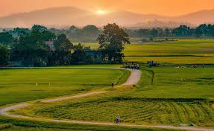
I. WARM - UP
1
1
Work in pairs. Discuss the following question.
What do you like or dislike about life in the countryside?

Slide 3
I. WARM - UP
What do you like or dislike about life in the countryside?
I like the life in the countryside because it’s quiet and peaceful. People are friendly, the air is fresh, the food is fresh and delicious
I don’t like the life in the countryside because it’s boring. there aren't many places for entertainment like theatres, cinemas, etc. There are few means of public transport.

Slide 4
I. WARM - UP
What do you like or dislike about life in the countryside?
LIKE
- low cost of living - many cheap things - peaceful - fresh air - many beautiful sceneries - friendly and hospitable villagers - delicious and fresh food - less traffic
DISLIKE
- not many entertainment places, such as theatres, cinemas, etc. - poor means of transport - lack of facilities - less job opportunities - small income

Slide 5
Unit
2
LIFE IN THE COUNTRYSIDE
LESSON 6: SKILLS 2

Slide 6
Tapescript
Speaker 1: I chose to live in a village because the relationships between people here are very good. There is a great sense of community here. The people welcome neighbours to their homes. They are always willing to help each other. They share almost everything with one another.
Speaker 2: There are many things I don't like about life in the countryside. There aren't many good schools or colleges. It's boring here because there aren't many places for entertainment like theatres, cinemas, etc. Transportation is another big problem. There are few means of public transport. And in general, there are many things that we should do to improve the life of villagers.
Speaker 3: I love to live in the countryside. It is spacious. We can do many, many things that are hard to do in the city. We can go swimming, play football, fly kites and do other interesting things. Life is also peaceful and simple here.

Slide 7
I. LISTENING
2
Listen to three people talking about life in the countryside. Choose the opinion (A - C) that each speaker (1 - 3) expresses.
B
A
C

Slide 8
3
Listen again and choose the correct answer A, B, or C.
1. According to speaker 1, there is a great sense of ______ in his village. A. security B. duty C. community 2. Speaker 1 says that people in his village are very ______. A. supportive B. unsociable C. well-trained 3. In speaker 2’s opinion, ______ is a big problem in the countryside. A. the cost of living B. safety C. transportation 4. Speaker 2 says that they should ______ in the countryside. A. improve the lives of people B. prevent crime C. protect nature 5. According to speaker 3, life in the countryside is peaceful and ______. A. slow B. simple C. safe

Slide 9
Tapescript
Speaker 1: I chose to live in a village because the relationships between people here are very good. There is a great sense of community here. The people welcome neighbours to their homes. They are always willing to help each other. They share almost everything with one another.
Speaker 2: There are many things I don't like about life in the countryside. There aren't many good schools or colleges. It's boring here because there aren't many places for entertainment like theatres, cinemas, etc. Transportation is another big problem. There are few means of public transport. And in general, there are many things that we should do to improve the life of villagers.
Speaker 3: I love to live in the countryside. It is spacious. We can do many, many things that are hard to do in the city. We can go swimming, play football, fly kites and do other interesting things. Life is also peaceful and simple here.

Slide 10
II. WRITING
4
Work in groups. Discuss and write what you like or dislike about life in the countryside.
LIKE | DISLIKE
– low cost of living – many cheap things | – not many entertainment places, such as theatres, cinemas, etc. – poor means of transport ...

Slide 11
II. WRITING
4
Work in groups. Discuss and write what you like or dislike about life in the countryside.
LIKE
- low cost of living - many cheap things - peaceful - fresh air - many beautiful sceneries - friendly and hospitable villagers - delicious and fresh food - less traffic
DISLIKE
- not many entertainment places, such as theatres, cinemas, etc. - poor means of transport - lack of facilities - less job opportunities - small income

Slide 12
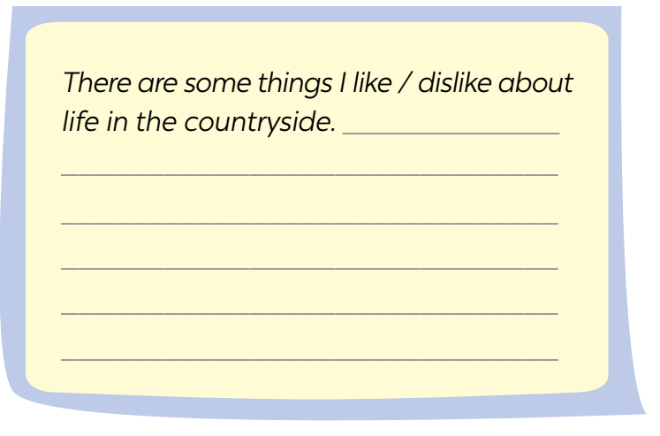
II. WRITING
5
Write a paragraph (80 - 100 words) about what you like or dislike about life in the countryside.
I live in Duong Lam. It’s an old village outside Ha Noi. It has ……...
…………………………………………………………………………………………………………………………………………………………………………………………………………………………….............................................

Slide 13
II. WRITING
5
Write a paragraph (80 - 100 words) about what you like or dislike about life in the countryside.
I like living in the countryside because of some reasons. It is a peaceful place with fresh air. We can enjoy a healthy natural condition without worrying much about air pollution. Moreover, rural is a safer place than a city. Because most of the villagers are friendly and willing to help each other. There is less traffic so it's safe for children. The special thing that people like living in the countryside is the cost of living here usually cheaper so this is an idea place to raise the child. In contrast, the bad things are very rare in the countryside. To sum up, except the problem of income, the countryside is a residence better than the cities.

Slide 14
II. WRITING
5
Write a paragraph (80 - 100 words) about what you like or dislike about life in the countryside.
I like the life in the countryside for many reasons. First of all, life in the countryside is much more peaceful than in the city. The air is so fresh and cool. Besides, there are so many beautiful sceneries there such as woods, mountains, rivers, ponds, and lakes... For that reason, many people choose the countryside as their refreshment site after tiring days at work. Moreover, rural people are very friendly and hospitable. You are always welcome to their place. They make a living by farming and breeding cattle and poultry. The food there is always fresh and delicious. Lastly, life in the countryside is very peaceful and good for our health. In conclusion, life in the countryside has many good points.

Slide 15
* CONSOLIDATION
What have we learnt in this lesson?
Listen to someone’s opinion about life in the countryside
Write a paragraph about what someone likes or dislikes about life in the countryside

Slide 16
* Homework
Do exercises in the workbook.
Prepair lesson 7( Looking back)

Slide 17
Website: hoclieu.vn
Fanpage: facebook.com/www.tienganhglobalsuccess.vn/

