Slide 1
Saturday september 28th 2024
Good morning class !!!
Welcome the teachers to attend our lesson to day - Class 8A

Slide 2
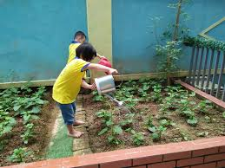
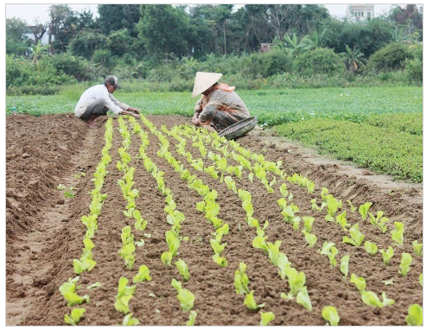
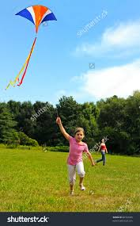
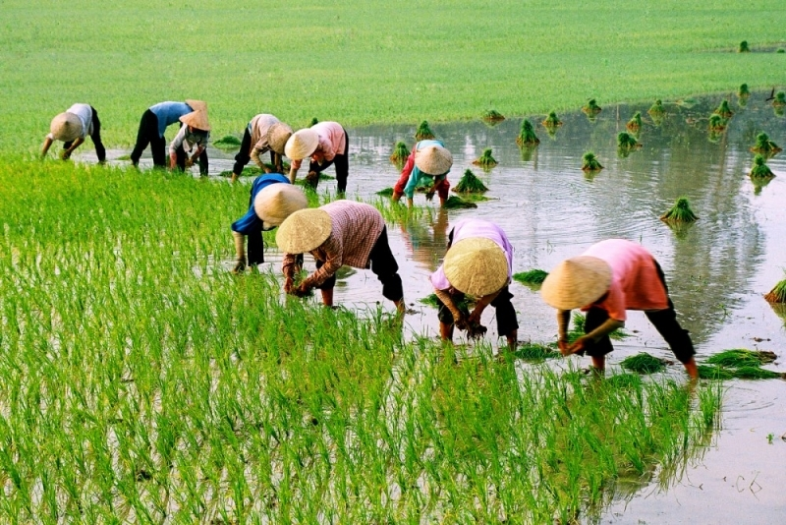
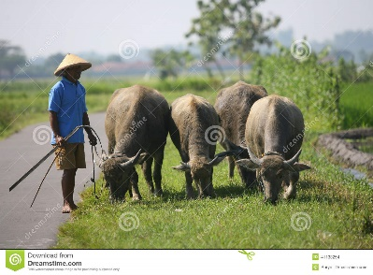
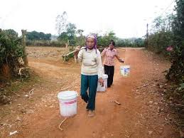
* WARM UP:
Write the activities with the pictures. (Bingo)
5. Water vegetables
3. plant vegetables
1. flying a kite
6. plant the rice
2. herding buffaloes
4. collecting water

Slide 3
* WARM UP: Answer my questions.
1. Do you think these activities in the city or in the countryside?
5. water vegetables
3. plant vegetables
2. Where do you live?
3. Do you often see these activities in your neibourhood?
1. flying a kite
6. plant the rice
3. Do you like living in the countryside?
2. herding buffaloes
4. collecting water

Slide 4
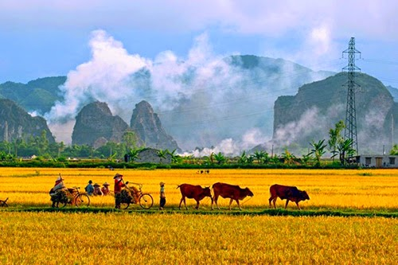
P9: Unit 2: Life in the countryside
Lesson 1: Getting started - Last summer holiday

Slide 5
1. What can you see in video?
2. How do you feel about the life in the countryside?

Slide 6
* Listen and read the dialogue.
Nick: You look great with a tan, Mai!
Mai: Thank you. I’ve just come back from a very enjoyable summer holiday.
Nick: Really? Where did you stay?
Mai: I stayed at my uncle’s house in a small village in Bac Giang Province.
Nick: What did you do there?
Mai: A lot of things. It was harvest time. The villagers were harvesting rice with a combine harvester. I helped them load the rice onto a truck. Then we unloaded the rice and dried it.
Nick: Sounds great!
Mai: And sometimes I went with the village children to herd the buffaloes and cows. I made friends with them on my first day.
Nick: Were they friendly?
Mai: Yes, they were. They took me to the paddy fields to fly kites. And in the evening, we played traditional games like bamboo dancing and dragon-snake.
Nick: Oh, I envy you!
Mai: Things move more slowly there than in our city, but people seem to have a healthier life.

Slide 7
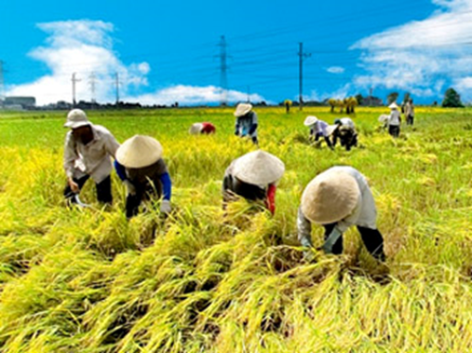
I. Presentation: Vocabulary.
- harvest (v)
/ˈhɑːvɪst/
thu hoạch

Slide 8
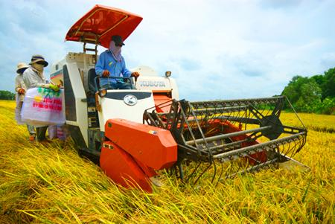
- combine harvester (n)
/kəmˈbaɪn ˈhɑːvɪstər /
máy gặt đập liên hợp

Slide 9
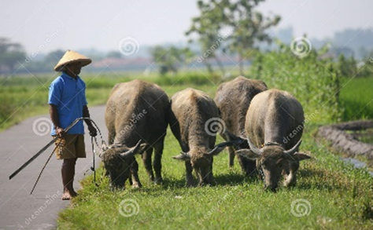
- herd (v)
/hɜːd/
chăn (gia súc)

Slide 10
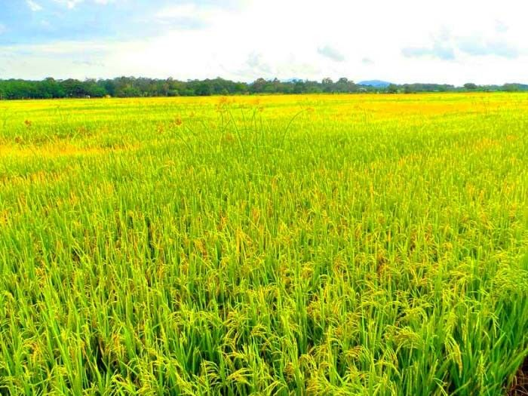
- paddy field (n)
/ˈpædi ˌfiːld/
cánh đồng lúa

Slide 11
- load (v) /loud/:
chất hàng lên, chở

Slide 12
I. Presentation : Vocabulary
New words | Pronunciation | Meaning
1. harvest (v) | /ˈhɑːvɪst/ | thu hoạch
2. combine harvester (n) | /kəmˈbaɪn ˈhɑːvɪstər/ | máy gặt đập liên hợp
3. herd (v) | /hɜːd/ | chăn
4. paddy field (n) | /ˈpædi ˌfiːld/ | đồng lúa
5. load (v) | /loud/ | chất hàng lên, chở

Slide 13
II. PRACTICE
1. Listen and read.
Nick: You look great with a tan, Mai!
Mai: Thank you. I’ve just come back from a very enjoyable summer holiday.
Nick: Really? Where did you stay?
Mai: I stayed at my uncle’s house in a small village in Bac Giang Province.
Nick: What did you do there?
Mai: A lot of things. It was harvest time. The villagers were harvesting rice with a combine harvester. I helped them load the rice onto a truck. Then we unloaded the rice and dried it.
Nick: Sounds great!
Mai: And sometimes I went with the village children to herd the buffaloes and cows. I made friends with them on my first day.
Nick: Were they friendly?
Mai: Yes, they were. They took me to the paddy fields to fly kites. And in the evening, we played traditional games like bamboo dancing and dragon-snake.
Nick: Oh, I envy you!
Mai: Things move more slowly there than in our city, but people seem to have a healthier life.

Slide 14
II. PRACTICE
1. Listen and read.
Nick: You look great with a tan, Mai!
Mai: Thank you. I’ve just come back from a very enjoyable summer holiday.
Nick: Really? Where did you stay?
Mai: I stayed at my uncle’s house in a small village in Bac Giang Province.
Nick: What did you do there?
Mai: A lot of things. It was harvest time. The villagers were harvesting rice with a combine harvester. I helped them load the rice onto a truck. Then we unloaded the rice and dried it.
Nick: Sounds great!
Mai: And sometimes I went with the village children to herd the buffaloes and cows. I made friends with them on my first day.
Nick: Were they friendly?
Mai: Yes, they were. They took me to the paddy fields to fly kites. And in the evening, we played traditional games like bamboo dancing and dragon-snake.
Nick: Oh, I envy you!
Mai: Things move more slowly there than in our city, but people seem to have a healthier life.

Slide 15
2. Work in pair and choose the correct answer to each question.
1. How does Mai feel about her summer holiday?
A. She likes it. B. She doesn’t like it. C. She thought it was fine.
2. Where did she stay during her summer holiday?
A. At her friend’s house. B. At her uncle’s house.
C. At her grandparents’ house.
2
3. During harvest time, people harvest rice by ______.
A. Themselves B. using a truck
C. using a combine harvester
4. Mai thinks people in the countryside lead ______.
A. a healthy life B. an exciting life C. an interesting life

Slide 16
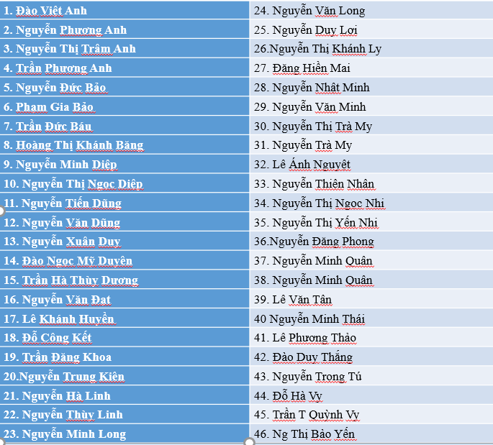
2. Choose the correct answer to each question.
1. How does Mai feel about her summer holiday?
A. She likes it.
B. She doesn’t like it.
C. She thought it was fine.
spin

Slide 17
2. Choose the correct answer to each question.
2. Where did she stay during her summer holiday?
A. At her friend’s house.
B. At her uncle’s house.
C. At her grandparents’ house.
spin

Slide 18
2. Choose the correct answer to each question.
3. During harvest time, people harvest rice by ______.
A. themselves
B. using a truck
C. using a combine harvester
spin

Slide 19
2. Choose the correct answer to each question.
4. Mai thinks people in the countryside lead ______.
A. a healthy life
B. an exciting life
C. an interesting life
spin

Slide 20
3. Read the conversation again and complete the sentences with the words and phrases from the box.
paddy field
herd
harvest time
load
combine harvester
1. It took them an hour to ___________ all the goods onto the truck.
2. Nowadays, people in my village use a _______________ to harvest their rice and separate the grains from the rest of the plant.
3. Today it is my turn to __________ the cows.
4. A place in which people grow rice is called a _______________.
5. A busy time when people cut and gather their crops is called _____________.
Game

Slide 21
Questions: Lucky numbers
1
2
3
4
5
6
7
8
Team A
Team B

Slide 22
3. Complete the sentences with the words and phrases from the box.
paddy field
herd
harvest time
load
combine harvester
1. It took them an hour to __________ all the goods
onto the truck.
load

Slide 23
3. Complete the sentences with the words and phrases from the box.
paddy field
herd
harvest time
load
combine harvester
2. Nowadays, people in my village use a ________________ to harvest their rice and separate the grains from the rest of the plant.
combine harvester

Slide 24
3. Complete the sentences with the words and phrases from the box.
paddy field
herd
harvest time
load
combine harvester
3. Today it is my turn to __________ the cows.
herd

Slide 25
3. Complete the sentences with the words and phrases from the box.
paddy field
herd
harvest time
load
combine harvester
4. A place in which people grow rice is called a ____________.
paddy fields

Slide 26
3. Complete the sentences with the words and phrases from the box.
paddy field
herd
harvest time
load
combine harvester
5. A busy time when people cut and gather their crops is called _____________.
harvest time

Slide 29
You get a gift

Slide 30
3
Complete the sentences with the words and phrases from the box.
1. It took them an hour to ___________ all the goods onto the truck.
2. Nowadays, people in my village use a __________________ to harvest their rice and separate the grains from the rest of the plant.
3. Today it is my turn to __________ the cows.
4. A place in which people grow rice is called a _______________.
5. A busy time when people cut and gather their crops is called _____________.
load
combine harvester
herd
paddy field
harvest time

Slide 31
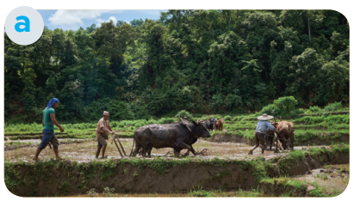
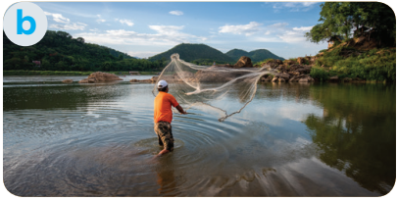
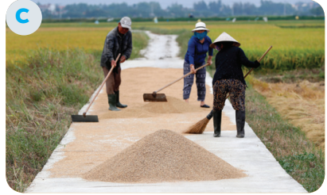
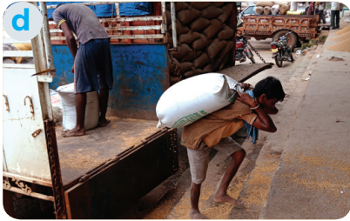
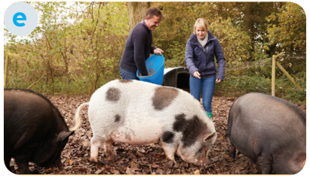
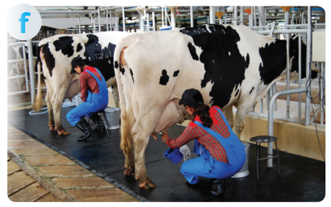
4. Match the activities that people living in the countryside often do with the pictures.
1. unloading rice
2. ploughing fields
3. milking cows
4. feeding pigs
5. catching fish
6. drying rice

Slide 32
4. Match the activities that people living in the countryside often do with the pictures.
1. unloading rice
2. ploughing fields
3. milking cows
4. feeding pigs
5. catching fish
6. drying rice

Slide 33
IV. PRODUCTION
5. Work in pairs. ask and answer about the pictures in 4
Example:
A: What are they doing in picture a? B: They’re ploughing fields

Slide 34
5
A: What are they doing in picture b?
B : They're catching fish.

Slide 35
A: What are they doing in picture c ?
B : They're drying rice.

Slide 36
A: What are they doing in picture d?
B : They're unloading rice.

Slide 37
A: What are they doing in picture e ?
B : They're feeding pigs.

Slide 38
A: What are they doing in picture f ?
B : They're milking cows.

Slide 39
* CONSOLIDATION
1
Wrap-up
What have we learnt in this lesson?
- Learn vocabulary about countrysiade.
- use lexical items related to life in the countryside

Slide 40
2
Homework
Do exercises in the workbook.
Start preparing for the Project of the unit.

Slide 41
Goodbye.
See you again

