Slide 1
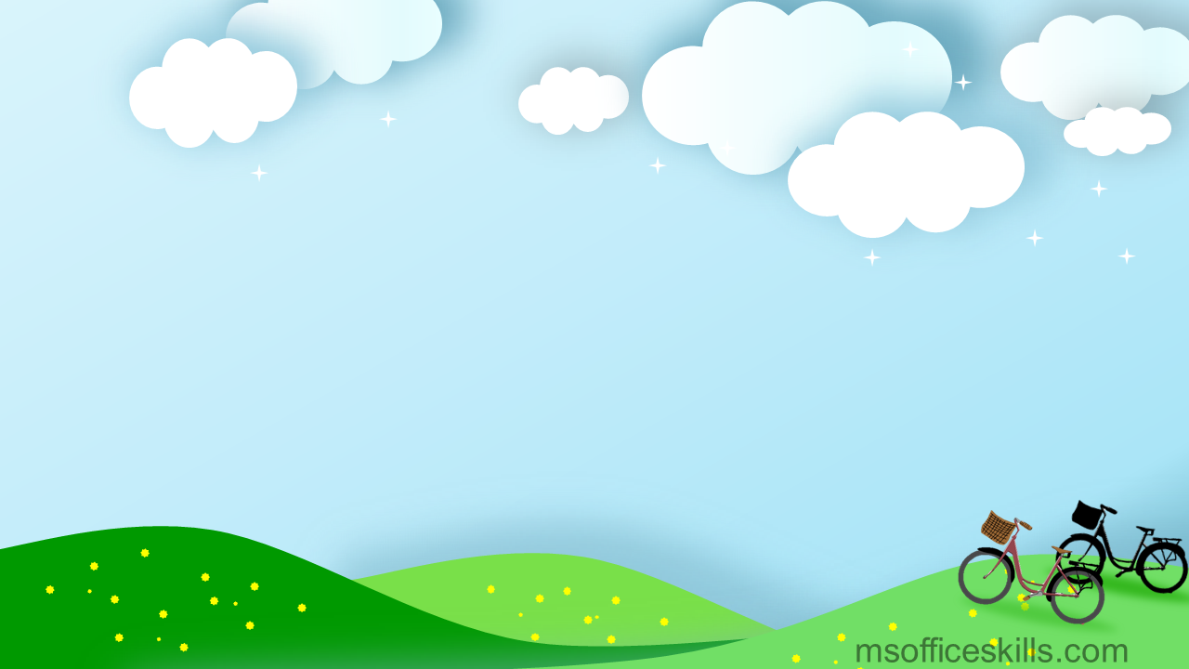
Hello everyone !!!

Slide 2
WARM-UP
Check out the old lesson by spinning the wheel to call out the name
DS HỌC SINH LỚP 8A
1. Đào Việt Anh | 24. Nguyễn Văn Long
2. Nguyễn Phương Anh | 25. Nguyễn Duy Lợi
3. Nguyễn Thị Trâm Anh | 26.Nguyễn Thị Khánh Ly
4. Trần Phương Anh | 27. Đặng Hiền Mai
5. Nguyễn Đức Bảo | 28. Nguyễn Nhật Minh
6. Phạm Gia Bảo | 29. Nguyễn Văn Minh
7. Trần Đức Báu | 30. Nguyễn Thị Trà My
8. Hoàng Thị Khánh Băng | 31. Nguyễn Trà My
9. Nguyễn Minh Diệp | 32. Lê Ánh Nguyệt
10. Nguyễn Thị Ngọc Diệp | 33. Nguyễn Thiện Nhân
11. Nguyễn Tiến Dũng | 34. Nguyễn Thị Ngọc Nhi
12. Nguyễn Văn Dũng | 35. Nguyễn Thị Yến Nhi
13. Nguyễn Xuân Duy | 36.Nguyễn Đăng Phong
14. Đào Ngọc Mỹ Duyên | 37. Nguyễn Minh Quân
15. Trần Hà Thùy Dương | 38. Nguyễn Minh Quân
16. Nguyễn Văn Đạt | 39. Lê Văn Tân
17. Lê Khánh Huyền | 40 Nguyễn Minh Thái
18. Đỗ Công Kết | 41. Lê Phương Thảo
19. Trần Đăng Khoa | 42. Đào Duy Thắng
20.Nguyễn Trung Kiên | 43. Nguyễn Trọng Tú
21. Nguyễn Hà Linh | 44. Đỗ Hà Vy
22. Nguyễn Thùy Linh | 45. Trần T Quỳnh Vy
23. Nguyễn Minh Long | 46. Ng Thị Bảo Yến
spin

Slide 3
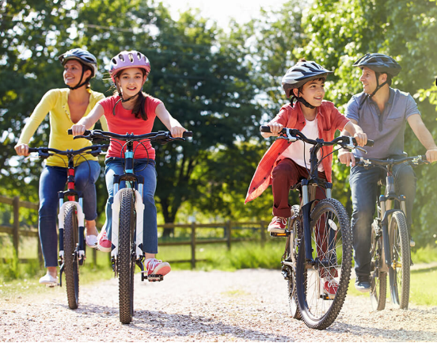
1
Look at the pictures. What activities can you see?
riding a bike/ cycling

Slide 4
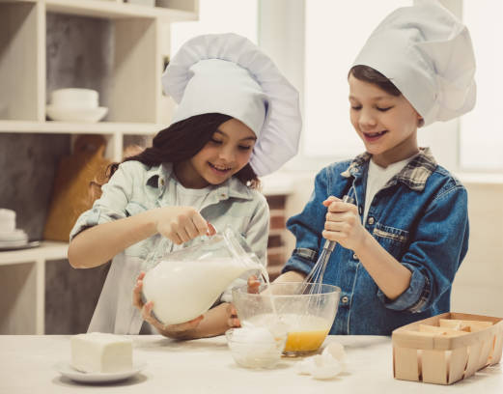
1
Look at the pictures. What activities can you see?
cooking

Slide 5
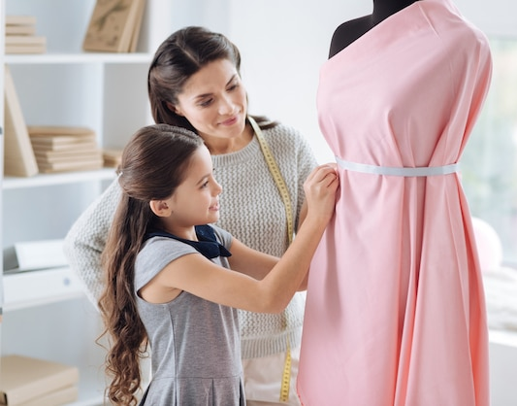
1
Look at the pictures. What activities can you see?
making a dress

Slide 6
1
Look at the pictures. What activities can you see?
riding a bike/ cycling
LEISURE ACTIVITIES
cooking
making a dress

Slide 7
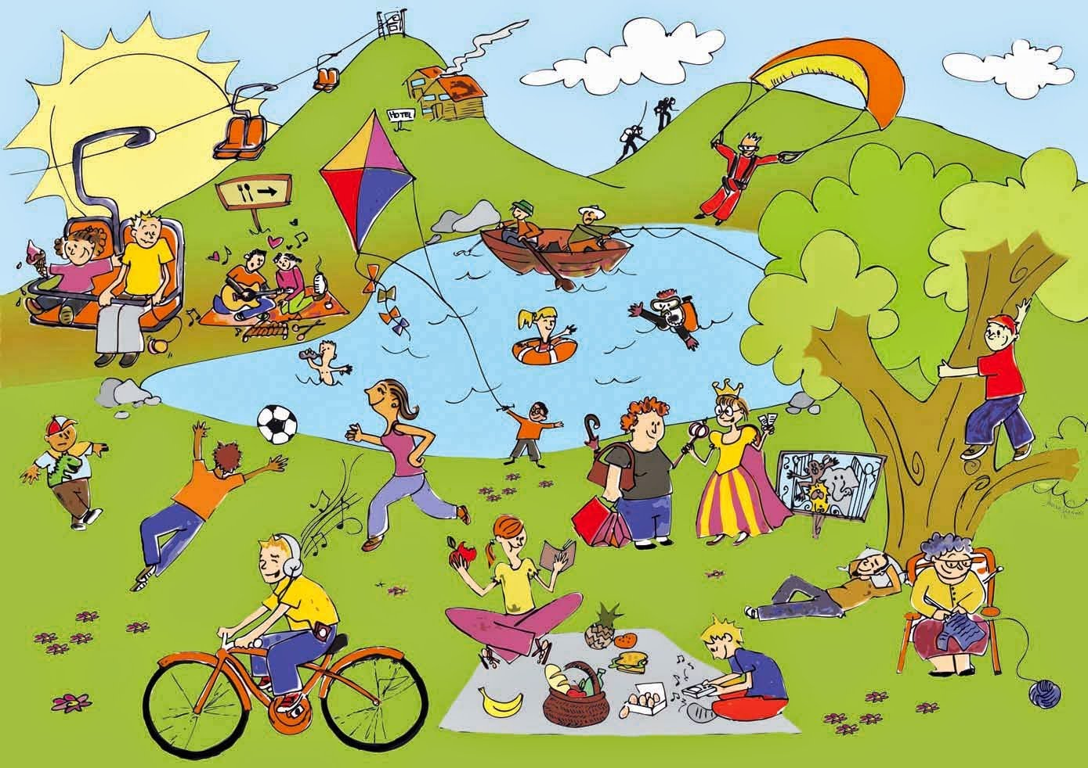
Unit
1
LEISURE TIME
LESSON 5: SKILL 1
1

Slide 8
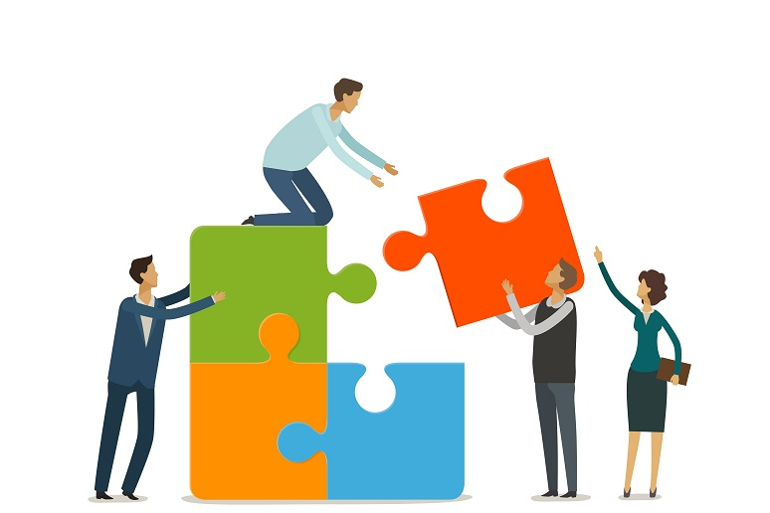
* Vocabulary
connect (v)
/kəˈnekt/
kết nối

Slide 9
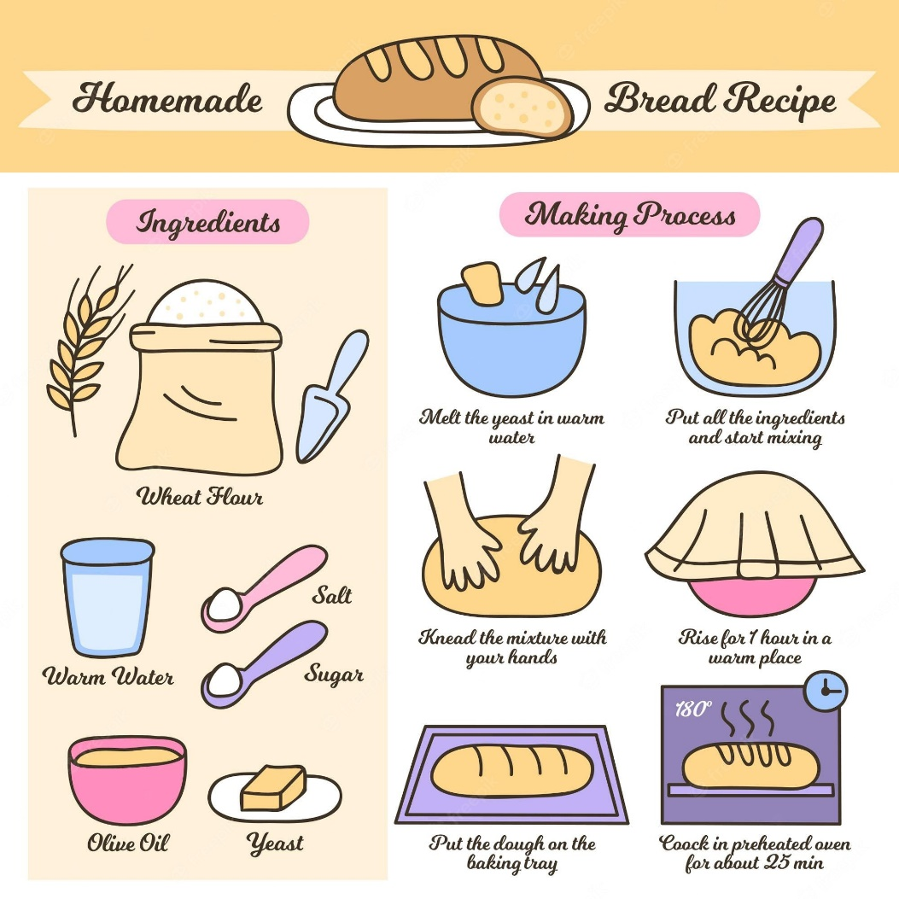
* Vocabulary
recipe (n)
/ˈresɪpi/
công thức

Slide 10
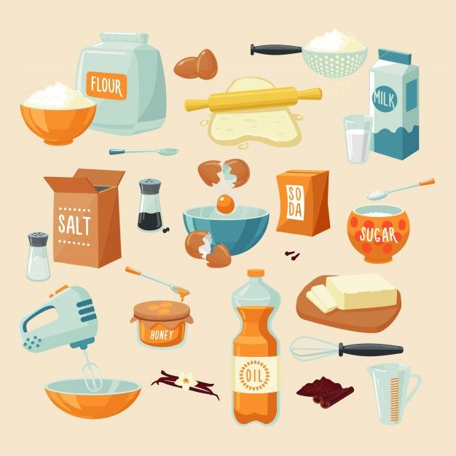
* Vocabulary
ingredient (n)
/ɪnˈɡriːdiənt/
nguyên liệu

Slide 11
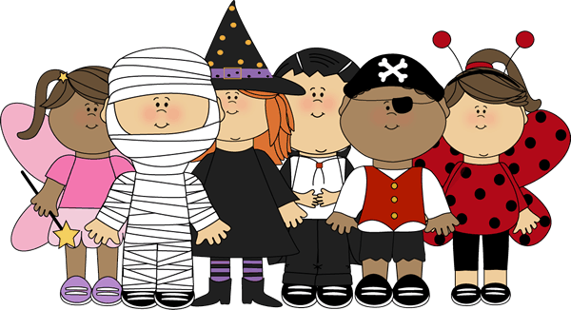
* Vocabulary
costume (n)
/ˈkɒstjuːm/
trang phục

Slide 12
* Vocabulary
New words | Pronunciation | Meaning
1. connect (v) | /kəˈnekt/ | kết nối
2. recipe (n) | /ˈresɪpi/ | công thức
3. ingredient (n) | /ɪnˈɡriːdiənt/ | nguyên liệu
4. costume (n) | /ˈkɒstjuːm/ | trang phục

Slide 13
I. READING
2
Read about Trang’s leisure activities. Choose the correct answer.
Some teenagers enjoy spending free time with their friends. Others prefer doing leisure activities with their family members. I love spending time with my family because it’s a great way to connect with them.
At the weekend, we usually go for a bike ride. We cycle to some nearby villages to enjoy the fresh air. We take photos and look at them later. My big brother and I are also into cooking. My brother looks for easy recipes. After that, we prepare the ingredients and cook. Sometimes the food is good, but sometimes it isn’t; nevertheless, we love whatever we cook. The leisure activity I like the most is doing DIY projects with my mum. She teaches me to make my own dresses and doll clothes. On special occasions, we make special dresses together. Once I won the first prize in a costume contest at my school.

Slide 14
2
Read about Trang’s leisure activities. Choose the correct answer.
1. The text is about Trang’s leisure activities ______.
A. in the past B. with her friends C. with her family
2. The word “connect” is closest in meaning to ______. A. join with something
B. better understand someone
C. speak to someone by phone

Slide 15
1. The text is about Trang’s leisure activities ______.
A. in the past
B. with her friends
C. with her family

Slide 16
2. The word “connect” is closest in meaning to ______.
A. join with something
B. better understand someone
C. speak to someone by phone

Slide 17
3
Read the text again and answer the questions.
* Questions
1. What does Trang do with her family members at the weekend?
2. Who looks for recipes when Trang and her brother cook?
3. Which leisure activity does she love the most?
4. What does Trang’s mum teach her to do?
5. What did she win?
Game

Slide 18
LUCKY NUMBER!
1
2
3
4
5
6
7
8
Tom
2
4
6
8
10
12
14
Jerry
2
4
6
8
10
12
14

Slide 19
1. What does Trang do with her family members at the weekend?
→ She goes for a bike ride, cooks, and does DIY projects.

Slide 20
2. Who looks for recipes when Trang and her brother cook?
→Her brother does.

Slide 21
3. Which leisure activity does she love the most?
→ She loves doing DIY projects with her mum the most.

Slide 22
4. What does Trang’s mum teach her to do?
→ Her mum teaches her to make her own dresses and doll clothes.

Slide 23
5. What did she win?
→ She won the first prize in a costume contest at her school.

Slide 24
LUCKY NUMBER!
you get 2 plus points

Slide 25
LUCKY NUMBER!
you get 2 plus points

Slide 26
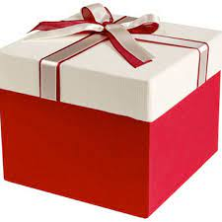
You get a gift

Slide 27
1. Trang and her family usually go for a bike ride. They cycle to some nearby villages to enjoy the fresh air. They take photos and look at them later.
2. When Trang and her brother cook, her brother looks for easy recipes.
3. The leisure activity she likes the most is doing DIY projects with her mum.
4. Trang's mum teaches her to make her own dresses and doll clothes.
5. She won the first prize in a costume contest at her school.

Slide 28
II. SPEAKING
4
Work in groups. Take turns to ask and answer the questions. Record your friends’ answer in the table below.
1. What leisure activities do you usually do with your family?
2. Which one do you like the most? Why?
3. How do you feel when you spend time with your family members?
Friends’ name | Questions 1 | Questions 2 | Questions 3

Slide 29
II. SPEAKING
4
Work in groups. Take turns to ask and answer the questions. Record your friends’ answer in the table below.
What leisure activities do you usually do with your family?
- I usually watch TV, eat meals, play badminton, talk, gardening, play chess, …
2. Which one do you like the most? Why?
I like gardening with my family because planting trees can protect the environment, giving more green for my neighbour…
3. How do you feel when you spend time with your family members?
Very happy…

Slide 30
II. SPEAKING
4
Work in groups. Take turns to ask and answer the questions. Record your friends’ answer in the table below.
1. What leisure activities do you usually do with your family?
2. Which one do you like the most? Why?
3. How do you feel when you spend time with your family members?
→ We usually watch TV, eat meals, play badminton, talk, do gardening, play chess,..
→The leisure activity I like the most is gardening with my family because it helps protect the environment, giving more green for my neighbour…
→ I feel very happy

Slide 31
II. SPEAKING
4
Work in groups. Take turns to ask and answer the questions. Record your friends’ answer in the table below.
1. What leisure activities do you usually do with your family?
→ We usually……………………………....
play badminton.
have dinner.
go jogging.
watch TV.
go to the beach.
Visit grandparents
Have a picnic
…………………….

Slide 32
II. SPEAKING
4
Work in groups. Take turns to ask and answer the questions. Record your friends’ answer in the table below.
2. Which one do you like the most? Why?
I like going to the beach the most. Because it helps me relax and it reduces stress.
- help me relax
- reduce stress
- good for my health
- explore interesting areas
- make delicious meal
- spend time together

Slide 33
II. SPEAKING
4
Work in groups. Take turns to ask and answer the questions. Record your friends’ answer in the table below.
3. How do you feel when you spend time with your family members?
→ I feel ………………….
- very happy.
- really comfortable.
- very cozy
- the relationship is connected

Slide 34
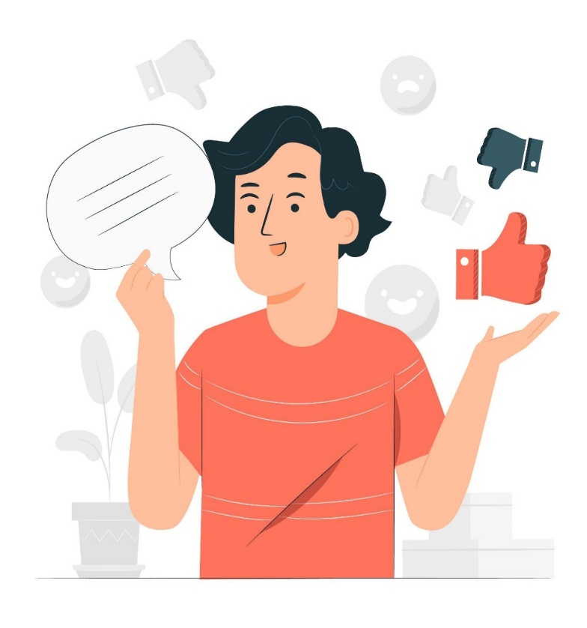
5
Report your group members’ answers to the class. What activities are the most common?
The most common activities is …
After discussing with members in our group, we see that riding bike is the most popular activity in our group. Also, almost members in our group are into………………………………….

Slide 35
CONSOLIDATION
What have we learnt in this lesson?
read about teen’s leisure activities
talk about friends’ leisure activities

Slide 36
Homework
Do exercises in the workbook.

Slide 37
Website: hoclieu.vn
Fanpage: facebook.com/www.tienganhglobalsuccess.vn/

