Slide 1
GOOD MORNING CLASS !!!

Slide 2
WARM-UP
HOT SEAT
How to play:
One student goes to the board and gets one activity from the teacher.
This student acts the activity without saying.
The rest of class guess the activity.
Example: - Flying the kites
- go fishing
- listening to music
- arranging flowers
- taking photos

Slide 3
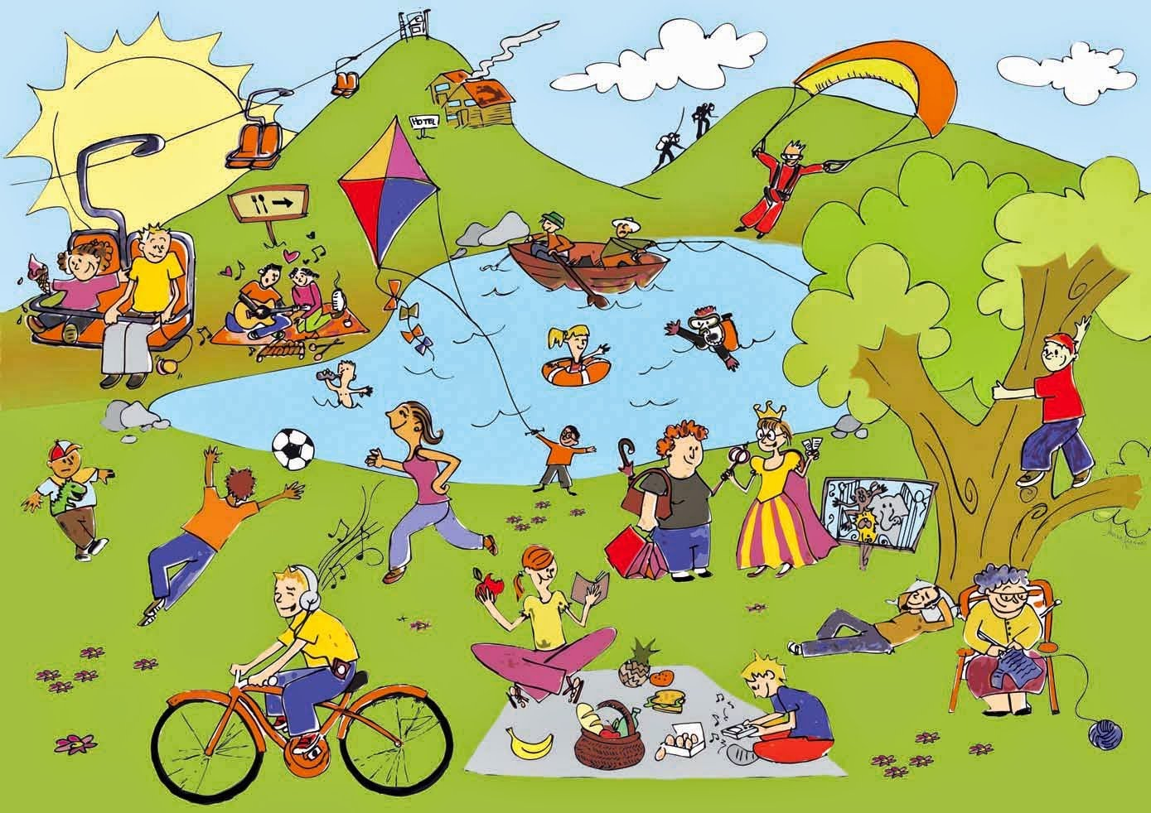
Unit
1
LEISURE TIME
LESSON 6: SKILLS 2
1

Slide 4
I. LISTENING
1
Answer the questions.
1. In your opinion, what activities can we do with our friends in our leisure time?
2. Why should we spend time with our friends?

Slide 5
DS HỌC SINH LỚP 8A
1. Đào Việt Anh | 24. Nguyễn Văn Long
2. Nguyễn Phương Anh | 25. Nguyễn Duy Lợi
3. Nguyễn Thị Trâm Anh | 26.Nguyễn Thị Khánh Ly
4. Trần Phương Anh | 27. Đặng Hiền Mai
5. Nguyễn Đức Bảo | 28. Nguyễn Nhật Minh
6. Phạm Gia Bảo | 29. Nguyễn Văn Minh
7. Trần Đức Báu | 30. Nguyễn Thị Trà My
8. Hoàng Thị Khánh Băng | 31. Nguyễn Trà My
9. Nguyễn Minh Diệp | 32. Lê Ánh Nguyệt
10. Nguyễn Thị Ngọc Diệp | 33. Nguyễn Thiện Nhân
11. Nguyễn Tiến Dũng | 34. Nguyễn Thị Ngọc Nhi
12. Nguyễn Văn Dũng | 35. Nguyễn Thị Yến Nhi
13. Nguyễn Xuân Duy | 36.Nguyễn Đăng Phong
14. Đào Ngọc Mỹ Duyên | 37. Nguyễn Minh Quân
15. Trần Hà Thùy Dương | 38. Nguyễn Minh Quân
16. Nguyễn Văn Đạt | 39. Lê Văn Tân
17. Lê Khánh Huyền | 40 Nguyễn Minh Thái
18. Đỗ Công Kết | 41. Lê Phương Thảo
19. Trần Đăng Khoa | 42. Đào Duy Thắng
20.Nguyễn Trung Kiên | 43. Nguyễn Trọng Tú
21. Nguyễn Hà Linh | 44. Đỗ Hà Vy
22. Nguyễn Thùy Linh | 45. Trần T Quỳnh Vy
23. Nguyễn Minh Long | 46. Ng Thị Bảo Yến
spin

Slide 6
I. LISTENING
1
1. - go to the cinema
- play sports
- go to the park
- have a dinner party
- Go fishing
- play video games…
Answer the questions. (groups work)
1. In your opinion, what activities can we do with our friends in our leisure time?
2. Why should we spend time with our friends?
2. - connect with other people and become closer with them.
- boost (tăng) your happiness and reduce your stress. - improve your self-confidence.
- help you overcome sad time

Slide 7
2
Listen to an interview with Mark about his leisure activities. Choose the correct answer. (pairwwork)
1. When does Mark usually have free time?
A. At weekends. B. On Sundays. C. On Saturdays.
2. Who does he spend his free time with?
A. His neighbours and friends.
B. His family and relatives. C. His family and friends.

Slide 8
3
Listen to the interview again. Fill in each blank in the table with no more than two words.
Activities | Reason
Inviting friends to his house Cooking and watching a (1) ______ | Fun and better than going to the (2) ________
Going to the (3) ______ to play volleyball or skateboard | Stay in (4) ______
Going for a (5) ________ around our city | See different (6) ______
video
cinema
park
shape
bike ride
places
K

Slide 9
Tapescript
Interviewer: When do you usually have free time?
Mark: I usually have free time at the weekend.
Interviewer: So how do you spend it?
Mark: I spend time to connect with my family on Saturdays. We do puzzles, play board games or go camping.
Interviewer: What about Sundays?
Mark: I usually spend Sundays with my friends. I have a group of friends and we do lots of things together.
Interviewer: For example?
Mark: Sometimes I invite them to my house. We cook our favourite food and watch a video. It's fun and better than going to the cinema.
Interviewer: Do you do outdoor activities together?
Mark: Yes, we love spending time outdoors. We go to the park to play volleyball or skateboard. It helps us stay in shape. Sometimes we go for a bike ride around our city. This gives us a chance to see different places in our city.
Interviewer: Thanks for letting us interview you.

Slide 10
II. WRITING
4
Work in pairs. Ask and answer the questions.
Questions
Sample answers
1. When do you usually have free time?
2. What do you usually do with your friends in your free time?
3. Why do you do these activities?
1. I often have free time at the weekend.
2. I usually hang out with my friends.
I usually play badminton …..
I usually go swimming ………
I play video games…………..
3. I do these activities because it helps me reduce stress and it also improves my mental health.

Slide 11
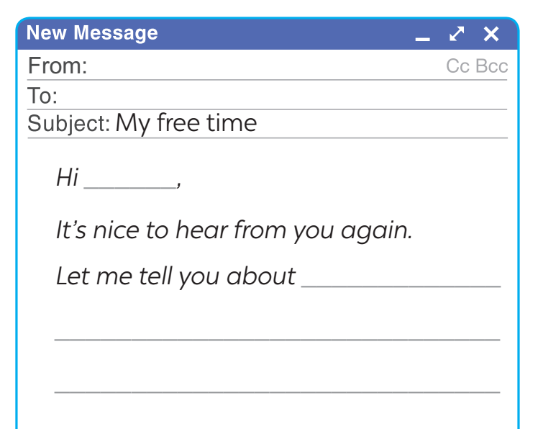
5
Write an email (80 - 100 words) to a penfriend to tell him / her about what you usually do with your friends in your free time. Use your answers in 4.
Start and end the email as follows:

Slide 12
From : (Tên mình)2010@gmail.com
To: (Tên bạn mình) 2010@gmail.com
Subject: My free time.
Hi ….,
It’s nice to hear from you again.
Let me tell you about the things I usually do with my friends/ family in my leisure time.
I usually have free time at weekends, and I often spend Sunday mornings with my friends. I have three close friends, and they live near my house. We usually play badminton together for about an hour in the playground. After that, we cycle around the neighborhood. This helps us relax and have a lot of fun.
What about you? What do you usually do with your friends in your free time?
Tell me in your next email.
Bye for now,
(Tên mình)

Slide 13
5
Write an email (80 - 100 words) to a penfriend to tell him / her about what you usually do with your friends in your free time. Use your answers in 4.
Start and end the email as follows:
Hi………..,
It’s nice to hear from you again.
Let me tell you about my leisure activities. At the weekend, I usually hang out and talk with my close friends. We also go swimming on Saturday afternoon. This helps us relax and have a lot of fun. Sometimes, I always help my mom with housework and cook meals.
How do you spend your free time? I’m looking forward to your reply.
Bye for now,
………………

Slide 14
*CONSOLIDATION
What have we learnt in this lesson?
Listen to someone talking about their leisure activities
Write an email to talk about leisure activities

Slide 15
* Homework
Do exercises in the workbook.
Prepare lesson 7: Looking back

Slide 16
Thanks for your atendance!
Goodbye. See you again
Notes:
16

