Slide 2
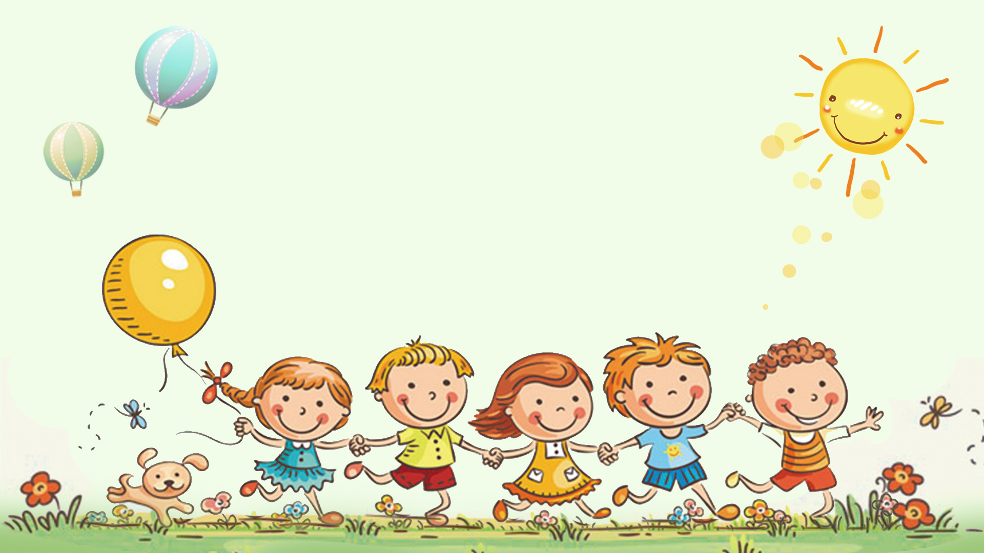
Unit 1: LEISURE TIME
LESSON 1: GETTING STARTED
I’m keen on DIY (do-it-yourself)

Slide 3
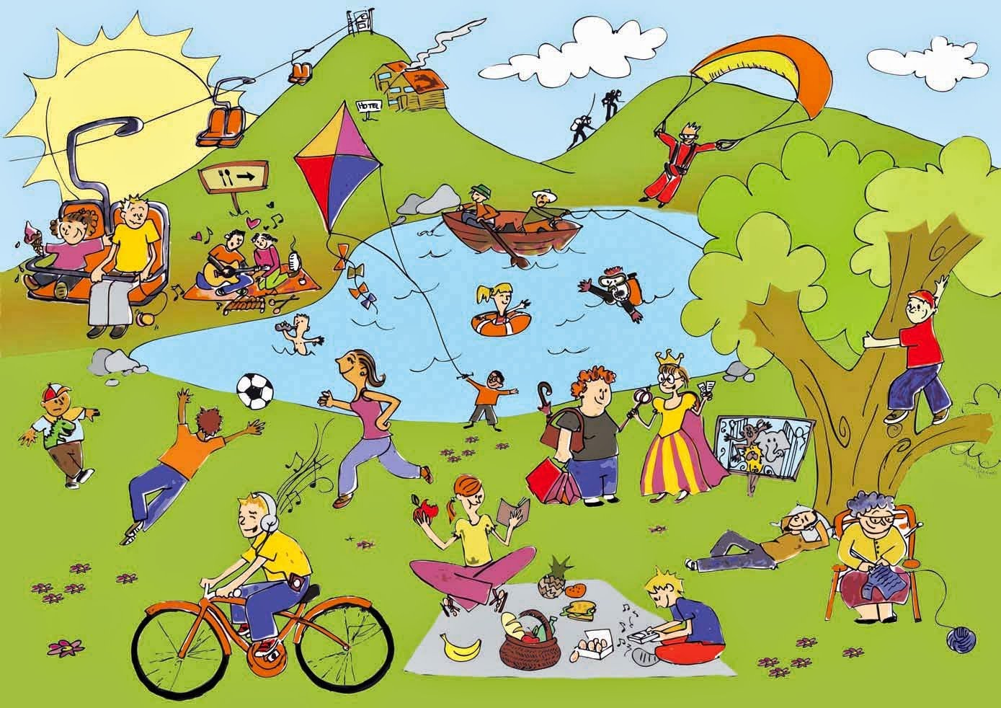
* WARM-UP: Name the activities in the picture
LEISURE ACTIVITIES
1. Fishing
2. Climbing tree
3. Knitting
4. Going on a picnic
5. Cycling
6. swimming

Slide 4
I. PRESENTATION: * Vocabulary.
DIY (n): (do-it-yourself)
/ˌdiːaɪˈwaɪ/
tự tay làm

Slide 5
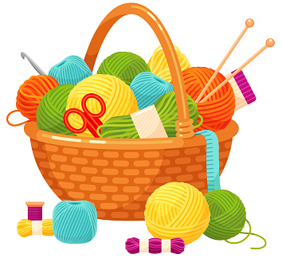
knitting kit (n)
/ˈnɪtɪŋ kɪt/
bộ dụng cụ đan len

Slide 6
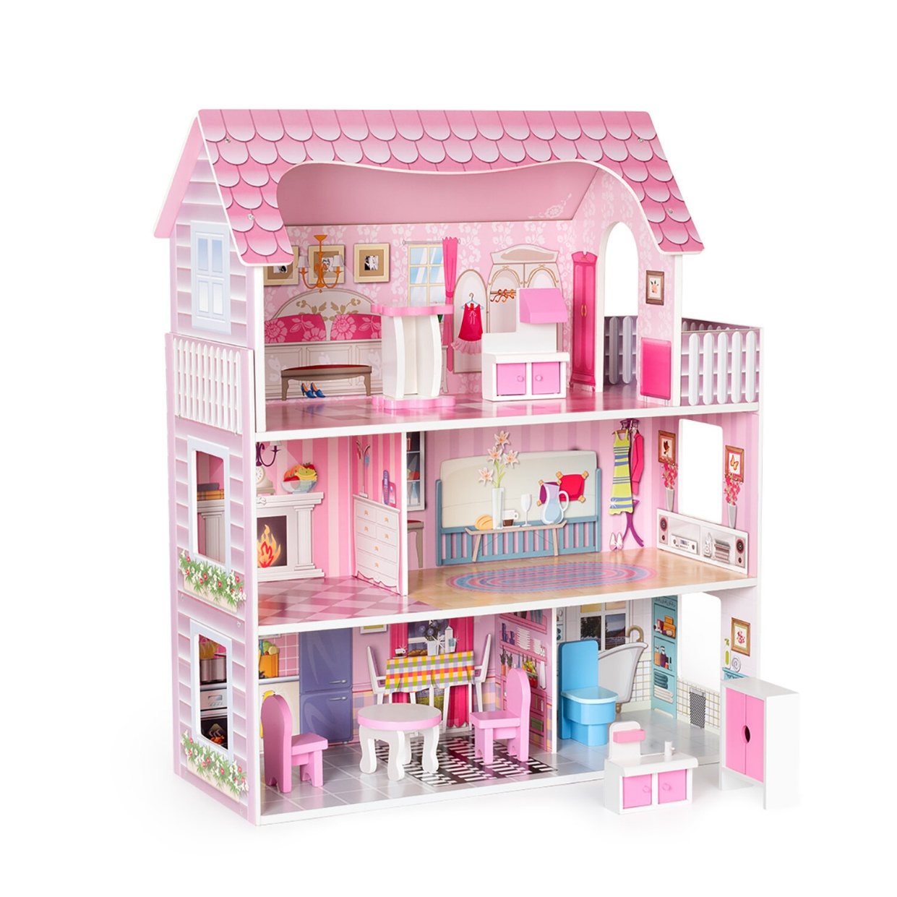
dollhouse (n):
/ˈdɒlhaʊs/:
nhà búp bê

Slide 7
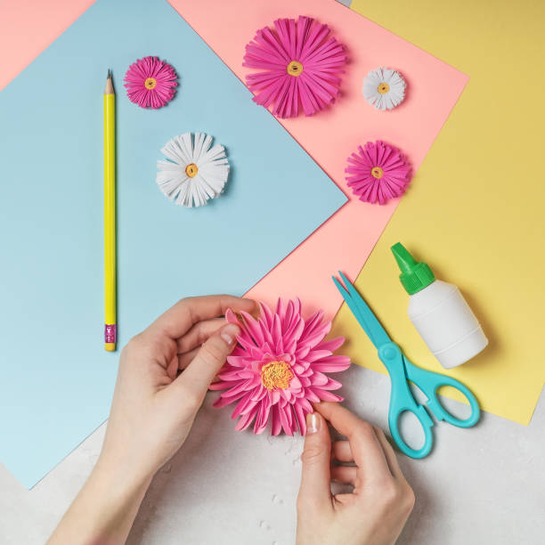
make paper flowers (v.phr)
/meɪk 'peɪpər 'flaʊərz/:
làm hoa giấy

Slide 8
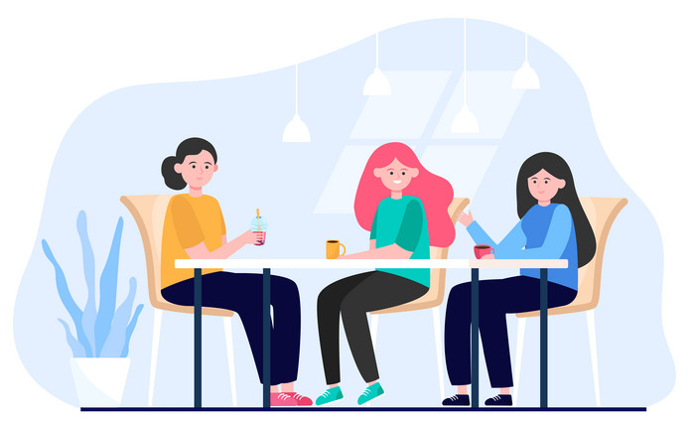
hang out (v):
/hæŋ aʊt/:
đi chơi

Slide 9
I. PRESENTATION: Vocabulary
New words | Pronunciation | Meaning
1. DIY (n) | /ˌdiːaɪˈwaɪ/ | tự tay làm
2. knitting kit (n) | /ˈnɪtɪŋ kɪt/ | bộ dcụ đan len
3. dollhouse (n) | /ˈdɒlˌhaʊs/ | nhà búp bê
4. make paper flowers (v.phr) | /meɪk 'peɪpər 'flaʊərz/ | làm hoa giấy
5. hang out (v) | /hæŋ aʊt/ | đi chơi

Slide 10
II. Listen and read
Tom: Hi, Trang. Surprised to see you. What brings you here?
Trang: Oh, hello Tom. I'm looking for a knitting kit.
Tom: A knitting kit? I didn't know you like knitting.
Trang: Actually, I'm keen on many DIY activities. In my leisure
time, I love knitting, building dollhouses, and making paper flowers.
Tom: I see. So, you like spending time on your own.
Trang: Yeah. What do you do in your free time?
Tom: I'm a bit different. I usually hang out with my friends. We go to the
cinema, go cycling, or play sport in the park.
Trang: You love spending free time with other people, don't you?
Tom: That's right. By the way, would you like to go to the cinema with
me and Mark this Sunday? There's a new comedy at New World Cinema.
Trang: Yes, I'd love to. Can I ask Mai to join us?
Tom: Sure. Let's meet outside the cinema at 9 a.m.

Slide 11
1. Read the conversation again and complete the sentences.
a knitting kit
1. Trang is looking for ____________
Trang: Oh, hello Tom. I'm looking for a knitting kit.
2. She likes doing DIY in her ____________
leisure time
Trang: In my leisure time, I love knitting……
3. Tom loves spending his free time with ____________
his friend
Trag: You love spending free time with other people, don't you?Tom: That's right.
4. Tom and his friend usually ____________ together
spend time
Tom: …..I usually hang out with my friends.
5. Tom, Mark, Trang, and Mai are going to see a comedy this ____________
Sunday
Tom: By the way, would you like to go to the cinema with me and Mark this Sunday?
Trang: Yes, I'd love to.

Slide 12
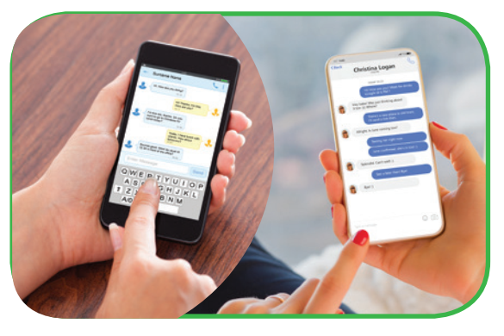
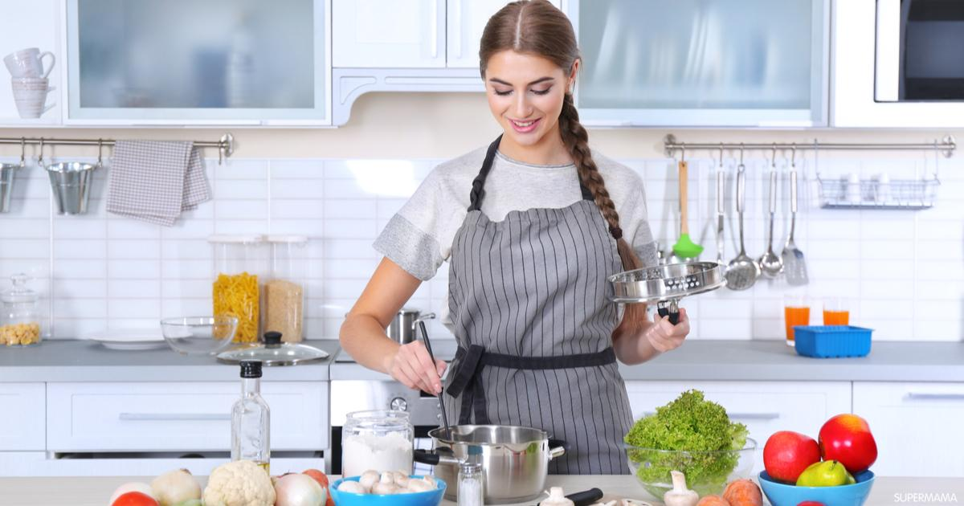
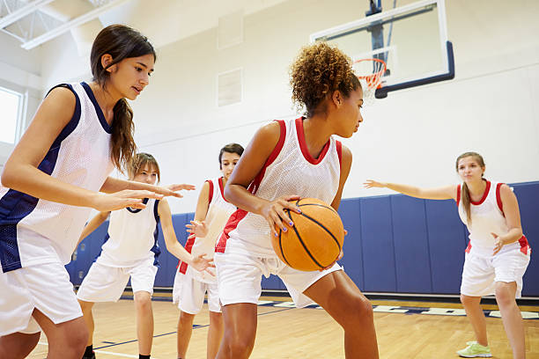
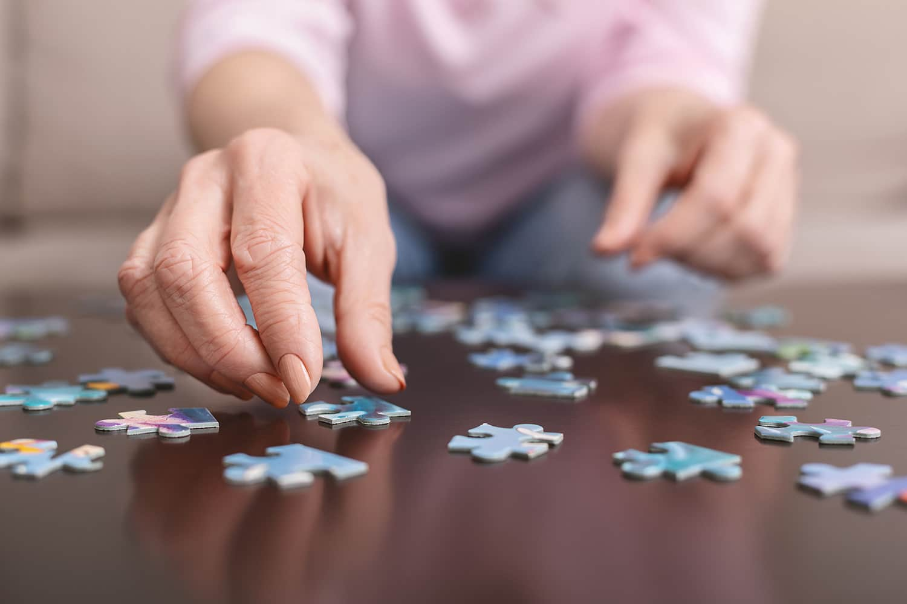
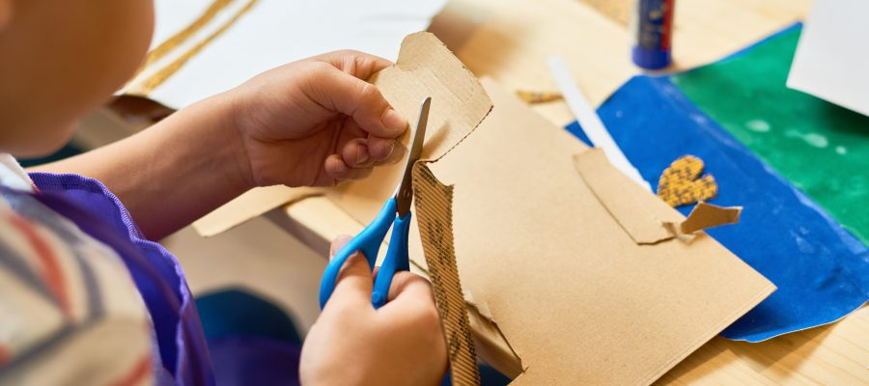
2. Work in pairs. Write the activities from the box under the correct pictures.
doing diy doing puzzles
surfing the net
cooking
playing sport
messaging friends
Messaging friends
cooking
Playing sport
1.______________
2.______________
3.______________
Nhấn vào ảnh để ra đáp án
doing puzzles
doing diy
Surfing the net
4.______________
5.______________
6.______________

Slide 13
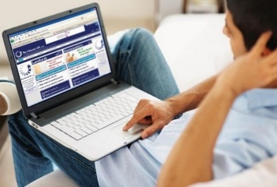
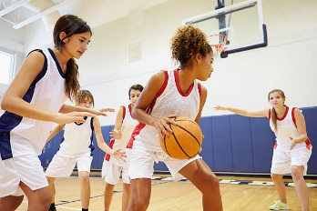
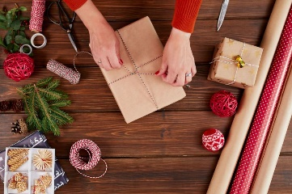
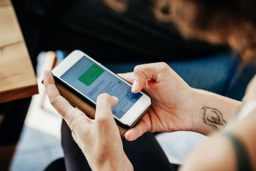
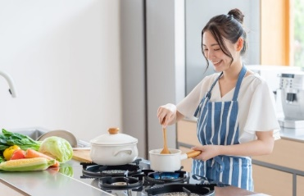
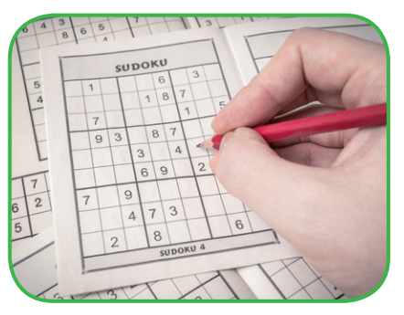
3. Read the word and phrases, and guess which activities in 3 are described
1. improve memory, a mental exercise
2. save money, increase creativity
3. improve physical health, make friends
4. keep in touch, relaxed
5. learn something about IT, computer skills
2. ⇨ Doing puzzles
3. ⇨ Doing DIY
6. ⇨ Playing sport
⇨ 1. Messaging friends
4. ⇨ Surfing the net
1
2
3
4
5
6

Slide 14
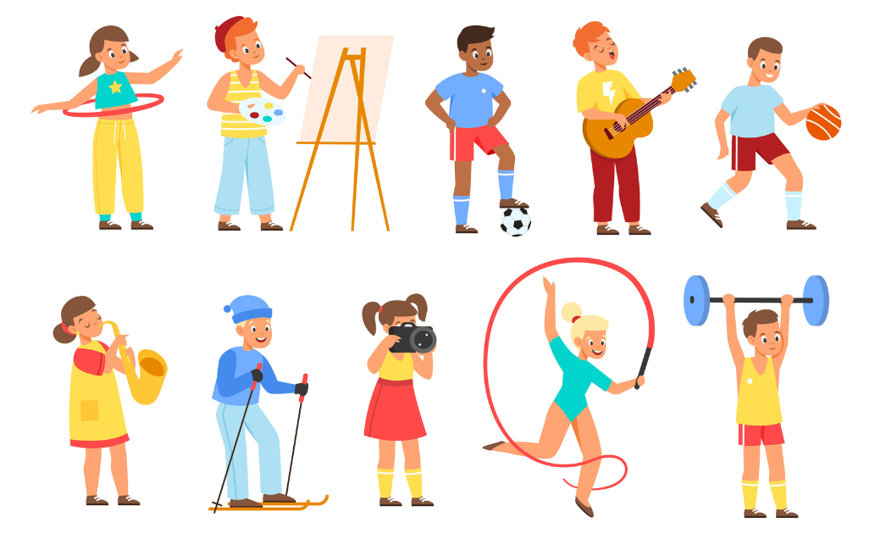
4. Work in groups. Ask one another the question below. Then report your friend’s answer to the class
If you have some free time this weekend, what will you do?
I will go for a picnic with my friends in the park
I will go to the cinema with my sister/brother
Good morning everyone. My name is Mai.
Now I’m going to tell you some of my friend’s leisure activities…

Slide 15
III. Consolidation
Leisure Time
Topic of the unit
Leisure activities
Vocabulary

Slide 16
IV
Homework
Name a list of cheap expensive, easy and difficult leisure activities.
Do exercises in the workbook.
Prepare for the Project of Unit 1.

Slide 17
Website: hoclieu.vn
Fanpage: facebook.com/www.tienganhglobalsuccess.vn/

