Slide 1
Hello every one !!!

Slide 2
Unit
2
HEALTHY LIVING
LESSON 5: SKILLS 1
READING
SPEAKING
Unit

Slide 3
OBJECTIVES
By the end of the lesson, students will be able to:
+ Reading:
- read for specific information about acne
+ Speaking:
- talk about how to deal with some health problems

Slide 4
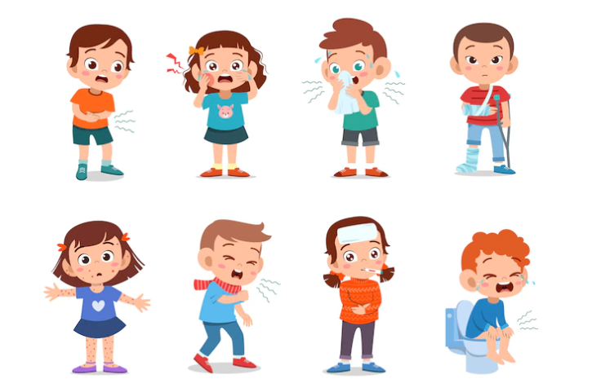
* VOCABULARY
- disease (n)
: bệnh tật
/dɪˈziːz/

Slide 5
- serious (adj)
/ˈsɪəriəs/
: nghiêm trọng

Slide 6
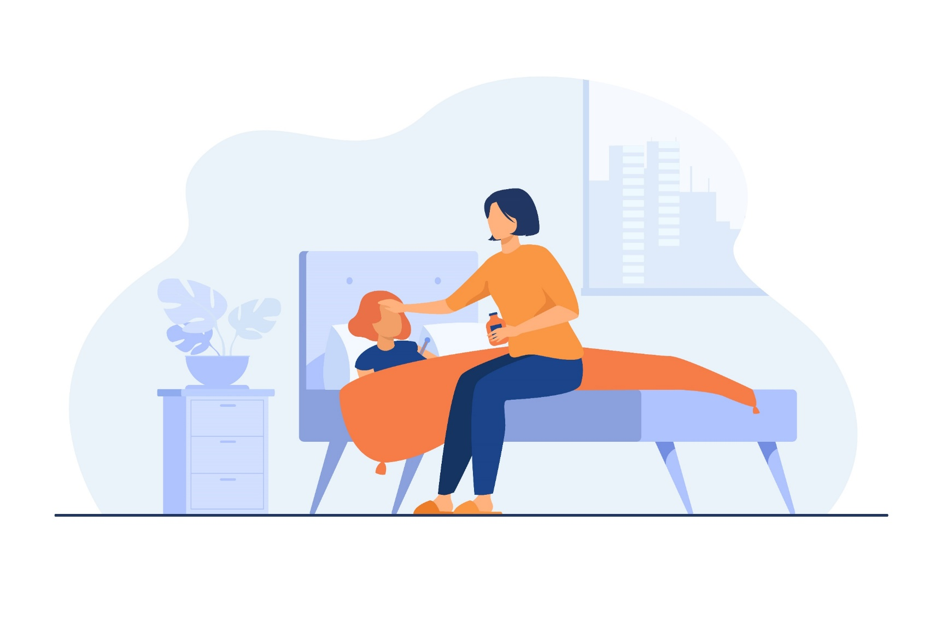
- take care of (phr v)
: chăm sóc
/teɪk keər əv/

Slide 7
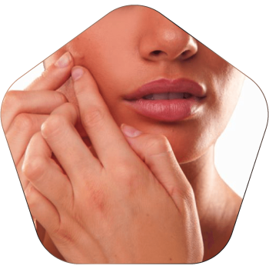
- pop (v)
/pɒp/
: nặn, bóp

Slide 8
* VOCABULARY
New words | Pronunciation | Meaning
disease (n) | /dɪˈziːz/ | bệnh tật
serious (adj) | /ˈsɪəriəs/ | nghiêm trọng
take care of (phr v) | /teɪk keər əv/ | chăm sóc
pop (v) | /pɒp/ | nặn, bóp

Slide 9
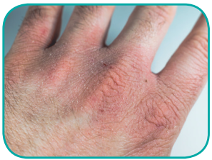
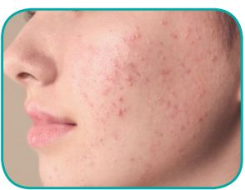
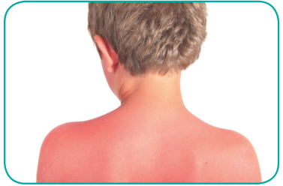
1
Work in pairs. Discuss and write each word or phrase under the correct picture.
Which skin condition is the most common among teenagers?
1.
chapped skin
2.
acne
=> Acne is the most common skin condition among teenagers.
3.
sunburn

Slide 10
2
Read the passage and match the beginnings in A with the endings in B.
Acne is a skin condition, it causes small, red spots on the face and the back. It affects 70-80% of young people between 12 and 30. More girls have acne than boys. It’s not a serious disease but young people want to avoid it.
Here are some tips for taking care of skin with acne.
- Go to bed early and get enough sleep.
- Eat more fruit and vegetables, and less fast food.
- Wash your face with special soap for acne, but no more than twice a day.
- Don’t touch or pop spots, especially when your hands are dirty.
- If it gets serious, see a doctor.

Slide 11
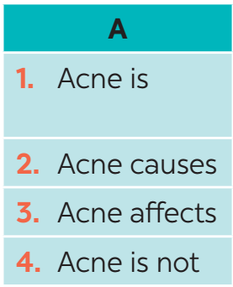
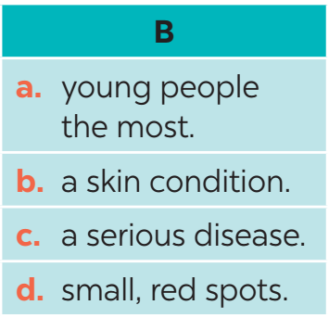
2
Read the passage and match the beginnings in A with the endings in B.

Slide 12
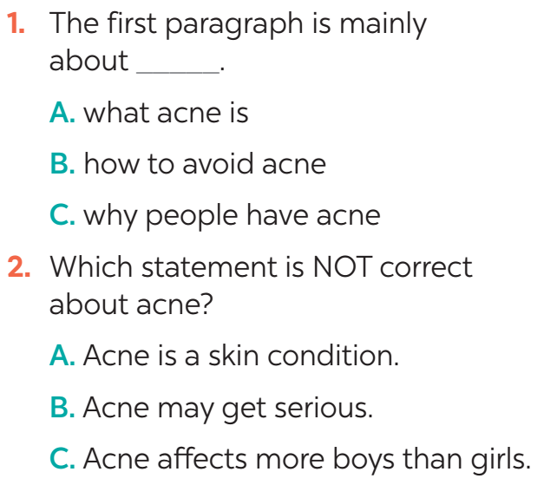
3
Read the passage again and choose the correct answer A, B, or C.
Evidence
Acne is a skin condition. It causes small, red spots on the face and the back. It affects 70 -80% of young people between 12 and 30. More girls have acne than boys.

Slide 13
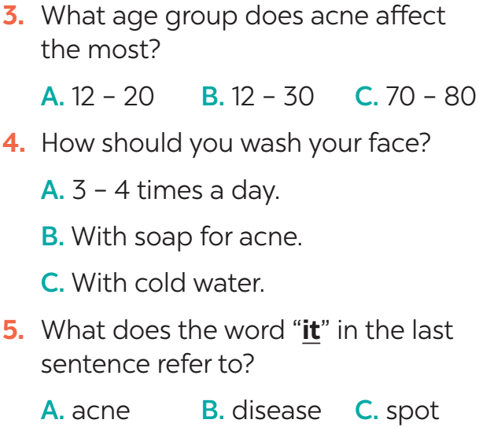
2
Read the passage again and choose the correct answer A, B, or C.
Evidence
It affects 70-80% of young people between 12 and 30.
Wash your face with special soap for acne, but no more than twice a day.
Here are some tips for taking care of skin with acne… If it gets serious, see a doctor.

Slide 14
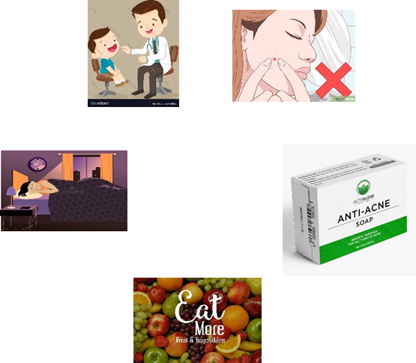
* Retelling
acne
a skin condition
causes small, red spots on the face and back
affects 70-80% of young people between 12 & 30
- more girls have acne than boys.
- not a serious disease
Tips
3

Slide 15
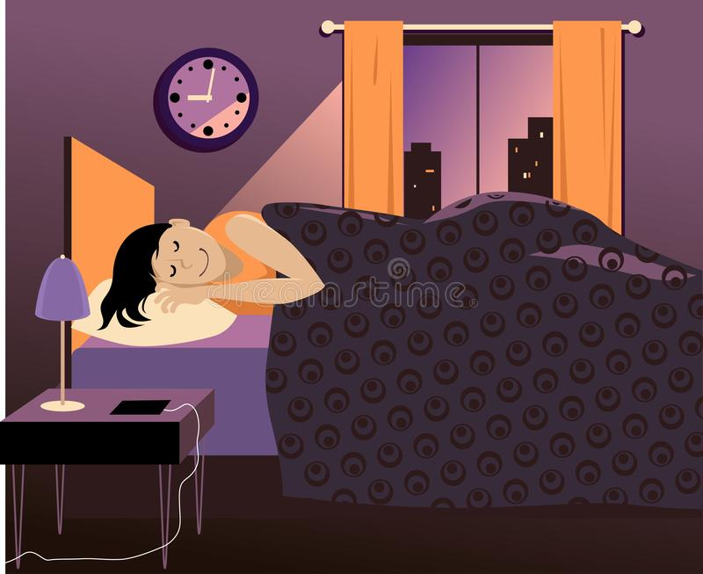
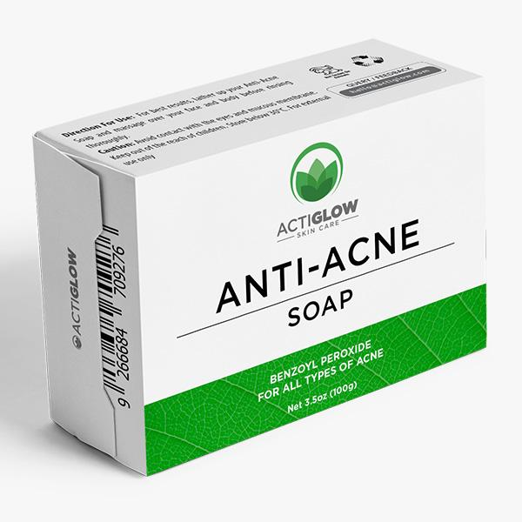
II. SPEAKING
Tips
4
Read the passage again. Pick the tips which you can easily follow. Share your ideas with your partner.
Example:
Nga: I can easily follow some tips:
- Go to bed early.
Eat more fruit and
vegetables.
Wash my face with
special soap for acne.
- Get enough sleep.

Slide 16
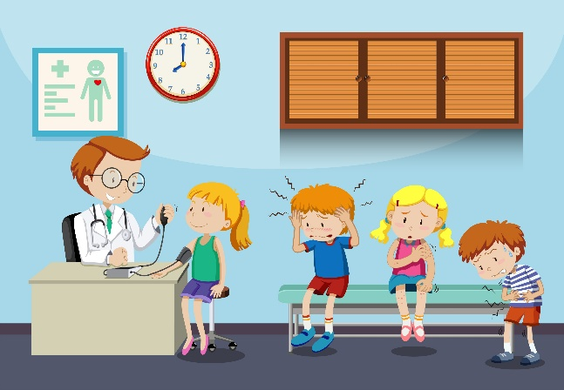
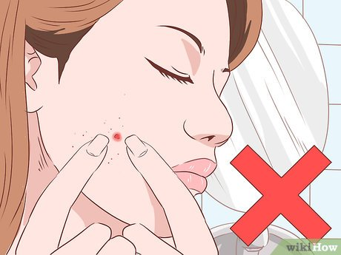
II. SPEAKING
Tips
4
Read the passage again. Pick the tips which you can easily follow. Share your ideas with your partner.
- See a doctor.
-Don’t touch or pop spots,
especially when my hands are dirty.

Slide 17
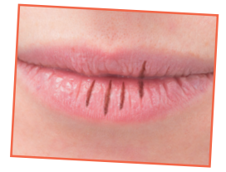
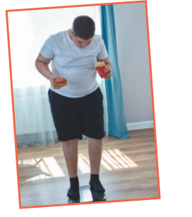
5
Read about the health problems below. Discuss and make notes of some tips you can give each person. Then share your ideas with the class
1. I have chapped lips.
Use some lip balm.
Use coconut oil or body lotion.
2. I’m putting on weight.
Eat less fast food, meat, and ice cream.
Eat more fruit and vegetable.

Slide 18
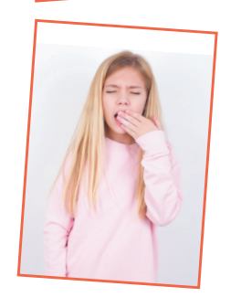
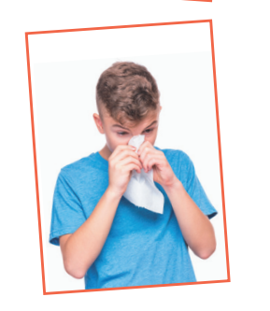
5
Read about the health problems below. Discuss and make notes of some tips you can give each person. Then share your ideas with the class
3. I often feel sleepy during the day.
Get enough sleep, 7 - 8 hours a day.
Don't go to bed too late.
4. I have the flu.
Keep warm and stay in bed.
Drink plenty of water and eat light food.

Slide 19
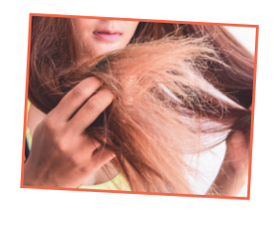
5
Read about the health problems below. Discuss and make notes of some tips you can give each person. Then share your ideas with the class
5. My hair is dry.
Avoid washing your hair every day.
Take vitamins.

Slide 20
* CONSOLIDATION
READING
SPEAKING

Slide 21
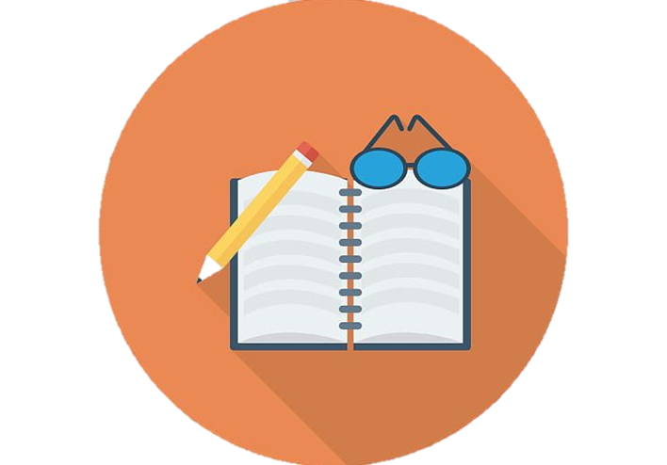
CONSOLIDATION
2
HOMEWORK
Prepare for the next lesson: Skills 2
Do exercises in the workbook.

Slide 22
Thank you!
Have a nice day!

