Slide 1
Good morning class!!!

Slide 2
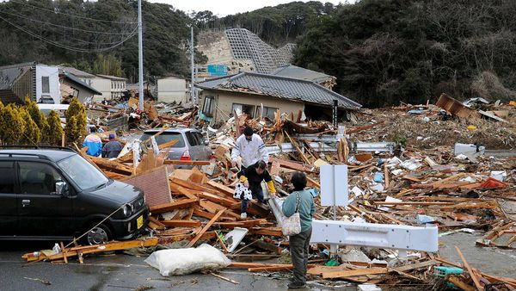
* WARM-UP
1. What do you see in the picture?
2. How do you feel?
many houses
collapsed
→It’s an earthquake
scared, sad,
worried

Slide 3
9
NATURAL DISASTERS
Unit
LESSON 3: A CLOSER LOOK 2
LESSON 4: COMMUNICATION (Page 96-97)
HOBBIES

Slide 4
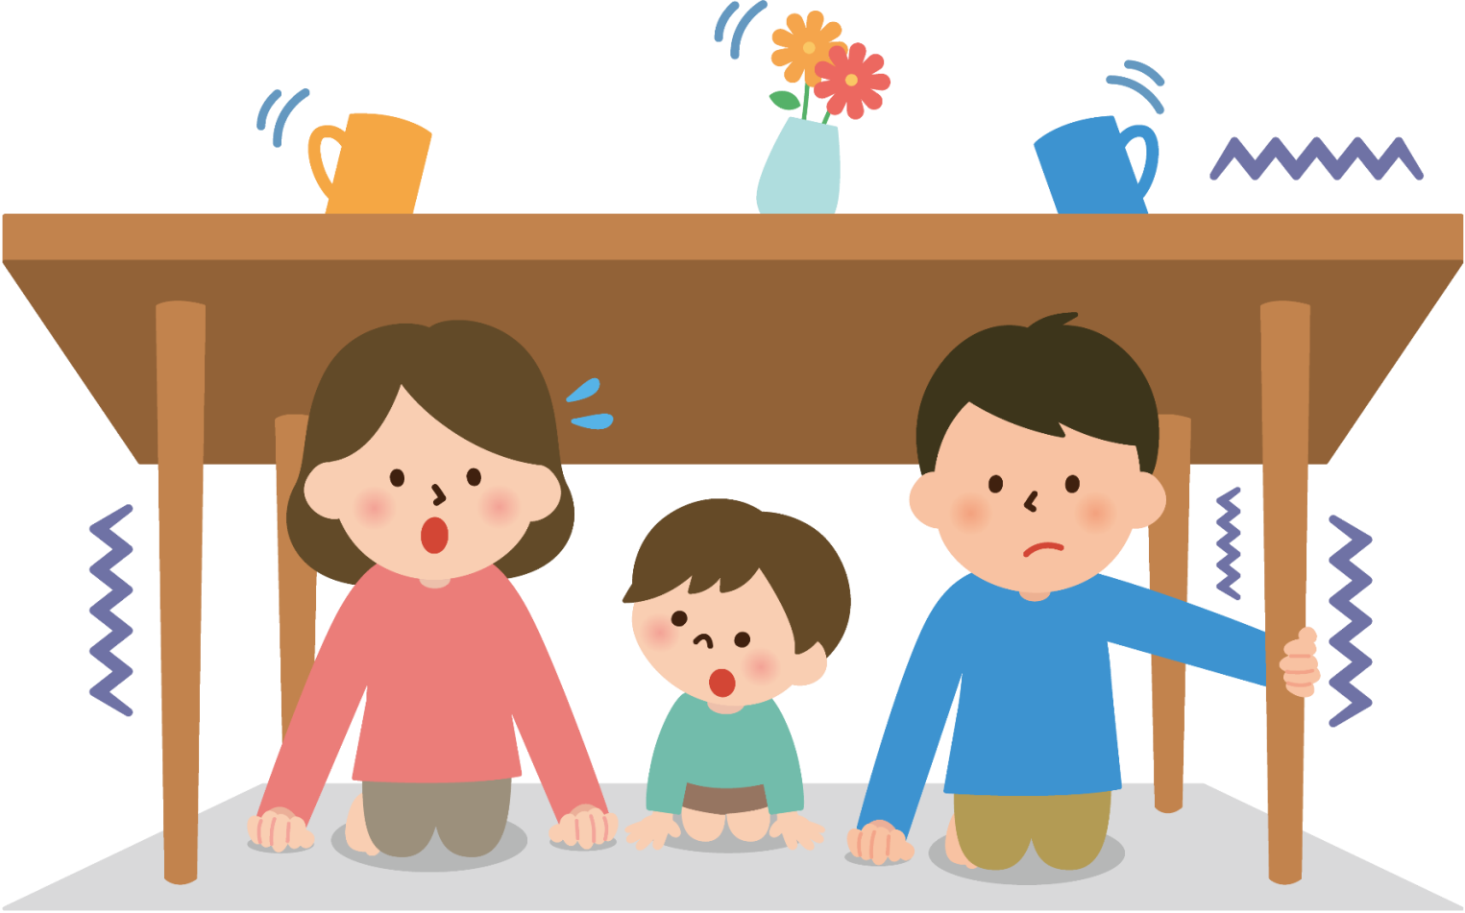
* VOCABULARY
shake (v):
rung, lắc
/ʃeɪk/

Slide 5
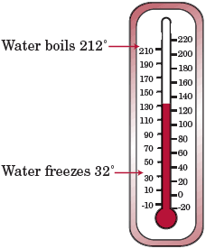
* VOCABULARY
Fahrenheit (n):
độ F (đo nhiệt độ)
/ˈfærənhaɪt/

Slide 6
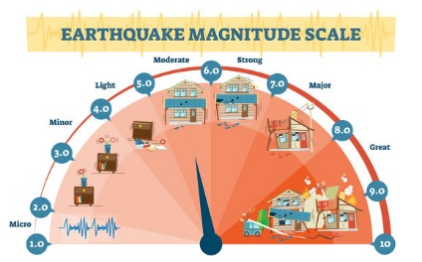
* VOCABULARY
Richter scale (n):
Độ rích te (đo độ mạnh của động đất)
/ˈrɪktə skeɪl/

Slide 7
* Vocabulary
New words | Pronunciation | Meaning
1. shake (v) | /ʃeɪk/ | rung, lắc
2. Fahrenheit (n) | /ˈfærənhaɪt/ | độ F (đo nhiệt độ)
3. Richter scale (n) | /ˈrɪktə skeɪl/ | độ rích te (đo độ mạnh của động đất)

Slide 8
* Checking vocabulary
New words | Pronunciation | Meaning
 | /ʃeɪk/ | rung, lắc
 | /ˈfærənhaɪt/ | độ F (đo nhiệt độ)
 | /ˈrɪktə skeɪl/ | độ rích te (đo độ mạnh của động đất)
1. shake (v)
2. Fahrenheit (n)
3. Richter scale (n)

Slide 9
EVERYDAY ENGLISH
1
Listen and read the dialogue below. Pay attention to the highlighted sentences.
Mark: Phong, why are you so sad?
Phong: My grandparents called this morning. A flood destroyed their house.
Mark: I’m sorry to hear that.
Phong: It also damaged all of their crops.
Mark: That’s awful. I hope your grandparents are safe.

Slide 10
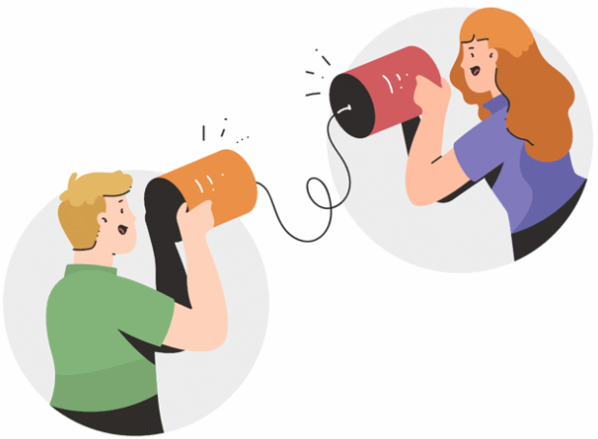
EVERYDAY ENGLISH
2
Work in pairs. Practice giving and responding to bad news in the following situations.
You have a friend in a mountainous area. A landslide destroyed his family’s garden yesterday. You share this news with your classmate.
You hear that a big earthquake hit a city. You share this news with your classmate.

Slide 11
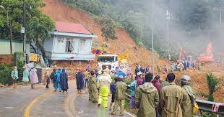
EVERYDAY ENGLISH
2
Work in pairs. Practice giving and responding to bad news in the following situations.
You have a friend in a mountainous area. A landslide destroyed his family’s garden yesterday. You share this news with your classmate.
A: Do you know my friend who lives in the mountainous area? A landslide destroyed his family's garden yesterday.
B: Oh no, that's terrible! Is everyone okay?
A: Thankfully, they're all safe. I hope they aren’t too upset.

Slide 12
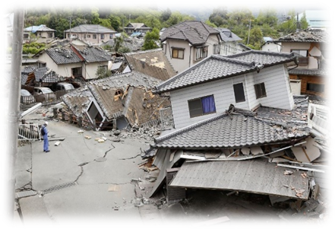
EVERYDAY ENGLISH
2
Work in pairs. Practise giving and responding to bad news in the following situations.
You hear that a big earthquake hit a city. You share this news with your classmate.
A: Have you heard about the big earthquake that hit the city?
B: No, what happened?
A: It was quite serious. Many buildings were damaged, and there was a lot of chaos in the nearby areas.
B: I’m sorry to hear that. I hope everyone affected by the earthquake is safe and gets the help they need.

Slide 13
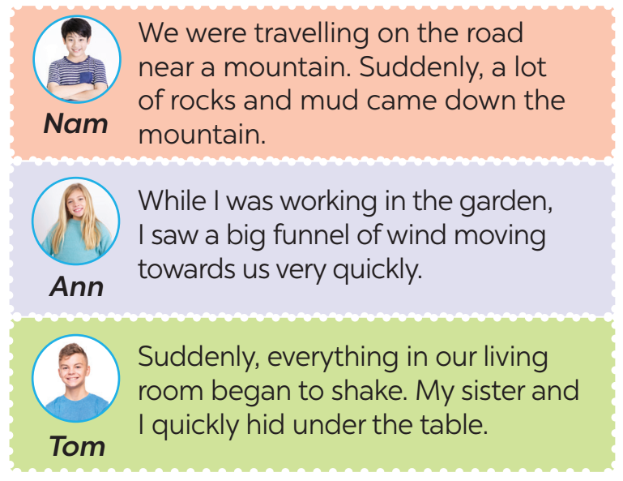
KNOWLEDGE OF NATURAL DISASTERS
3
Read the short passages below. Decide which natural disaster each person below is talking about.
landslide
tornado
earthquake

Slide 14
4
Choose the correct answer to each question to see how much you know about natural disasters.
Question 1: Which of these may cause landslides?
A. Heavy rain. B. Wind. C. Lightning.
Question 2: Which of these activities may cause landslides?
A. Littering. B. Cutting down trees. C. Polluting the air.
Question 3: What scale is used for measuring earthquakes?
A. Fahrenheit scale. B. Celsius scale. C. Richter scale.

Slide 15
KNOWLEDGE OF NATURAL DISASTERS
4
Choose the correct answer to each question to see how much you know about natural disasters.
Question 4: What natural disaster can an earthquake cause?
A. A flood. B. A landslide. C. A tornado.
Question 5: What do tornadoes form from?
A. An earthquake. B. A flood. C. A thunderstorm.
Question 6: Where do tornadoes mostly happen?
A. In the USA. B. In the UK. C. In Viet Nam.

Slide 16
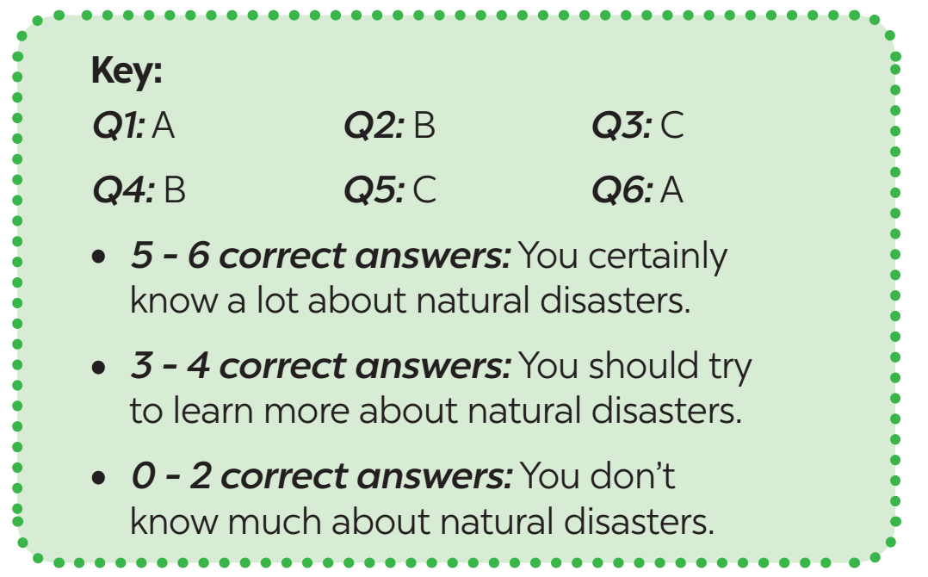
KNOWLEDGE OF NATURAL DISASTERS
5
Work in pairs. Compare your answers. Then check your answers with the key below. How many points did each of you get?

Slide 17
* CONSOLIDATION
In this lesson, you have:
learnt new words related to natural disasters.
learnt how to give and respond to bad news.

Slide 18
CONSOLIDATION
2
Homework
Learn the new words by heart .
Do exercises in the workbook.
Prepare for Lesson 5 – Skills 1.

Slide 19
