Slide 1
Good morning class !!!

Slide 2
* WARM-UP
LUNAR NEW YEAR / TET HOLIDAY

Slide 3
* WARM-UP
FULL MOON FESTIVAL / MID-AUTUMN FESTIVAL

Slide 4
* WARM-UP
HUNG KING TEMPLE FESTIVAL

Slide 5
* WARM-UP
BUDDHA’S BIRTHDAY

Slide 6
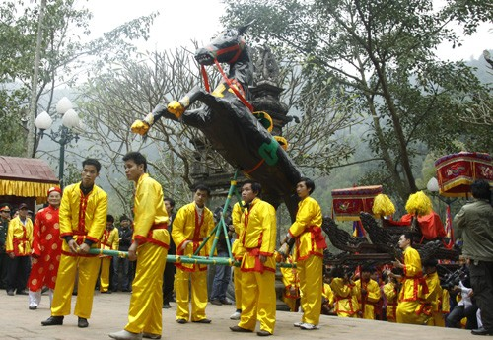
* WARM-UP
GIONG FESTIVAL

Slide 7
* WARM-UP
boat racing festival.

Slide 8
Unit
ETHNIC GROUPS OF VIET NAM
Unit
5
OUR CUSTOMS AND TRADITIONS
LESSON 3: A CLOSER LOOK 2
(page 56,57)
LESSON 6: SKILLS 2
Unit
HOBBIES
LISTENING
WRITING
Notes:
Mark, moonlight; position; monks, the ealders, shorts; sleeveless shirt; litter, flying lantern contest, religious ceremony

Slide 9
Mark,
moonlight;
position;
monks,
the elders,
shorts;
sleeveless shirt;
litter,
flying lantern contest,
religious ceremony

Slide 10
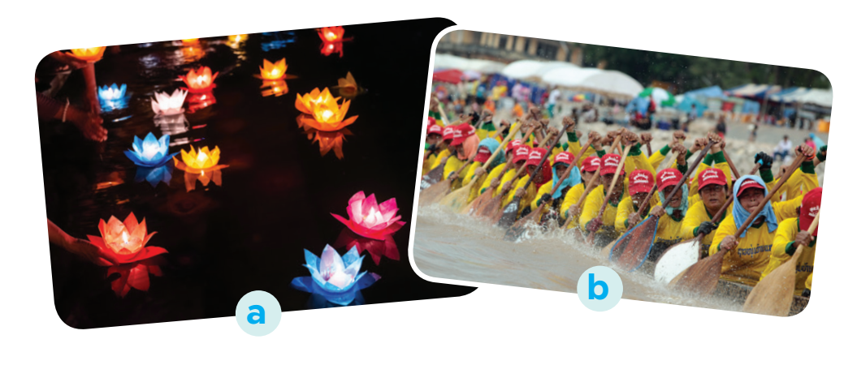
I. LISTENING
1
Work in pairs. Look at the picture and answer the following questions.
In picture b,
I see many people are trying to row the boat and it's a boat racing festival.
In the picture a,
I can see many flower lanterns on the water, and it is a flower Lanterns Festival.
.
1. What can you see in the photos?
2. In which part of Viet Nam might the festival occur?
2. In Central region of Vietnam might the festival occur

Slide 11
I. LISTENING
2
Listen to part of the programme “Charming Viet Nam”. Fill in each blank with no more than TWO words.
Ok Om Bok Festival
Purposes | - to thank the Moon God - to mark the (1) ______ of the Khmer year
Time | mid-October (lunar calendar)
Offerings | (2) ___________ and fruits
Activities | - singing and dancing - games and traditional (3) ______________ - Ngo Boat (4) ______

Slide 12
I. LISTENING
2
Listen to part of the programme “Charming Viet Nam”. Fill in each blank with no more than TWO words.
Ok Om Bok Festival
Purposes | - to thank the Moon God - to mark the (1) ______ of the Khmer year
Time | mid-October (lunar calendar)
Offerings | (2) ___________ and fruits
Activities | - singing and dancing - games and traditional (3) ______________ - Ngo Boat (4) ______
end
young rice
fashion shows
Race

Slide 13
I. LISTENING
3
Listen again and tick T (True) or F (False).
 | T | F
1. Ok Om Bok is the Moon Worshipping Festival.
2. On the night of the festival, the elders talk about their wishes.
3. There are lantern contests at the festival.
4. Tourists should wear informal clothes when attending the worshipping ceremony.
K

Slide 14
I. LISTENING
3
What should/shouldn;’t tourists do at the Ok Om Bok festival
Listen again and tick T (True) or F (False).
They should not wear shorts or sleeveless shirts when attending the religious ceremony. And don't litter the temple grounds.
 | T | F
1. Ok Om Bok is the Moon Worshipping Festival.
2. On the night of the festival, the elders talk about their wishes.
3. There are lantern contests at the festival.
4. Tourists should wear informal clothes when attending the worshipping ceremony.
K

Slide 15
Tapescript
Let’s go to the Mekong Delta enjoying the Ooc-om-bok Festival of the Khmer people. It is also called the moon worshiping festival. Traditionally, the Khmer use the festival to thank the Moon God for giving them a good harvest. It also marks the end of the year of the Khmer calendar. Ooc-om-bok occurs in mid October, according to the lunar calendar. When the Moon is at its highest position, the monks and the elders offer young rice and fruits to the moon God. Then they take some young rice to feed children and ask them about their wishes. People sing and dance in the moonlight. Visitors can participate in games, watch traditional fashion shows, and see flying lantern contests. The next day, villagers organize the race. This is a boat race that attracts many tourists. Here is some advice to tourists at the Ooc-om-bok Festival. They should not wear shorts or sleeveless shirts when attending the religious ceremony. And don't litter the temple grounds. And now, let's …

Slide 16
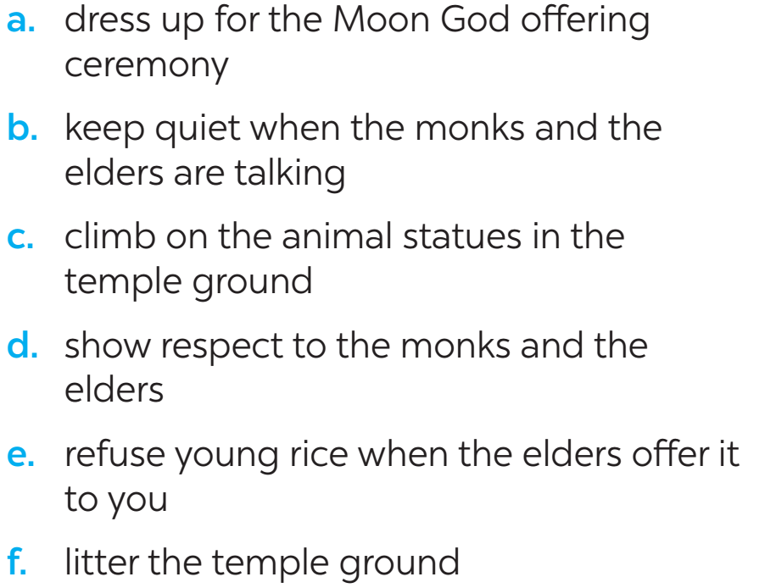
II. WRITING
4
Work in groups. Read the following pieces of advice for tourists at the Ok Om Bok Festival. Put them in the correct column.
Do | Don’t
Notes:
Hóa trang dự lễ cúng thần mựt trăng

Slide 17
II. WRITING
4
Work in groups. Read the following pieces of advice for tourists at the Ok Om Bok Festival. Put them in the correct column.
Do | Don’t
- Dress up for the Moon God offering ceremony. - Keep quiet when the monks and the elders are talking. - Show respect to the monks and the elders. | - Climb on the animal statues in the temple ground. - Refuse young rice when the elders offer it to you. - Litter the

Slide 18
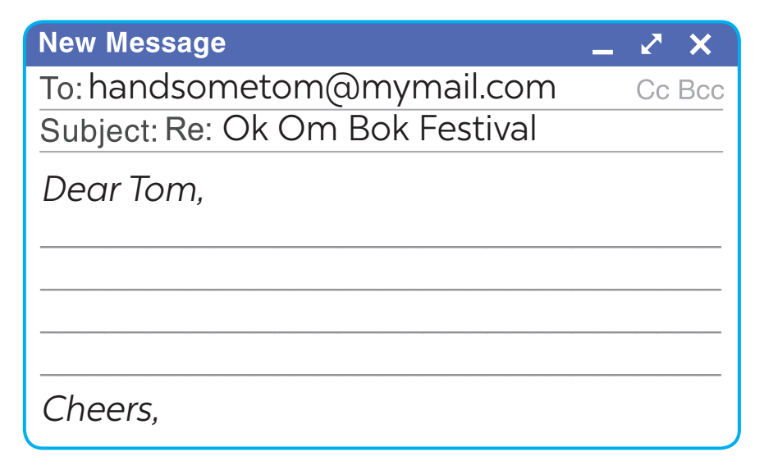
II. WRITING
5
Tom sent you an email. Read part of his email below.
“… Guess what! My dad is taking me with him to Soc Trang Province. We will be there during the Ok Om Bok Festival. What are some dos and don’ts at this festival? ...”
Write an email (80 - 100 words) to advise Tom about participating in the Ok Om Bok Festival.

Slide 19
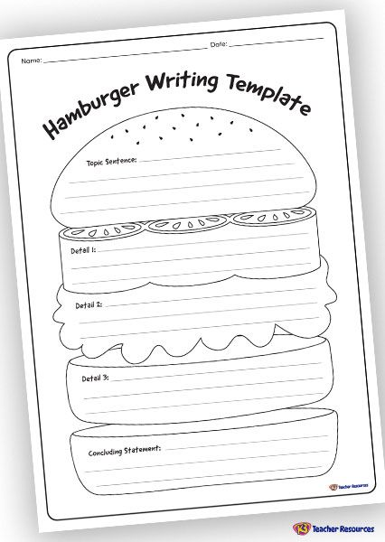

Slide 20
* Write an email (80 - 100 words) to advise Tom about participating in the Ok Om Bok Festival.
Dear Tom,
I'm happy to hear that you are going to join the Ok Om Bok Festival in Soc Trang Province. Here, I have some advice for you to do and don't at that festival. First, I think you should wear trainers or shoes and comfortable clothes because maybe you must be walk a lot. And then, remember to bring some bottles of water, it will be hot in Soc Trang so you will get thirsty. Also, I should remind you that you must not litter on the ground or run away from your father. It's a big festival so it will be crowded, you should be careful to not get lost.
I hope you will have a great time with your dad and enjoy the festival.
Best wishes,
Linh

Slide 21
* CONSOLIDATION
In this lesson, we have learnt to:
listen about a festival;
write an email to give advice on participating in a traditional festival.

Slide 22
Suggested answer
Dear Tom,
Glad to hear you are coming to Soc Trang. You can't miss the Ok Om Bok Festival. Here are a few things for you to remember when joining the festival.
First, you should wear polite clothes when attending the Moon God offering ceremony. Always show respect to monks and elderly people. Remember to keep quiet when the monks and the elders are talking.
Besides, there are many animal statues in the temple ground. Don't climb on them. The young rice represents the hope for luck in the new year. Don't refuse when the elders give you some.
Send me an email if you need more information.
Warm regards,

Slide 23
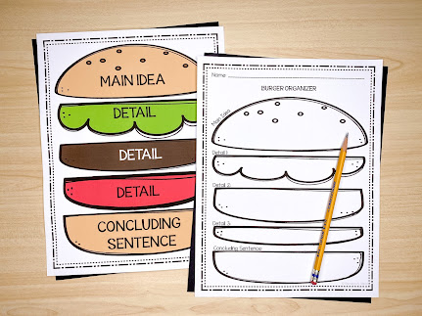

Slide 24
* Homework
2
Rewrite the passage on the notebook.
Prepare for Lesson 7 – Looking back & project.

