Slide 1
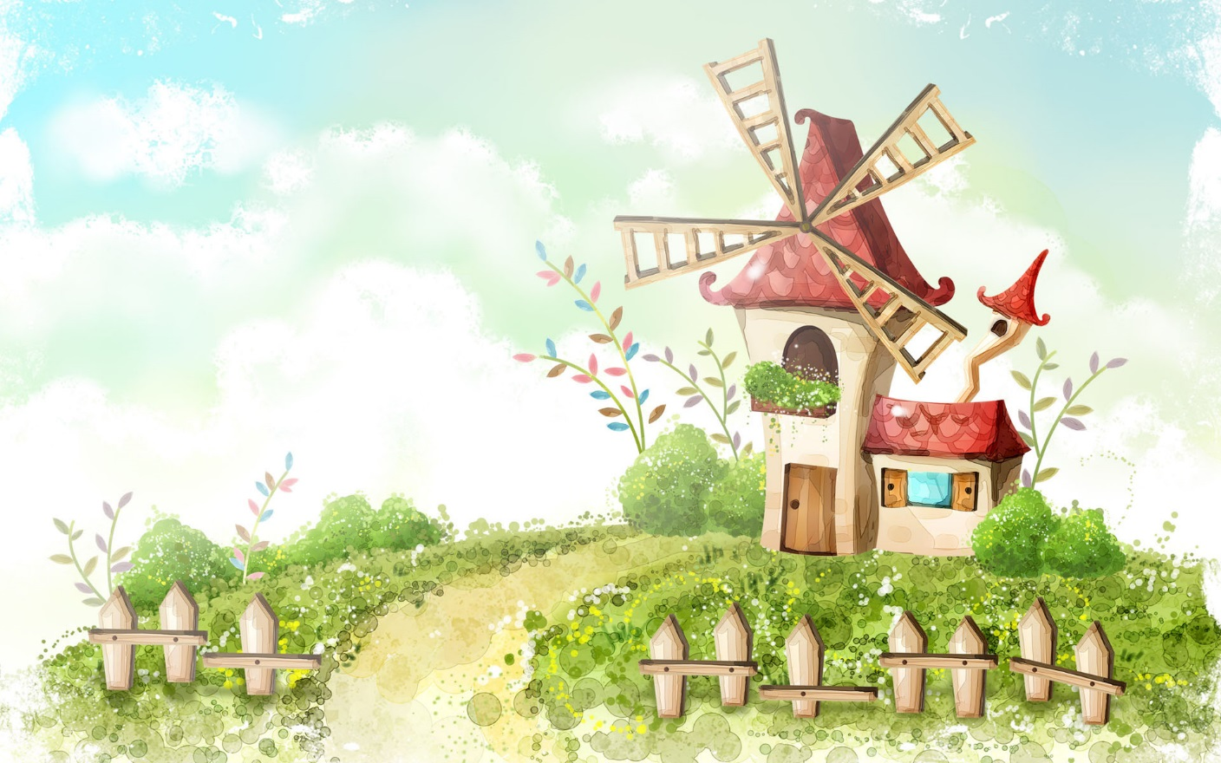
HELLO EVERYONE !!!
ENGLISH 8

Slide 2
* Warm -up
Help make meals (dinner/lunch/….).
Look after the house
Clean the floor
What do you do to help your parents?
Collect the eggs
Cook meals
Water the plants.
Set the table for dinner.
Feed the chicken

Slide 3
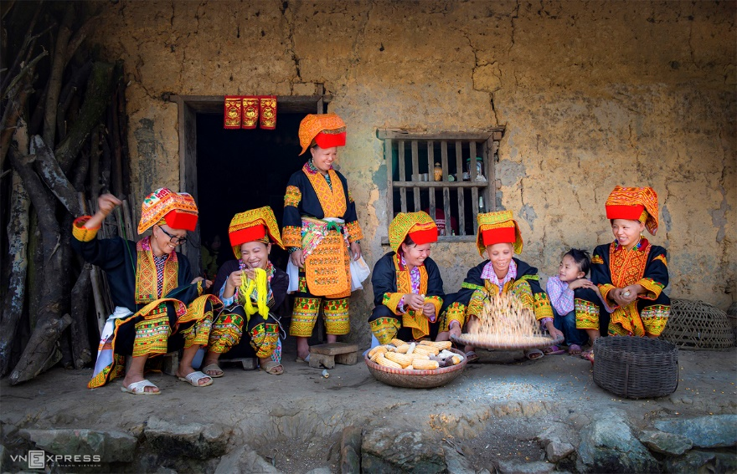
Unit
4
ETHNIC GROUPS OF VIET NAM
Unit
ETHNIC GROUPS OF VIET NAM
LESSON 6: SKILLS 2
LESSON 3: A CLOSER LOOK 2
Unit
HOBBIES

Slide 4
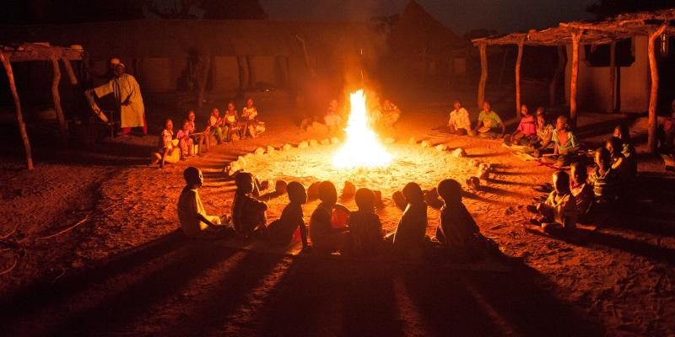
* VOCABULARY
- gather (v):
tụ họp
/ˈɡæðər/

Slide 5
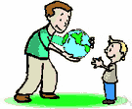
* VOCABULARY
- pass on (v):
để lại
/pɑːs ɒn/

Slide 6
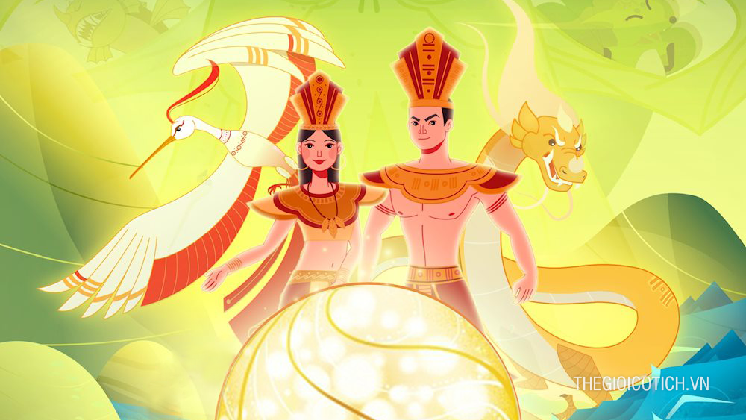
* VOCABULARY
- legend (n):
truyền thuyết
/ˈledʒənd/

Slide 7
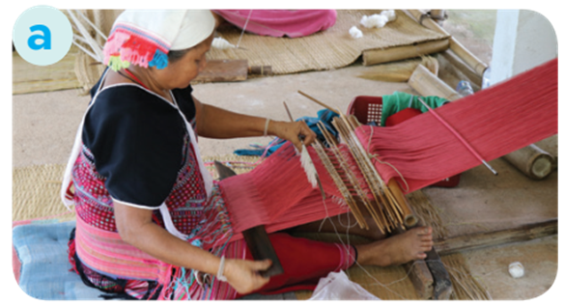
* VOCABULARY
- weave (v):
dệt, đan, kết lại
/wiːv/

Slide 8
* VOCABULARY
New words | Pronunciation | Meaning
1. gather (v) | /ˈɡæðər/ | tụ họp
2. pass on (v) | /pɑːs ɒn/ | để lại
3. legend (n) | /ˈledʒənd/ | truyền thuyết
4. weave (v) | /wiːv/ | Đan, dệt

Slide 9
* Checking vocab:
New words | Meaning
1. legend (n)
truyền thuyết
2. pass on (v)
để lại
3. weave (v)
Đan, dệt
4. gather (v)
tụ họp

Slide 10
I/ LISTENING
1
Match the phrases with the correct pictures.
1. catching fish
2. weaving clothing
3. growing crops
_______________
_______________
_______________

Slide 11
I/ LISTENING
2
Listen and tick ( ) the activities that minority children do to help their families.
1. look after the house
2. weave clothing
3. prepare food
4. build houses
5. grow crops
6. raise livestock

Slide 12
3
Listen again and circle the correct answer A, B, or C.
1. Minority children usually learn to work at ______.
A. twelve B. ten C. six
2. Girls ______.
A. weave clothing
B. do the gardening
C. catch fish
3. Boys ______.
A. prepare food
B. raise livestock
C. do housework
4. Children learn traditions through _____
A. work B. music C. stories
5. The number of minority children going to school is ______.
A. going up
B. going down
C. staying the same

Slide 14
3
Listen again and circle the correct answer A, B, or C.
1. Minority children usually learn to work at ______.
A. twelve B. ten C. six
2. Girls ______.
A. weave clothing
B. do the gardening
C. catch fish
3. Boys ______.
A. prepare food
B. raise livestock
C. do housework
4. Children learn traditions through _____
A. work B. music C. stories
5. The number of minority children going to school is ______.
A. going up
B. going down
C. staying the same

Slide 15
tape transcript
Ethnic minority children might live the life different from that of most Kinh children. They spend some of their time helping their parents inside and outside the house. They learn to work from an early age, usually at six. Girls help look after the house, care for smaller children, weave clothing, and prepare food. Boys learn to do what their fathers do. They grow crops, raise the family's livestock, and catch fish.
In the evening, the family often gathers round the open fire. Children listen to stories or legends of heroes from their grandparents. They also listen to adults talk about their work. This is how the elders pass on traditions and knowledge to their children.
Nowadays, more and more minority children are going to school. There, they meet children from other ethnic groups. They play new games and learn new things.

Slide 16
II/ WRITING
4
Note five things you do to help your family.
Example: - cook meals
Clean the floor
Cook meals
Look after the house
Water the plants
Wash the dishes

Slide 17
5
Write a paragraph (80 - 100 words) about the things you do to
help your family. Use the ideas in 4.
Though I don’t have much time at home, I try my best to do something to help my family. I take out the garbage, dust the room, make my bed and water the plants. I also help my mother with cooking dinner and my family likes my food so much. Sometimes I ask my family members if they need help. If I have more time stay at home, I would love to help my family with more housework.

Slide 18
5
Write a paragraph (80 - 100 words) about the things you do to
help your family. Use the ideas in 4.
model writing
I often help my parents with housework in my free time so that they don't have to be tired after a hard day's work. I often help my mother with cooking such as picking vegetables and washing dishes. Sometimes I also help my dad feed the birds and water the plants. In addition, I usually help my mother clean the house and many other jobs that are suitable my physical strength.

Slide 19
model writing
I'm the eldest sister in my family. So, I have to help my parents to do the housework. I often clean the floor and do the laundry. After the meals, I help my mom to do the dishes. On Sunday, me and my younger brother walk the dog. When my parents come home late from work, I usually cook the dinner. I'm glad I can help my parents out. I want my parents to have less trouble.

Slide 20
* CONSOLIDATION
In this lesson, you have:
learnt new words related the topic of the listening text.
understood more about ethnic children through listening tasks.
written a paragraph about the things you do to help your family.

Slide 21
* Homework
Learn by heart all the words.
Do exercises in the workbook.
Prepare for Lesson 7 – Looking back & project.

Slide 22
Thank you!
Goodbye!

