Slide 2
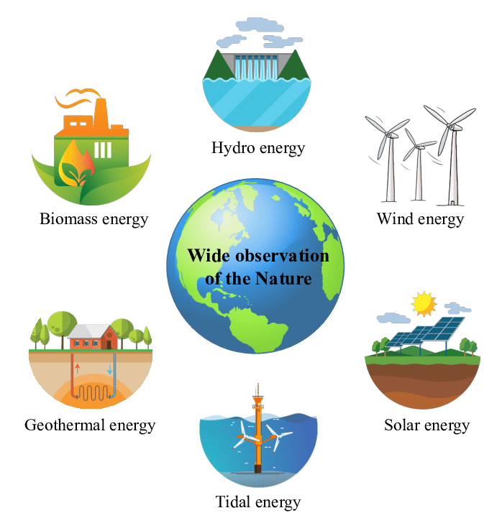
Unit
10
ENERGY SOURCES
LESSON 5: SKILLS 1
Unit

Slide 3
OBJECTIVES
By the end of the lesson, students will be able to:
+ Reading: read for specific information about renewable and non-renewable sources of energy
+ Speaking: talk about advantages and disadvantages of different sources of energy

Slide 4
LESSON 5: SKILLS 1
WARM-UP
Game: Hangman
Task 1: Discuss the questions.
Task 2: Read the text and choose the best option to complete the sentences.
Task 3: Read the text again and answer the questions.
READING
Task 4: Work in groups. Discuss and put the following words or phrases in the appropriate columns.
Task 5: Work in pairs. Ask and answer questions about the advantages and disadvantages of different energy sources.
SPEAKING
CONSOLIDATION
Wrap-up
Homework

Slide 5
LESSON 5: SKILLS 1
WARM-UP
Game: Hangman
Aims of the stage:
To introduce the topic of reading

Slide 6
WARM-UP
R E N E W A B L E

Slide 7
LESSON 5: SKILLS 1
WARM-UP
Game: Hangman
Task 1: Discuss the questions.
Task 2: Read the text and choose the best option to complete the sentences.
Task 3: Read the text again and answer the questions.
READING
Aims of the stage:
To provide students with some lexical items before reading the text.

Slide 8
READING
produce (v)
= to make things, mostly in large quantity
Examples:
Companies produce many toys for children before Christmas.
/prəˈdjuːs/
sản xuất

Slide 9
READING
limited (adj)
= not very great in amount or extent
Examples:
Coal is limited.
/ˈlɪmɪtɪd/
bị hạn chế

Slide 10
READING
available (adj)
= that you can get, buy or find
Examples:
The coal takes a long time to be available again.
/əˈveɪləbl/
có sẵn

Slide 11
READING
New words | Pronunciation | Meaning
produce (v) | /prəˈdjuːs/ | sản xuất
limited (adj) | /ˈlɪmɪtɪd/ | bị hạn chế
available (adj) | /əˈveɪləbl/ | có sẵn

Slide 12
READING
1
Work in pairs. Discuss the following questions.

Slide 13
READING
2
Read the text and choose the best option to complete the sentences.
1. Non-renewable sources are cheap and ______.
A. available B. easy to use C. expensive
2. ______ come from the sun, wind or water.
A. Renewable sources B. All energy sources C. Non-renewable sources
3. When energy comes from water, we call it ______.
A. wind energy B. solar energy C. hydro energy
4. Renewable energy sources are better for ______.
A. the environment B. our cars C. hydro energy

Slide 14
READING
3
Read the text again and answer the questions.
1. How many energy sources are there? What are they?
_________________________________________________________
2. What do non-renewable sources include? _________________________________________________________
3. What are the advantages of renewable energy?
_________________________________________________________
4. What will we rely more on in the future?
_________________________________________________________
There are two. They are non-renewable and renewable.
They include coal, oil and natural gas.
It’s available, clean, and safe to use.
We will rely more on renewable energy sources in the future.

Slide 15
LESSON 5: SKILLS 1
WARM-UP
Game: Hangman
Task 1: Discuss the questions.
Task 2: Read the text and choose the best option to complete the sentences.
Task 3: Read the text again and answer the questions.
READING
Task 4: Work in groups. Discuss and put the following words or phrases in the appropriate columns.
Task 5: Work in pairs. Ask and answer questions about the advantages and disadvantages of different energy sources.
SPEAKING

Slide 16
SPEAKING
4
Work in groups. Discuss and put the following words or phrases in the appropriate columns.
run out limited easy to use cheap expensive
available safe to use good for the environment
Advantages | Disadvantages
easy to use
run out
cheap
limited
available
expensive
safe to use
good for the environment

Slide 17
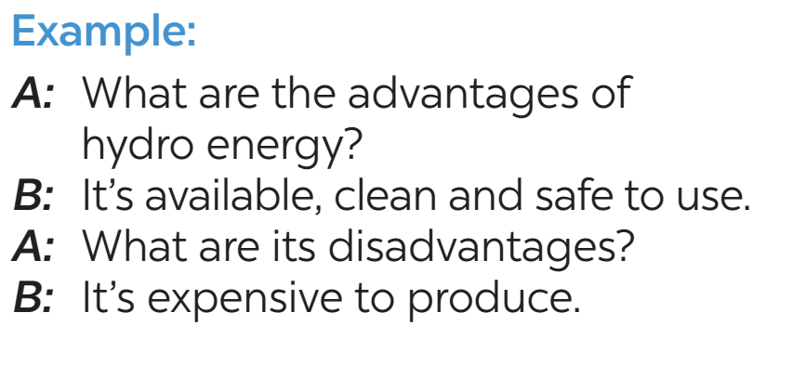
SPEAKING
5
Work in pairs. Ask and answer questions about the advantages and disadvantages of different energy sources

Slide 18
A: What type of energy is oil?
B: It is a non-renewable source of energy, because it can't be easily be replaced.
A: What are its advantages and disadvantages?
B: It can be used to power machinery, but it also pollutes the environment.

Slide 19
LESSON 5: SKILLS 1
WARM-UP
Game: Hangman
Task 1: Discuss the questions.
Task 2: Read the text and choose the best option to complete the sentences.
Task 3: Read the text again and answer the questions.
READING
Task 4: Work in groups. Discuss and put the following words or phrases in the appropriate columns.
Task 5: Work in pairs. Ask and answer questions about the advantages and disadvantages of different energy sources.
SPEAKING
CONSOLIDATION
Wrap-up
Homework

Slide 20
CONSOLIDATION
1
WRAP-UP
READING
SPEAKING

Slide 21
CONSOLIDATION
2
HOMEWORK
Do exercises in the workbook.
Prepare for the next lesson: Skills 2

Slide 22
Website: hoclieu.vn
Fanpage: facebook.com/www.tienganhglobalsuccess.vn/

