Slide 1


Slide 2




Unit
10
ENERGY SOURCES
LESSON 4: COMMUNICATION
Unit
HOBBIES

Slide 3

OBJECTIVES
By the end of the lesson, students will be able to:
ask for explanations
talk about how well your partner saves energy

Slide 4
LESSON 4: COMMUNICATION
WARM-UP
Game: Brainstorming
Task 1: Listen and read the conversation. Pay attention to the highlighted questions.
Task 2: Work in pairs. Make similar conversations.
EVERYDAY ENGLISH
Task 3: Work in pairs. Ask your partner and tick his or her answers in the boxes.
Task 4: Work in groups. Speech: how well your partner saves energy.
Task 5: Answer the questions in 3 on your own. Speech: how well you save energy.
SAVING ENERGY
CONSOLIDATION
Wrap-up
Homework

Slide 5

LESSON 4: COMMUNICATION
WARM-UP
Game: Brainstorming

Slide 6
WARM-UP
hydro
solar
coal
TYPES OF ENERGY
natural gas
oil
wind

Slide 7
LESSON 4: COMMUNICATION
WARM-UP
Game: Brainstorming
Task 1: Listen and read the conversation. Pay attention to the highlighted questions.
Task 2: Work in pairs. Make similar conversations.
EVERYDAY ENGLISH

Slide 8

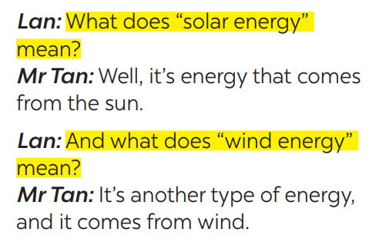

EVERYDAY ENGLISH
1
Listen and read the conversation. Pay attention to the highlighted questions.
Which tense do we use to ask and answer?
Which question word and verb do we use?

Slide 9
EVERYDAY ENGLISH
STRUCTURES
WHAT + DOES + S + MEAN…?
S + MEANS …
Which question word and verb do we use?

Slide 10

EVERYDAY ENGLISH
2
Work in pairs. Make similar conversations to ask for explanations.
What does solar energy mean?
It’s energy that comes from the sun. What does nuclear energy mean?
It’s energy that comes from nuclear power.

Slide 11
LESSON 4: COMMUNICATION
WARM-UP
Game: Brainstorming
Task 1: Listen and read the conversation. Pay attention to the highlighted questions.
Task 2: Work in pairs. Make similar conversations.
EVERYDAY ENGLISH
Task 3: Work in pairs. Ask your partner and tick his or her answers in the boxes.
Task 4: Work in groups. Speech: how well your partner saves energy.
Task 5: Answer the questions in 3 on your own. Speech: how well you save energy.
SAVING ENERGY

Slide 12

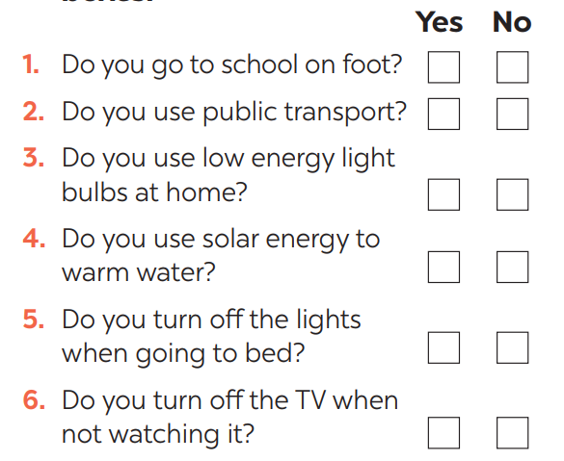
SAVING ENERGY
3
Work in pairs. Ask your partner the following questions and tick his or her answers in the boxes.

Slide 13

SAVING ENERGY
4
Work in groups. Tell the group how well your partner saves energy.
Example:
Mai saves a lot of energy. She often goes to school on foot and uses public transport. She always turns oﬀ the lights when going to bed.

Slide 14

SAVING ENERGY
5
Answer the questions in 3 on your own. Tell the class how well you save energy.
Example:
I don’t save much energy. I go to school on foot, but I don’t turn oﬀ the TV when not watching it.

Slide 15
LESSON 4: COMMUNICATION
WARM-UP
Game: Brainstorming
Task 1: Listen and read the conversation. Pay attention to the highlighted questions.
Task 2: Work in pairs. Make similar conversations.
EVERYDAY ENGLISH
Task 3: Work in pairs. Ask your partner and tick his or her answers in the boxes.
Task 4: Work in groups. Speech: how well your partner saves energy.
Task 5: Answer the questions in 3 on your own. Speech: how well you save energy.
SAVING ENERGY
CONSOLIDATION
Wrap-up
Homework

Slide 16

CONSOLIDATION
1
WRAP-UP
In this lesson, we have learn to:
ask for explanations
talk about saving energy

Slide 17

CONSOLIDATION
2
HOMEWORK
Do exercises in the workbook.
Prepare for the next lesson.

Slide 18

Website: hoclieu.vn
Fanpage: facebook.com/www.tienganhglobalsuccess.vn/

