Slide 1


Slide 2




Unit
10
ENERGY SOURCES
LESSON 3: A CLOSER LOOK 2
GRAMMAR:
THE PRESENT CONTINUOUS
Unit
HOBBIES

Slide 3

OBJECTIVES
By the end of the lesson, students will be able to know how to use The present continuous

Slide 4
LESSON 3: A CLOSER LOOK 2
WARM-UP
Jumble sentences
PRESENTATION
The present continuous
Task 1: Work in pairs. Tell your partner what the people in the pictures are doing.
Task 2: Complete the sentences.
Task 3: Circle the correct form of the verb in each sentence.
Task 4: Write sentences about what the people are doing or not doing, using the suggestions.
Task 5: Work in pairs. Ask and answer the following questions.
PRACTICE
CONSOLIDATION
Wrap-up
Homework

Slide 5

LESSON 3: A CLOSER LOOK 2
WARM-UP
Jumble sentences
Aims of the stage:
To activate students’ knowledge on the targeted grammar
To enhance students’ skills of cooperating with team mates

Slide 6
WARM-UP
1. She / now / English / learning / is / .
____________________________________________
2. are / They / not / energy / using / solar / .
____________________________________________
3. project / you / on / working / are / your / ?
____________________________________________
4. studying / brother / Where / your / is / ?
Where is your brother studying ?
5. basketball / She / yard / the / in / playing / is / school /
____________________________________________
She is learning English now.
They are not using solar energy.
Are you working on your Project?
She is playing basketball in the school yard.

Slide 7
LESSON 3: A CLOSER LOOK 2
WARM-UP
Jumble sentences
PRESENTATION
The present continuous

Slide 8
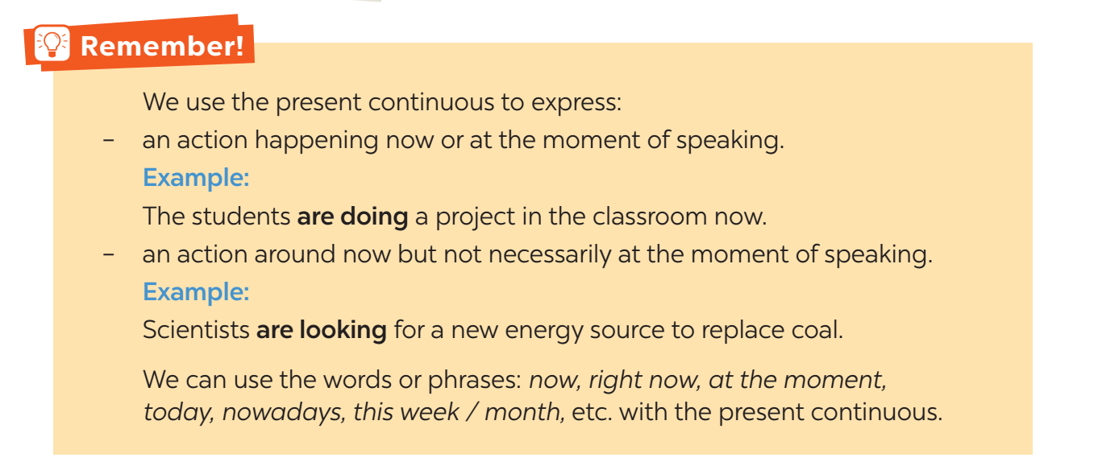

PRESENTATION
THE PRESENT CONTINUOUS

Slide 9
LESSON 3: A CLOSER LOOK 2
WARM-UP
Jumble sentences
PRESENTATION
The present continuous
Task 1: Work in pairs. Tell your partner what the people in the pictures are doing.
Task 2: Complete the sentences.
Task 3: Circle the correct form of the verb in each sentence.
Task 4: Write sentences about what the people are doing or not doing, using the suggestions.
Task 5: Work in pairs. Ask and answer the following questions.
PRACTICE

Slide 10
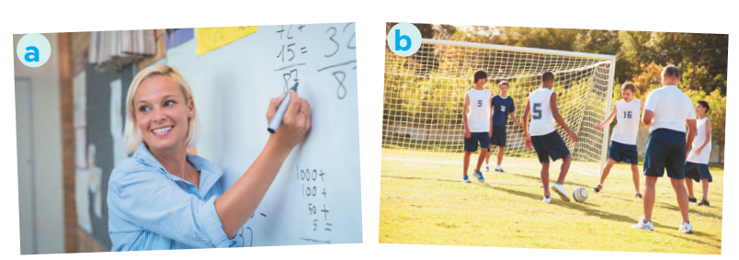
PRACTICE
1
Work in pairs. Tell your partner what the people in the pictures are doing.
a. She is teaching maths/ is writing on the board.
b. They are playing football/ soccer.

Slide 11
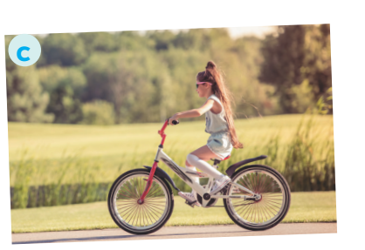

PRACTICE
1
Work in pairs. Tell your partner what the people in the pictures are doing.
c. She is riding her bike/ bicycle.
d. She is cooking.

Slide 12

PRACTICE
1
Work in pairs. Tell your partner what the people in the pictures are doing.
e. She is singing.
f. He is watering the flowers/ plans.
He is doing gardening.

Slide 13
PRACTICE
2
Complete the sentences, using the present continuous form of the verbs in brackets.
1. Mai (talk) ____________ about types of energy sources now.
2. We (use) ____________ solar energy to replace energy from coal today.
3. Keep quiet! The students of Class 7C (take) ____________ a test.
4. Scientists (develop) ____________ new energy sources to protect the environment.
5. We (reduce) ____________ the use of nuclear energy nowadays.
is talking
are using
are taking
are developing
are reducing

Slide 14
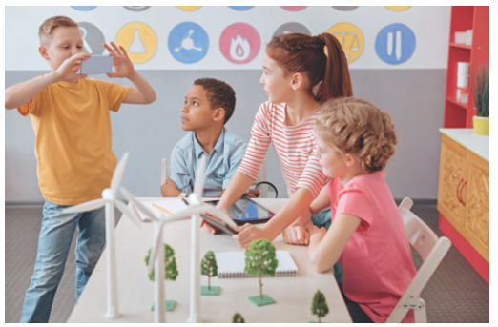

PRACTICE
3
Circle the correct form of the verb in each sentence.
1. Are you still work / working on your project now?
2. Nam and Lan do / are doing quite well at school this year.

Slide 15


PRACTICE
3
Circle the correct form of the verb in each sentence.
3. Does she study / Is she studying at the school library at the moment?
4. Hoa studies / is studying for her exam, so she can’t come to the party right now.

Slide 16

PRACTICE
3
Circle the correct form of the verb in each sentence.
5. We have / are having English three times a week.

Slide 17
PRACTICE
4
Write sentences about what the people are doing or not doing, using the suggestions.
1. The students / do the project / now.
_______________________________________________
2. Mrs Lien / teach us about solar energy / at the moment.
_______________________________________________
3. They / learn about energy / this month.
_______________________________________________
4. She / not swim / in the swimming pool / right now.
_______________________________________________
5. Nowadays, people in Iceland / not use energy from coal.
_________________________________________________
The students are doing the project now.
Mrs Lien is teaching us about solar energy at the moment.
They are learning about energy this month.
She is not swimming in the swimming pool right now.
Nowadays, people in Iceland are not using energy from coal.

Slide 18

PRACTICE
5
Work in pairs. Ask and answer the following questions.
1. What book are you reading now?
2. What sport are you playing these days?
3. What courses are you taking this term?
4. What are you doing to save energy?

Slide 19
LESSON 3: A CLOSER LOOK 2
WARM-UP
Jumble sentences
PRESENTATION
The present continuous
Task 1: Work in pairs. Tell your partner what the people in the pictures are doing.
Task 2: Complete the sentences.
Task 3: Circle the correct form of the verb in each sentence.
Task 4: Write sentences about what the people are doing or not doing, using the suggestions.
Task 5: Work in pairs. Ask and answer the following questions.
PRACTICE
CONSOLIDATION
Wrap-up
Homework

Slide 20
CONSOLIDATION
1
WRAP-UP
GRAMMAR:
THE PRESENT CONTINUOUS

Slide 21

CONSOLIDATION
2
HOMEWORK
Do exercises in the workbook.

Slide 22

Website: hoclieu.vn
Fanpage: facebook.com/www.tienganhglobalsuccess.vn/

