Slide 1
* WARM-UP
Watch the video and answer the question:
What is this video about?
A water puppet show

Slide 2
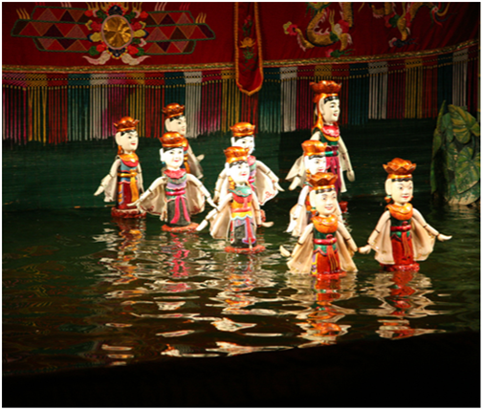
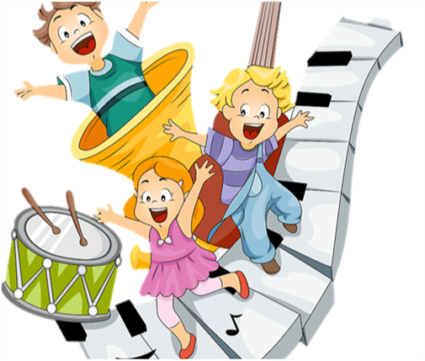
Unit
4
MUSIC AND ARTS
Period 32 : LESSON 5: SKILLS 1
READING
SPEAKING
Unit

Slide 3
Part 1: Reading

Slide 4
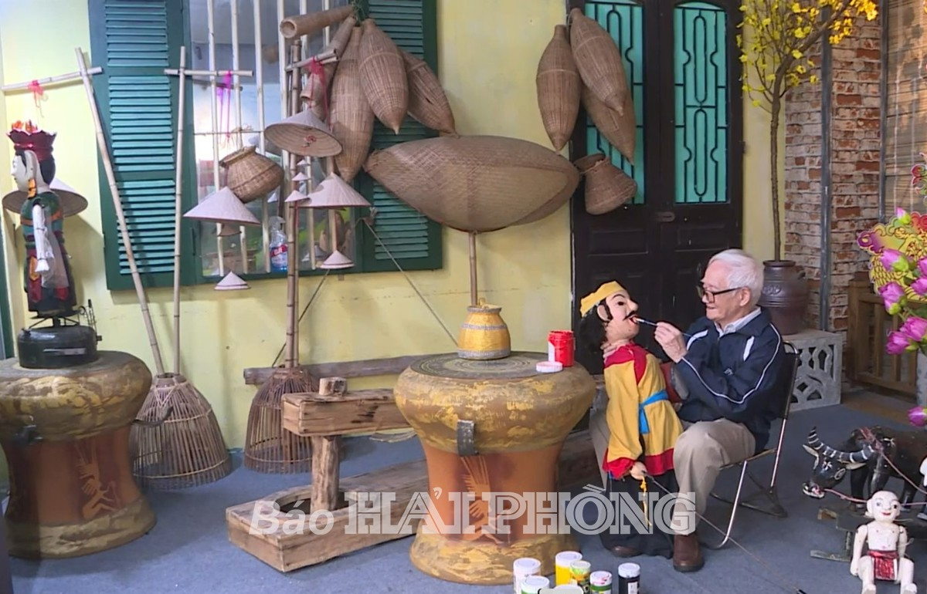
I. Vocabulary
1. puppetry (n) :
/ˈpʌpɪtri/
nghệ thuật múa rối
He is making a puppet. He is keen on puppetry

Slide 5
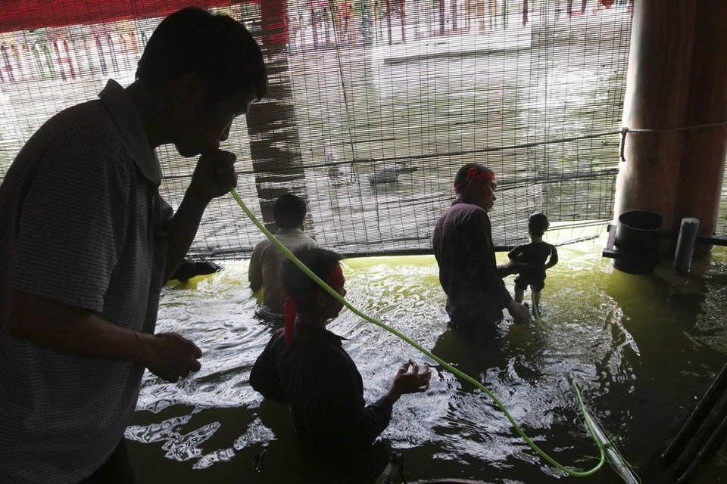
2. a string:
sợi dây
/strɪŋ/

Slide 6
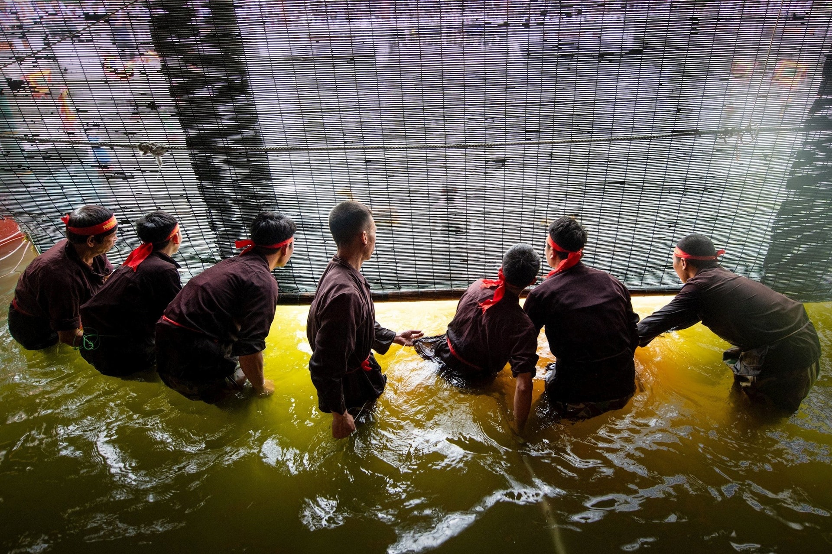
3. control (v):
/kənˈtrəʊl/
kiểm soát, điều khiển

Slide 7
4. a pool:
/puːl/
nhà rối, thủy đình

Slide 8
Tell me a word which has the same meaning as happen
5. take place (phr.v) = happen : diễn ra

Slide 9
* Checking vocabulary:
Words | Pronunciation | Vietnamese meaning
1. puppetry (n) | /ˈpʌpɪtri/ | nghệ thuật múa rối
2. string (n) | /strɪŋ/ | sợi dây
3. control (v) | /kənˈtrəʊl/ | kiểm soát, điều khiển
4. a pool | /puːl/ | nhà rối, thủy đình
5. take place | /teɪk pleɪs/ | diễn ra

Slide 10
Task 1. Look at the pictures. Discuss the questions below with a partner
1/ - The first picture shows a water puppet show.
- The second picture is the Quan Ho singing.
2/ Yes/ No …….

Slide 11
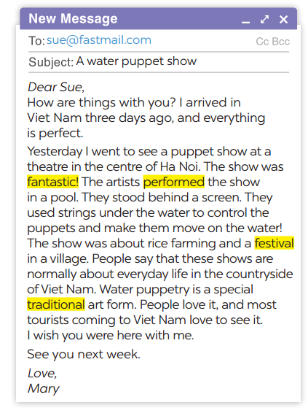
Task 2. Read the email and match the highlighted words with their meanings.
1. showed or presented
2. following tradition
3. nice, interesting
4. event or celebration
→ performed
→ traditional
→ fantastic
→ festival

Slide 12
Task 3: Read the email again and answer the questions.
1. Who went to see a water puppet show yesterday?
2. Where did the artists perform the show?
3. Who controlled the puppets?
4. What are water puppet shows normally about?
5. Is water puppetry a traditional Vietnamese art form?
→ Mary went to see a water puppet show yesterday.
→The artists performed the show in a pool.
→The artists controlled the puppets.
→The water puppet shows normally about everyday life in the countryside of VN.
→ Yes, it is.

Slide 13
Part 2. Speaking
Matching
Words | Vietnamese meanings
1. duration (n)
a. đóng góp
2. an item
b. thời lượng
3. last (v)
c. tiết mục
4. contribute(v)
d. kéo dài

Slide 14
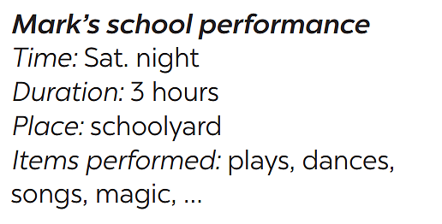
Part 2. Speaking
Task 4. Ask and answer about Mark’s school musical performance last year.
A:
B:
A:
B:
When was the performance?
On Saturday night.
How long did it last?
It lasted three hours.

Slide 15
Task 5: Make a plan for the performance and talk about the items you will contribute.
Your school is going to have a musical performance to celebrate Teachers’ Day.
Our school performance
- Time: ……………….
- Duration:…………….
- Place: .. ………………..
- Items contribute: …………………..

Slide 16
Our school performance
- Time: 8 p.m
- Duration: 3 hours
- Place: school stage
- Items contribute: songs, plays, folk dances, modern dances, bamboo dances

Slide 17
Retell your plan for a school musical performance?
Our school musical performance will be on .......................
It will last ...................................................
It will take place ........................................
I think we will …………………………………..
…………………………….sing a solo because ................................

Slide 18
Do you know which communes in Quoc Oai district have water puppetry?

Slide 19
Which communes in Quoc Oai district have water puppetry?

Slide 20
* CONSOLIDATION
READING
SPEAKING

Slide 21
* HOMEWORK
Do exercises in the workbook.
Prepare for the next lesson: Skills 2.

