Slide 1
Bài dạy chủ đề Steam Unit 7: Traffic: HĐ3,4,5 Class: 7A – Trường THCS Phượng Cách

Slide 2
+ Activity 2: Researching Background Knowledge and Proposing Design Solutions
🎯 Exploring Traffic Signs:
Divide students into 6 groups (6-7students per group), with each group researching six traffic signs (from books, real-life photos, or the internet).
Each group prepares an information board for each traffic sign, including: • Image or hand-drawn sketch. • Meaning of the traffic sign. • Specific regulations for the sign’s application. • The sign’s impact on pedestrians and cyclists.

Slide 3
🎯 Proposing a Traffic Sign Design:
Each group selects one traffic sign to create a model.
Develop a design plan ensuring: ✅ Appropriate size, easy to observe. ✅ Standardized colors and shapes. ✅ Environmentally friendly, recyclable materials. ✅ Practical application, easy recognition. 📌 Outcome: • Each group presents one researched traffic signs and one proposed design for model creation.

Slide 4
+ Activity 3: Presenting and Discussing Design Proposals
🎯 Objectives: • Students present their chosen traffic sign. • Analyze, explain, and refine their design based on background knowledge.

Slide 5
* How to do: 1. Each group presents their chosen traffic sign, covering: Shape, color, and meaning. Reasons for selecting the sign. Initial design proposal (size, materials, method of creation).

Slide 6
2. Other groups ask questions, critique, and suggest improvements:
Is the material durable?
Is the color visible from a distance?
Is the sign suitable for pedestrians and cyclists?
3. Adjusting the design plan based on feedback for optimization. 📌 Outcome: • Each group refines their design based on feedback.

Slide 7
Activity 4: Creating the Product, Testing, and Evaluating
🎯 Objectives: • Students practice making a traffic sign based on their design proposal. • Evaluate the effectiveness and practicality of the product.
* How to do:
1. Students craft traffic signs using prepared materials :
(cardboard, foam, colored paper, paint, wooden sticks, etc.).

Slide 8
2. Students test the product:
Place the sign in different locations to check visibility.
Examine stability, color accuracy, and size suitability.
3. Evaluating the product:
Groups self-assess based on criteria: accuracy, aesthetics, practicality.
The teacher observes and provides feedback. 📌 Outcome: • Each group produces a complete traffic sign model.

Slide 9
Activity 5: Presenting the Product and Adjusting the Design(Trình bày sản phẩm và điều chỉnh thiết kế)
🎯 Objectives: • Students present their product, discuss, and refine the design. • Develop skills in critical thinking, evaluation, and creativity..

Slide 10
💡How to do:
1. Each group displays their completed traffic sign and presents:
The actual image of the traffic sign.
The process of creating the sign.
Challenges encountered and how they were resolved.
The real-world application of the sign.

Slide 11
2. Other groups ask questions and give feedback on the product.
Phân công nhiệm vụ đánh giá và đặt câu hỏi phản biện sản phẩm của các nhóm:
Nhóm 1 – Nhóm 2
Nhóm 2 – Nhóm 3
Nhóm 3 – Nhóm 4
Nhóm 4 – Nhóm 5
Nhóm 5 – Nhóm 6
Nhóm 6 – Nhóm 1

Slide 12
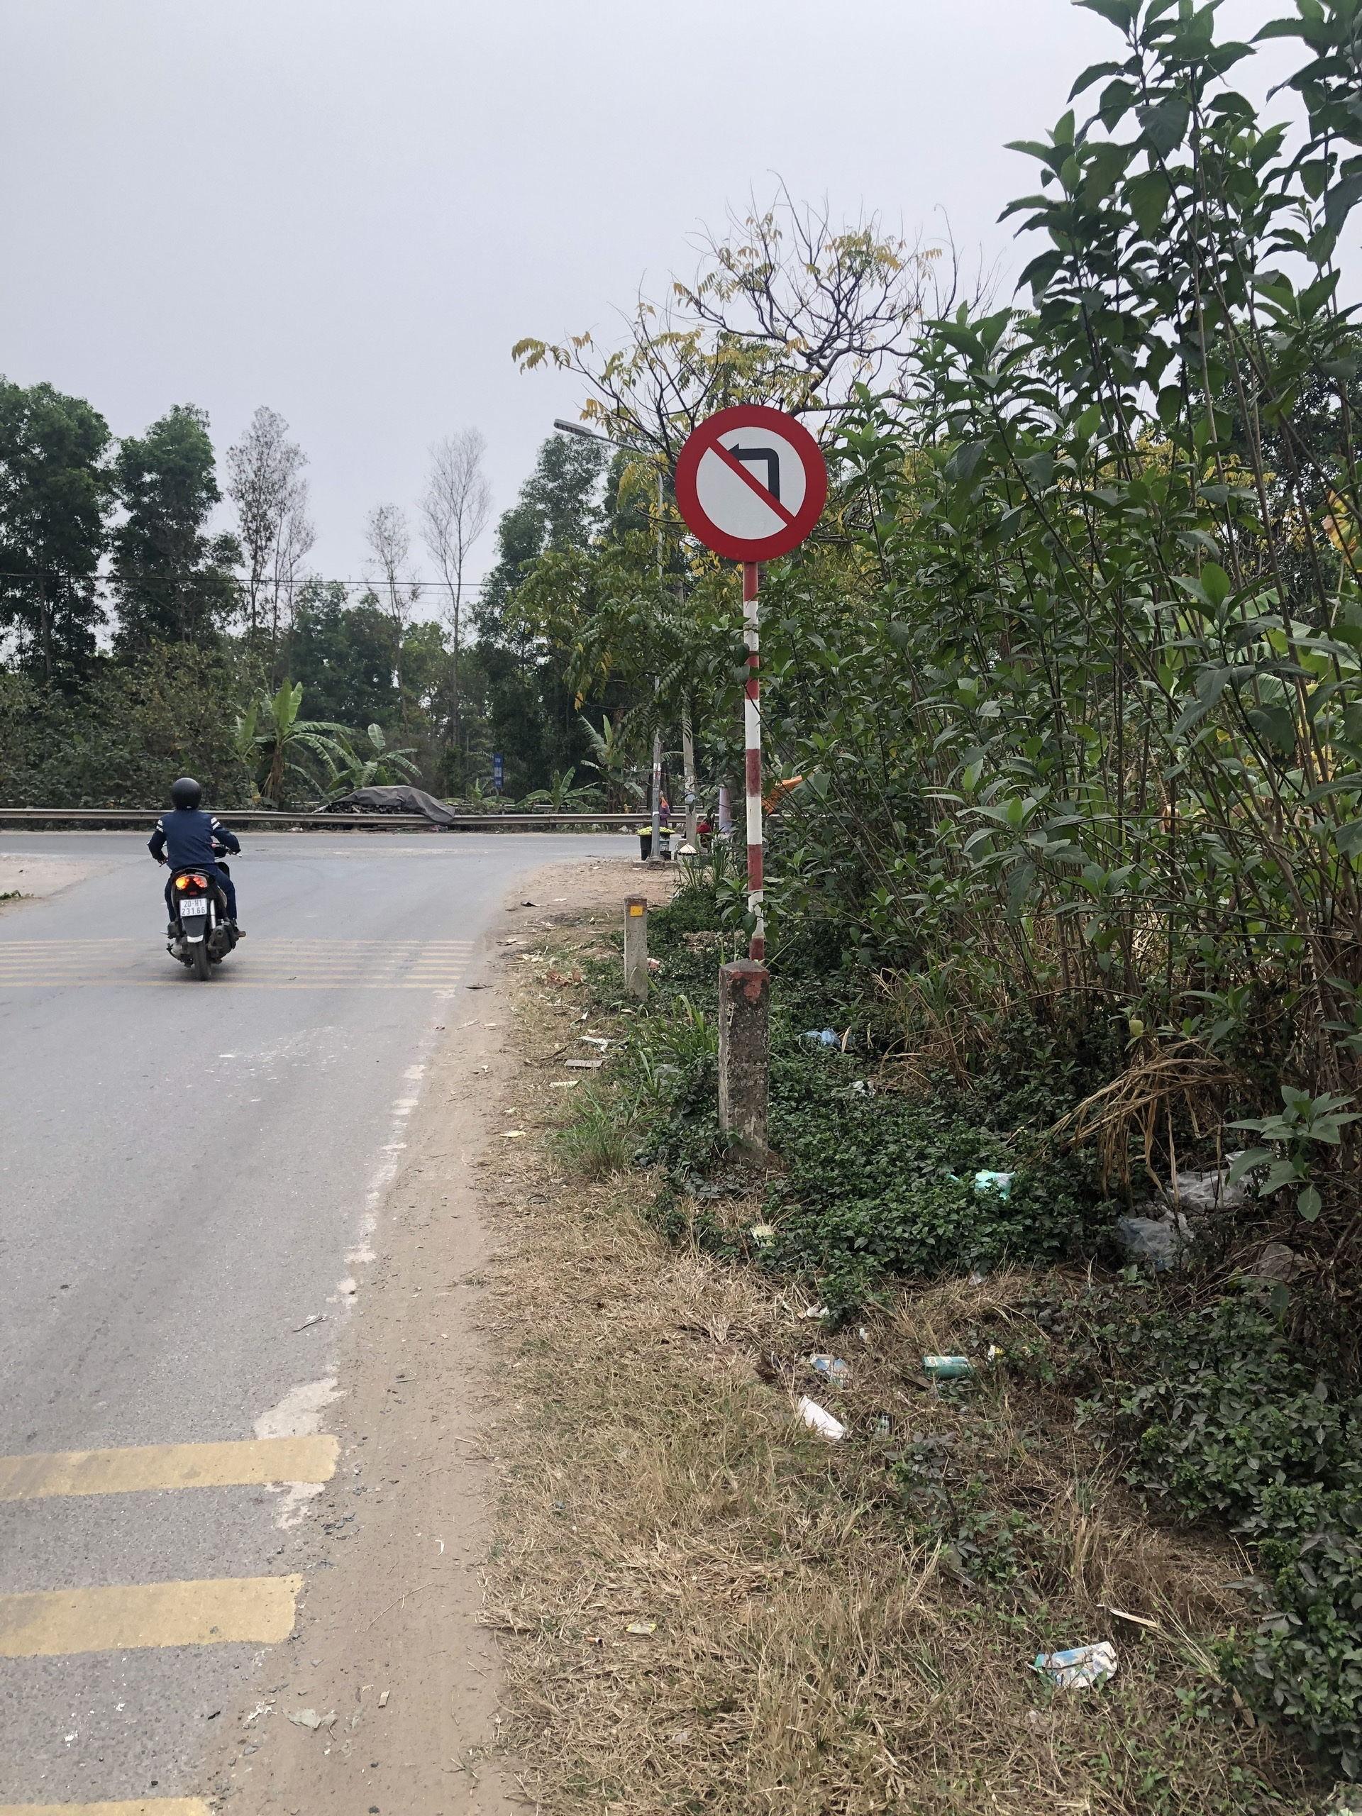
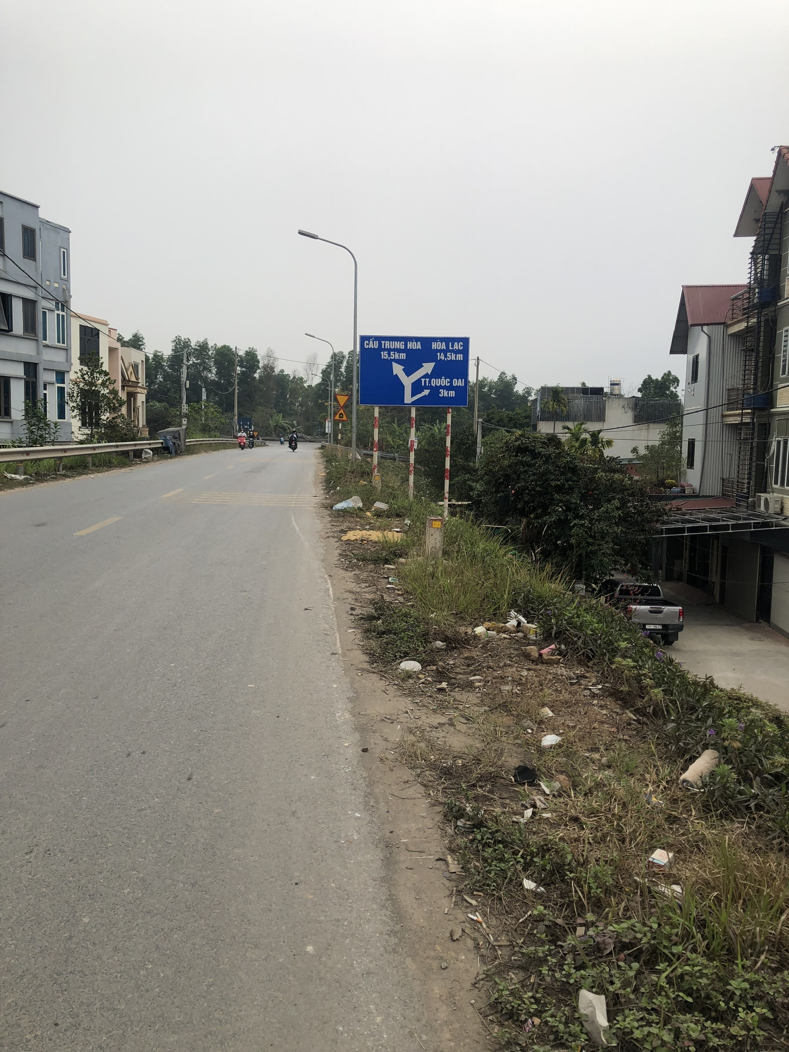

Slide 13
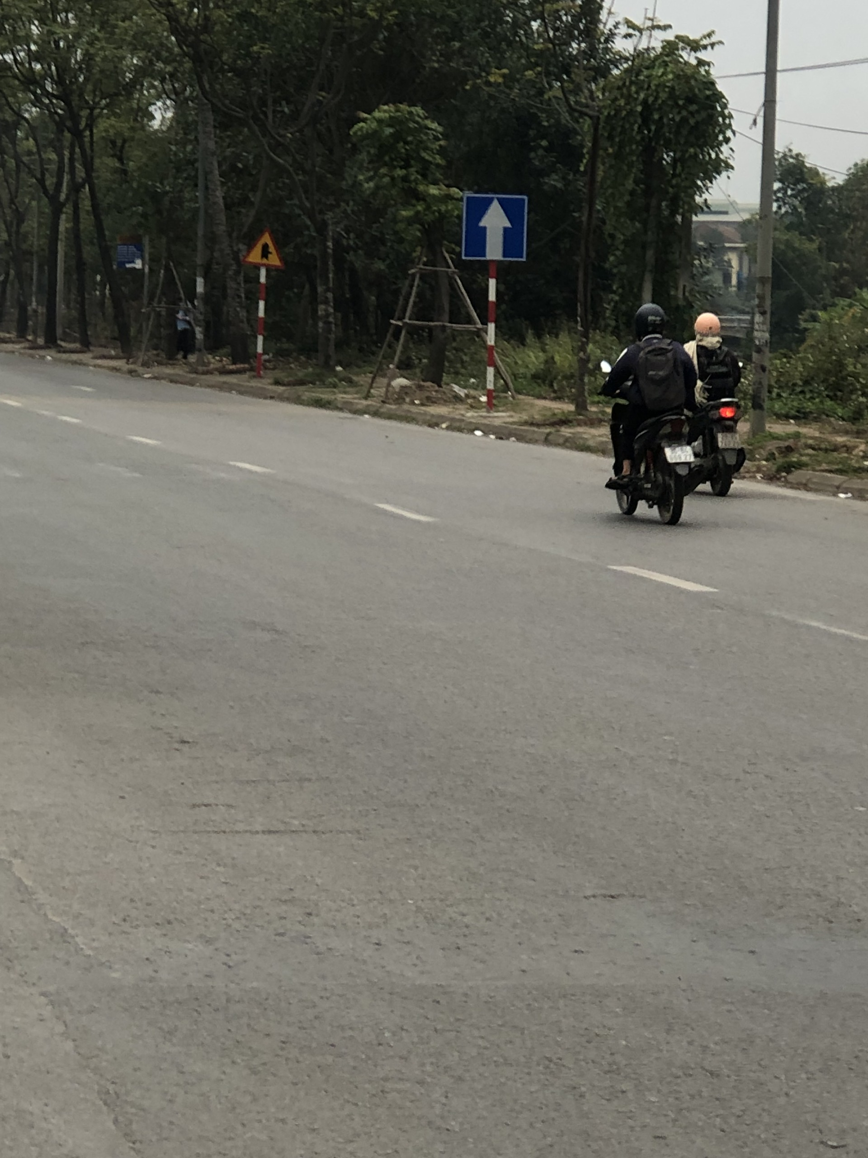
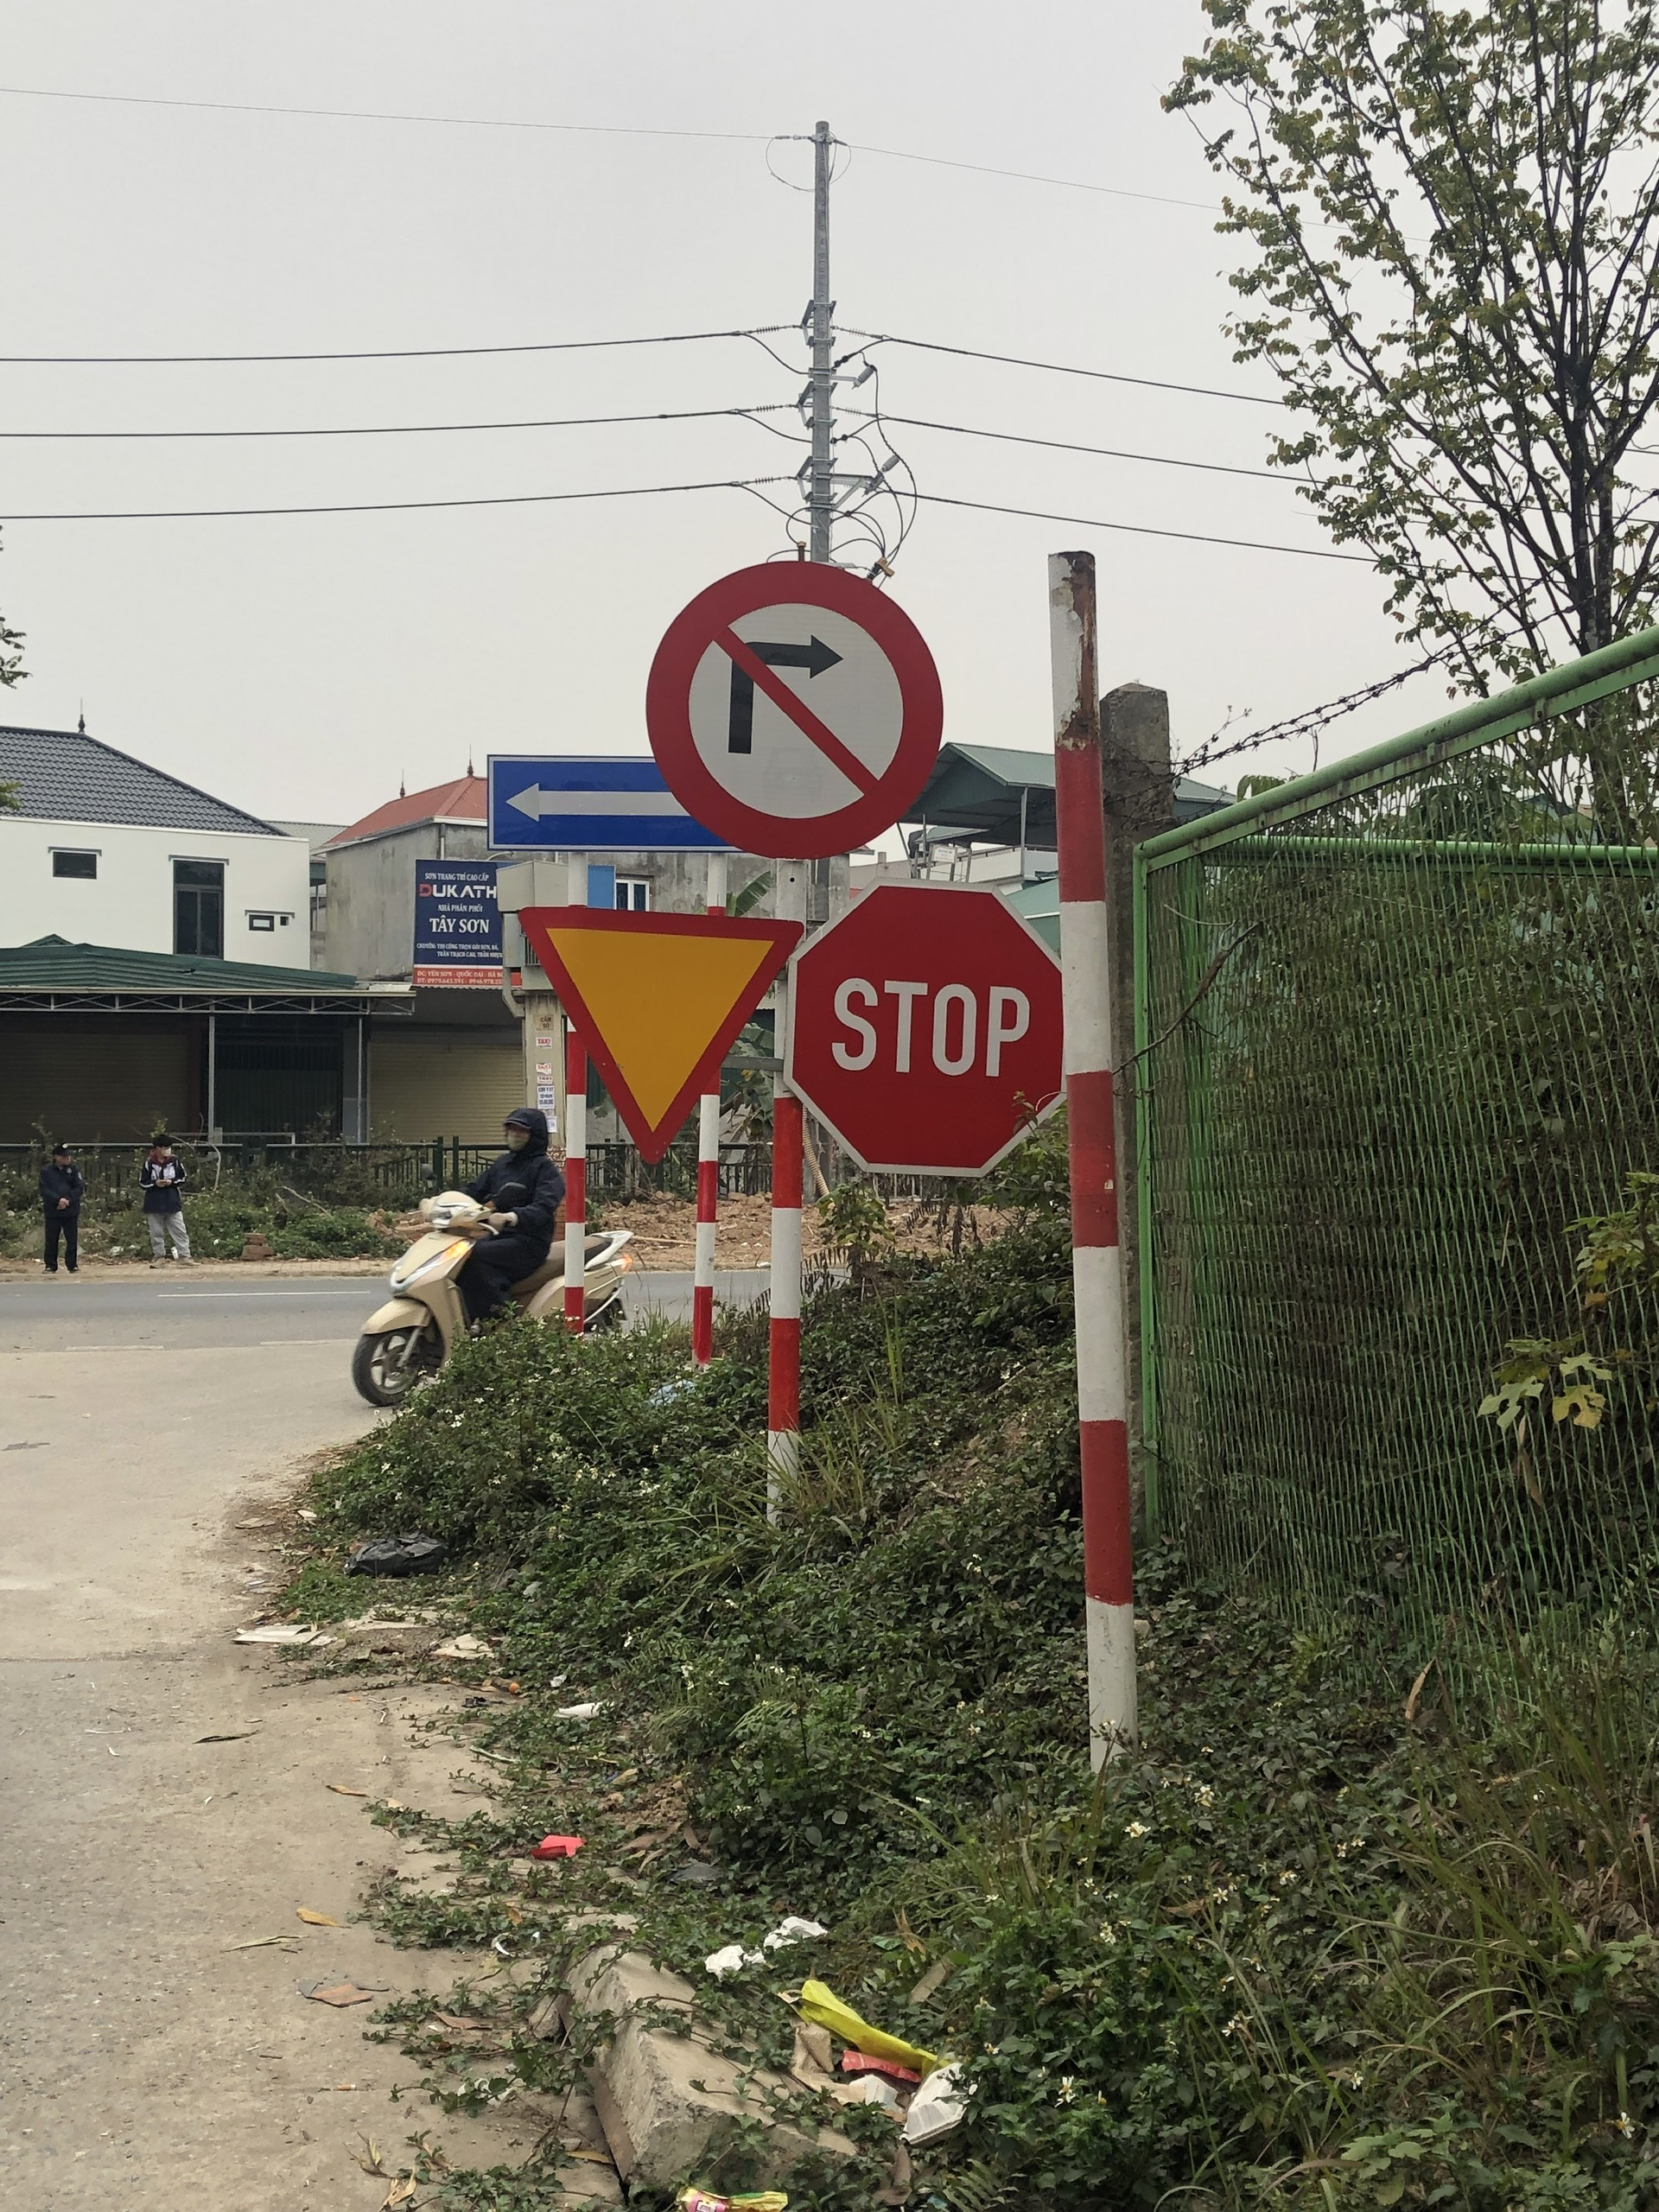

Slide 14
3. Adjusting the product based on feedback:
If needed, groups can improve the design (add details, modify size, change materials). 📌 Outcome: • The completed traffic sign is refined for better usability and application.

Slide 15
* Conclusion and Home work:
📝 Consolidation:
Summarize the key points of today’s lesson, including the importance of traffic signs and their design principles.
Review the traffic signs created by each group and highlight creative and practical aspects.
Encourage students to reflect on how traffic signs contribute to road safety and their daily lives.

Slide 16
🎯 Homework:
Observe and take pictures of at least three traffic signs in your neighborhood. Write a short description of their meaning and importance.
Think of ways to improve the effectiveness of traffic signs (e.g., adding reflective materials, using different symbols).
Prepare for the next lesson by researching unique traffic signs from different countries and their purposes.

