Slide 1
WELCOME TO OUR CLASS

Slide 2
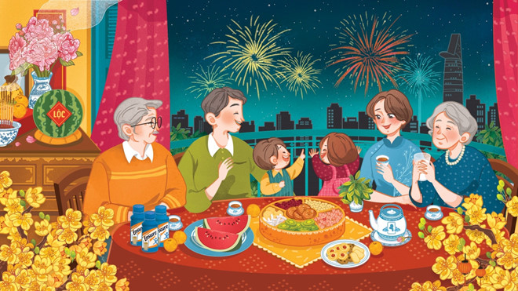
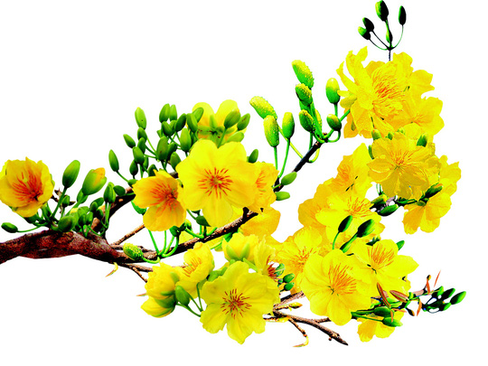
Unit 6: oUR TET HOLIDAY

Slide 3
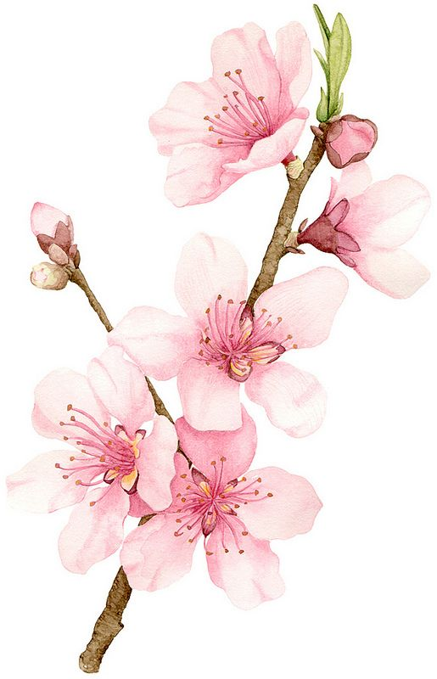
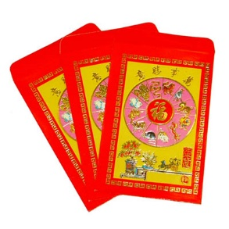
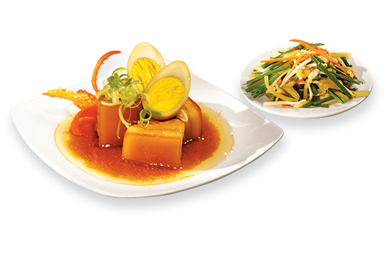
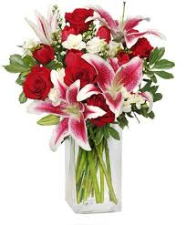
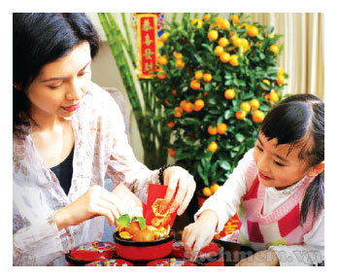
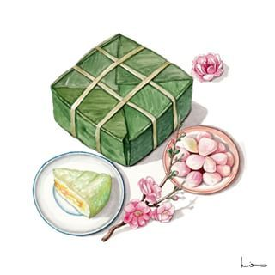
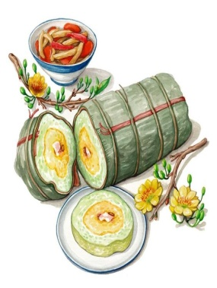
NETWORK
apricot blossoms
lucky money
peach blossoms
TET HOLIDAY
Things for Tet
great food
fireworks
flowers
house decorations
Banh Chung and Banh Tet

Slide 4
Unit 6: oUR TET HOLIDAY
LESSON 2

Slide 5
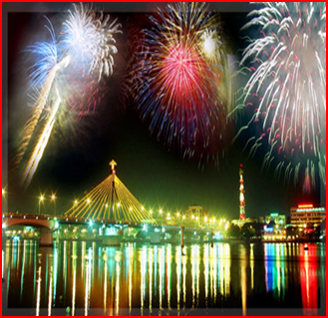
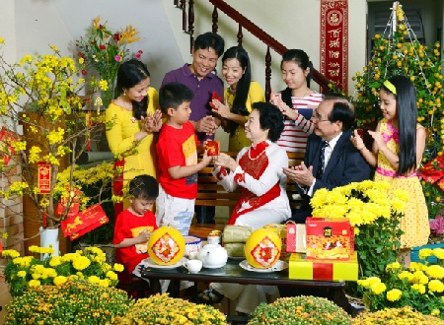
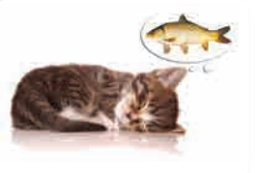
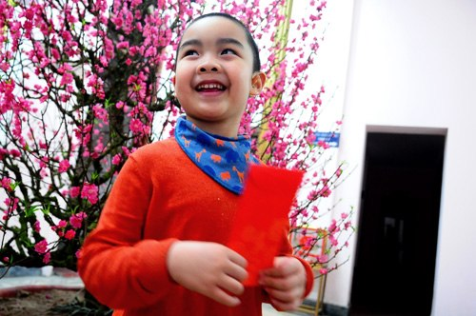
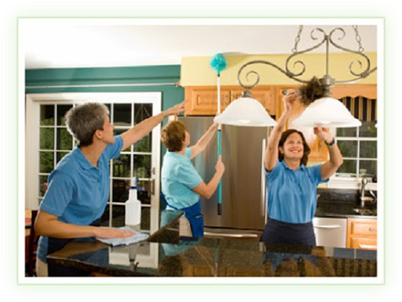
* Vocabulary
- visit relatives /ˈvisit ˈrel.ə.tɪv/
thăm họ hàng
- watch fireworks /wɒtʃ ˈfɑɪərˌwɜrks/
xem pháo hoa
- make a wish /meɪk eɪ wɪʃ /
làm điều ước
- give lucky money /ɡɪv lʌk.i mʌn.i /
nhận tiền lì xì
- clean the furniture /kliːn ðə ˈfɜː.nɪ.tʃər/
lau chùi đồ đạc

Slide 6
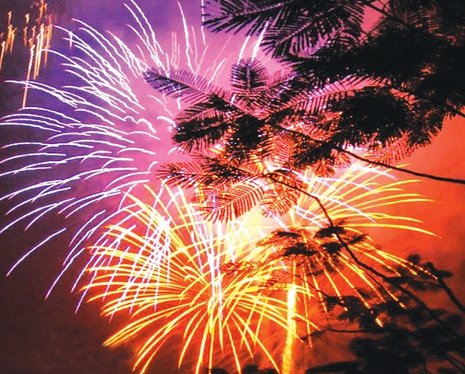
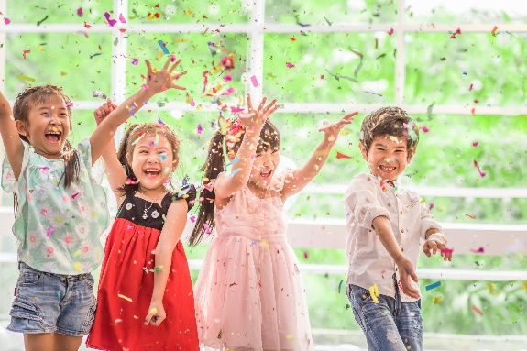
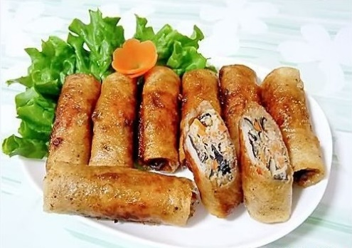
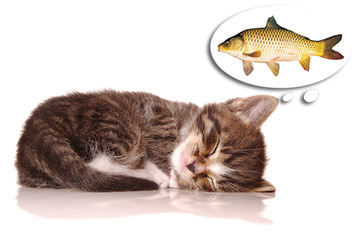
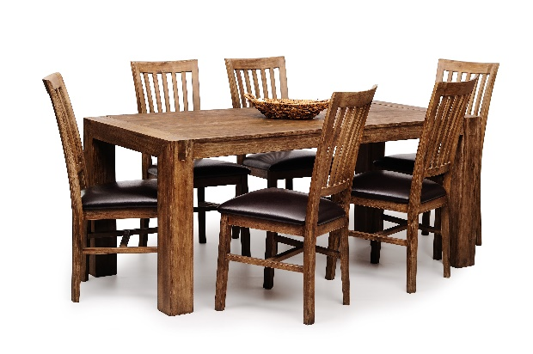
Write the words / phrases in the box under the pictures.
wish
fun
fireworks
special food
furniture
1.
fireworks
2.
special food
3.
fun
4.
wish
5.
furniture

Slide 7
Match the verbs with the nouns.
Verbs
Nouns
a. a wish
1. have
f. fun
e. relatives
2. visit
b. fireworks
d. lucky money
3. give
c. the furniture
4. make
d. lucky money
a. a wish
5. clean
e. relatives
c. the furniture
f. fun
6. watch
b. fireworks

Slide 8
Complete the sentences with the words in the box.
shopping
celebrate
clean
food
peach
1.
In Viet Nam, we
celebrate
Tet in January or February.
2.
At Tet, we decorate our houses with
peach
flowers.
3.
Children should help their parents to
clean.
their houses.
4.
People do a lot of
shopping
before Tet.
food
5.
My mother usually cooks special
during Tet.

Slide 9
/∫/ and /s/

Slide 10
* Pronunciation
/s/ and /ʃ/
Listen and repeat the words.
shopping
special
rice
spring
wish
celebrate
/s/: special, rice, spring, celebrate
/ʃ/: shopping, wish, special

Slide 11
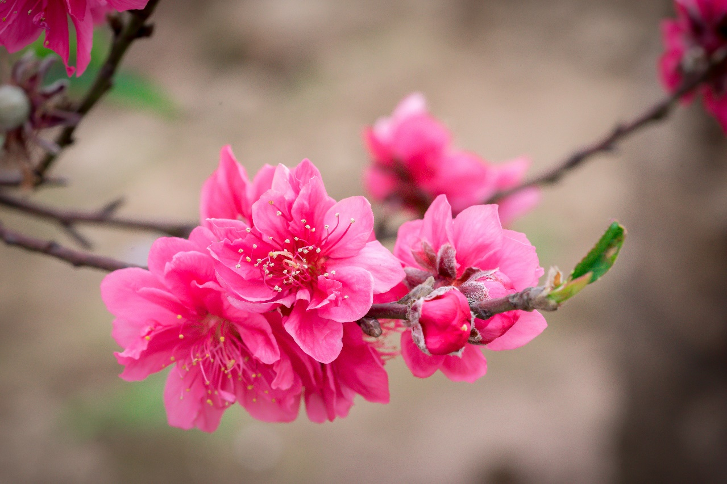
Listen and repeat the poem. Pay attention to the sounds /s/ and /ʃ/ in the underlined words.
Spring is coming!
Tet is coming!
She sells peach flowers.
Her cheeks shine.
Her eyes smile.
Her smile is shy.
She sells peach flowers.

Slide 12
* Production
EX1. Practise saying the following sentences with a focus on the underlined words
1. The policeman showed me the way to the centre.
2. Do you have peach flowers during summer?
3. Children shouldn’t eat too much ice cream.
4. Most countries celebrate the New Year.
5. When Tet comes, everybody makes a wish.

Slide 13
Game: Sentence race
The tongue twister: Seashells
She sells sea shells by the sea shore.
The shells she sells are surely seashells.
So if she sells shells on the seashore.
I'm sure she sells seashore shells.

Slide 14
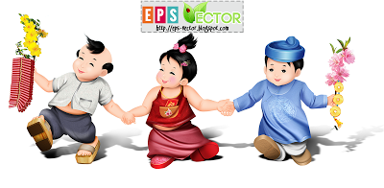
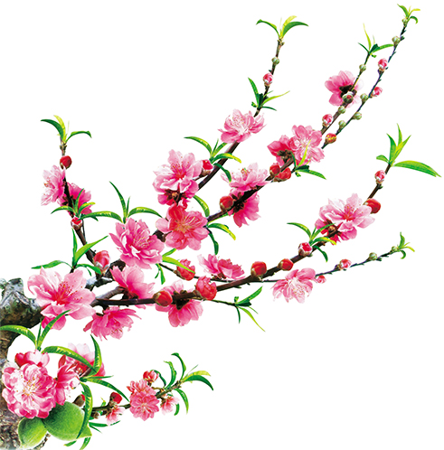
Homework
Learn by heart all new words.
Do exercises on workbook.
Prepare A closer look 2.

Slide 15
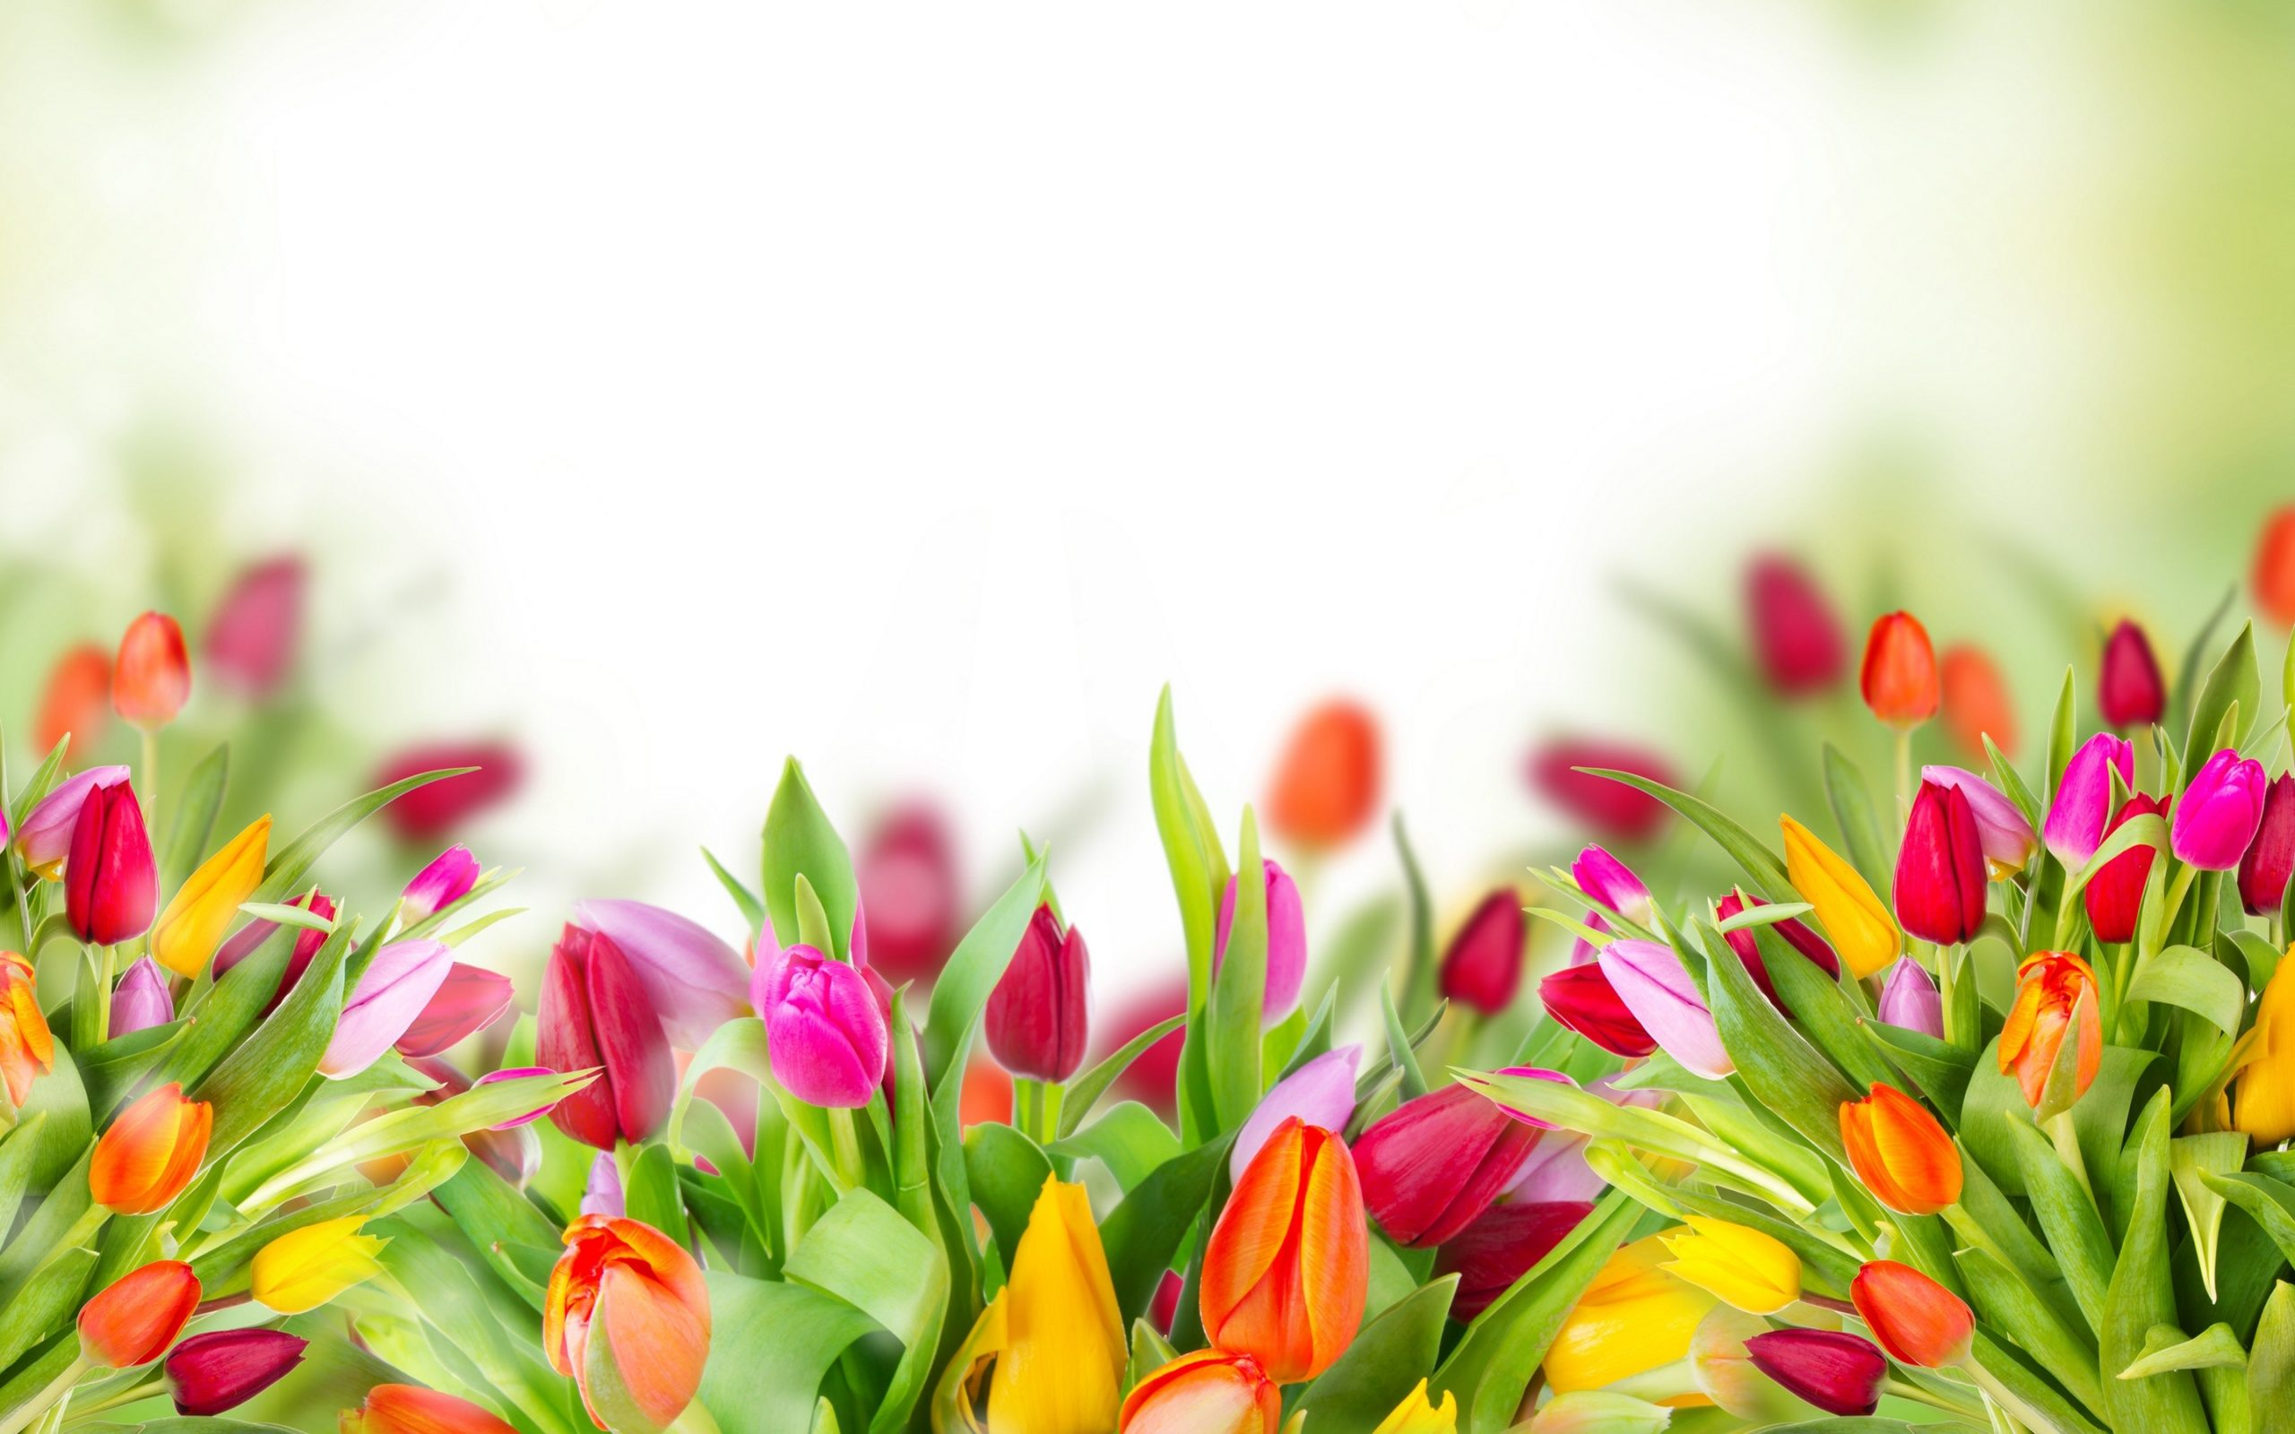
Thank you!
Have a nice day!

