Slide 1
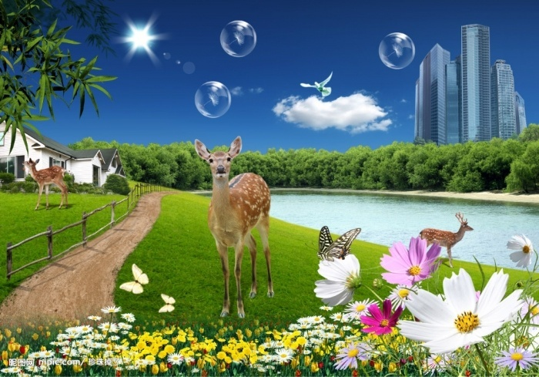
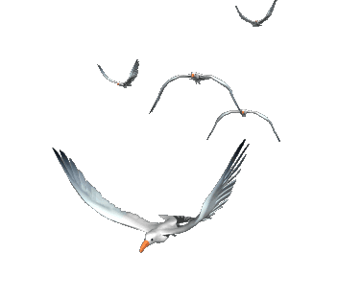
WELCOME TO OUR CLASS

Slide 2
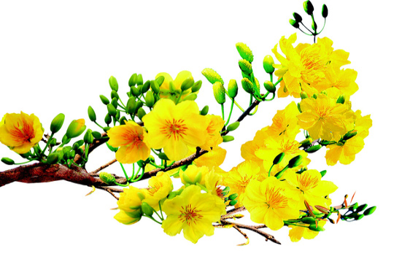
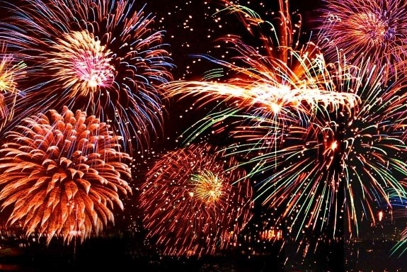
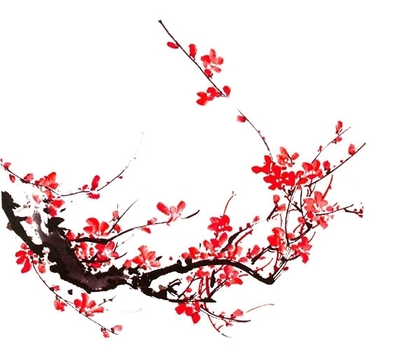
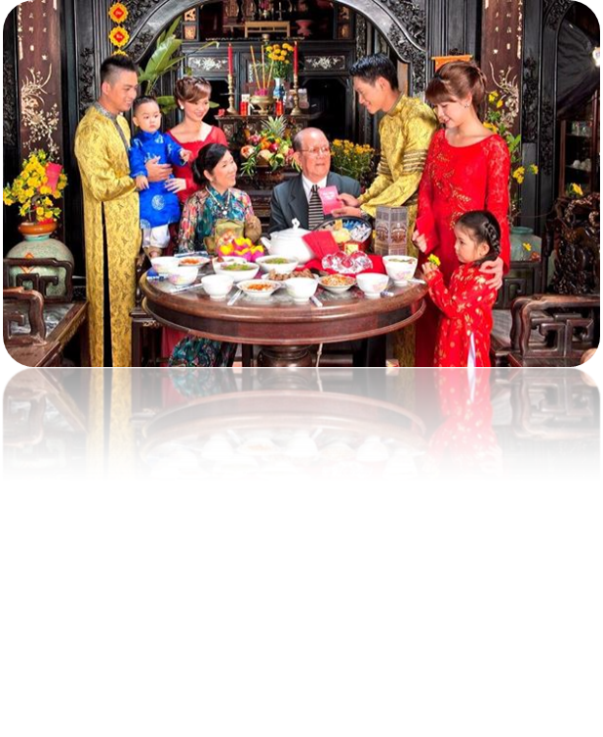
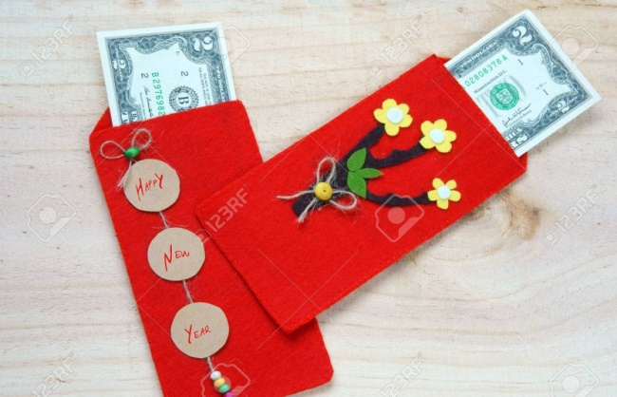
* Chatting:
1.What holiday are these pictures about?
2. What are there in the picture?
3. What do you think about when talking about Tet?
1. Tet holiday.
2. Cherry flower and apricot flowers , firework, lucky money, Tet greetings
3. funny, delicous food, get lucky money, visit relatves,…..

Slide 3
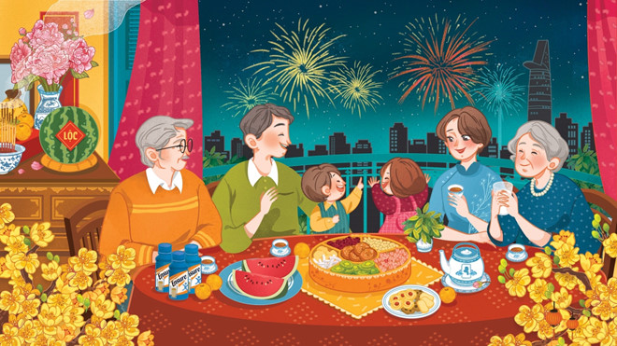
Unit 6: oUR TET HOLIDAY

Slide 4
Unit 6: oUR TET HOLIDAY
LESSON 1
Happy New Year!

Slide 5
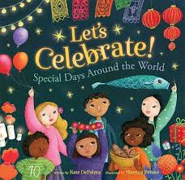
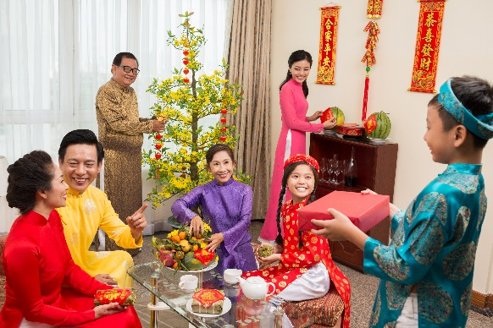
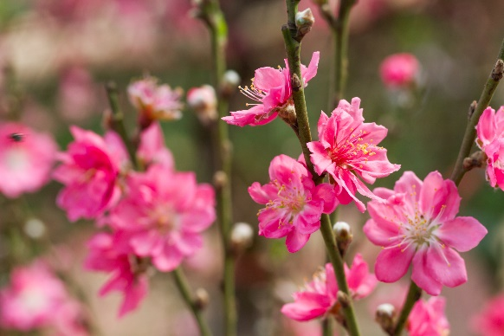
* Vocabulary
- celebrate (v):
kỉ niệm
- decorate (v):
trang trí
- family gathering (N. phr.):
sum họp gia đình
- lucky money (N. phr.)
tiền lì xì
- peach flowers
hoa đào

Slide 6
* Checking vocab:
RUB OUT AND REMEMBER
- peach flowers
hoa đào
- decorate (v):
trang trí
- family gathering (N. phr.):
sum họp gia đình
- lucky money (N. phr.)
tiền lì xì
- celebrate (v):
kỉ niệm

Slide 7
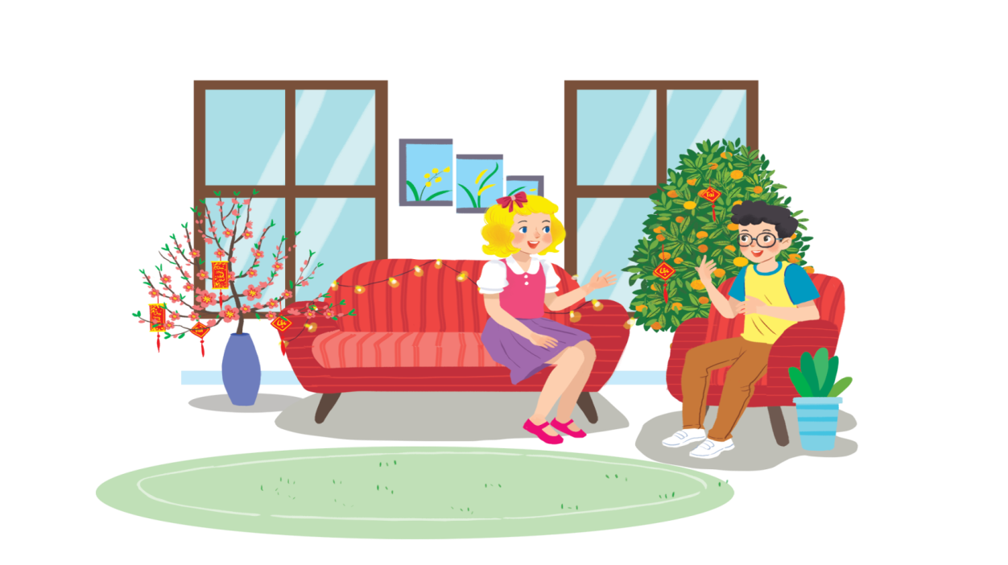
Listen and read.
Happy New Year!
1. What do you think they are talking about?
2. When is Tet?
3. Is it a holiday?
4. What do we do at Tet?
* Suggested answers:
1. They are talking about Tet/ New Year.
2. It’s in January/ February.
3. Yes, it is.
4. We clean our houses, decorate them, meet relatives,…
Notes:
Thiếu tên bài đọc.

Slide 8
1. Listen and read.
Happy New Year!
Linda: Phong, does Viet Nam celebrate New Years?
Phong: Yes, we do. We have Tet.
Linda: When is Tet?
Phong: At different times. This year, it’s in January.
Linda: What do you do at Tet?
Phong: We clean our homes and decorate them with ﬂowers.
Linda: Is Tet a time for family gatherings?
Phong: Yes. It’s a happy time for everybody.
Linda: Great.
Phong: Yes, and another good thing about Tet is that children get lucky money.
Linda: That sounds interesting. Is there anything special people should do?
Phong: We should say “Happy New Year” when we meet people, and we shouldn’t break anything.

Slide 9
What are Linda and Phong talking about?
A.
New Years in the world
B.
Tet in Viet Nam
C.
What to eat and wear during tet

Slide 10
Complete the sentences about Tet with the information from the conversation in 1.
1.
January
.
This year Tet is in
.
2.
We decorate our
homes
.
.
3.
Tet is a time for family
gatherings
.
.
4.
Children get
lucky money
.
.
5.
People shouldn’t
break
anything.
anything.

Slide 11
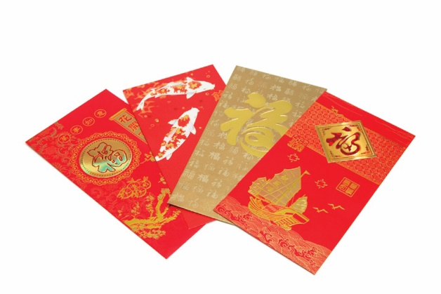
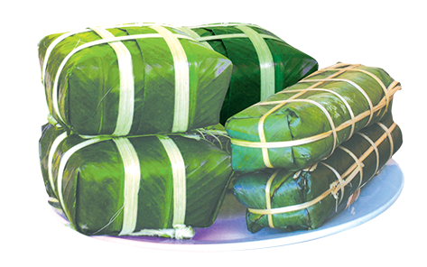
Match the words / phrases in the box with the pictures.
a. lucky money
a. lucky money
c. banh chung and banh tet
c. banh chung and banh tet
b. peach flowers
b. peach flowers
d. family gathering
d. family gathering
1
2
b. peach flowers
a. lucky money
3
4
c. banh chung and banh tet
d. family gathering

Slide 12
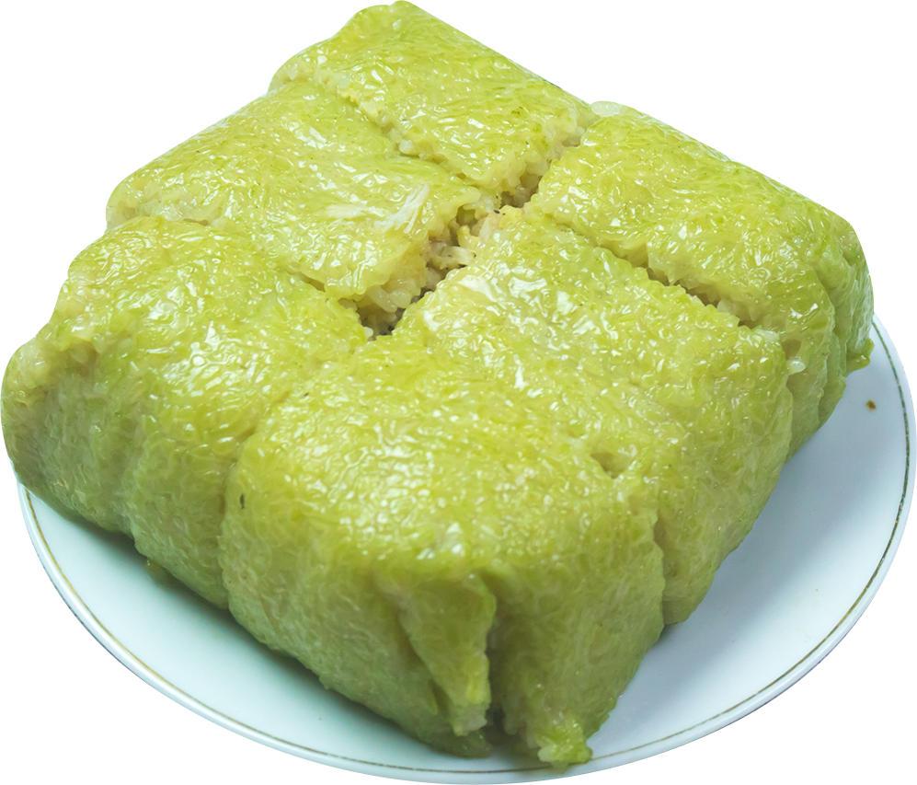
Is it about Tet?
Write two things or activities and share them with the class. The class listen and decide whether they are about or not about Tet.
Example 1:
Student: banh chung
Class: It’s about Tet.
Student: flying a kite.
Class: It’s not about Tet.

Slide 13
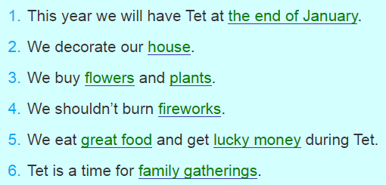
* Production
Fill in the blanks.

Slide 14
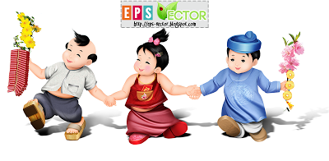
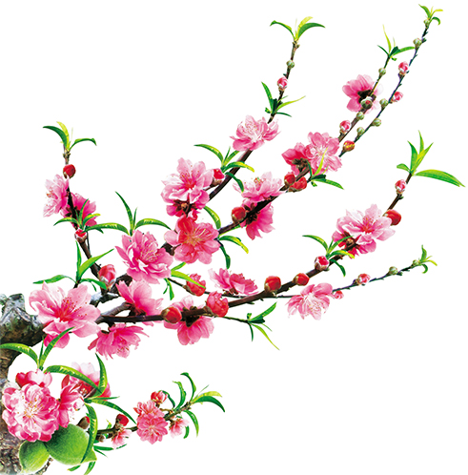
Homework
Learn by heart all new words.
Read the dialogue again.
Do exercises on workbook.
Prepare A closer look 1.

Slide 15
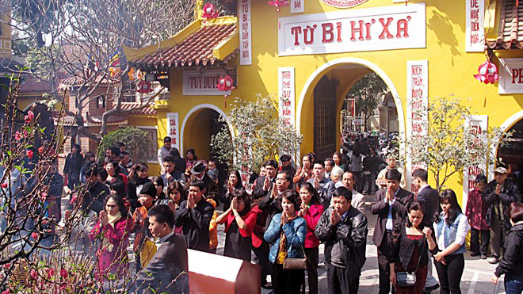
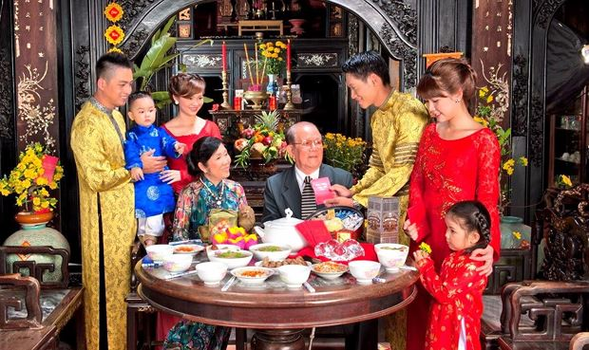
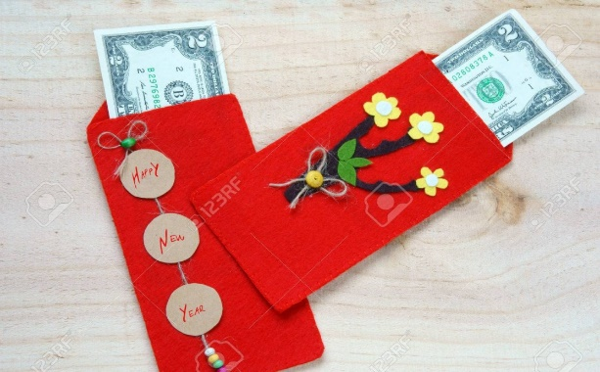
HAPPY NEW YEAR

