Slide 2
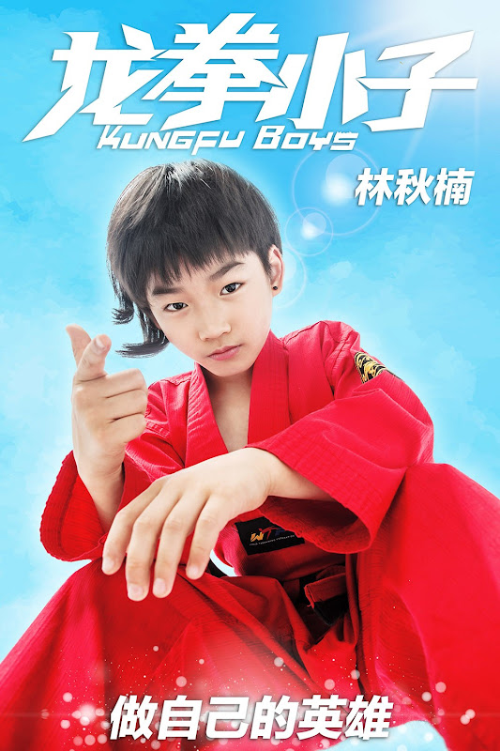
Unit
8
FILMS
LESSON 5: SKILLS 1
Unit
READING
SPEAKING

Slide 3
OBJECTIVES
By the end of the lesson, students will be able to:
develop reading skill about one’s favourite film;
develop speaking skill: Talking about a film.

Slide 4
LESSON 5: SKILLS 1
WARM-UP
Game: Who is faster?
Task 1: Work in pairs. Discuss the following questions.
* Vocabulary
Task 2: Match the words or phrases with their meanings.
Task 3: Read Mark’s blog and answer the questions.
READING
Task 4: Look at the table. Work in pairs. Ask and answer questions about the film Kungfu Boy.
Task 5: Work in groups. Take turns to talk about the film Kungfu Boy.
SPEAKING
POST-READING & SPEAKING
Evaluation
CONSOLIDATION
Wrap-up
Homework

Slide 5
LESSON 5: SKILLS 1
WARM-UP
Game: Who is faster?
Aims of the stage:
To introduce the topic of reading.
To enhance students’ skills of cooperating with team mates.

Slide 6
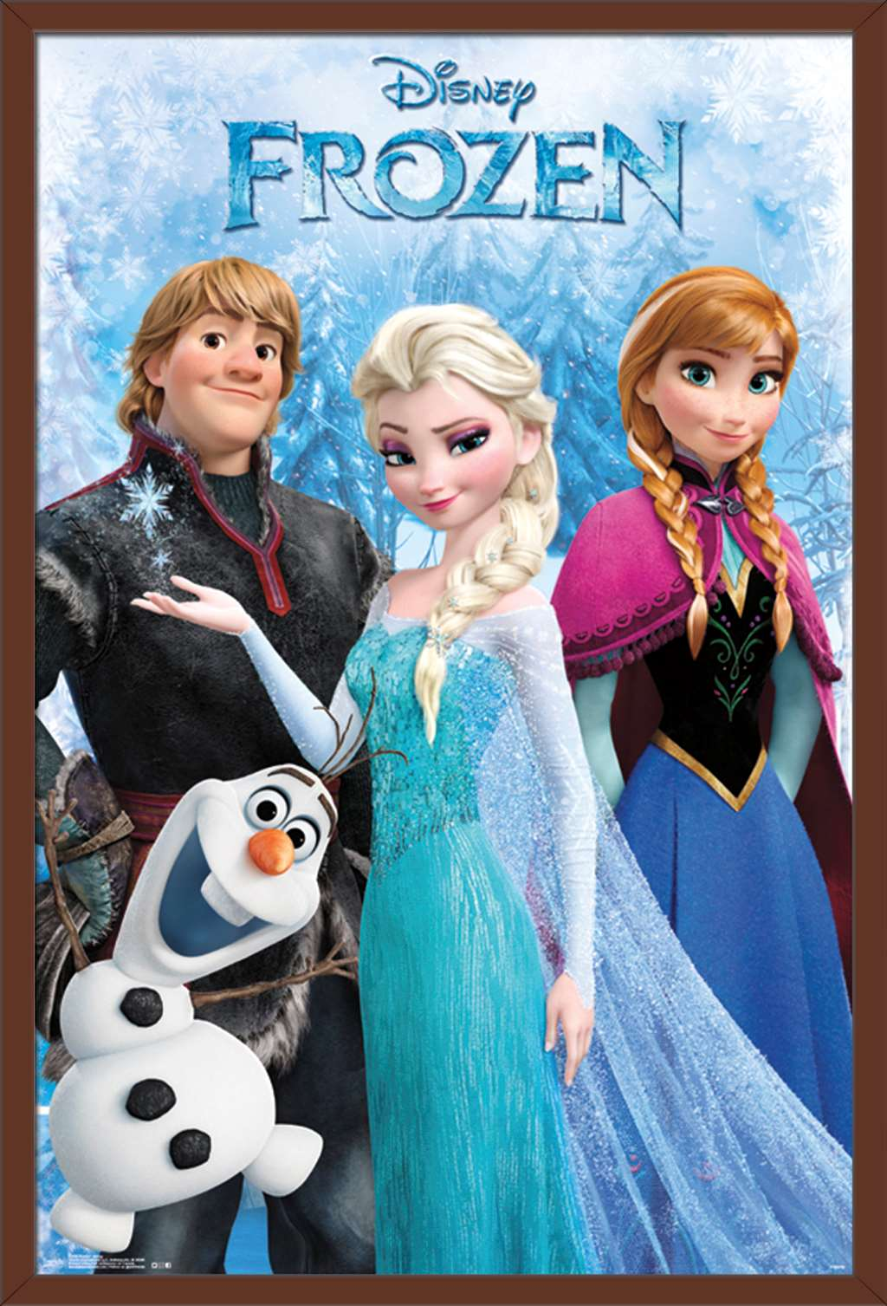
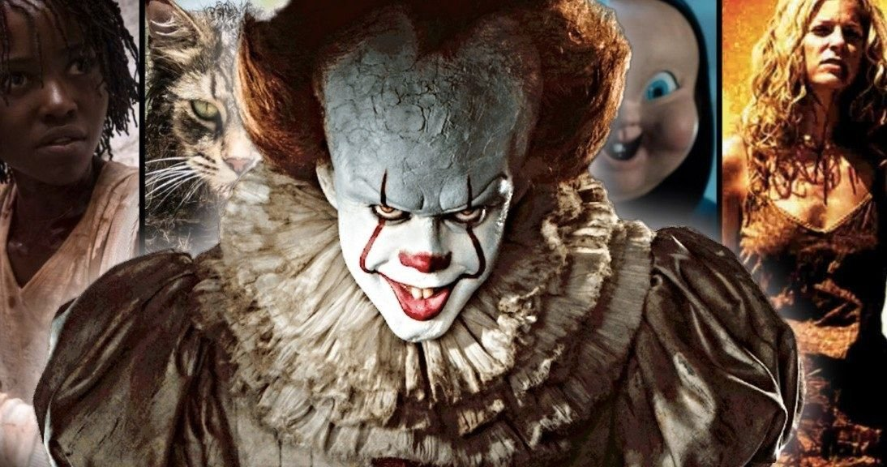
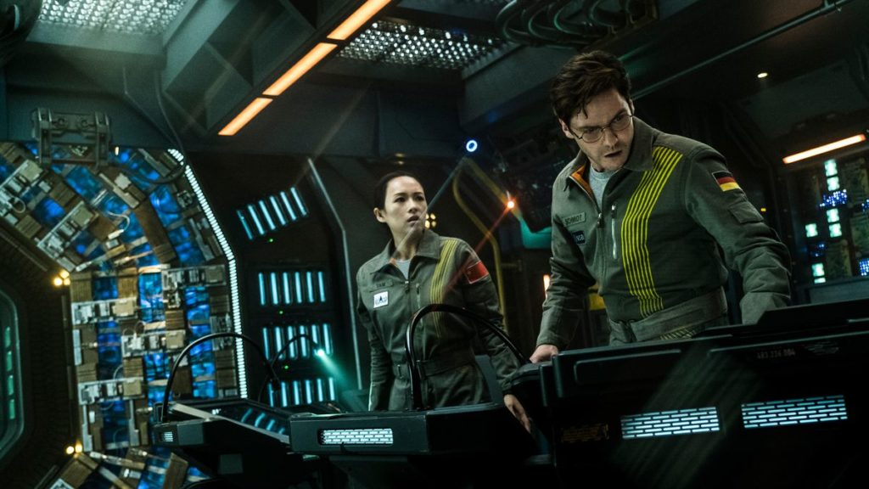
WARM-UP
Look at the posters, say the correct types of films.
animation
horror film
science fiction film

Slide 7
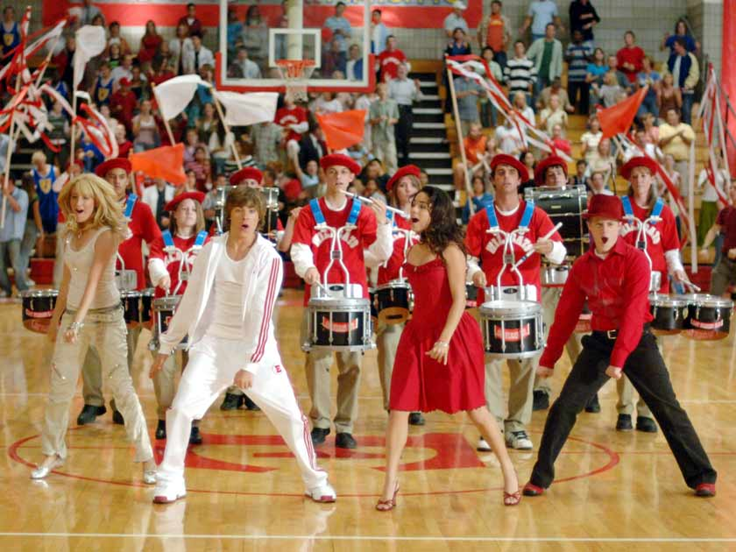
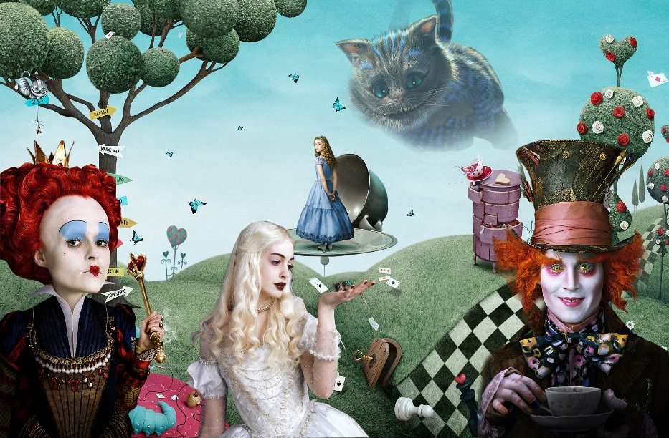
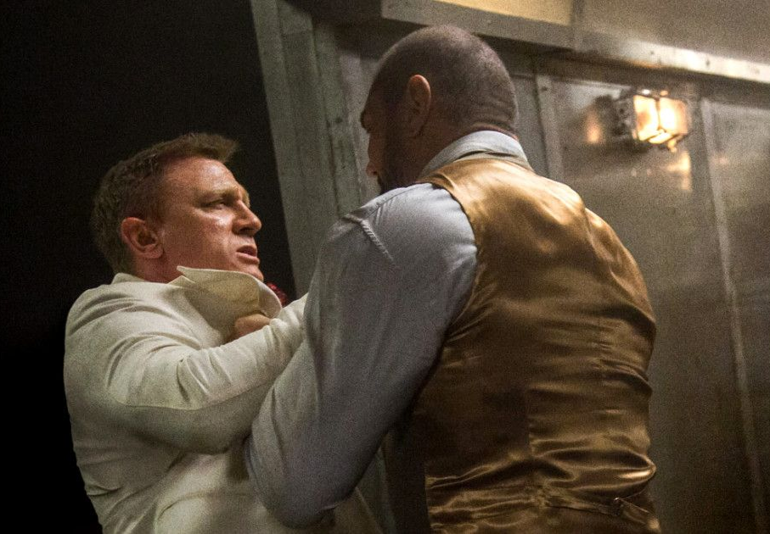
WARM-UP
Look at the posters, say the correct types of films.
action film
musical
fantasy

Slide 8
LESSON 5: SKILLS 1
WARM-UP
Game: Who is faster?
* Pre-Reading:
Vocabulary
Task 1: Work in pairs. Discuss the following questions.
Task 2: Match the words or phrases with their meanings.
READING
Aims of the stage:
To provide students with some lexical items before reading the text.

Slide 9
PRE-READING
1
Work in pairs. Discuss the following questions.
>-Do you like fantasies?
>-Why or why not?
Key:
-Yes, I do because they’re surprising and shocking.
- I don't like fantasies because it is very boring and not on real facts.
fantasy

Slide 10
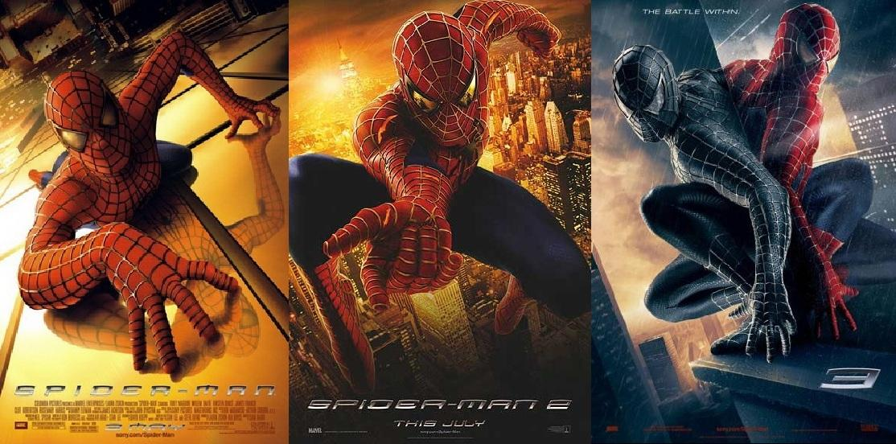
PRE-READING - VOCABULARY
series (n)
/'siəri:z/
chuỗi, loạt (phim dài tập)

Slide 11
PRE-READING - VOCABULARY
wizard (n)
/'wizəd/
phù thủy, người có tài phi thường

Slide 12
PRE-READING - VOCABULARY
must-see (n)
/ˈmʌstˈsiː/
bộ phim đáng xem, nên xem

Slide 13
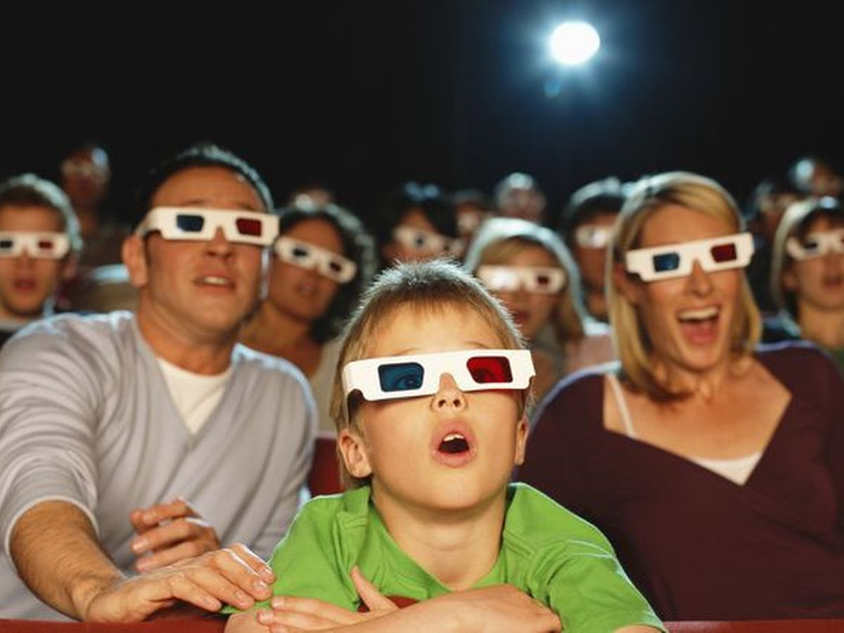
PRE-READING - VOCABULARY
gripping (adj)
/'gripiη/
cuốn hút, hấp dẫn

Slide 14
PRE-READING - VOCABULARY
New words | Pronunciation | Meaning
series | /'siəri:z/ | chuỗi, loạt (phim dài tập)
wizard | /'wizəd/ | phù thủy, người có tài phi thường
must-see | /ˈmʌstˈsiː/ | bộ phim đáng xem, nên xem
gripping | /'gripiη/ | cuốn hút, hấp dẫn

Slide 15
2. Read the film review of Harry Potter and the Sorcerer’s Stone on Mark’s blog. Match the words or phrases with their meanings.

Slide 16
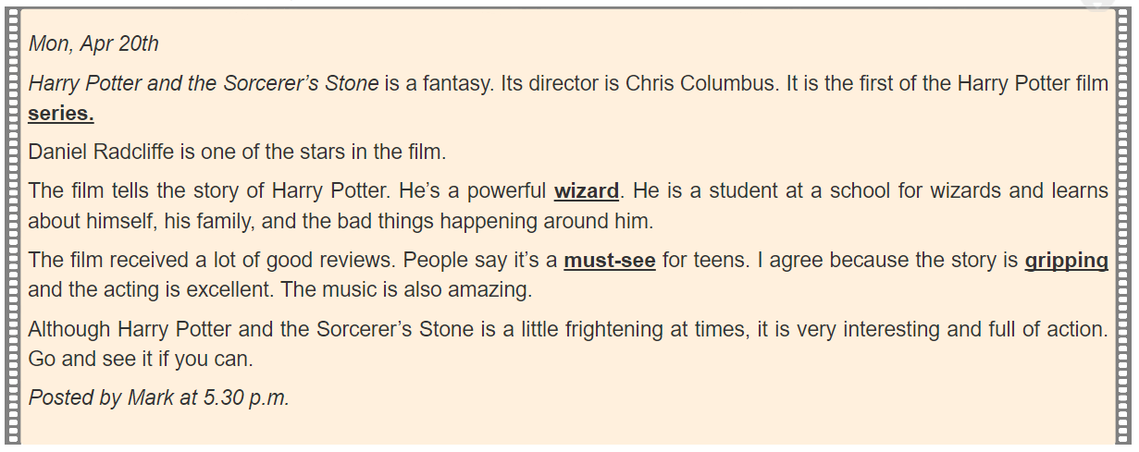
Mon, Apr 20th
Harry Potter and the Sorcerer's Stone is a fantasy. Its director is Chris Columbus. It is the first of the Harry Potter film series.
Daniel Radcliffe is one of the stars in the film.
The film tells the story of Harry Potter. He's a powerful wizard. He is a student at a school for wizards and learns about himself, his family, and the bad things happening around him.
The film received a lot of good reviews. People say it's a must-see for teens. I agree because the story is gripping and the acting is excellent. The music is also amazing.
Although Harry Potter and the Sorcerer's Stone is a little frightening at times, it is very interesting and full of action. Go and see it if you can.
Posted by Mark at 5.30 p.m.

Slide 17
PRE-READING - VOCABULARY
2
Match the words or phrases with their meanings.
Words | Meanings
1. series | a. something that is so good that you think others should see it
2. wizard | b. related films that tell stories about the same characters
3. must-see | c. very exciting or interesting
4. gripping | d. a man who has magical powers

Slide 18
PRE-READING - VOCABULARY
2
Match the words or phrases with their meanings.
Words | Meanings
1. series | a. something that is so good that you think others should see it
2. wizard | b. related films that tell stories about the same characters
3. must-see | c. very exciting or interesting
4. gripping | d. a man who has magical powers

Slide 19
PRE-READING - VOCABULARY
2
Match the words or phrases with their meanings.
Words | Meanings
1. series | a. something that is so good that you think others should see it
2. wizard | b. related films that tell stories about the same characters
3. must-see | c. very exciting or interesting
4. gripping | d. a man who has magical powers
1. b
2. d
3. a
4. c

Slide 20
LESSON 5: SKILLS 1
WARM-UP
Game: Who is faster?
* Pre-Reading:
Vocabulary
Task 1: Work in pairs. Discuss the following questions.
Task 2: Match the words or phrases with their meanings.
* While-Reading:
Task 3: Read Mark’s blog again and answer the questions.
READING

Slide 21
WHILE-READING
3
Read Mark’s blog and answer the questions.
Aim of the task:
To develop reading skill for specific information.

Slide 22
WHILE-READING
3
Read Mark’s blog and answer the questions.
Aim of the task:
To develop reading skill for specific information.

Slide 23
WHILE-READING
3
Read Mark’s blog and answer the questions.
What kind of film is Harry Potter and the Sorcerer’s Stone?
2. Who is Daniel Radcliffe?
3. What is the film about?
4. What do people say about the film?

Slide 24
WHILE-READING
3
Read Mark’s blog and answer the questions.
1. What kind of film is Harry Potter and the Sorcerer’s Stone?
Harry Potter and the Sorcerer’s Stone is a fantasy.

Slide 25
WHILE-READING
3
Read Mark’s blog and answer the questions.
2. Who is Daniel Radcliffe?
Daniel Radcliffe is one of the stars in the film.

Slide 26
WHILE-READING
3
Read Mark’s blog and answer the questions.
3. What is the film about?
The film tells the story of Harry Potter. He’s a powerful wizard. He is a student at a school for wizards and learns about himself, his family, and the bad things happening around him.

Slide 27
WHILE-READING
3
Read Mark’s blog and answer the questions.
4. What do people say about the film?
People say it’s a must-see for teens.

Slide 28
LESSON 5: SKILLS 1
LESSON 5: SKILLS 1
WARM-UP
Game: Who is faster?
* Pre-Reading:
Vocabulary
Task 1: Work in pairs. Discuss the following questions.
Task 2: Match the words or phrases with their meanings.
* While-Reading:
Task 3: Read Mark’s blog and answer the questions.
READING
Task 4: Look at the table. Work in pairs. Ask and answer questions about the film Kungfu Boy.
Task 5: Work in groups. Take turns to talk about the film Kungfu Boy.
SPEAKING

Slide 29
SPEAKING
4
Look at the table. Work in pairs. Ask and answer questions about the film Kungfu Boy.
Film’s name | Kungfu Boy
Director | John Stevenson
Type of film | Comedy
Main actor / actress | Bruce Wane
Main content | About a very big boy who saves his town and becomes a hero
Reviews | Funny and interesting
Time | 4.30 p.m and 8.30 p.m daily
Place | Ngoc Khanh Cinema
Example: A: How about seeing a film this evening? B: That’s a great idea. What film shall we see? A: Kungfu Boy. B: What kind of film is it?
A: __________________

Slide 30
4
Look at the table. Work in pairs. Ask and answer questions about the film Kungfu Boy.
4
What kind of film is it?
Film’s name | Kungfu Boy
Director | John Stevenson
Type of film | Comedy
Main actor / actress | Bruce Wane
Main content | About a very big boy who saves his town and becomes a hero
Reviews | Funny and interesting
Time | 4.30 p.m and 8.30 p.m daily
Place | Ngoc Khanh Cinema
Who stars in it?
What is the film about?
What do people say about it?
What time does it start?
Where is it?
Notes:
Aim: To provide an opportunity for Ss to practise asking and answering about a film, using the information on a given film poster.
First, ask Ss to read the film poster of the film Kungfu Boy. T can help them with the new vocabulary.
Then ask Ss to work in pairs, asking and answering questions about the film Kungfu Boy.
T can go around to help Ss. After finishing, T calls on some pairs to practise in front of the class.

Slide 31
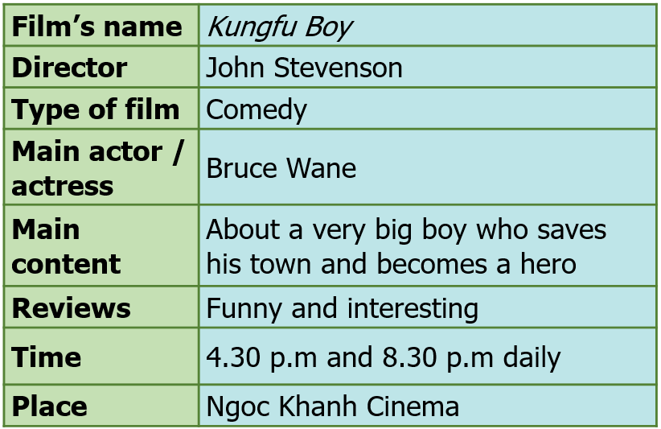
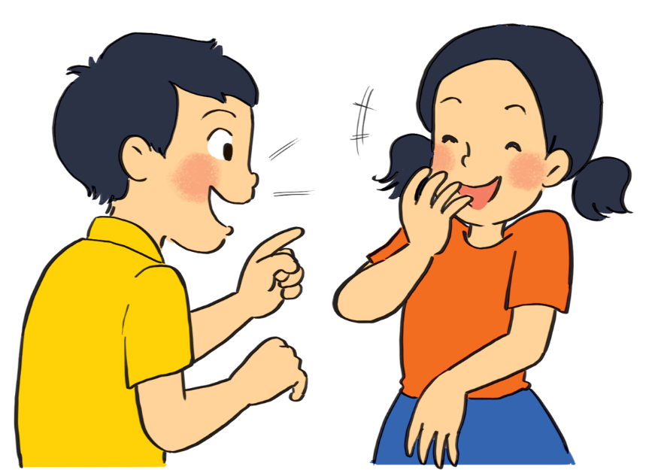
5
Work in groups. Take turns to talk about the film Kungfu Boy.
cues
Example: Kungfu Boy is on at … at … p.m.
It’s (an) … about …
Kungfu Boy is on at Ngoc Khanh Cinema at 4.30 p.m and 8.30 pm every day.
It’s a_ _ _ _ _ _ _ _ _ _ _ _ _.
The main actor is _ _ _ _ _ _ _ _ _ _ _ _ _.
It’s about _ _ _ _ _ _ _ _ _ _ _ _ _.
People say _ _ _ _ _ _ _ _ _ _ _ _ _.
Notes:
Kungfu Boy is a comedy directed by John Stevenson. Bruce Wane is the main actor in this film. It's about a very big boy who saves his town and becomes a hero. People say that it's a must-see because it's very funny and interesting. It's at 4.30 p.m. and 8.30 p.m. daily at Ngoc Khanh Cinema. Let's go to see it!

Slide 32
PRODUCTION (Post-Read & Speak)
5
Work in groups. Take turns to talk about the film Kungfu Boy.
Example: Kungfu Boy is on at … at … p.m.
It’s (an) … about …
Suggestion:
Kungfu Boy is a comedy directed by John Stevenson. Bruce Wane is the main actor in this film. It's about a very big boy who saves his town and becomes a hero. People say that it's a must-see because it's very funny and interesting. It's at 4.30 p.m. and 8.30 p.m. daily at Ngoc Khanh Cinema. Let's go to see it!

Slide 33
LESSON 5: SKILLS 1
WARM-UP
Game: Who is faster?
* Pre-Reading:
Vocabulary
Task 1: Work in pairs. Discuss the following questions.
Task 2: Match the words or phrases with their meanings.
* While-Reading:
Task 3: Read Mark’s blog and answer the questions.
READING
Task 4: Look at the table. Work in pairs. Ask and answer questions about the film Kungfu Boy.
Task 5: Work in groups. Take turns to talk about the film Kungfu Boy.
SPEAKING
PRODUCTION
(Post-Read & Speak)
Evaluation
CONSOLIDATION
Wrap-up
Homework

Slide 34
CONSOLIDATION
1
Wrap-up
Unit
READING
SPEAKING

Slide 35
CONSOLIDATION
2
Homework
Prepare for the lesson: Looking back & Project
Choose one of your favourite films:
– name of the film – type of film – its director and main actors / actresses – a short summary – your overall opinion about the film – the showtime and cinema – pictures or photos to illustrate the film

Slide 36
Website: hoclieu.vn
Fanpage: facebook.com/www.tienganhglobalsuccess.vn/

