Slide 1
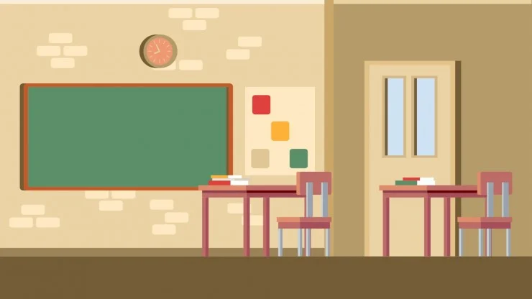
22nd October 2024
Welcome to class 7E!
Teacher : Do Thi Ngan - Ngoc My Secondary School

Slide 2
Game: Memory challenge
What can you see in the video?
Write the activities in the pictures.

Slide 3


Slide 4
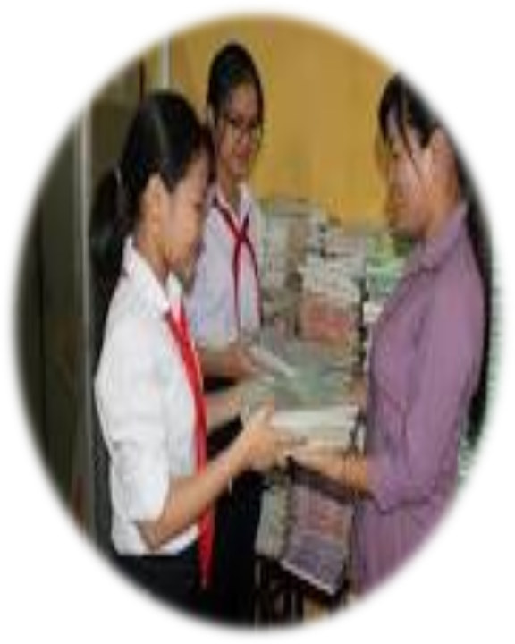
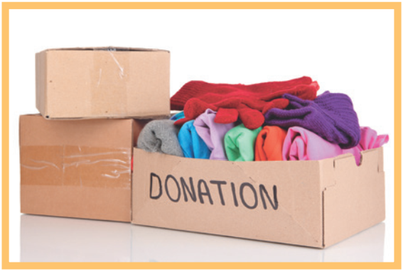
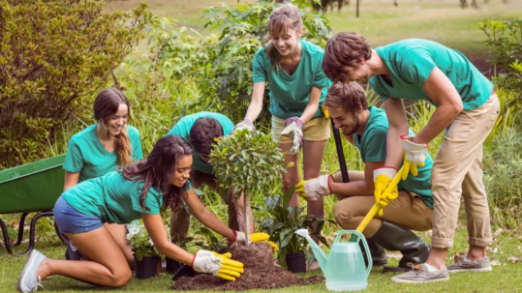

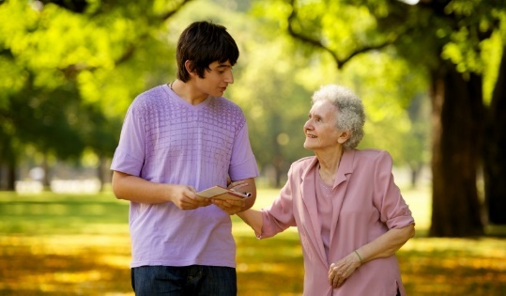
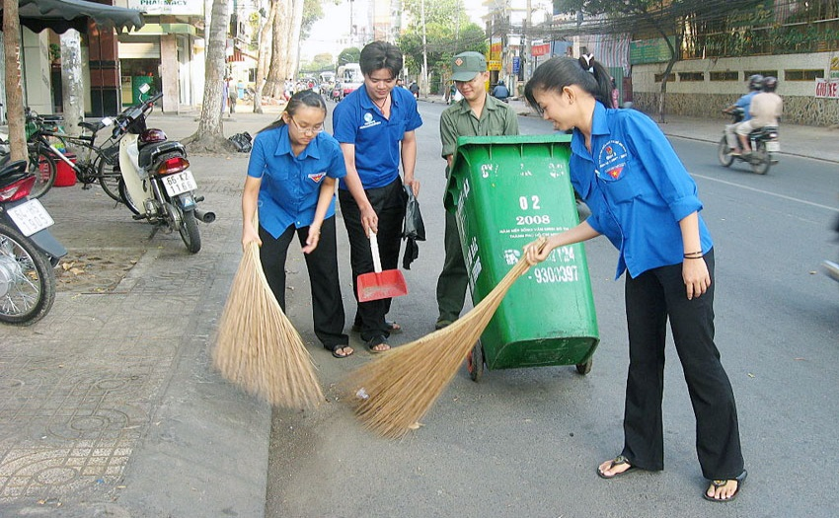
donating books for the school library
- donating clothes
- planting trees
Community activities
- tutoring younger students
- cleaning the street
- Helping elderly people

Slide 5
What are the pictures about ?
→ our new lesson

Slide 6




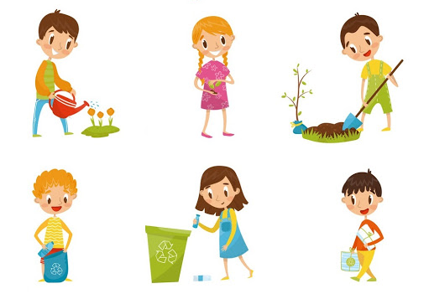
Unit
5
COMMUNITY SERVICE
Period 20: LESSON 5: SKILLS 1
READING
SPEAKING
Unit
Projects in Bright Future School
What project you can do?

Slide 7
Projects in Bright Future School
- Growing vegetables in the school garden

Slide 8

Listen and read the passage quietly to check your predictions and note the highlighted words
Bright Future school has many community activities for students. The school believes that a good way for students to develop themselves is through community service. All students can join any of these different projects:
- Tutoring: Upper grade students tutor lower grade students.
- Postcard-to-Help: Students make and sell postcards to raise money for local children.
- Visit-to-Read: Students visit a nursing home monthly and read books to the elderly.
- Garden-to-Give: Students grow vegetables and donate them to local schools.
- Paper-Plant-Exchange: Students collect paper and exchange it for plants. They then look after the plants in their school garden.
Students learn that they can help people and the world around them when they do community service. They feel useful and proud because they do good things.

Slide 9
2. Read the passage and match the highlighted words with their meanings.
1. give 2. give and receive 3. every month 4. pleased 5. teach
Bright Future School has many community activities for students. The school believes that a good way for students to develop themselves is through community service. All students can join any of these different projects:
– Tutoring: Upper grade students tutor lower grade students.
– Postcard-to-Help: Students make and sell postcards to raise money for local children.
– Visit-to-Read: Students visit a nursing home monthly and read books to the elderly.
– Garden-to-Give: Students grow vegetables and donate them to local schools.
– Paper-Plant-Exchange: Students collect paper and exchange it for plants. They then look after the plants in their school garden.
Students learn that they can help people and the world around them when they do community service. They feel useful and proud because they do good things.
5. teach
3. every month
1. give
2. give and receive
4. pleased

Slide 10
Note:
1. give
donate
2. give and receive
exchange
3. every month
monthly
4. pleased
proud
5. teach
tutor

Slide 11
WHILE-READING
3
Read the passage again and tick True or False.
 | True | False
1. Community service allows students to develop themselves.
2. Each student can join only one project.
3. They tutor younger students.
4. Local children receive postcards from the Postcard-to-Help project.
5. Students receive plants when they give paper.

Slide 12
3. Read the passage again and tick True or False.
 | True | False
1. Community service allows students to develop themselves.
✓
Bright Future School has many community activities for students. The school believes that a good way for students to develop themselves is through community service.

Slide 13
3. Read the passage again and tick True or False.
 | True | False
2. Each student can join only one project.
✓
All students can join any of these different projects:
 | True | False
3. They tutor younger students.
✓
– Tutoring: Upper grade students tutor lower grade students.

Slide 14
3. Read the passage again and tick True or False.
 | True | False
4. Local children receive postcards from the Postcard-to-Help project.
✓
– Postcard-to-Help: Students make and sell postcards to raise money for local children.
 | True | False
5. Students receive plants when they give paper.
✓
– Tutoring: Upper grade students tutor lower grade students.

Slide 15
3. Read the passage again and tick True or False.
 | True | False
1. Community service allows students to develop themselves.
2. Each student can join only one project.
3. They tutor younger students.
4. Local children receive postcards from the Postcard-to-Help project.
5. Students receive plants when they give paper.
✓
✓
✓
✓
✓

Slide 16
** SPEAKING

Slide 17
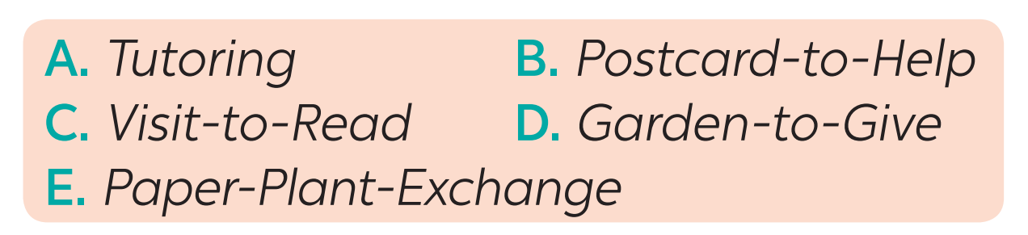
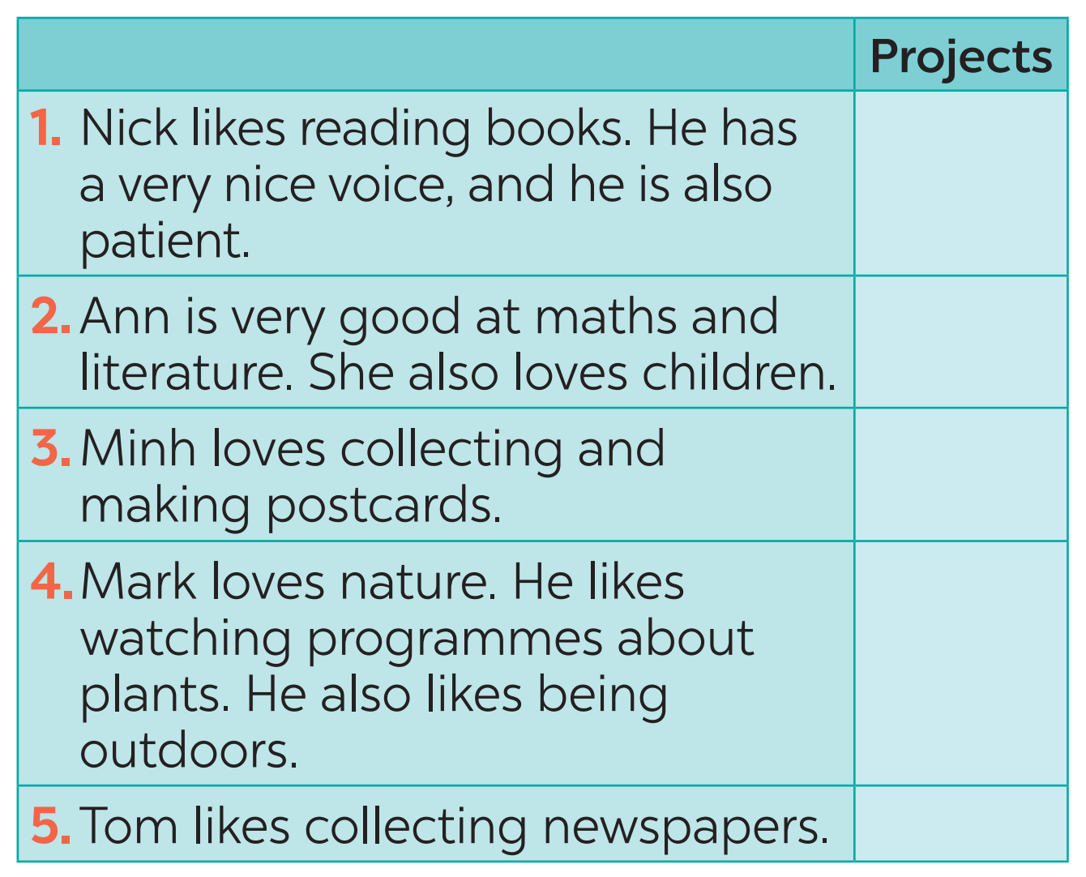
4
Visit –to Read
Tutoring
Postcard – to- help
Garden - to - Give
Paper-Plant-Exchange

Slide 18
Discuss which project each person would like to join and why.
Example:
T: Which project Nick would like to join?
S: He would like to join the
Visit – to -Read project.
T: Why?
S: Because he likes reading books.
He has a very nice voice,
and he is also patient
Visit –to Read
Tutoring
Postcard – to- help
Garden - to - Give
Paper-Plant-Exchange

Slide 19

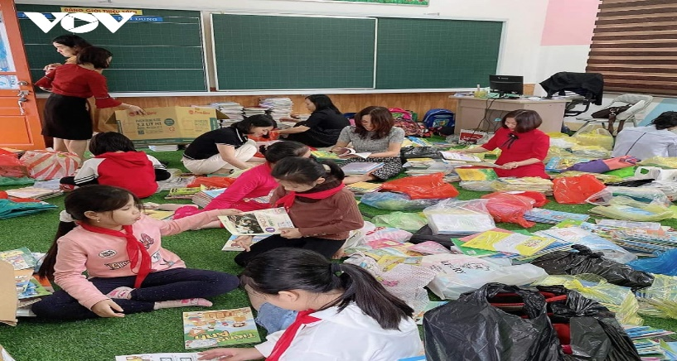
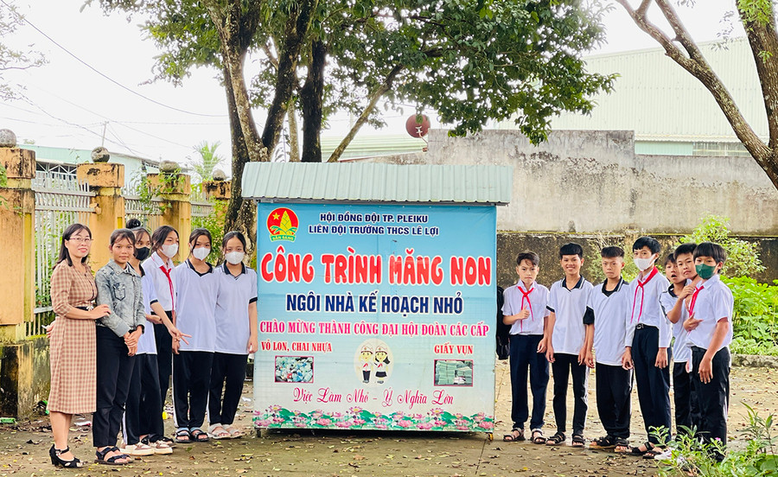
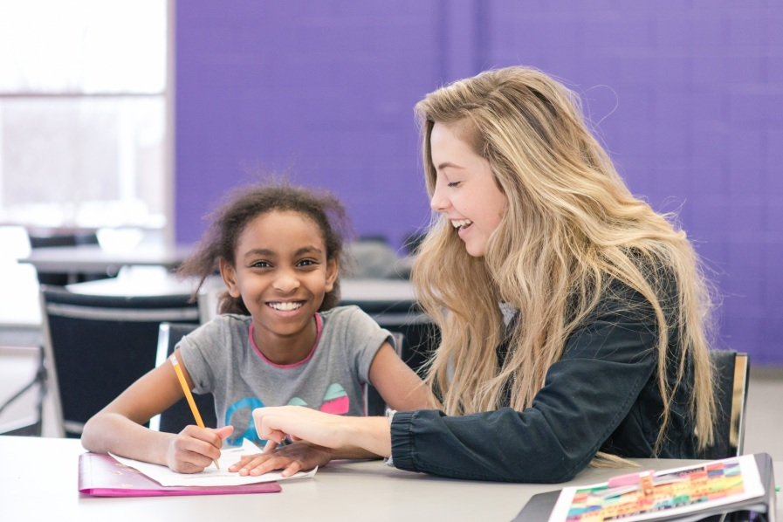
Give the names of these projects
3
Helping old people
Donating books for school library
Protecting the environment
Tutoring

Slide 20


Find suitable projects for the benefits
Benefits
A. making the elderly less lonely
B. Having more books to read
C. Making our school greener
D. helping children have a better future
Projects
Helping old people
Donating books for school library
Protecting the environment
Tutoring

Slide 21
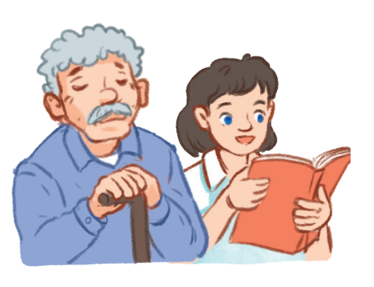
Work in pair: Which project you would like to join?
Why?
Example:
A : Which project you would like to join?
B: I will join the Visit-to-Read project
A: Why ?
B: Because I like reading books and help elderly people

Slide 22
A : Which project you would like to join?
B: I will join the donating books for school library
project
A: Why ?
B: Because I like reading books and I want to have more books to read

Slide 23
A : Which project you would like to join?
B: I will join the Planting trees project.
A: Why ?
B: Because I love nature very much and I also like planting trees and take care of them.

Slide 24
A : Which project you would like to join?
B: I will join Protecting the environment project
A: Why ?
B: Because I like making our school greener

Slide 25
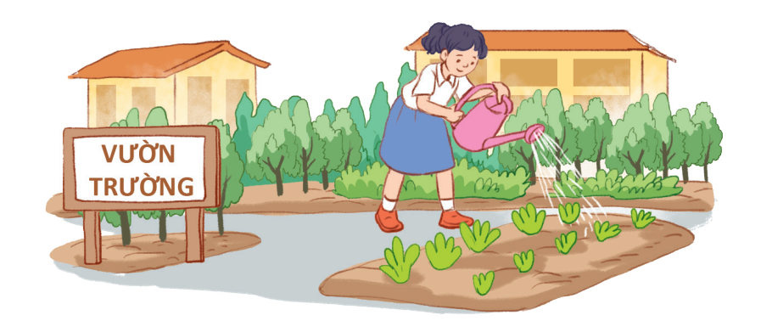
5. Report your group’s answers to the class.
Lan will join the Garden –to –Give project. Because she loves nature very much and she also likes making other people happy

Slide 26
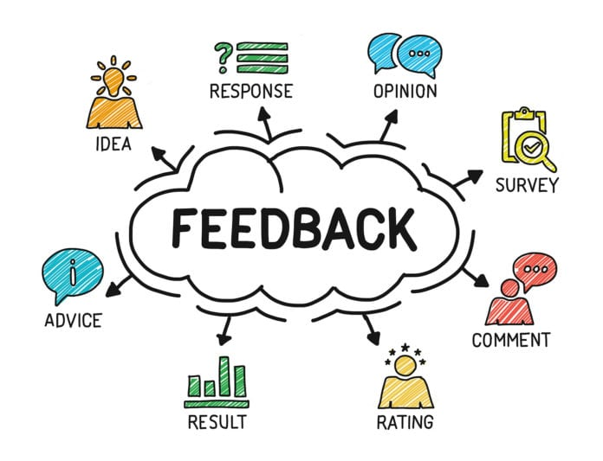
* POST-READING & SPEAKING
Let’s give comments for your friends and vote for the most interesting and informative presentation.

Slide 27
* CONSOLIDATION
1
Wrap-up
READING
SPEAKING
Projects in Bright Future School
What project you can do?

Slide 28


homework
Redo all the exercises.
Prepare SKILLS 2

Slide 29


Thank you!
Goodbye!

