Slide 1
6th October 2024
Welcome to our class- 8A!
Teacher: Do Thi Ngan – Ngoc My Secondary School

Slide 2
Game: Memory challenge
What can you see in the video?
Write the words for the pictures.

Slide 4
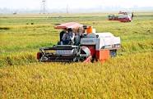
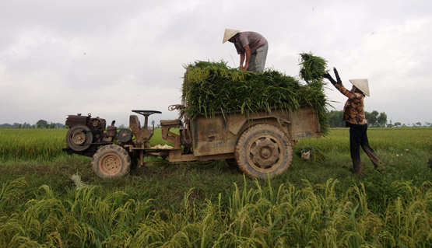
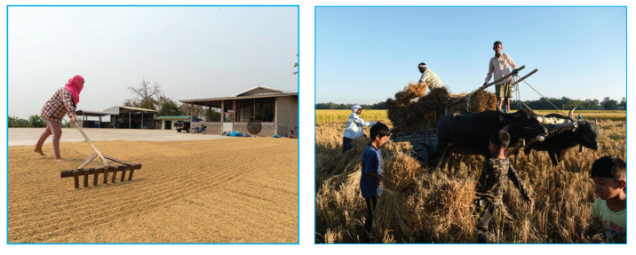
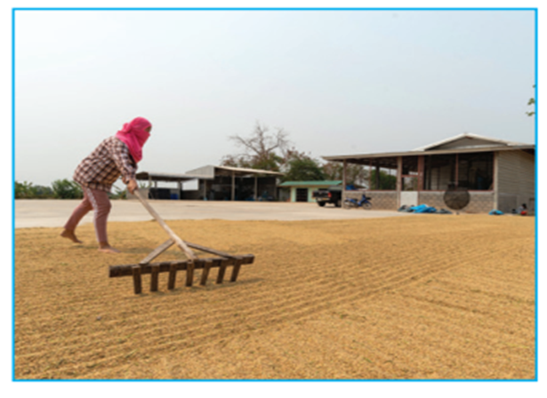
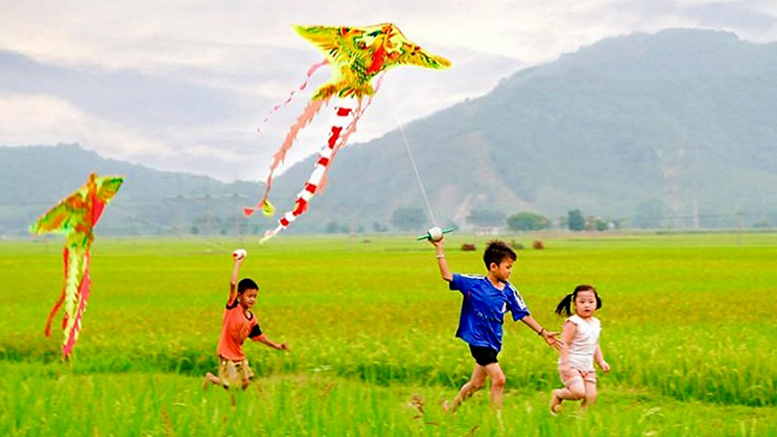
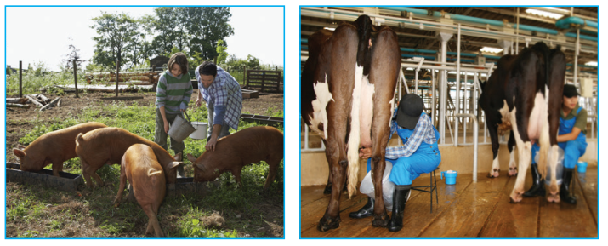
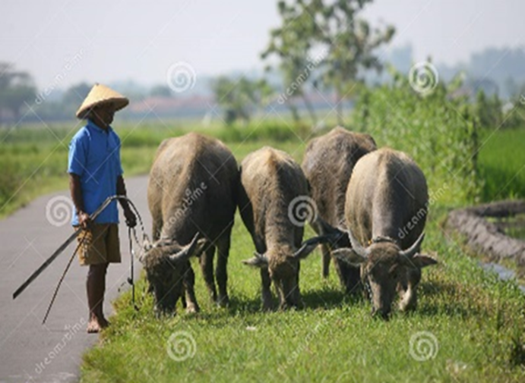
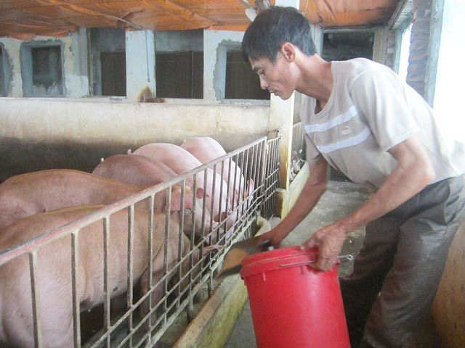
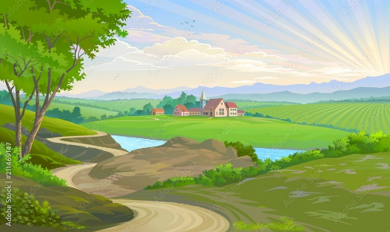
1
2
3
4
harvesting rice
loading rice
unloading rice
drying rice
5
7
8
6
flying kites
milking cows
ploughing fields
herding buffaloes
9
10
11
12
catching fish
feeding pigs
vast
picturesque

Slide 5
What are the pictures about ?
→ our new lesson

Slide 6
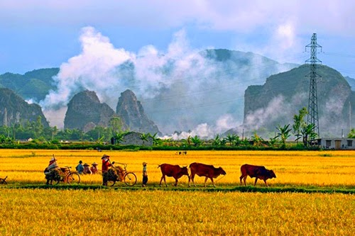
Unit
2
LIFE IN THE COUNTRYSIDE
Period 15: LESSON 7: LOOKING BACK & PROJECT

Slide 7
VOCABULARY
2
Choose the correct answer A, B, or C.
1. There is a huge cloud ______ as far as the eye can see. A. surrounded B. stretching C. vast
2. People in my village are really ______; they are always generous and friendly to visitors. A. well-trained B. funny C. hospitable

Slide 8
VOCABULARY
2
Choose the correct answer A, B, or C.
3. The development of cities destroys ______ areas of countryside. A. vast B. much C. stretching
4. The workers in our factory are very ______ because they took a lot of good training courses. A. hospitable B. kind C. well-trained
5. The area around the village is famous for its ______ landscape. A. picturesque B. boring C. dull

Slide 9
GRAMMAR
3
Complete the sentences with suitable comparative forms of the adverbs from the box.
1. Every morning nick gets up ten minutes (early) ______ than his sister.
2. I speak French (fluently) ____________ now than I did last year.
3. You’ll find your way around the village (easily) __________ if you have a good map.
4. It rained (heavily) ____________ today than it did yesterday.
5. If you work (hard) _________, you will do (well) ________ in your exam.
Game

Slide 10
LUCKY NUMBERS
1
2
3
4
5
6
7
8
BOYS
2
4
6
8
10
12
14
GIRLS
2
4
6
8
10
12
14

Slide 11
3
Complete the sentences with suitable comparative forms of the adverbs from the box.
1. Every morning nick gets up ten minutes (early) ______ than his sister.
earlier

Slide 12
3
Complete the sentences with suitable comparative forms of the adverbs from the box.
more fluently
2. I speak French (fluently) ______________ now than I did last year.

Slide 13
3
Complete the sentences with suitable comparative forms of the adverbs from the box.
3. You’ll find your way around the village (easily) ______________ if you have a good map.
more easily

Slide 14
3
Complete the sentences with suitable comparative forms of the adverbs from the box.
more heavily
4. It rained (heavily) _______________ today than it did yesterday.

Slide 15
3
Complete the sentences with suitable comparative forms of the adverbs from the box.
harder
better
5. If you work (hard) _________, you will do (well) ________ in your exam.

Slide 19
3
Complete the sentences with suitable comparative forms of the adverbs from the box.
earlier
1. Every morning nick gets up ten minutes (early) ______ than his sister.
2. I speak French (fluently) ______________ now than I did last year.
3. You’ll find your way around the village (easily) _____________ if you have a good map.
4. It rained (heavily) ________________ today than it did yesterday.
5. If you work (hard) _________, you will do (well) ________ in your exam.
more fluently
more easily
more heavily
harder
better

Slide 20
What structure have met in exercise 3?
comparative forms of the adverbs

Slide 21
GRAMMAR
4
Underline the mistakes in the sentences and correct them.
1. I run faster as my brother does.
2. People in the city seem to react quicklier to changes than those in the country.
→ than
→ more quickly

Slide 22
GRAMMAR
4
Underline the mistakes in the sentences and correct them.
3. We need to work more hardly, especially at exam time.
4. You must finish harvesting the rice the earlier this year than you did last year.
5. As they climbed more highly up the mountain, the air became cooler.
→ harder
→ earlier
→ higher

Slide 23
* PROJECT
- Show your group’s slides about a village that you would like to live in.
- Present your ideas to the class.

Slide 24
What have we learnt in Unit 2?
- words about life in the countryside
- the sounds /ə/ and /ɪ/ in words and sentences
- comparative forms of adverbs
- giving and responding to compliments

Slide 25
* Homework
Do exercises in the workbook.
Prepare unit 3

