Slide 1
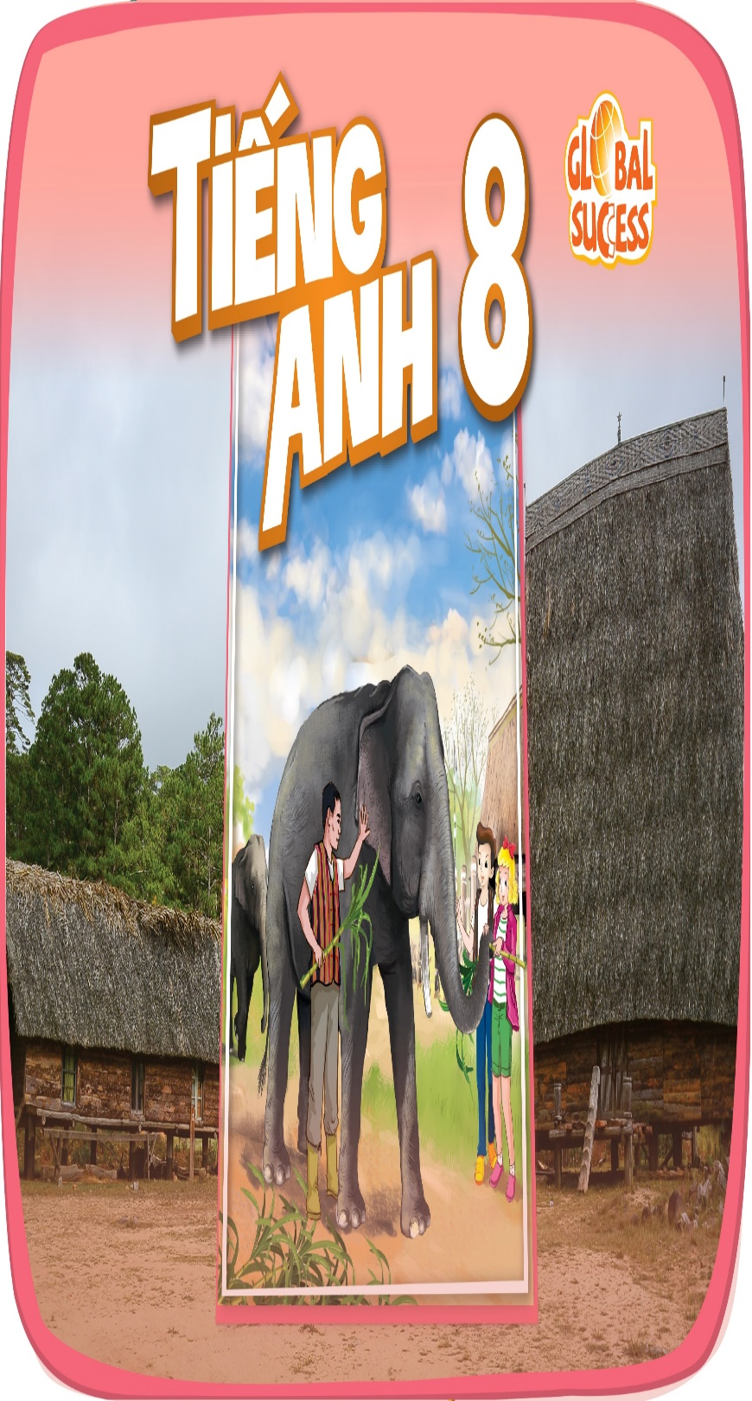
Welcome to class 8A!
Ngoc My Secondary School
Teacher: Do Thi Ngan

Slide 2
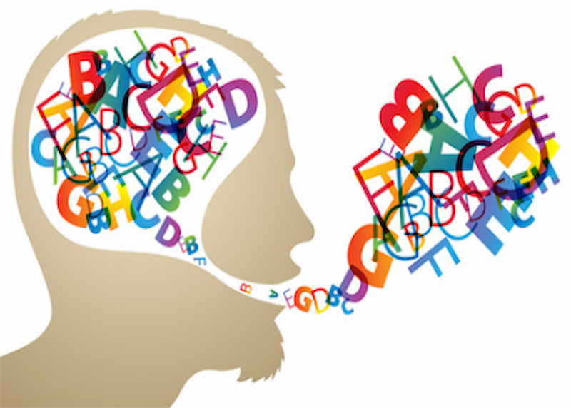
Unit
12
LIFE ON OTHER PLANETS
LESSON 5: SKILLS 1
1
Unit
READING
SPEAKING

Slide 3
WARM UP
1
Work in pairs. Discuss the following questions.
1. What do you know about other planets?
2. Would you like to live on another planet? Why / Why not?

Slide 4
PRESENTATION
liquid (n)
/ˈlɪk.wɪd/
chất lỏng

Slide 5
PRESENTATION
temperature (n)
/ˈtem.pɚ.ə.tʃɚ/
nhiệt độ

Slide 6
PRESENTATION
atmosphere (n)
: air
/ˈæt.mə.sfɪr/
không khí

Slide 7
PRESENTATION
gravity (n)
/ˈɡrævəti/
trọng lực, lực hút trái đất

Slide 8
PRESENTATION
habitable (adj)
: providing conditions that are good enough to live in or on
/ˈhæbɪtəbl/
có thể ở được, phù hợp để ở

Slide 9
PRESENTATION
promising (adj)
: signs that it is going to be successful or enjoyable.
/ˈprɒmɪsɪŋ/
đầy hứa hẹn, triển vọng

Slide 10
PRESENTATION
trace (n)
:a sign that something has happened or existed
/treɪs/
dấu hiệu, dấu vết, vết tích

Slide 11
PRESENTATION
New words | Pronunciation | Meaning
1. liquid (n) | /ˈlɪk.wɪd/ | chất lỏng
2 temperature (n) | /ˈtem.pɚ.ə.tʃɚ/ | nhiệt độ
3. atmosphere (n) | /ˈæt.mə.sfɪr/ | không khí
4. gravity (n) | /ˈɡrævəti/ | trọng lực, lực hút trái đất.
5. habitable (adj) | /ˈhæbɪtəbl/ | có thể ở được, phù hợp để ở.
6. promising (adj) | /ˈprɒmɪsɪŋ/ | đầy hứa hẹn, triển vọng
7. trace (n) | /treɪs/ | dấu hiệu, dấu vết, vết tích

Slide 12
2
Read the text and match the highlighted words in the text with their
meanings.
Nowadays humans are still wondering what planets in outer space might support life.
Scientists say planets need to meet three main conditions to support life. Firstly, they must have liquid water, so their temperature must not be too high or too low. Secondly, the planets need to have the correct amount of air so that they can hold an atmosphere around. Finally, their size is also important. If a planet is too small, its gravity is not strong enough to hold an enough amount of air. If it is too big, its gravity will be so strong that it will hold too much air.
Scientists are using space telescopes to find habitable planets. According to them, Mars is one of the most promising planets for life in our solar system. It is a planet like Earth. Its days last for 24.5 hours and its seasons are similar to Earth's. Although scientists have not found actual water on Mars, there seems to be traces of it on the planet's surface. However, the climate on Mars is unsuitable for human life because it is too cold and Mars lacks oxygen to support human life.

Slide 13
READING
2
Read the text and match the highlighted words in the text with their
meanings.
1. liquid | a. suitable for people to live in
2. gravity | b. marks, objects, or signs that show that somebody or something existed
3. habitable | c. in the form of a substance that flows freely and is not a solid or a gas
4.promising | d. the force that causes something to fall to the ground
5.traces | e. showing signs of being good or successful
1. c 2. d 3. a 4. e 5. b

Slide 14
READING
3
Read the text again and answer the following questions
1. What are humans still wondering nowadays?
2. Why does a habitable planet need to have the correct amount of air?
3. What happens if a planet is too small?
4. How long does a day on Mars last?
5. Why can we not live on Mars?
They are still wondering what planets in outer space might support life.
It needs to have the correct amount of air to hold an atmosphere around it.
Its gravity is not strong enough to hold an enough amount of air.
Its day lasts for 24.5 hours.
Because it is too cold and lacks oxygen.

Slide 15
SPEAKING
4
Work in pairs.Tick (√) the boxes to show what conditions a planet needs to support human life.
1. There must be enough liquid water on the planet.
2. The planet must have craters on its surface.
3. The planet must hold an atmosphere.
4. The planet must have at least two moons.
5. The planet must have enough oxygen in the air.

Slide 16
SPEAKING
4
Can you add other conditions for a habitable planet?
Some ideas:
– The planet must experience at least two seasons.
– The planet's temperature of the planet must be suitable for humans to live on it.
– There must be enough sources of energy on the planet.
– The planet must be a comfortable distance away from a star.
– The planet must rotate on its axis and revolve.
– The planet must hold an atmosphere.
– The stars around the planet must be stable.
– The planet must have carbon that is found in all living things.

Slide 17
SPEAKING
5
Work in groups. Take turns to talk about the conditions you think are required for a planet to support human life. Use the information in and your own ideas.
4
Example: There are some conditions planets must have to support human life on them. First, the most important
condition is that ...

Slide 18
SPEAKING
5
Work in groups. Take turns to talk about the conditions you think are required for a planet to support human life. Use the information in and your own ideas.
4
Example:
There are some conditions planets must have to support human life on them. First, the most important
condition is that there must be enough liquid water on the planet. Second, the planet must hold an atmosphere. And the planet must have enough oxygen in the air for people to survive...

Slide 19
CONSOLIDATION
1
Wrap-up
What have we learnt in this lesson?
Read for specific information about the possibility of life on other planets.
Talk about the conditions needed for planets to support human life.

Slide 20
CONSOLIDATION
2
Homework
Do exercise in workbook

Slide 21
Website: hoclieu.vn
Fanpage: facebook.com/sachmem.vn/

