Slide 2


Unit
3
HEALTHY LIVING FOR TEENS
Period 21: LESSON 6: SKILLS 2
1

Slide 3
LESSON 2: SKILLS 2
LESSON 1: GETTING STARTED
WARM-UP
Unscrambled words
Vocabulary
Task 1: Work in pairs. Discuss the following question.
Task 2: You will hear Trang, Phong, and Tom talking about how to manage their time effectively. For each student (1 – 3), choose the opinion (A – C) each of them expresses.
Task 3: Listen again and choose the correct answer A, B, or C.
LISTENING
Task 4: Match the time management tips in column a with the explanations and / or reasons in column B.
Task 5: Write a paragraph (about 100 words) about how to manage your time effectively. Use the tips in 4 or your own ideas.
WRITING
CONSOLIDATION
Wrap-up
Homework

Slide 4

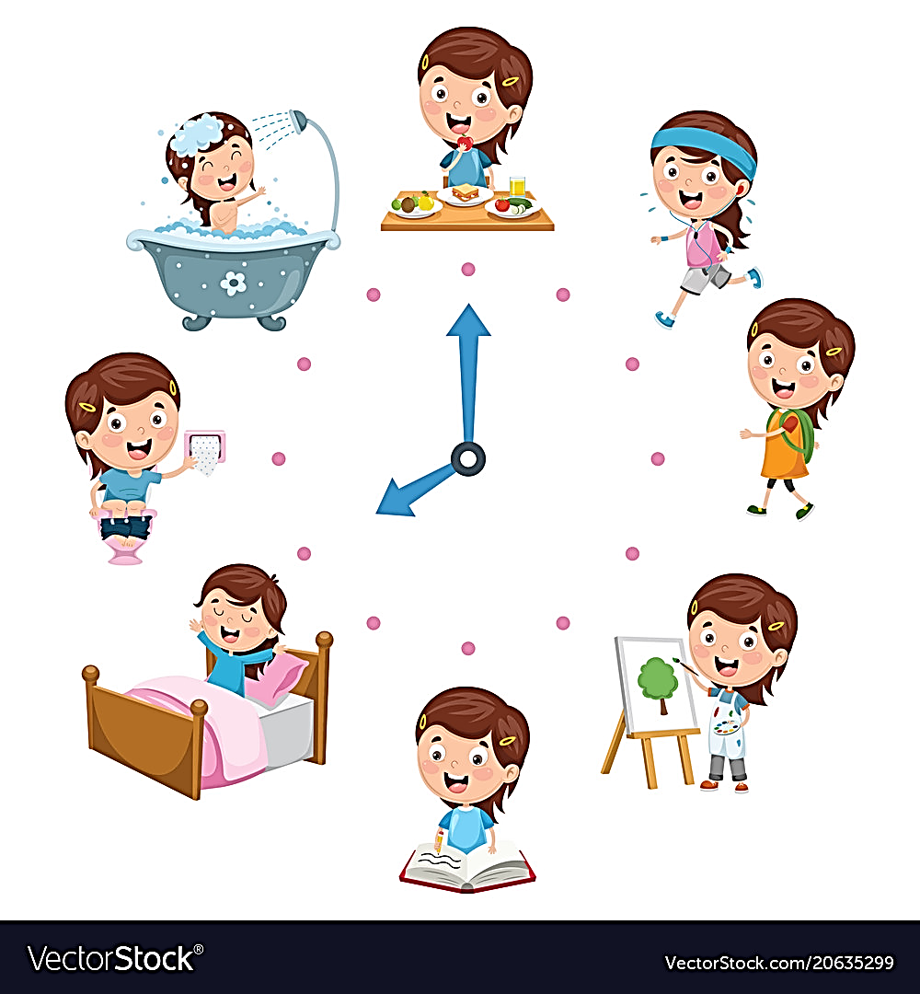

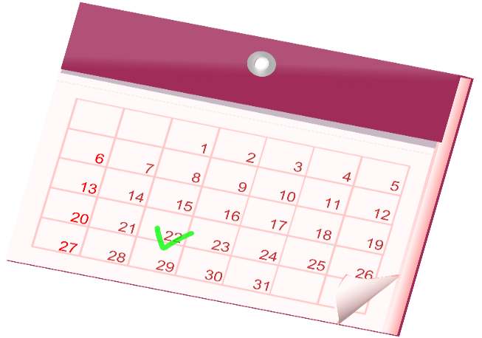
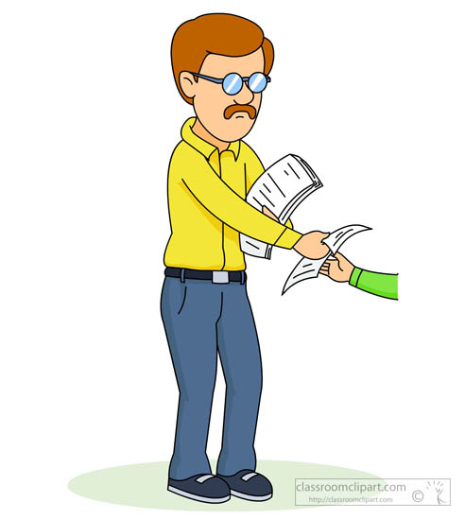
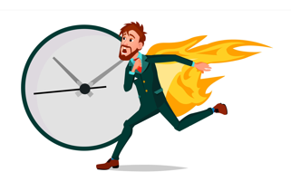

UNSCRAMBLED WORDS
COWKROSHOL
RTNUOIE
LCEADANR
UIMBTS
EIALNEDD
MIMSIINE

Slide 5
UNSCRAMBLED WORDS
SCHOOLWORK
ROUTINE
CALENDAR
SUBMIT
DEADLINE
MINIMISE

Slide 6


LISTENING
schoolwork (n)
/ˈskuːlwɜːk/
việc học tập
Notes:
studying done by a child at school or at home

Slide 7
LISTENING
routine (n)
/ruːˈtiːn/
việc thường làm (hằng ngày)
Notes:
a usual or fixed way of doing things:

Slide 8
LISTENING
submit (v)
/səbˈmɪt/
nộp, đệ trình
Notes:
to give or offer something for a decision to be made by others

Slide 9

LISTENING
minimise (v)
/ˈmɪnɪmaɪz/
giảm đến mức tối thiểu
Notes:
to reduce something to the least possible level or amount:

Slide 10
LISTENING
New words | Pronunciation | Meaning
1. schoolwork (n) | /ˈskuːlwɜːk/ | việc học tập
2. routine (n) | /ruːˈtiːn/ | việc thường làm (hằng ngày)
3. submit (v) | /səbˈmɪt/ | nộp, đệ trình
4. minimise (v) | /ˈmɪnɪmaɪz/ | giảm đến mức tối thiểu

Slide 11



LISTENING
1
Work in pairs. Discuss the following question.
How do you make time for study and other activities?

Slide 12
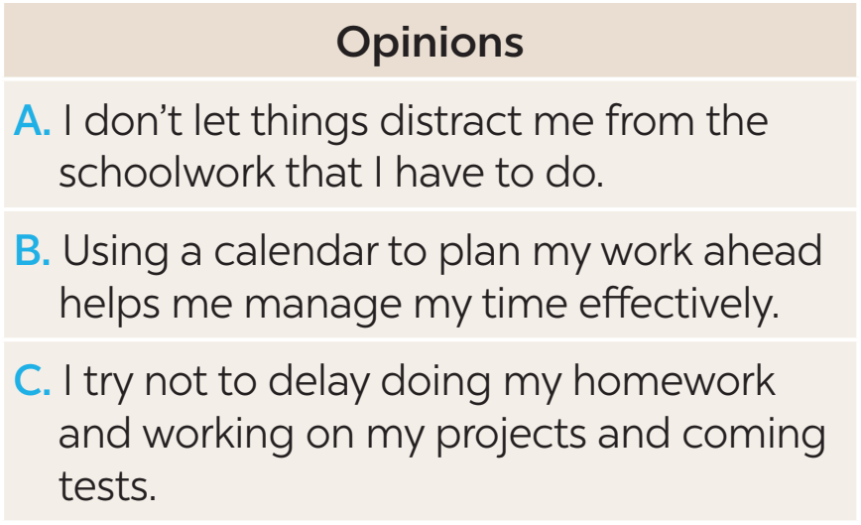
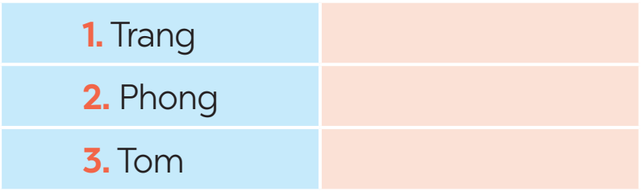
LISTENING
2
You will hear Trang, Phong, and Tom talking about how to manage their time effectively. For each student (1 – 3), choose the opinion (A – C) each of them expresses.
B
A
C
Notes:
Trang: B, Phong: A, Tom: C.

Slide 13
LISTENING
3
Listen again and choose the correct answer A, B, or C.
1. Trang enters what she has to do into a ______ at the beginning of each term.
Poster B. routine C. calendar
2. Trang often uses ______ colours to mark project due dates and exam times on her calendar.
Different B. the same C. similar
Notes:
1. C 2. A 3. A 4. A 5. B

Slide 14

LISTENING
3
Listen again and choose the correct answer A, B, or C.
3. Phong turns off his cell phone and signs out of social media ______ when he starts his work.
Accounts B. networks C. websites
4. Tom tries not to ______ homework until just before the due date.
Leave B. complete C. submit
5. Tom ______ his projects and coming tests and adds them to his schedule.
Prepares B. reviews C. revises
Notes:
1. C 2. A 3. A 4. A 5. B

Slide 15
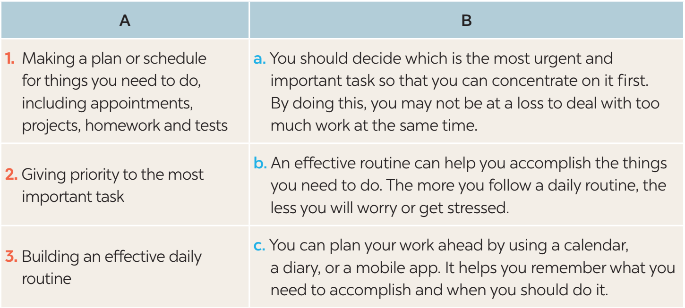
WRITING
4
Match the time management tips in column A with the explanations and / or reasons in column B.
Notes:
Key: 1. c 2. a 3. b

Slide 16
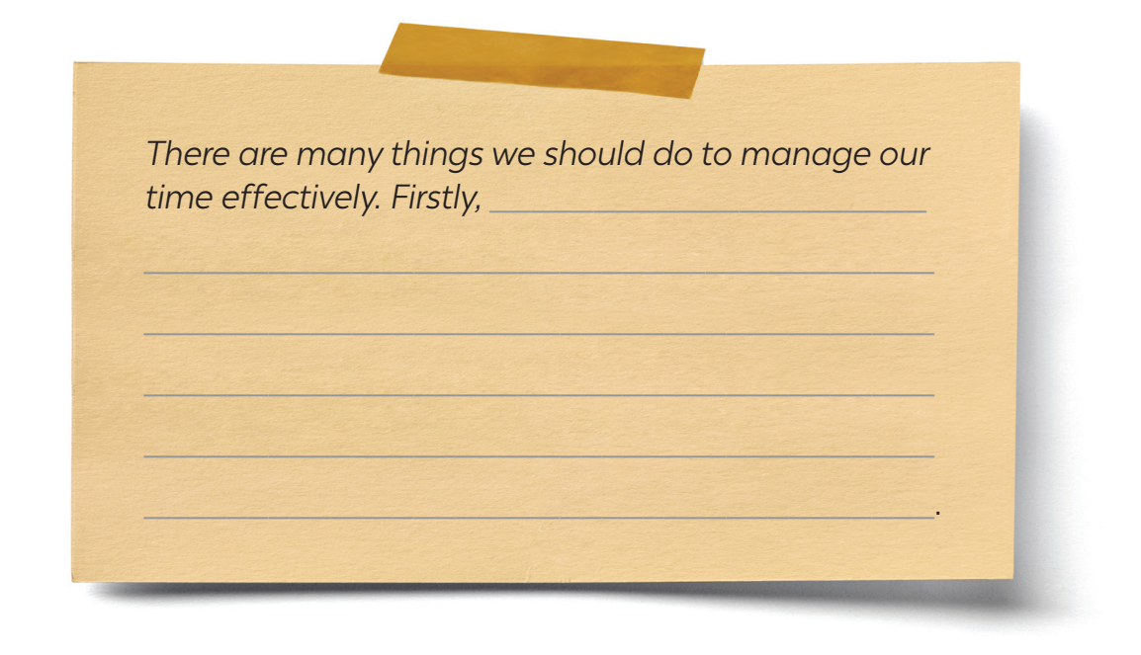
WRITING
5
Write a paragraph (about 100 words) about how to manage your time effectively. Use the tips in 4 or your own ideas.
Notes:
Key: 1. c 2. a 3. b

Slide 17
WRITING
5
Write a paragraph (about 100 words) about how to manage your time effectively. Use the tips in 4 or your own ideas.
Suggested answer:
There are many things we should do to manage our time effectively. Firstly, we should set specific goals and priority them according to their importance level. This will help us keep focused on our most important tasks and avoid wasting time on tasks that do not contribute to our goals. Secondly, creating a schedule or to-do list can help us manage our time efficiently by breaking down our day into manageable chunks. We should also be realistic about how long each task will take and build in extra time for unexpected interruptions or delays. Thirdly, it is essential to eliminate distractions and time-wasting activities, such as social media or unnecessary meetings, which can reduce our productivity. By following these tips, you we can effectively manage your time and achieve success in all aspects of your life.
Notes:
Key: 1. c 2. a 3. b

Slide 18

CONSOLIDATION
1
Wrap-up
What have we learnt in this lesson?
Listening skill for specific information.
Writing a paragraph about how to manage their time effectively, using the given tips or their own ideas.

Slide 19

CONSOLIDATION
2
Homework
Do exercises in the workbook.

Slide 20
Website: hoclieu.vn
Fanpage: facebook.com/www.tienganhglobalsuccess.vn/

