Slide 1


Slide 2
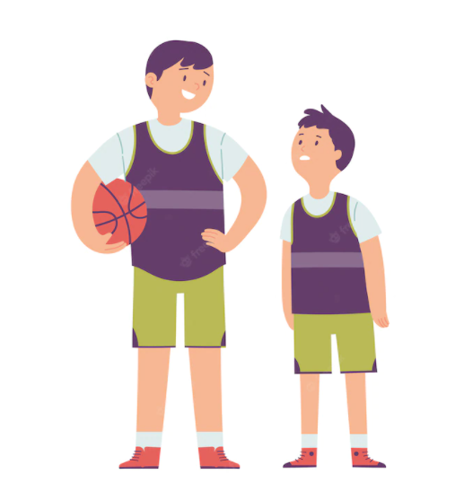
WARM-UP
TUẤN
tall
short
NAM
ADJECTIVES
big
small

Slide 3

OBSERVE THE FOLLOWING OBJECTS AND STATE HOW DO YOU DESCRIBE?
WHO’S FASTER?
Rules
- Look at two pictures. Then using comparative adjectives to describe them.
- Each correct answer will be worth 10 points.

Slide 4


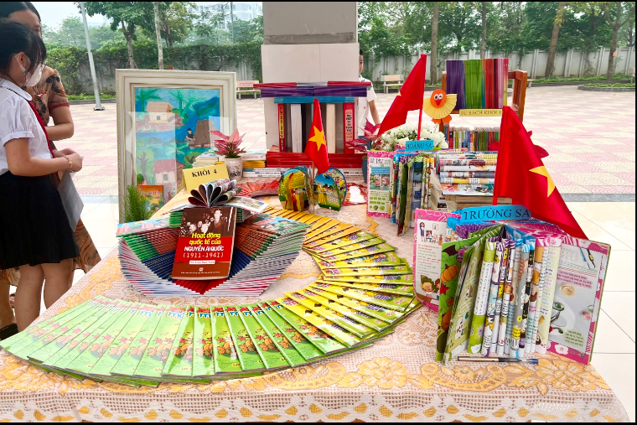
A
B
Picture A is ___________ Picture B

Slide 5

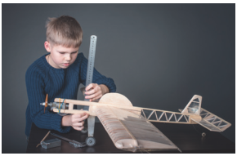

Nam
Hai
making models
building dollhouses
Hai’s hobby is ___________ Nam’s hobby

Slide 6

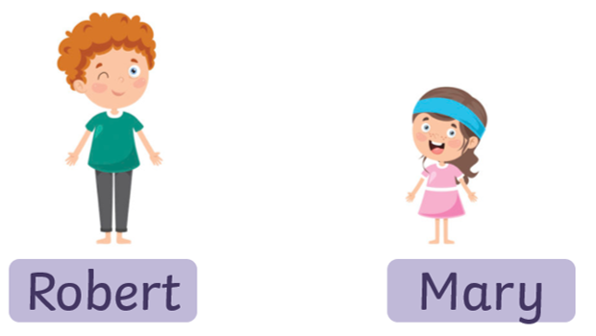

→ Robert’s pencil case is ________ Mary’s pencil case.

Slide 7
COMPARISONS
short
tall
like
ADJECTIVES
as
as
big
different from
small

Slide 8

Period 29
UNIT 4: MUSIC AND ARTS
Lesson 3: A closer look 2

Slide 9

OBJECTIVES
By the end of the lesson, students will be able to know how to recognize and write comparisons with “like, different from, (not) as … as”

Slide 10

LESSON 3: A CLOSER LOOK 2
WARM-UP
Brainstorming
PRESENTATION
Comparisons
Task 1: Write like, as, or different in the gaps.
Task 2: Finish the second sentence in each pair.
Task 3: Compare the two museums.
Task 4: Rewrite the sentences.
PRACTICE
PRODUCTION
Task 5: Discuss and write a simple sentence from the two given sentences.
CONSOLIDATION
Wrap-up
Homework

Slide 11

I. GRAMMAR:
COMPARISONS
(to) be + (not) as + adj + as
(to) be+ (not so) + adj + as
(to) be like/ the same as
(to) be different from

Slide 12
II. PRACTICE
1
Write like, as, or different in the gaps.
This camera is not as expensive ________ I thought at first.
Her room is lovely. It is ________ a princess’s room.
You like folk songs; I like pop music. Your taste is __________ from mine.
My dad is not always as busy ________ my mum.
Some of us think that Spiderman 2 is not too __________ from Spiderman 1.
as
like
different
as
different

Slide 13
PRACTICE
Finish the second sentence in each pair, using like, as … as, or different from.
2
1. Rock is very exciting. It is not like country music.
Rock is very ________________ country music.
2. Composer Hoang Long wrote many good songs for children. Composer Pham Tuyen also wrote many good songs for children. → Composer Hoang Long, ___________ Pham Tuyen, wrote many good songs for children.
3. The Vatican Museum has excellent works of art. The Louvre Museum has excellent works of art too
The Vatican Museum ‘s works of arts are __________ excellent _________ the Louvre Museum’s works of art.
4. A vacation on the beach is relaxing, while a vacation in a big city may not be.
→ A vacation on the beach is ______________ a vacation in a big city
5. City life is busy, but country life is peaceful.
→ City life is not ____________ peaceful ___________ country life.

Slide 14


- Smurf participates in an obstacle course to get home. For each obstacle, he must complete the second sentence based on the first sentence and the initial clues. Are you ready to help him?
rules
- Divide the class into 2 teams:
Team 1 and Team 2
- Each correct answer will score 10 points for each team and Smurf will overcome 1 obstacle. If you cannot answer, you can ask the organizer and Smurf will also overcome the obstacle. However, the teams do not score any points. The game ends when Smurf reaches home. The team with more points will wins.

Slide 15



Overcoming obstacles
BEGINNING

Slide 16

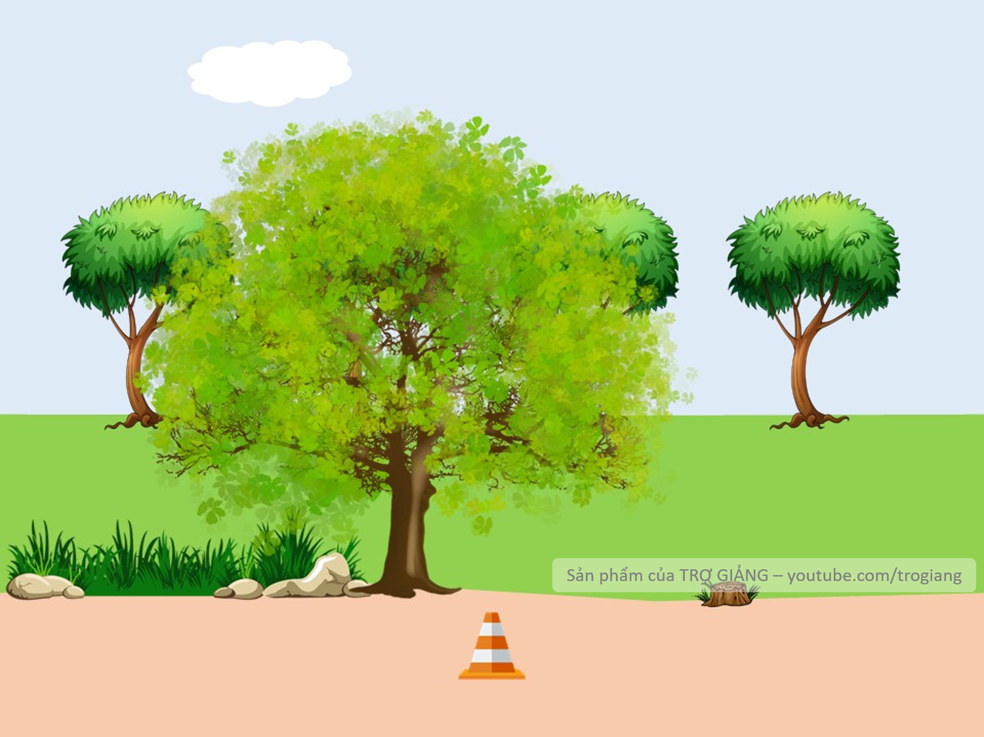



1. Rock is very exciting. It is not like country music.
Rock is very _______________country music.
different from
Rock is very different from country music.
Can I help you?

Slide 17
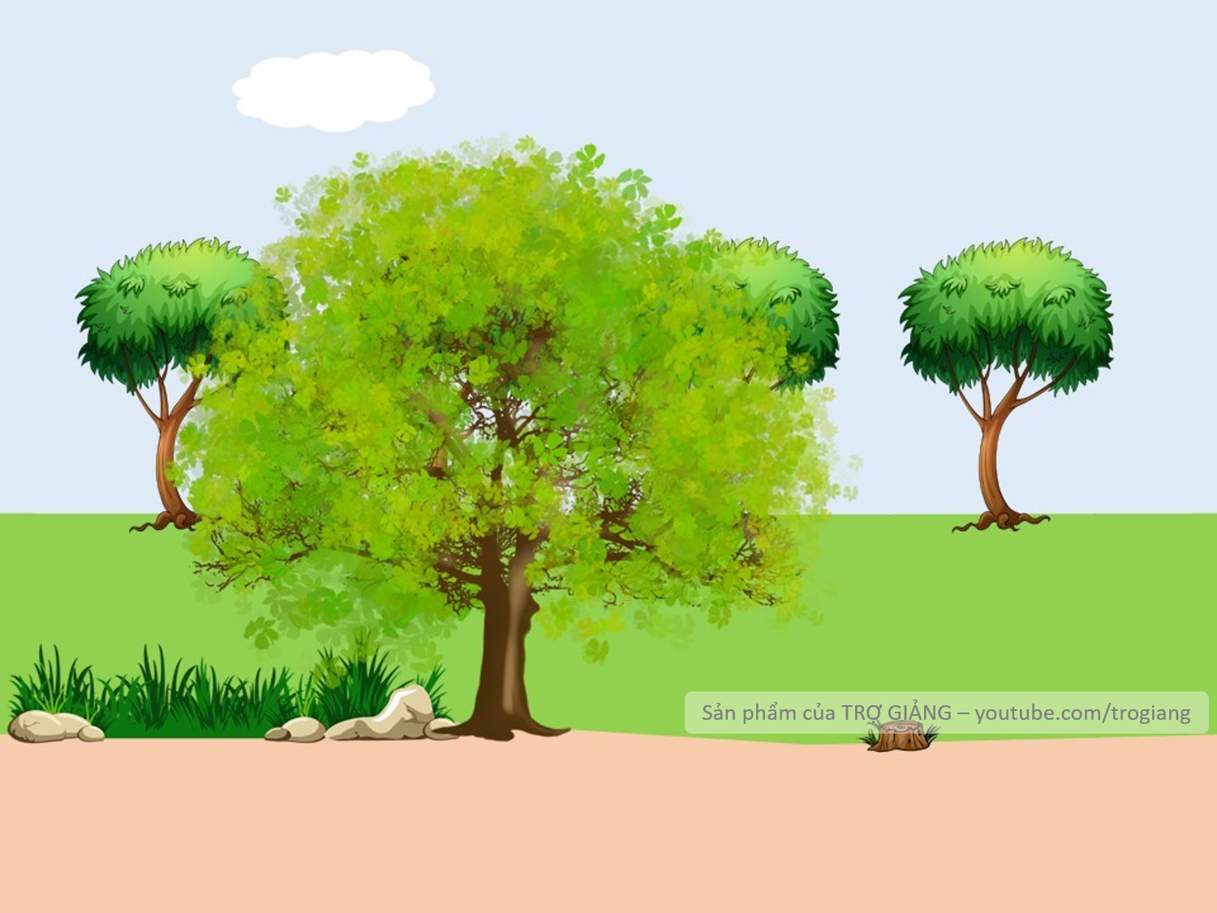



2. Composer Hoang Long wrote many good songs for children. Composer Pham Tuyen also wrote many good songs for children.
→ Composer Hoang Long, ______Pham Tuyen, wrote many good songs for children.
like
→ Composer Hoang Long, like Pham Tuyen, wrote many good songs for children.
Can I help you?

Slide 18


3. The Vatican Museum has excellent works of art. The Louvre Museum has excellent works of art too.
→ The Vatican Museum ‘s works of arts are _____ excellent _____ the Louvre Museum’s works of art.
as
as
The Vatican Museum ‘s works of arts are as excellent as the Louvre Museum’s works of art.
Can I help you?

Slide 19
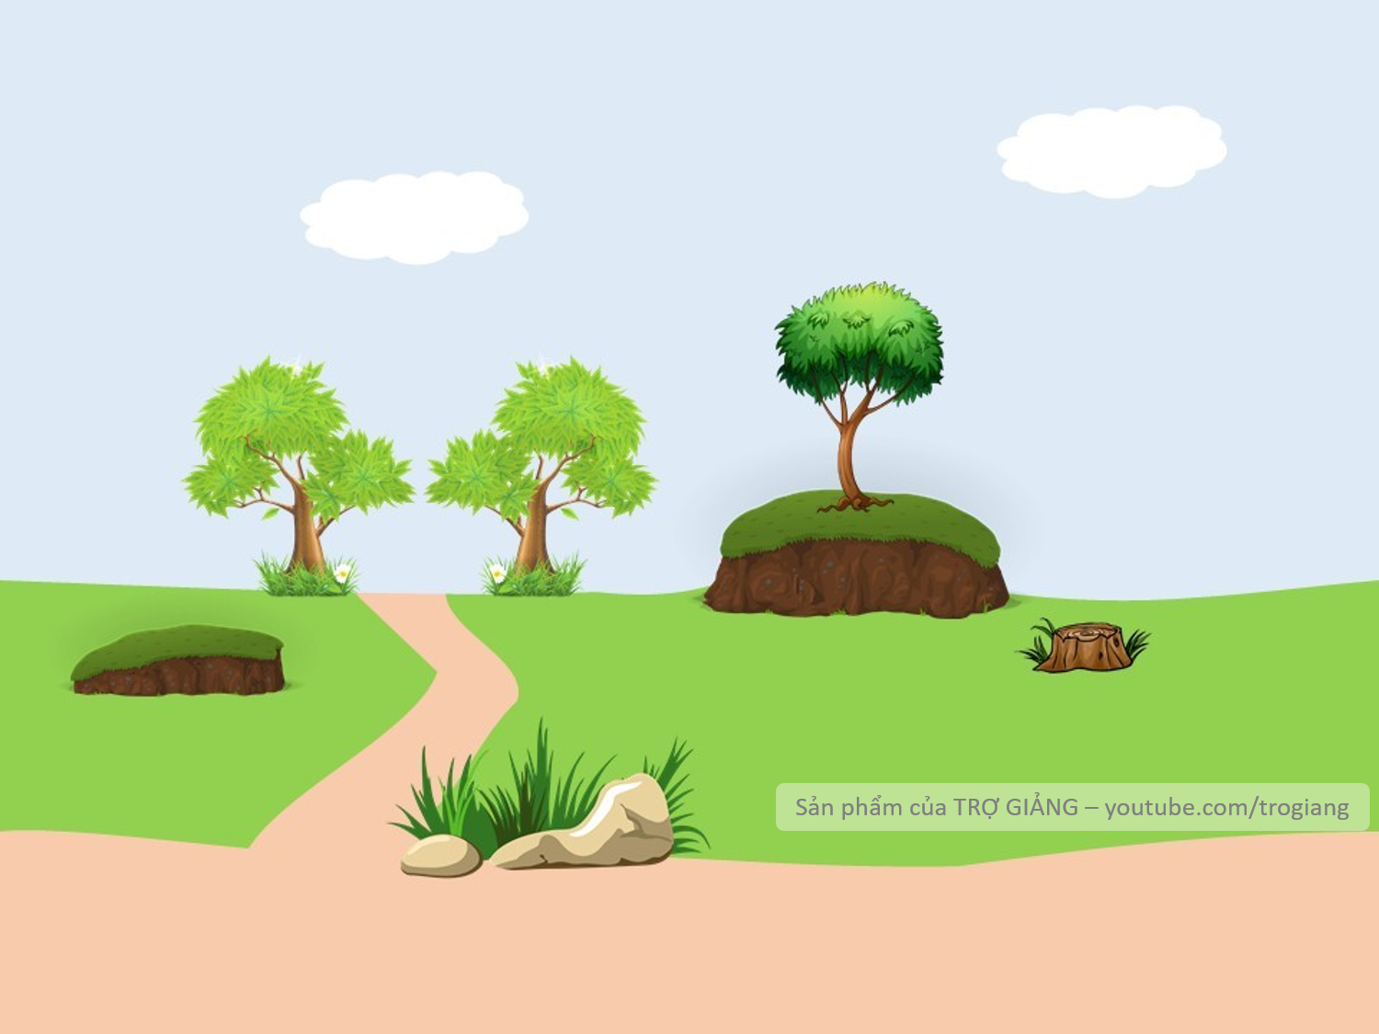
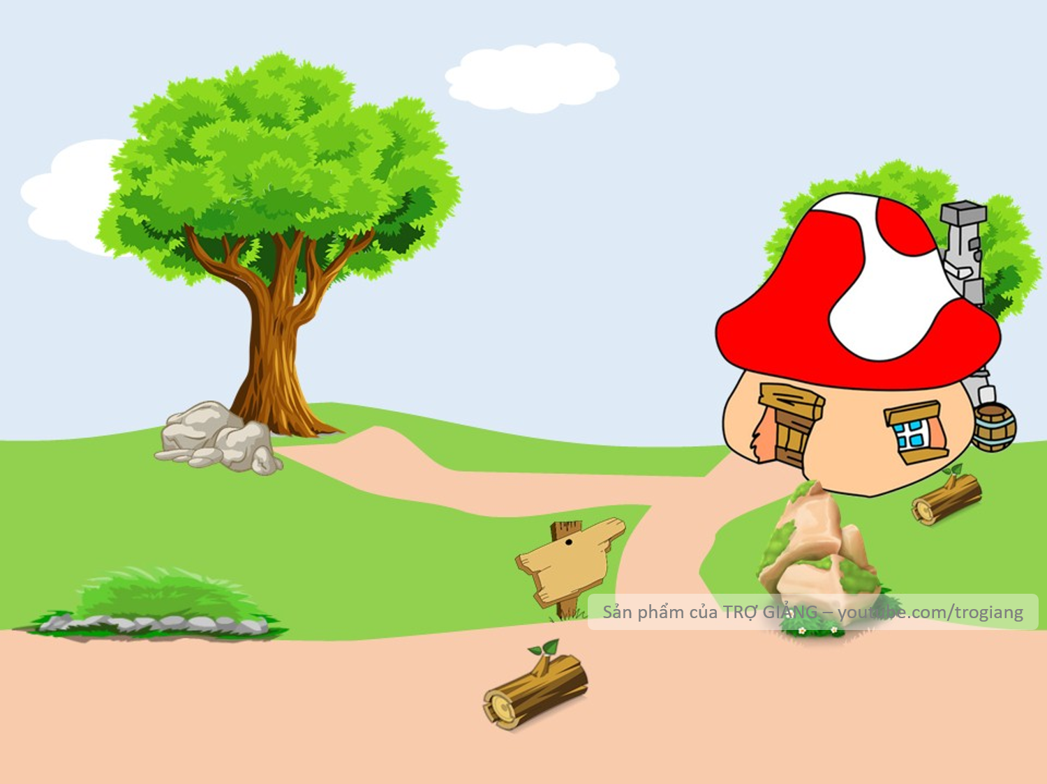

4. A vacation on the beach is relaxing, while a vacation in a big city may not be.
→ A vacation on the beach is ___________ a vacation in a big city.
different from
A vacation on the beach is different from a vacation in a big city
Can I help you?

Slide 20
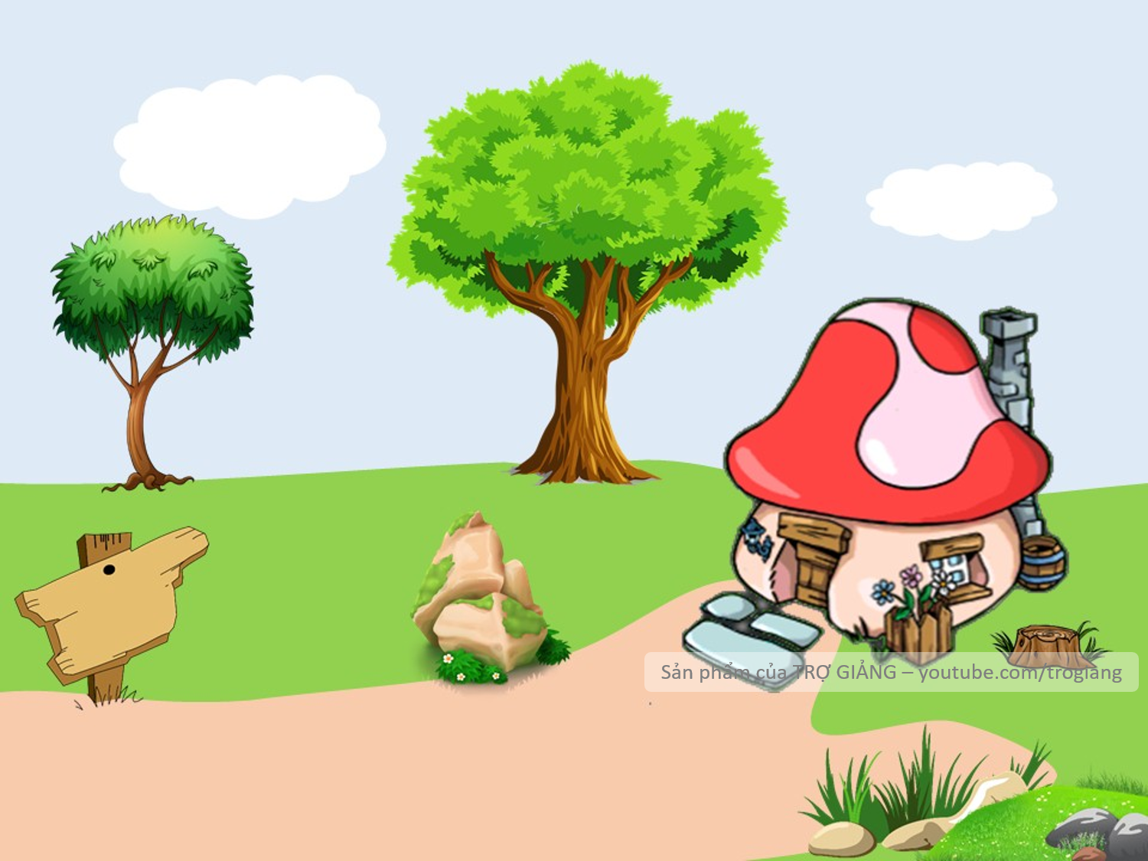




5. City life is busy, but country life is peaceful.
→ City life is not ___ peaceful ____country life.
as
as
Welcome home Smurf!
→ City life is not as peaceful as country life.
Can I help you?

Slide 21
PRACTICE
2
Finish the second sentence in each pair, using like, as … as, or different from.
1. Rock is very exciting. It is not like country music.
Rock is very ________________ country music.
2. Composer Hoang Long wrote many good songs for children. Composer Pham Tuyen also wrote many good songs for children. → Composer Hoang Long, ___________ Pham Tuyen, wrote many good songs for children.
3. The Vatican Museum has excellent works of art. The Louvre Museum has excellent works of art too.
→ The Vatican Museum ‘s works of arts are __________ excellent _________ the Louvre Museum’s works of art.
different from
like
as
as

Slide 22
PRACTICE
2
Finish the second sentence in each pair, using like, as … as, or different from.
4. A vacation on the beach is relaxing, while a vacation in a big city may not be.
→ A vacation on the beach is ______________ a vacation in a big city
5. City life is busy, but country life is peaceful.
→ City life is not ____________ peaceful ___________ country life.
different from
as
as

Slide 23


PRACTICE
3
Compare the two museums: History and Science, using like, as … as, or different from.
 | History | Science
1. modern | ** | ***
2. friendly | *** | ***
3. safe | *** | **
4.expensive | ** | **
History museum is not as modern as science museum.
History museum is not like science museum.
History museum is different from science museum.

Slide 24
PRACTICE
4
Rewrite the sentences, using the words given at the beginning.
1. I think action films are more interesting than comedies.
I think comedies are not ________________________________.
2. Our maths homework is more difficult than out history homework. → Our history homework is not ______________________________.
3. This year’s music contest is different from last year’s.
→ This year’s music contest is not ______________________________.
4. The characters in the film are not the same as the ones in the play.
The characters in the film are ________________________________.
5. This picture is brighter than that picture.
→ That picture is not ________________________________.
as/so interesting as action films
as/ so difficult as our maths homework
like last year’s
different from the ones in the play
as/so bright as this one

Slide 25

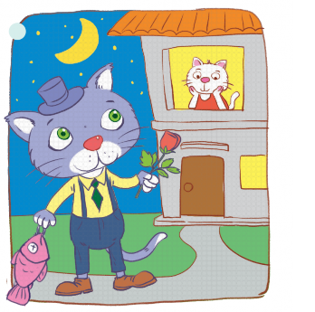
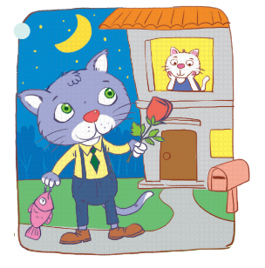
III. PRODUCTION
5
Look at the two pictures and compare them, using like, as … as, or different from.
Picture A is not as big as picture B
Suggestion:
Picture A is not like picture B
Picture A is different from picture B
B
A

Slide 26
IV. CONSOLIDATION
1
Grammar:
WRAP-UP
(not) as/ so … as
Comparisons:
like
different from

Slide 27

CONSOLIDATION
2
HOMEWORK
Do exercises in the workbook.
Prepare for the next lesson.
Unit 4: Communication

Slide 28

Website: hoclieu.vn
Fanpage: facebook.com/www.tienganhglobalsuccess.vn/

