Slide 1
Hoa Thach secondary school
ENGLISH 8
Welcome to our class
Teacher : Nguyen Thi Le Yen
2/17/2025 8:09:25 PM

Slide 2
WARM-UP
1. I always take a bath before I go to bed.
2. Will you wait here until I am ready?
3. I was not at home when he came to see me.
4. Do not disturb me when I am busy with my work.
5. As soon as she finished that project, she started working on the next.
6. After I have finished my work, I will accompany you to the park.
ADVERB CLAUSES OF TIME

Slide 3
Unit
7
ENVIRONMENTAL PROTECTION
PERIOD 57
LESSON 3: A CLOSER LOOK 2 2
1

Slide 4
LESSON 3: A CLOSER LOOK 2
WARM-UP
Asking questions
PRESENTATION
Introduction of complex sentences with adverb clauses of time
Task 1: Read the sentences and write I.C if the underlined clause is an independent clause or D.C if it is a dependent clause.
Task 2: Choose A, B, or C to complete each sentence.
Task 3. Match the clauses in the two columns to form complex sentences.
Task 4: Combine each pair of sentences, using the conjunction in brackets.
PRACTICE
PRODUCTION
Task 5: Matching game.
CONSOLIDATION
Wrap-up
Homework

Slide 5
PRESENTATION
Complex sentences with adverb clauses of time
– A complex sentence contains one independent clause and at least one dependent clause.
Example:
The roads were slippery when it rained.
independent clause
dependent clause
– An adverb clause is a dependent clause.
– An adverb clause of time shows when something happens. It is usually introduced by time connectors: before, after, when, while, till / until, as soon as, …

Slide 6
PRESENTATION
1
Read the sentences and write I.C if the underlined clause is an independent clause or D.C if it is a dependent clause
Example :
You must be careful when you cross the street
D.C
I.C
1. I’ll wait for you here until you get back.
2. Make sure you lock the door when you go out.
3. You must get a permit before you build a campfire at a national park. 4.Don’t use too much water while you are having a shower.
5. As soon as my friends come, we will pick up rubbish on the beach.
D.C
I.C
D.C
.
D.C

Slide 7
PRACTICE
2
Choose A, B, or C to complete each sentence.
1. I was not at home ______ he came to see me yesterday. A. when B. until C. as soon as
2. We called the forest guard unit ______ we saw the bush fire. A. as soon as B. while C. until
3. I went straight to the gym ______ I left home. A. while B. before C. after
4. You can stay with us ______ you find a suitable place to stay. A. as soon as B. before C. until
5. We cleaned up everything at the campsite ______ we left. A. until B. before C. while

Slide 8
PRACTICE
3
Match the clauses in the two columns to form complex sentences.

Slide 9
PRACTICE
4
Combine each pair of sentences, using the conjunction in brackets.
1. I arrive at the station. I will call you right after. (as soon as)
2. Many Vietnamese women wear conical hats. They work in the field. (when)
3. My father taught me how to use the computer. Then he bought one for me. (before)
4. Nick is reading a novel. Jack is reading a cartoon. (while)
5. The tornado hit. There were only a few houses left standing.
(after)

Slide 10
PRACTICE
4
Combine each pair of sentences, using the conjunction in brackets.
1. I arrive at the station. I will call you right after. (as soon as)
2. Many Vietnamese women wear conical hats. They work in the field. (when)
-> I will call you as soon as I arrive at the station.
->Many Vietnamese women wear conical hats when they work in the field.
3. My father taught me how to use the computer. Then he bought one for me. (before)
->My father taught me how to use the computer before he bought one for me.

Slide 11
PRACTICE
4
Combine each pair of sentences, using the conjunction in brackets.
4. Nick is reading a novel. Jack is reading a cartoon. (while)
- Nick is reading a novel while Jack is reading a cartoon.
5. The tornado hit. There were only a few houses left standing. (after)
-After the tornado hit, there were only a few houses left standing.

Slide 12
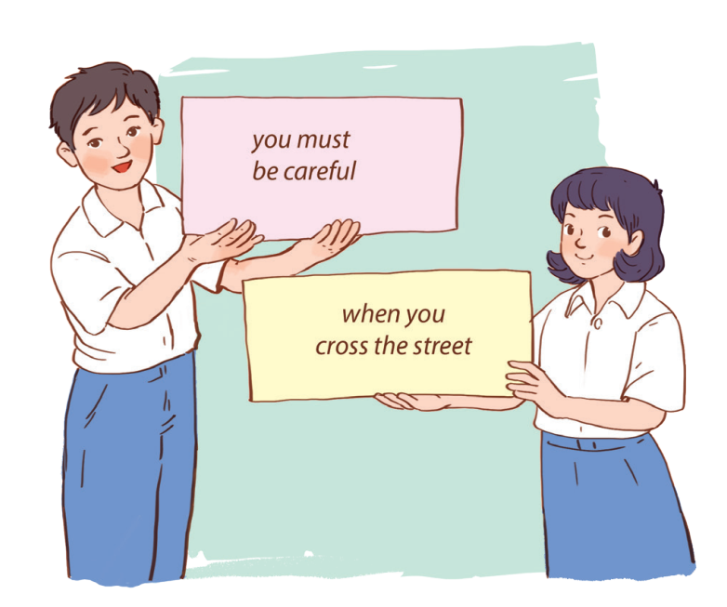
PRODUCTION
Work in groups.
5
Each group writes two complex sentences

Slide 13
CONSOLIDATION
1
Wrap-up
What have we learnt in this lesson?
use the Complex sentences with adverb clauses of time;

Slide 14
CONSOLIDATION
2
Homework
-Redo all execises
-Do more exercises in the workbook.

Slide 15
Website: hoclieu.vn
Fanpage: facebook.com/www.tienganhglobalsuccess.vn/

Slide 16
PRESENTATION
1
Read the sentences and write I.C if the underlined clause is an independent clause or D.C if it is a dependent clause
I.C
1. I’ll wait for you here until you get back.
2. Make sure you lock the door when you go out.
3. You must get a permit before you build a campfire at a national park.
D.C
I.C

