Slide 1


Slide 2



Review
3
LESSON 2: SKILLS
Speaking
Writing
Reading
Listening
Unit

Slide 3

OBJECTIVES
By the end of the lesson, students will be able to:
- practise reading for specific information about traffic rules, a film review and an unusual festival;
- practise asking and answering about the topic of traffic
- practise listening for specific information about watching films
- practise writing a paragraph about means of transport

Slide 4
LESSON 2: SKILLS
WARM-UP
Chatting
Task 1: Read the passage. Match the headings in the box with the paragraphs.
Task 2: Read the passage again and answer the questions.
READING
SPEAKING
Task 3: Interview your group members. Take notes of their answers and report to the class.
LISTENING
Task 4: Listen to Trang talking about watching films with her family. Fill in each blank with ONE word.
WRITING
Task 5: Write a paragraph of about 70 words about your favourite means of transport. You may use the following questions as cues.
CONSOLIDATION
Wrap-up
Homework

Slide 5
LESSON 2: SKILLS
WARM-UP
Chatting
Aims of the stage:
To increase students’ interest and lead them into the lesson.

Slide 6

WARM-UP
LIST THE FESTIVALS IN UNIT 9

Slide 7

LESSON 2: SKILLS
WARM-UP
Chatting
Task 1: Read the passage. Match the headings in the box with the paragraphs.
Task 2: Read the passage again and answer the questions.
READING

Slide 8
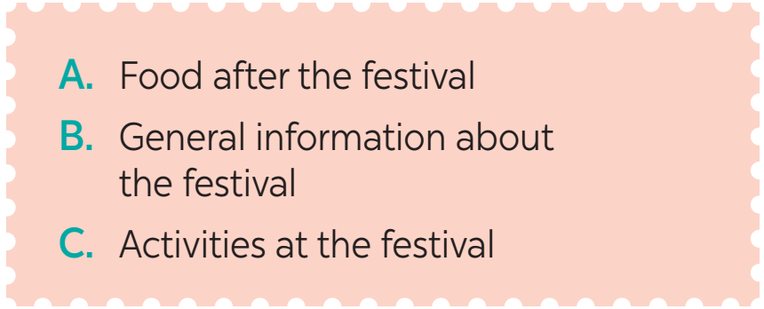
READING
1
Read the passage. Match the headings in the box with the paragraphs.
B
1.______
La Tomatina is an unusual festival. It’s a fun fight with tomatoes. People hold it in Buñol, Spain on the last Wednesday of every August.
C
2. ______
In the town square, there is a high pole with a ham on top of it. People climb the pole and get the ham. At 11 a.m., a jet of water shoots from the water cannons, and people start throwing tomatoes. People throw bags of tomatoes at the crowd. They then throw tomatoes at one another. After one hour, there is another jet of water, and people stop throwing. The whole square now is red with rivers of tomato juice.
A
3. ______
After the fight, many people go to restaurants to try paella. It is a traditional Spanish rice dish. It has rice, chicken, seafood, and herbs.

Slide 9
READING
2
Read the passage again and answer the questions.
1. When and where do people hold La Tomatina?
_________________________________________________________
2. What is on the top of the pole?
_________________________________________________________
3. What signals the start and end of the festival?
_________________________________________________________
4. How long is the fight?
_________________________________________________________
5. What is paella?
_________________________________________________________
People hold it in Buñol, Spain on the last Wednesday of every August.
There is a ham.
A jet of water from the water cannons.
It’s one hour.
It’s a traditional Spanish rice dish.

Slide 10
LESSON 2: SKILLS
WARM-UP
Chatting
Task 1: Read the passage. Match the headings in the box with the paragraphs.
Task 2: Read the passage again and answer the questions.
READING
SPEAKING
Task 3: Interview your group members. Take notes of their answers and report to the class.

Slide 11
SPEAKING
3
Interview your group members. Take notes of their answers and report to the class.
Questions | S1 | S2 | S3
1. How far is it from your house to your school?
2. How do you go to school?
3. What is good about walking?
4. What is good about public transport?
Aim of the task:
To help students practise asking about Traffic

Slide 12
LESSON 2: SKILLS
WARM-UP
Chatting
Task 1: Read the passage. Match the headings in the box with the paragraphs.
Task 2: Read the passage again and answer the questions.
READING
SPEAKING
Task 3: Interview your group members. Take notes of their answers and report to the class.
LISTENING
Task 4: Listen to Trang talking about watching films with her family. Fill in each blank with ONE word.

Slide 13
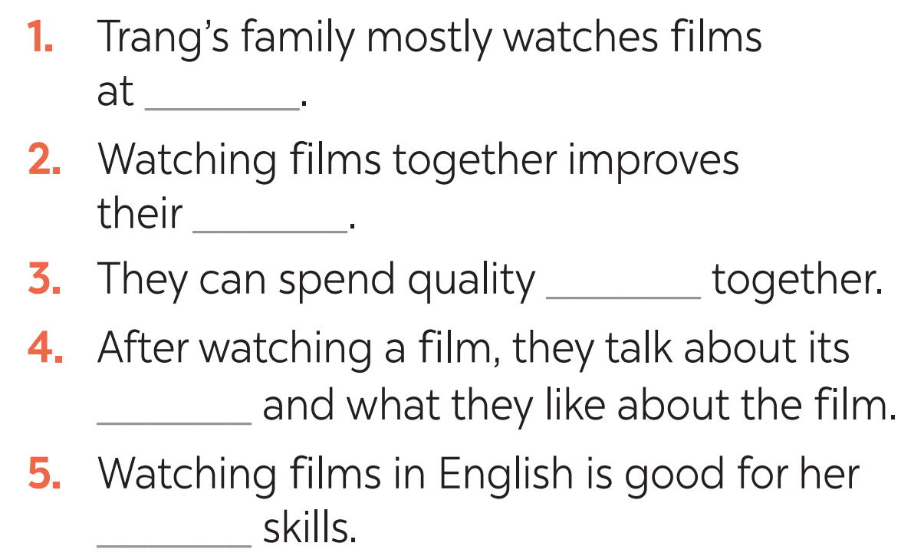

LISTENING
Listen to Trang talking about watching films with her family. Fill in each blank with ONE word.
4
home
Aim of the task:
To help students practise listening for specific information (gap-filling).
relationship
time
lessons
language

Slide 14
LESSON 2: SKILLS
WARM-UP
Chatting
Task 1: Read the passage. Match the headings in the box with the paragraphs.
Task 2: Read the passage again and answer the questions.
READING
SPEAKING
Task 3: Interview your group members. Take notes of their answers and report to the class.
LISTENING
Task 4: Listen to Trang talking about watching films with her family. Fill in each blank with ONE word.
WRITING
Task 5: Write a paragraph of about 70 words about your favourite means of transport. You may use the following questions as cues.

Slide 15
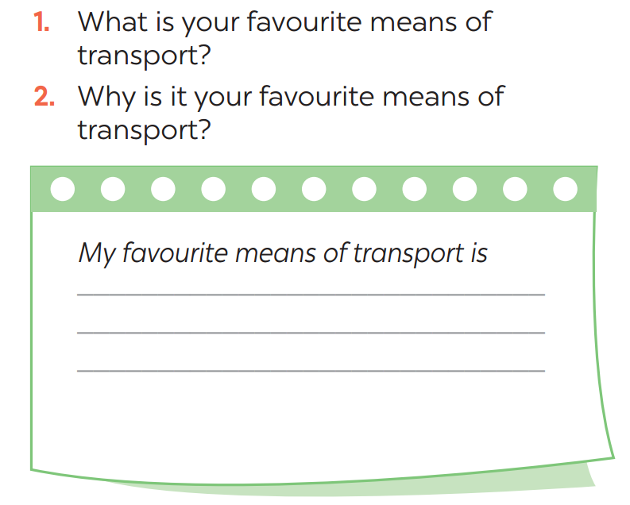
WRITING
5
Write a paragraph of about 70 words about your favourite means of transport. You may use the following questions as cues.

Slide 16
LESSON 2: SKILLS
WARM-UP
Chatting
Task 1: Read the passage. Match the headings in the box with the paragraphs.
Task 2: Read the passage again and answer the questions.
READING
SPEAKING
Task 3: Interview your group members. Take notes of their answers and report to the class.
LISTENING
Task 4: Listen to Trang talking about watching films with her family. Fill in each blank with ONE word.
WRITING
Task 5: Write a paragraph of about 70 words about your favourite means of transport. You may use the following questions as cues.
CONSOLIDATION
Wrap-up
Homework

Slide 17
CONSOLIDATION
1
WRAP-UP
Speaking
Writing
Reading
Listening

Slide 18

CONSOLIDATION
2
HOMEWORK
Prepare for the next lesson: Unit 10 – Getting started
Do Test yourself 3 in workbook

Slide 19

Website: sachmem.vn
Fanpage: facebook.com/sachmem.vn/

