Slide 1
Thursday , March 21st 2024 Unit 10: Our houses in the future Lesson 2: A closer look 1

Slide 2
I.Vocabulary.
wireless(adj) : không dây
Washing machine(n): máy giặt
Electric cooker (n): bếp điện
dishwasher(n) : máy rửa bát
housework(n) : công việc nhà
Electric fan(n : quạt điện
Smart clock (n): đồng hồ thông minh

Slide 3
Listen and repeat the words / phrases in the box. Then put them in the appropriate columns. You may use some more than once.
electric cooker
fridge
dishwasher
electric fan
washing machine
computer
wireless TV
smart clock
living room | bedroom | kitchen
wireless TV
wireless TV
electric cooker
electric fan
smart clock
fridge
smart clock
computer
dishwasher
computer
washing machine

Slide 4
Match the appliances in A with what they can help us to do in B.
A
1. electric cooker
2. dishwasher
3. fridge
4. washing machine
5. computer
B
B
c. cook rice
d. wash and dry dishes
b. keep food fresh
e. wash and dry clothes
a. receive and send emails
a. receive and send emails
b. keep food fresh
c. cook rice
d. wash and dry dishes
e. wash and dry clothes

Slide 5
Work in pairs. Ask and answer questions about appliances, using the information in 2.
Example:
A: What can an electric cooker help us to do?
B: It can help us to cook rice.

Slide 6
II. Pronunciation
Stress in two-syllable words
(Trọng âm của từ có 2 âm tiết)

Slide 7
Listen and repeat the words.
‘picture
‘robot
‘bedroom
‘kitchen
‘housework
‘palace
‘village
‘mountains
- Thông thường danh từ 2 âm tiết trọng âm rơi vào âm 1

Slide 8
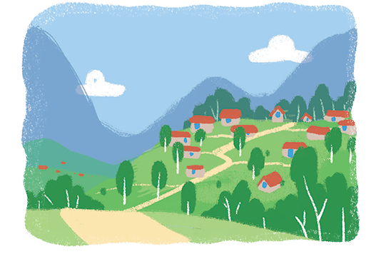
Listen and repeat the sentences. Pay attention to the stress of the underlined words.
1.
The picture is on the wall of the bedroom.
2.
The robot helps me to do the housework.
3.
There’s a very big kitchen in the palace.
4.
Their village is in the mountains.

