Slide 1
Monday , March 18th 2024 Unit 10: Our houses in the future Lesson 1: Getting started

Slide 2
I.Vocabulary.
Appliance(n) : thiết bị
UFO= unidentified flying object(n): đĩa bay
Solar energy(n): năng lượng mặt trời
Ocean(n) : đại dương
Location(n) : địa điểm

Slide 3
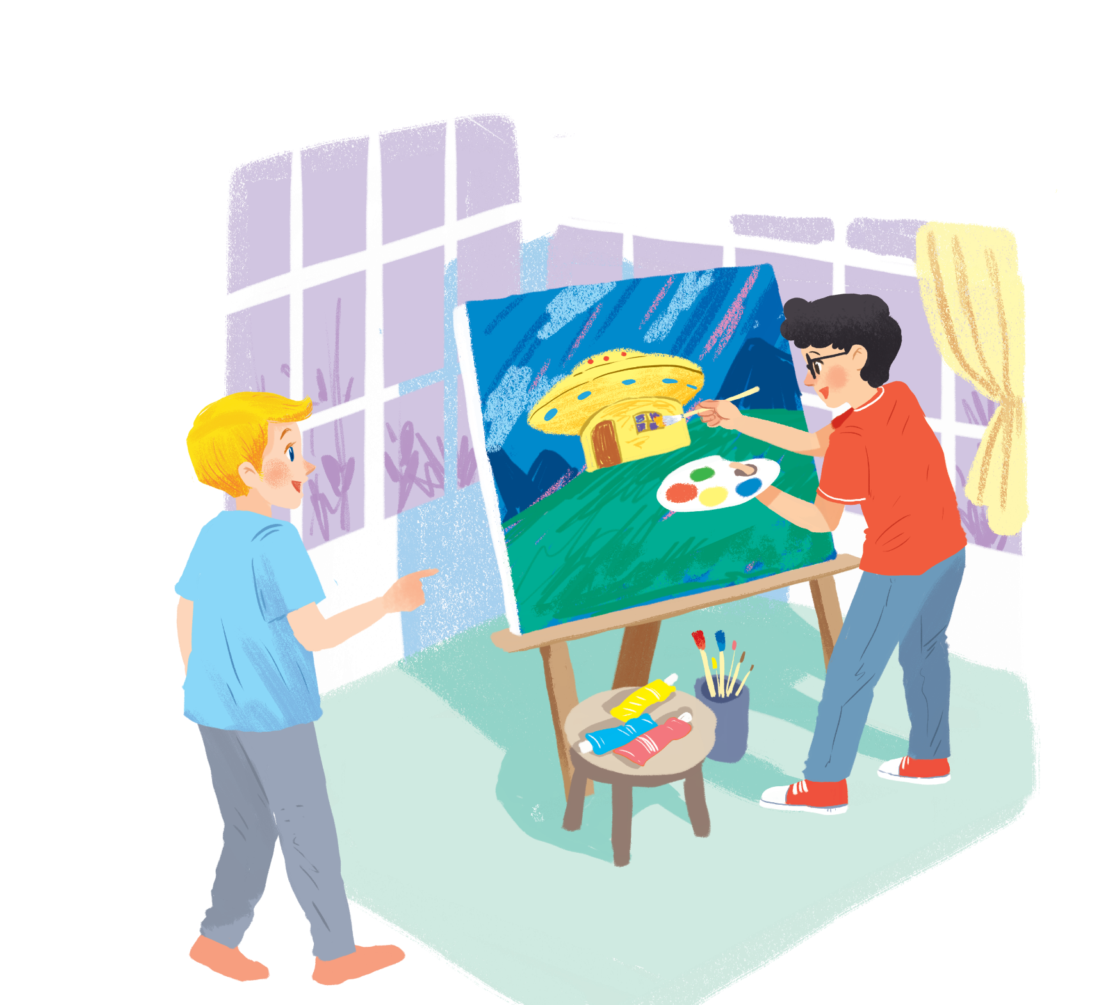
Listen and read.
My future house

Slide 4
My future house
Nick: What are you doing, Phong?
Phong: I’m painting a picture of my house.
Nick: Your house! That’s a UFO.
Phong: It looks like a UFO but it’s my house in the future.
Nick: Where will it be?
Phong: It’ll be in the mountains.
Nick: What will it be like?
Phong: It’ll be a large house. It’ll have twenty rooms.
Nick: Twenty rooms!
Phong: Yes, and it’ll have solar energy.
Nick: Fantastic! Which room will you like best?
Phong: My bedroom, of course.
Nick: What appliances might the house have?
Phong: My house might have some smart TVs and ten robots.
Nick: Sounds great! And how much will ...

Slide 5
Read the conversation again. Find and write down the words or phrases that show:
Type of house
Location
Appliances in the house
UFO
in the mountains
some smart TVs and ten robots

Slide 6
My future house
Nick: What are you doing, Phong?
Phong: I’m painting a picture of my house.
Nick: Your house! That’s a UFO.
Phong: It looks like a UFO but it’s my house in the future.
Nick: Where will it be?
Phong: It’ll be in the mountains.
Nick: What will it be like?
Phong: It’ll be a large house. It’ll have twenty rooms.
Nick: Twenty rooms!
Phong: Yes, and it’ll have solar energy.
Nick: Fantastic! Which room will you like best?
Phong: My bedroom, of course.
Nick: What appliances might the house have?
Phong: My house might have some smart TVs and ten robots.
Nick: Sounds great! And how much will ...

Slide 7
Read the conversation again. Tick () T (True) or F (False).
 | T | F
1. Phong’s house will be in the mountains.
2. His house will be large.
3. There’ll be a lot of rooms in his house.
4. He might have a smart TV and five robots.





Slide 8
Order the words to make a phrase about a place.
Each group has one extra word.
1.
sea / a / in / the
5.
countryside / a / the / in
in the sea
in the countryside
2.
on / in / the / city
6.
Moon / in / the / on
in the city
on the Moon
3.
the / in / at / town
7.
in / at / the / sky
in the town
in the sky
4.
the / on / in / mountains
in the mountains

Slide 9
In groups, describe to your classmates what you can see outside the window of your future house. Your group tries to guess where your house is.
Example:
A: Outside my window I can see the beach and the water. Where’s my house?
B: It’s in the sea.
A: Correct!

