Slide 1
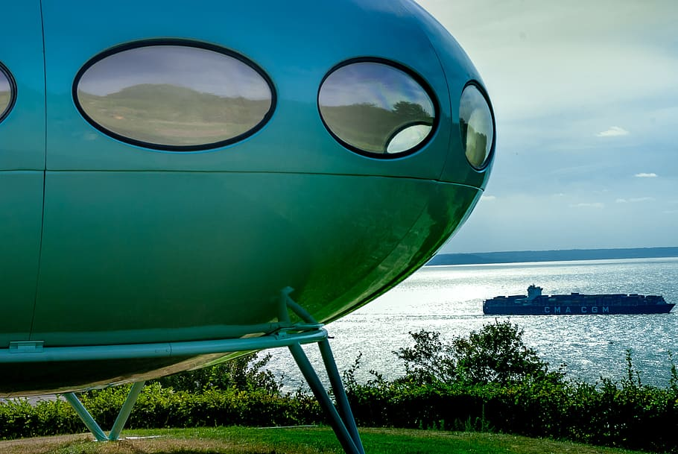
1
2
3
Can You Guess the Picture?
4
5
6
7
8
9

Slide 2
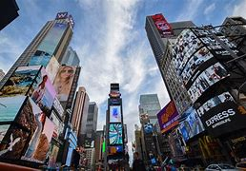
Question 1
Explain the term ‘survival of the fittest’.
OrganismAs with the most suitable characteristics for the environment survive and pass on their genes to their offspring.
back

Slide 3
Question 2
What is meant by ‘genetic variation’?
Variation caused by different alleles.
back
back

Slide 4
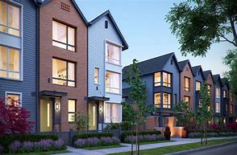
Question 3
Name two methods of cloning plants.
Cuttings and tissue cell culture.
back

Slide 5
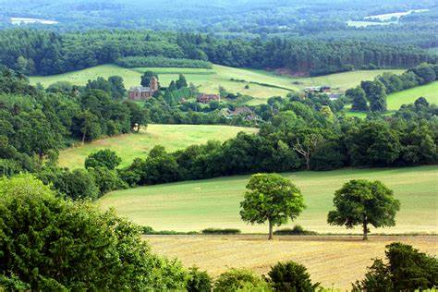
Question 4
What is genetic engineering?
Cutting a desired gene from one organism and placing it in another organism.

Slide 6
Question 5
What problems may arise from selective breeding?
back
back

Slide 7
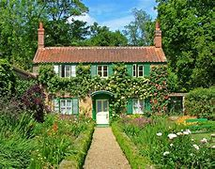
Question 6
State three ways fossils are formed.
Replacement of minerals, no decay occurs (wrong conditions), and casts or impressions.
back

Slide 8
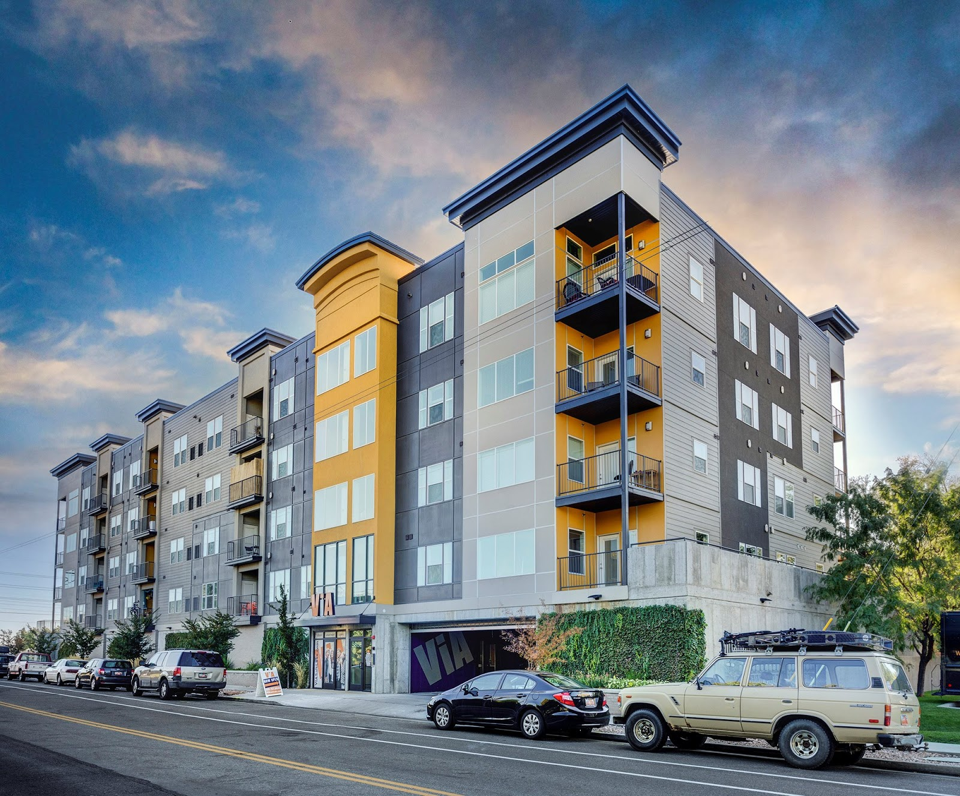
Question 7
Who proposed the three-domain system of classification?
back
back

Slide 9
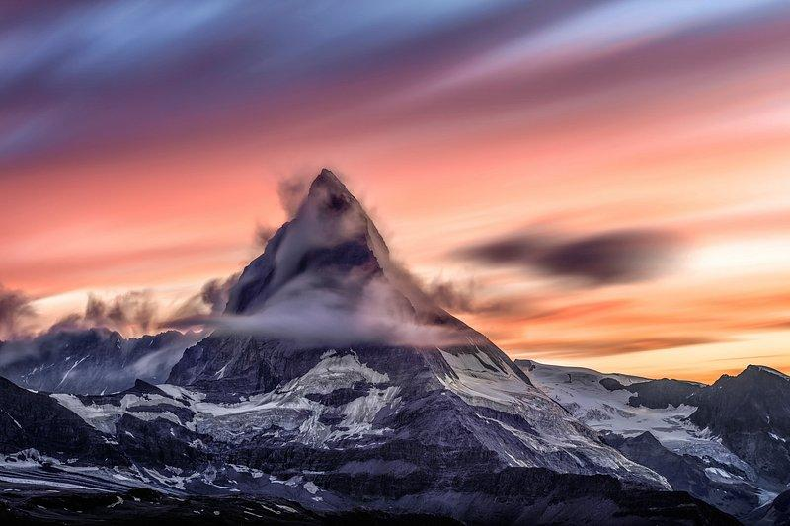
Why is it important to take the full course of antibiotics?
back
back

Slide 10
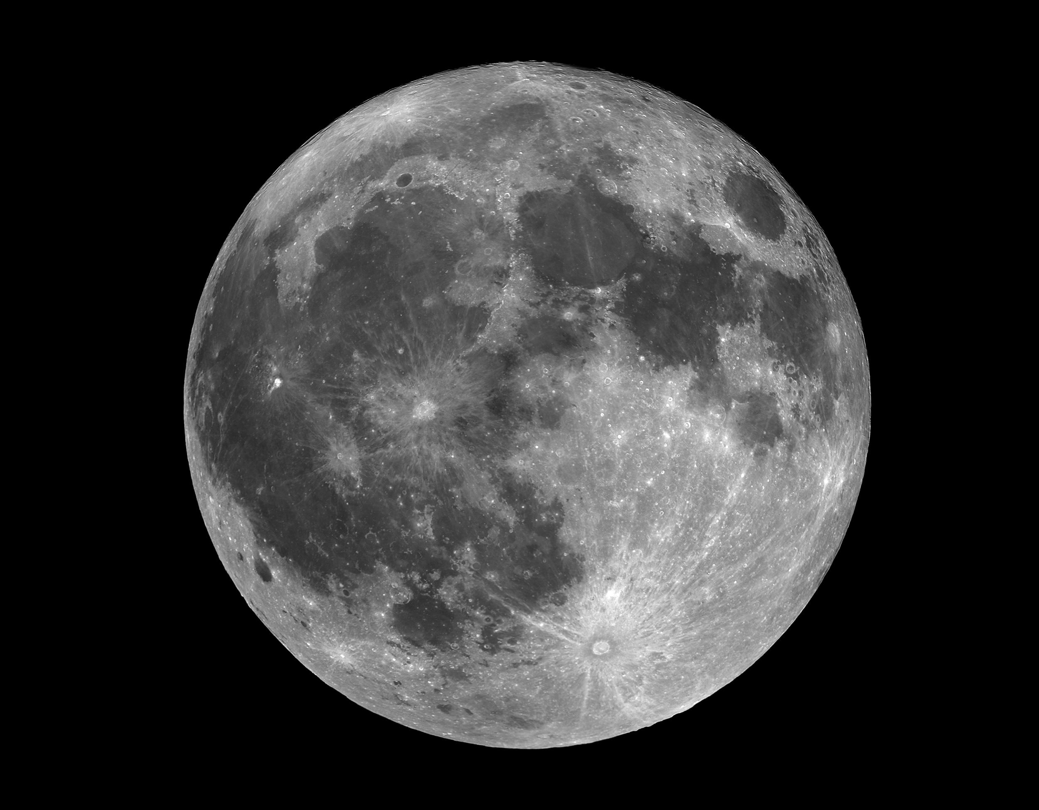
Question 9
State three causes of extinction.
Any three: new predator, disease, lack of food, environmental changes.
back
back

Slide 11
Wednesday, March 20th ,2024
Unit 10: Our houses in the future
Lesson 1: Getting started

Slide 12
My future house
Listen and read.
Order the words to make a phrase about a place. Each group has one extra word.
Read the conversation again. Find and write down the words or phrases that show:
In groups, describe to your classmates what you can see outside the window of your future house. Your group tries to guess where your house is.
Read the conversation again. Tick (✓) T (True) or F (False).

Slide 13
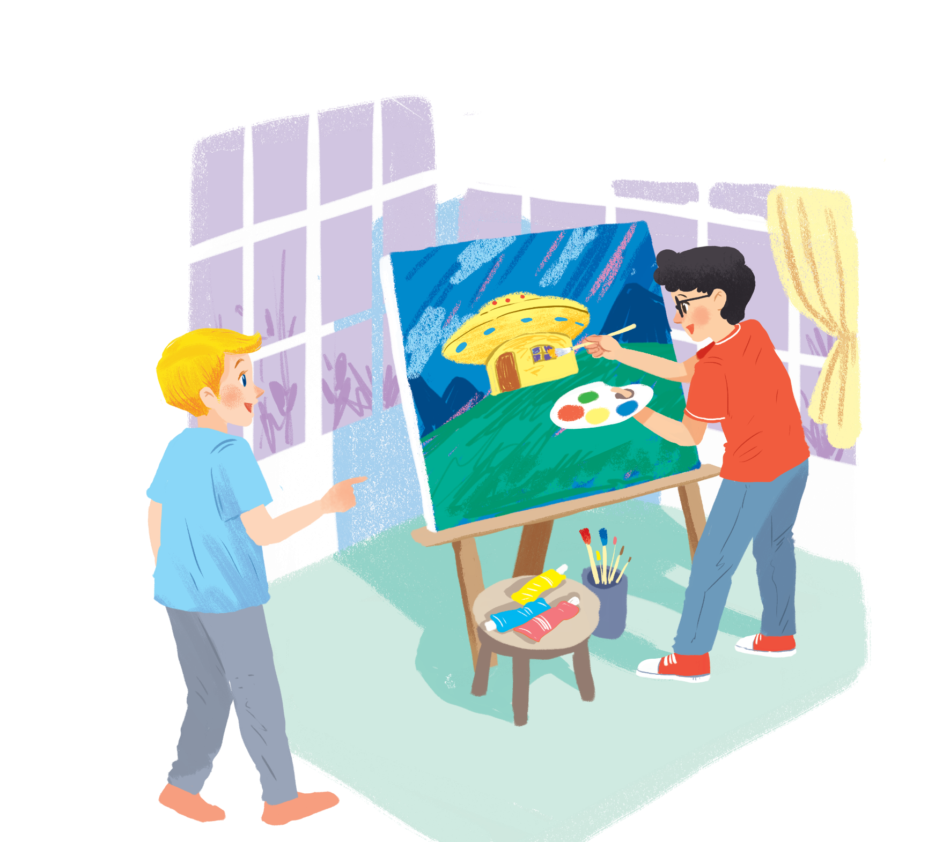
Listen and read.
My future house
Notes:
‹#›

Slide 14
My future house
Nick: What are you doing, Phong?
Phong: I’m painting a picture of my house.
Nick: Your house! That’s a UFO.
Phong: It looks like a UFO but it’s my house in the future.
Nick: Where will it be?
Phong: It’ll be in the mountains.
Nick: What will it be like?
Phong: It’ll be a large house. It’ll have twenty rooms.
Nick: Twenty rooms!
Phong: Yes, and it’ll have solar energy.
Nick: Fantastic! Which room will you like best?
Phong: My bedroom, of course.
Nick: What appliances might the house have?
Phong: My house might have some smart TVs and ten robots.
Nick: Sounds great! And how much will ...

Slide 15
UFO (n):

Slide 16
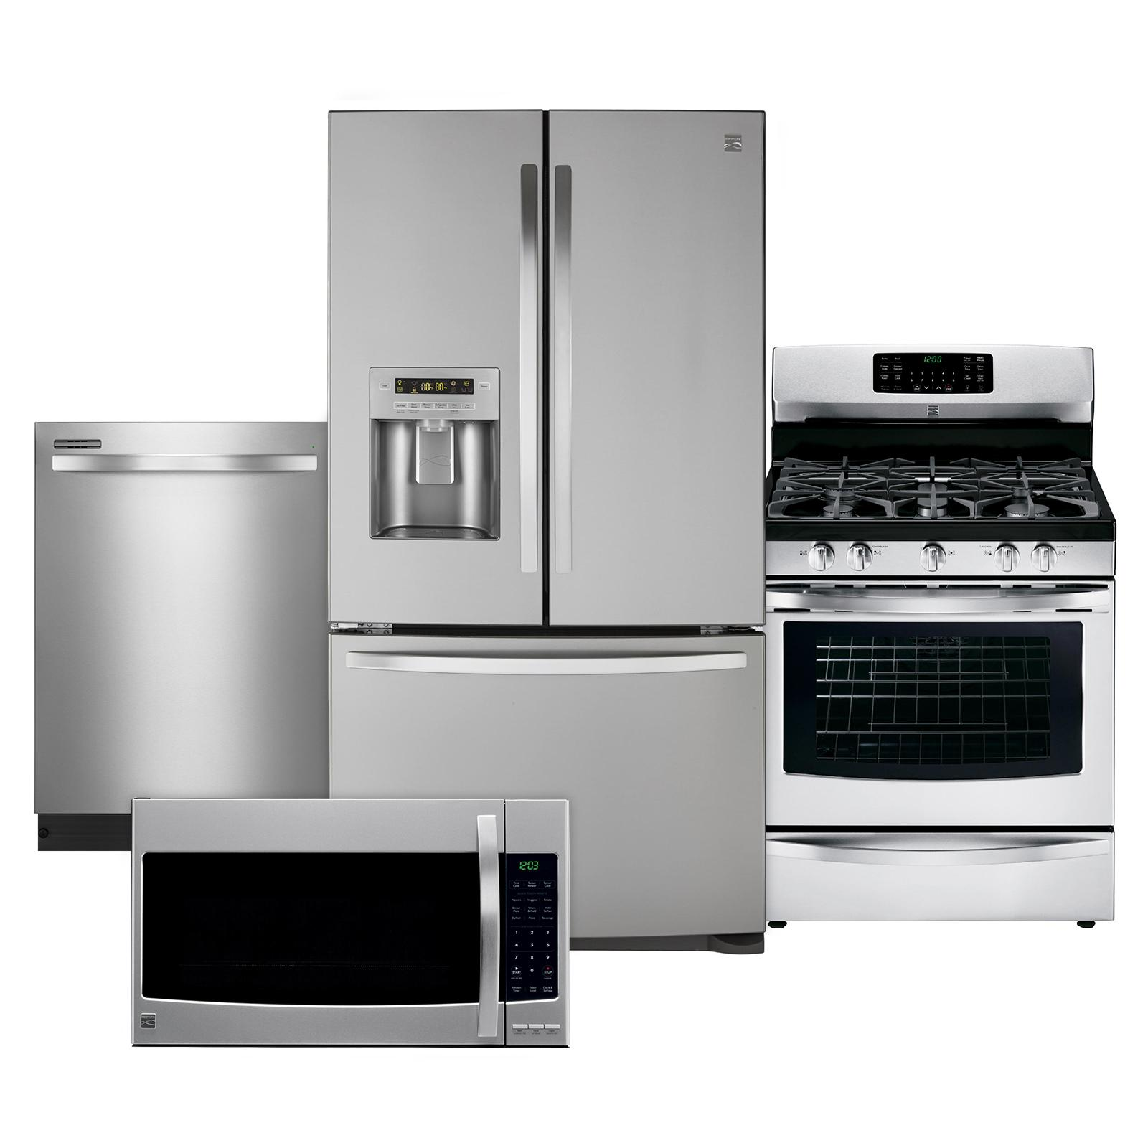
Appliance (n):

Slide 17
Location(n)

Slide 18
I, Vocabulary:
Location(n): vị trí
Appliance(n) : thiết bị
UFO (n) : đĩa bay, vật thể bay không xác định

Slide 19
where the words
1.

Slide 20
My future house
Nick: What are you doing, Phong?
Phong: I’m painting a picture of my house.
Nick: Your house! That’s a UFO.
Phong: It looks like a UFO but it’s my house in the future.
Nick: Where will it be?
Phong: It’ll be in the mountains.
Nick: What will it be like?
Phong: It’ll be a large house. It’ll have twenty rooms.
Nick: Twenty rooms!
Phong: Yes, and it’ll have solar energy.
Nick: Fantastic! Which room will you like best?
Phong: My bedroom, of course.
Nick: What appliances might the house have?
Phong: My house might have some smart TVs and ten robots.
Nick: Sounds great! And how much will ...

Slide 21
My future house
Nick: What are you doing, Phong?
Phong: I’m painting a picture of my house.
Nick: Your house! That’s a UFO.
Phong: It looks like a UFO but it’s my house in the future.
Nick: Where will it be?
Phong: It’ll be in the mountains.
Nick: What will it be like?
Phong: It’ll be a large house. It’ll have twenty rooms.
Nick: Twenty rooms!
Phong: Yes, and it’ll have solar energy.
Nick: Fantastic! Which room will you like best?
Phong: My bedroom, of course.
Nick: What appliances might the house have?
Phong: My house might have some smart TVs and ten robots.
Nick: Sounds great! And how much will ...

Slide 22
Read the conversation again. Find and write down the words or phrases that show:
Type of house
Location
Appliances in the house
UFO
in the mountains
some smart TVs and ten robots

Slide 23
Read the conversation again. Tick (✓) T (True) or F (False).
 | T | F
1. Phong’s house will be in the mountains.
2. His house will be large.
3. There’ll be a lot of rooms in his house.
4. He might have a smart TV and five robots.
✓
✓
✓
✓

Slide 24
Order the words to make a phrase about a place.
Each group has one extra word.
1.
sea / a / by / the
5.
countryside / a / the / in
by the sea
in the countryside
2.
on / in / the / city
6.
Moon / in / the / on
in the city
on the Moon
3.
the / in / at / town
7.
in / at / the / sky
in the town
in the sky
4.
the / on / in / mountains
in the mountains

Slide 25
In groups, describe to your classmates what you can see outside the window of your future house. Your group tries to guess where your house is.
Example:
A: Outside my window I can see the beach and the water. Where’s my house?
B: It’s in the sea.
A: Correct!
Notes:
‹#›

