Slide 1
WELCOME TO OUR CLASS

Slide 2
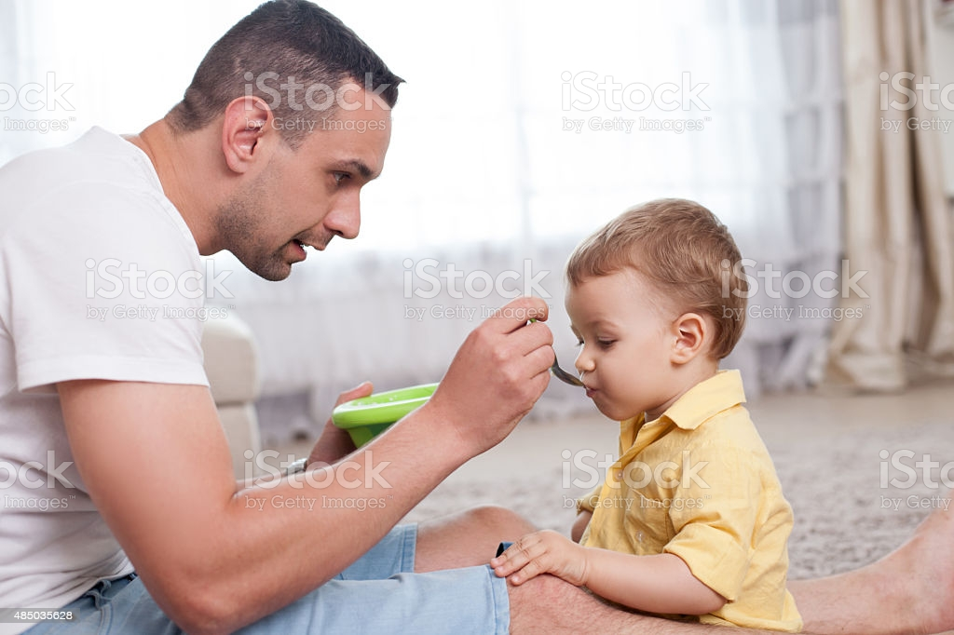
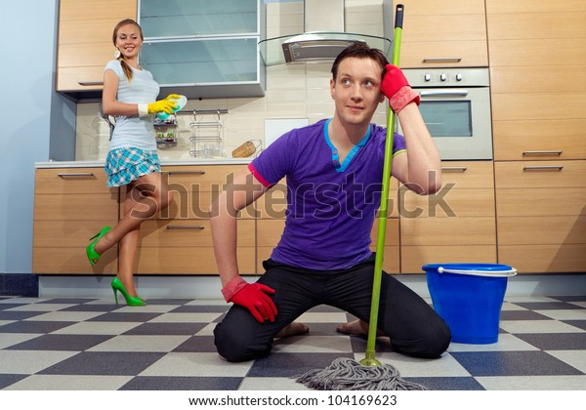

Slide 3
Unit 11: CHANGING ROLES IN SOCIETY
Lesson 1 : GETTING STARTED

Slide 4
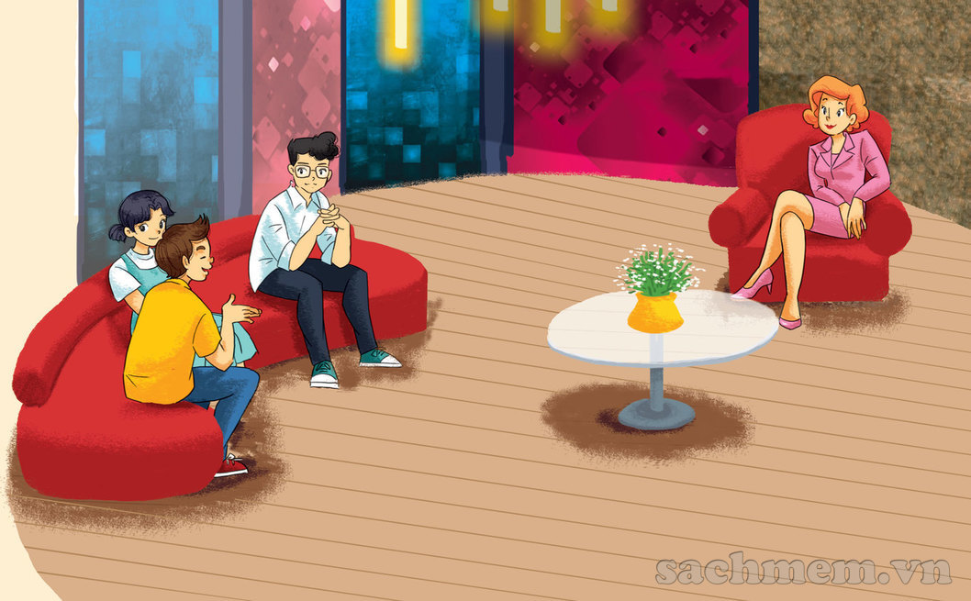

Slide 5
* Vocabulary:
- society (n) : xã hội /səˈsaiəti/
- application (n) : việc áp dụng, ứng dụng ˌ/æplɪˈkeɪʃn/
- real-life (adj) : cuộc sống thực
- facilitator (n) : người hỗ trợ/ điều hành /fəˈsiləˌteitər/
→ facilitate (v) : tạo điều kiện dễ dàng, điều phối
- drastically (adv): mạnh mẽ, quyết liệt /ˈdrastikli:/
- breadwinner (n): trụ cột gia đình /ˈbredˌwinər/
- externally (adv): bên ngoài /ekˈstərnəli:/
- sense of …. (exp) : nhận thức được
- involvement (n) : sự có mặt /inˈvalvmənt/
- bond (n) : mối quan hệ, liên kết /band/
- negative (adj) : tiêu cực /ˈneɡətiv/

Slide 6
1. Listen and read
Interviewer: We have invited some students from Oak Tree School in Happy Valley to this Beyond 2030 forum, and they are going to share with us their vision of the future. Would you like to go first, Phong?
Phong: I believe the biggest change will take place within the school system. Apart from at school, we will also be learning from places which will give us real-life knowledge and experience, such as at a railway station, in a company, or on a farm.
Mai: I agree. This real-life application of learning will give us a sense of participation, a feeling that we are part of the process.
Interviewer: And what about the role of teachers?
Phong: Ah, they will be more like facilitators, rather than information providers.
Interviewer: Fascinating. How else do you see the future, Nguyen?
Nguyen: Well, I think the role of fathers will drastically change.
Interviewer: Oh yes? In what way?
Nguyen: The modern father will not necessarily be the breadwinner of the family. He may be externally employed or he may stay at home to take care of his children.
Interviewer: And do the housework?
Nguyen: Yes. It's work, paid or not, isn't it?
Mai: Absolutely. The benefit will be that children will see their fathers more often and have a closer relationship with them. I don't see much of my dad, but I love every moment I spend with him.
Interviewer: Well, we are certainly covering some interesting topics …

Slide 7
1a. Tick the person who has this idea.
 | Idea | Phong | Nguyen | Mai
1 | Students will learn from a real workplace.
2 | Students love seeing themselves as part of the process.
3 | The teacher will act more like a facilitator.
4 | The father will not necessarily be the breadwinner of the family.
5 | With the in the home, they will develop a closer bond with their chidren.
√
√
√
√
√

Slide 8
Words | Explanations
1. facilitator | A. a person who provides facilitieslike the projector, the interactive whiteboard. B. a person who helps somebody to do something more easily by discussing and giving guidance.
2. information provider | A. a person who gathers information and uses it to teach others. B. a machine which sells newspapers.
3. breadwinner | A. a person who makes bread to feed the family. B. a person who supports the family with the money he/she earns.
B
A
B
.

Slide 9
1. Listen and read
Interviewer: We have invited some students from Oak Tree School in Happy Valley to this Beyond 2030 forum, and they are going to share with us their vision of the future. Would you like to go first, Phong?
Phong: I believe the biggest change will take place within the school system. Apart from at school, we will also be learning from places which will give us real-life knowledge and experience, such as at a railway station, in a company, or on a farm.
Mai: I agree. This real-life application of learning will give us a sense of participation, a feeling that we are part of the process.
Interviewer: And what about the role of teachers?
Phong: Ah, they will be more like facilitators, rather than information providers.
Interviewer: Fascinating. How else do you see the future, Nguyen?
Nguyen: Well, I think the role of fathers will drastically change.
Interviewer: Oh yes? In what way?
Nguyen: The modern father will not necessarily be the breadwinner of the family. He may be externally employed or he may stay at home to take care of his children.
Interviewer: And do the housework?
Nguyen: Yes. It's work, paid or not, isn't it?
Mai: Absolutely. The benefit will be that children will see their fathers more often and have a closer relationship with them. I don't see much of my dad, but I love every moment I spend with him.
Interviewer: Well, we are certainly covering some interesting topics …

Slide 10
2b. Answer the questions
1. What is the purpose of the Beyond 2030 forum?
→ It's for people to share their vision of the future.
2. Who has been invited to the discussion?
→ Some students from Oak Tree School in Happy Valley.
3. What does Phong think about classes in the future?
→ He says that learning will also take place outside school.
4. Why might students like having classes outside school?
- It will give them a sense of participation and of being part of the process.
5. Will the father of the future always stay at home?
→ No, he won't. He may still go to work.
6. Does Nguyen feel negative about a man doing housework?
→ No, he doesn't.

Slide 11
2c. Find the meaning of the phrases and sentences.
A | B
1. Beyond 2030. | a. Ideas about what life will be in the future.
2. Vision of the future . | b.Both housework and paid work are worthy of respect.
3. It's work, paid or not, isn't it? | c. I love being with my father.
4. I love every moment, I spend with him. | d. after the year 2030.

Slide 12
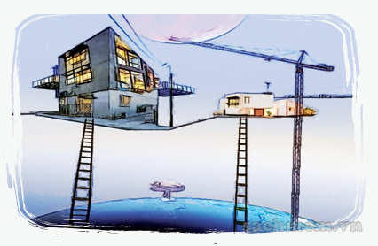
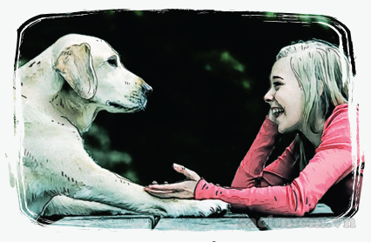
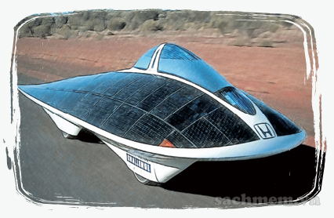
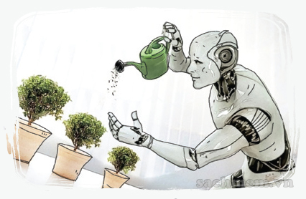
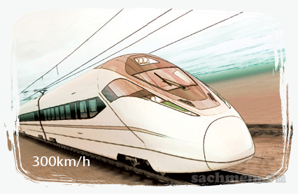
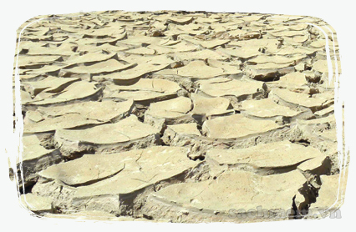
3. Work in groups.
1.Car will be running
on water.
2. People will live in houses in the sky.
3. People will be able to
talk with their pets.
4. Robots will be doing
the housework.
5. Trains will be running
as fast as 300 km/h.
6. Land will become
barren.

Slide 13
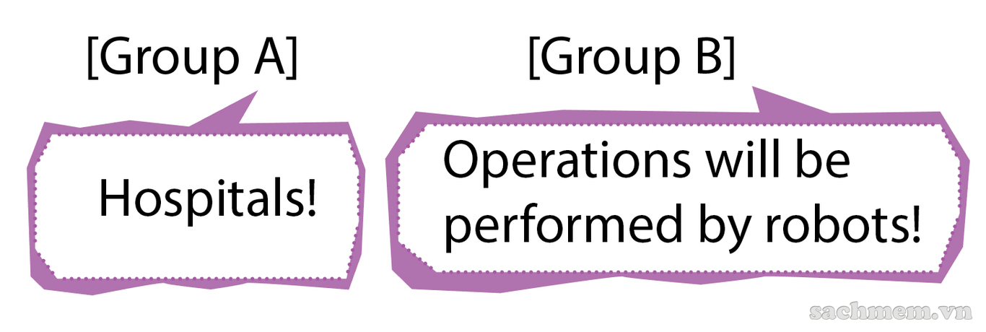
4. GAME
Make two big groups. One group names a service. The other group gives their vision of that service in the future. Take turns to do this. The group with the most predictions wins.
Example:

Slide 14
HOMEWORK
- Do activity 2 in notebook.
- Learn newwords by heart.
- Prepare new lesson Unit 11: A closer look 1.

