Slide 1


Slide 2












Hoa Thach secondary school
ENGLISH 9
Welcome to our class
Teacher : Nguyen Thi Le Yen
12/21/2025 3:36:41 PM

Slide 3
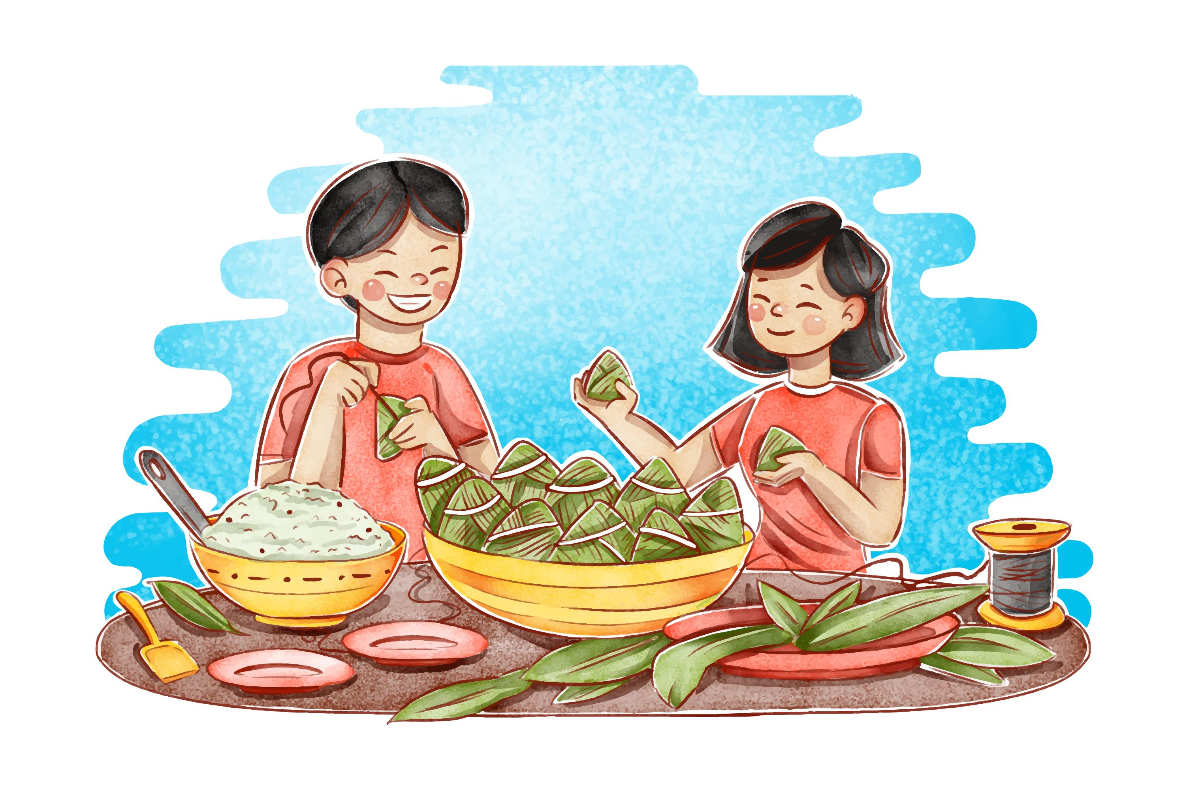


Unit
6
VIETNAMESE LIFESTYLE:
THEN AND NOW
LESSON 7: LOOKING BACK & PROJECT

Slide 4

OBJECTIVES
By the end of the lesson, students will be able to:
Review the vocabulary and grammar of Unit 6;
Apply what they have learnt (vocabulary and grammar) into practice through a project.

Slide 5

LESSON 7: LOOKING BACK & PROJECT
LESSON 1: GETTING STARTED
WARM-UP
Brainstorming
Task 1: Choose the correct answer A, B, C, or D to complete each sentence.
Task 2: Complete the sentences with the correct forms of the words in brackets.
VOCABULARY
GRAMMAR
Task 3: Circle the correct words or phrases to complete the following sentences.
Task 4: Make complete sentences from the clues. Make any changes and add more words if necessary.
PROJECT
Poster presentation
Wrap-up
Homework
CONSOLIDATION

Slide 6
WARM-UP
BRAINSTORMING
- Work in teams.
- Members of each team take turns and write as many vocabulary in Unit 6 as possible in ______ minutes.
- The group having more correct answers is the winner.

Slide 7
VOCABULARY
1
Choose the correct answer A, B, C, or D to complete each sentence.
1. I love animals and I’m determined to __ my dream of becoming a vet.
A. have B. pursue C. do D. depend on
2. ___ people tend to put the needs of their families ahead of their own.
A. Independent B. Democratic C. Kind D. Family-oriented
3. Rapid changes in society and lifestyle have made the ______ in many families wider.
A. generation gap B. family relation C. family values D. experiences
24. She has found ____ sources of information about life in Viet Nam a century ago.
A. extended B. alive C. various D. long
5. Like adults, children sometimes want some ______.
A. opportunity B. relations C. values D. privacy

Slide 8
VOCABULARY
2
Complete the sentences with the correct forms of the words in brackets.
private
1. My parents taught me not to listen to other people’s _______ conversations. (privacy)
memorise
2. It’s amazing that the boy can __________ all the information in such a short time. (memory)
3. Living away from home to attend college has made me more ______________. (independence)
independent
feedom
4. In a modern society, we learn to value a person’s _________. (free)
democratic
5. In a ____________ classroom, every student has the right to speak as well as the responsibility to listen to others. (democracy)

Slide 9
LESSON 7: LOOKING BACK & PROJECT
LESSON 1: GETTING STARTED
WARM-UP
Brainstorming
Task 1: Choose the correct answer A, B, C, or D to complete each sentence.
Task 2: Complete the sentences with the correct forms of the words in brackets.
VOCABULARY
GRAMMAR
Task 3: Circle the correct words or phrases to complete the following sentences.
Task 4: Make complete sentences from the clues. Make any changes and add more words if necessary.

Slide 10
GRAMMAR
Circle the correct words or phrases to complete the following sentences.
3
1. Do you mind turning / to turn the volume down? I’m studying.
2.We decided spending / to spend this whole week learning to cook traditional foods
3. If you want seeing / to see the differences between the past and the present of a city, visit its museum.
4.He stayed in his room to avoid meeting / to meet his parents’ guests.
5. My brother promised taking / to take me to the exhibition of traditional farming tools.

Slide 11
GRAMMAR
Make complete sentences from the clues. Make any changes and add more words if necessary.
4
4
1.we / plan / visit / historical places / Cao Bang.
2. we / hope / have / bus station / near / village / soon.
3. even / grandmother /enjoy / use / Facebook / communicate / her friends.
4. last year / I / learn / make cakes / watch / cooking videos / Internet.
5. this morning / I / suggest / do a survey / northern women's traditional costumes.

Slide 12
GRAMMAR
4
4
Make complete sentences from the clues. Make any changes and add more words if necessary.
1. we / plan / visit / historical places / Cao Bang.
We plan / are planning to visit some historical places in Cao Bang.
2. we / hope / have / bus station / near / village / soon.
We hope to have a bus station near our village soon.

Slide 13
GRAMMAR
Make complete sentences from the clues. Make any changes and add more words if necessary.
4
3. even / grandmother / enjoy / use / Facebook / communicate / her friends.
4
Even my grandmother enjoys using Facebook to communicate with her friends.
4. last year / I / learn / make cakes / watch / cooking videos / Internet.
Last year, I learned to make cakes by watching cooking videos on the Internet.
5. this morning / I / suggest / do a survey / northern women’s traditional costumes.
This morning, I suggested doing a survey on northern women’s traditional costumes

Slide 14
LESSON 7: LOOKING BACK & PROJECT
LESSON 1: GETTING STARTED
WARM-UP
Brainstorming
Task 1: Choose the correct answer A, B, C, or D to complete each sentence.
Task 2: Complete the sentences with the correct forms of the words in brackets.
VOCABULARY
GRAMMAR
Task 3: Circle the correct words or phrases to complete the following sentences.
Task 4: Make complete sentences from the clues. Make any changes and add more words if necessary.
PROJECT
Video presentation

Slide 15
PROJECT
- Work individually or groups to prepare for your presentation.
- There are checklists for self and peer assessment.
- Check appropriate items while listening to your classmates’ presentations and write comments if you have any.

Slide 16
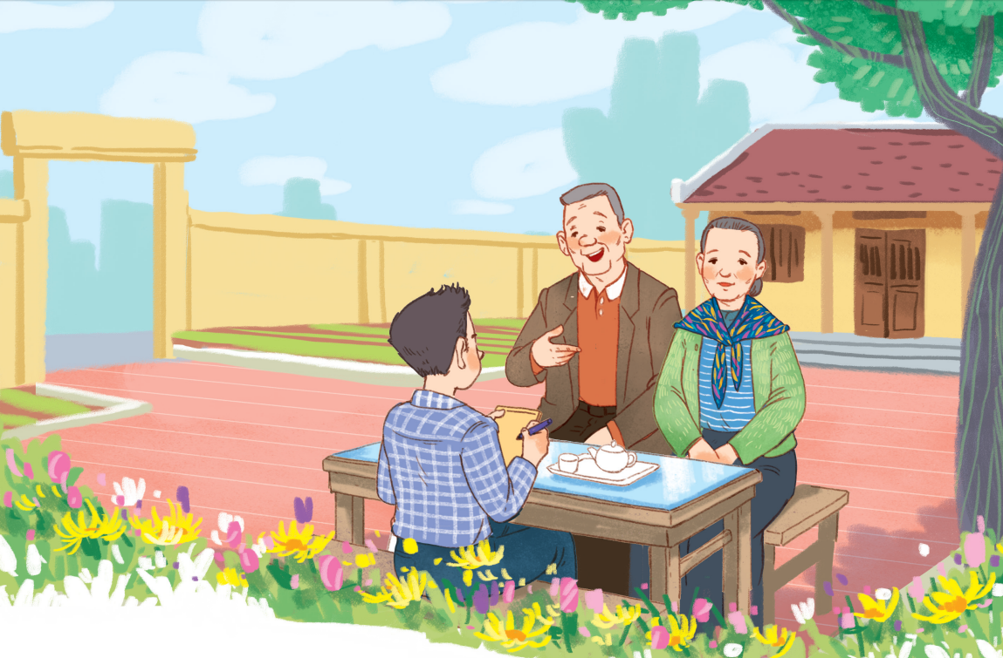
PROJECT
I KNOW MY ______ WELL!

Slide 17
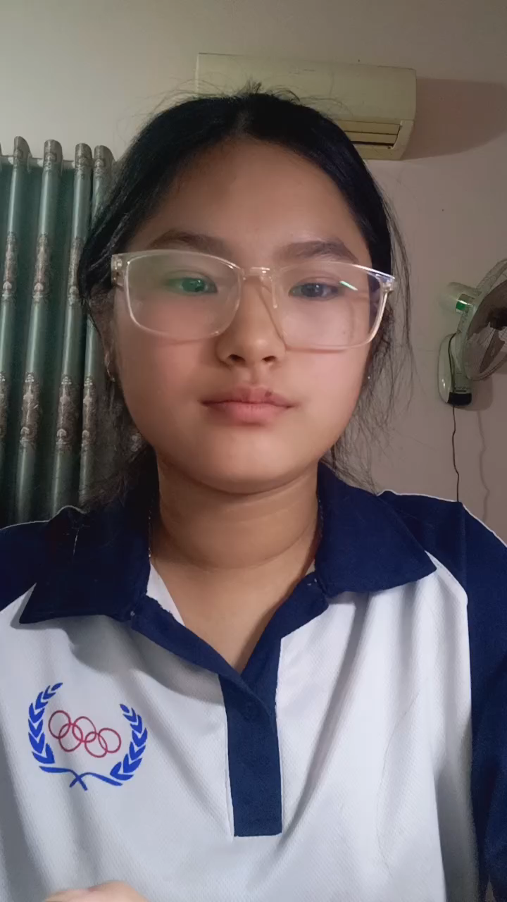

PROJECT
PRESENTATION
- Students work in groups.
- One presents in front of the class.

Slide 18
LESSON 7: LOOKING BACK & PROJECT
LESSON 1: GETTING STARTED
WARM-UP
Brainstorming
Task 1: Choose the correct answer A, B, C, or D to complete each sentence.
Task 2: Complete the sentences with the correct forms of the words in brackets.
VOCABULARY
GRAMMAR
Task 3: Circle the correct words or phrases to complete the following sentences.
Task 4: Make complete sentences from the clues. Make any changes and add more words if necessary.
PROJECT
Video presentation
Wrap-up
Homework
CONSOLIDATION

Slide 19

CONSOLIDATION
1
Wrap-up
What have we learnt in this lesson?
Review the vocabulary and grammar of Unit 6;
Apply what they have learnt (vocabulary and grammar) into practice through a project.

Slide 20

CONSOLIDATION
2
Homework
- Prepare for the next lesson.

Slide 21
Website: hoclieu.vn
Fanpage: facebook.com/www.tienganhglobalsuccess.vn/

