Slide 1

English 8
Class : 8 A

Slide 2
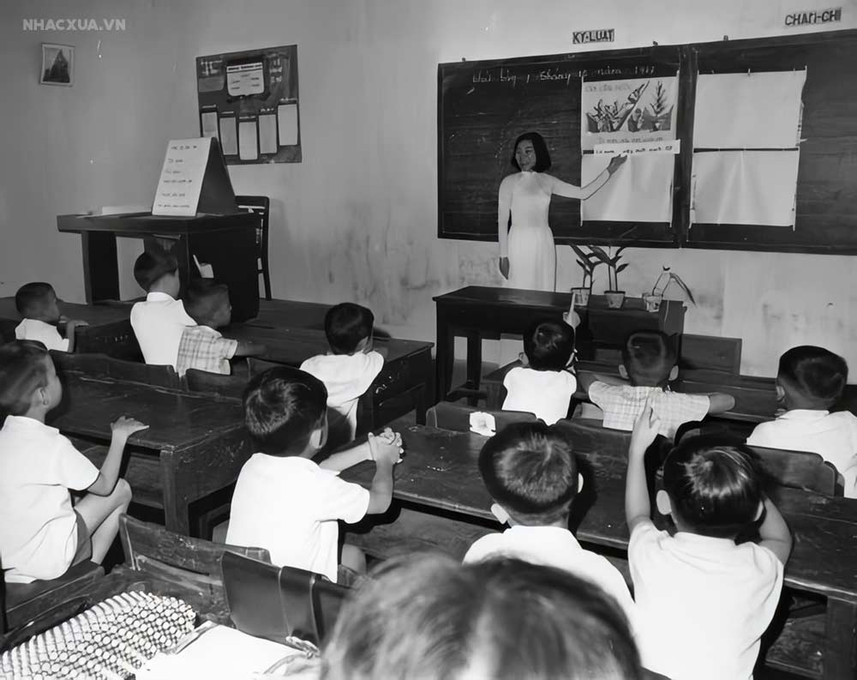
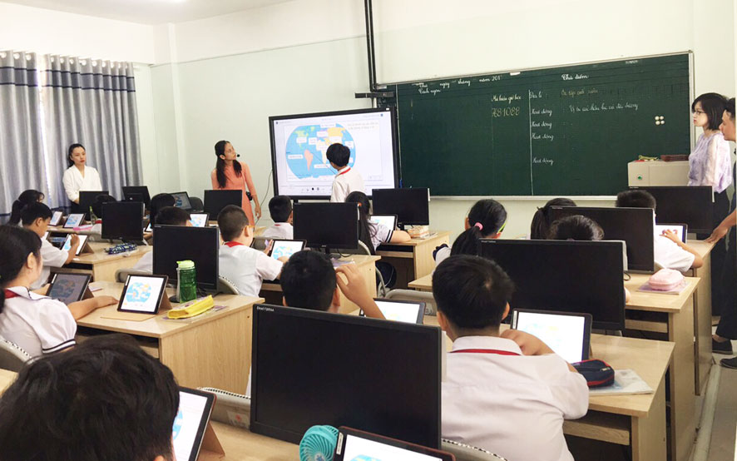
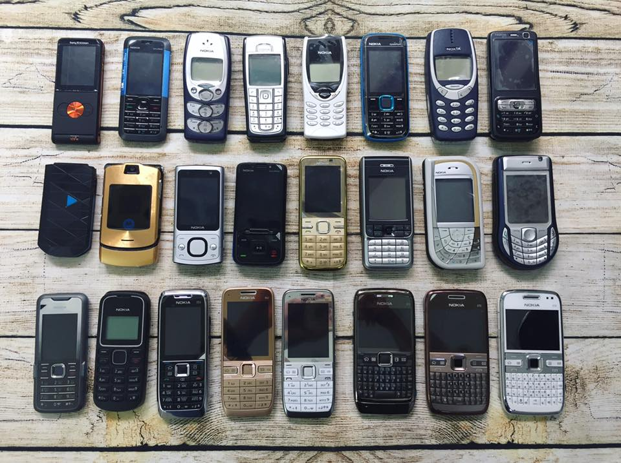
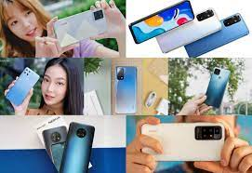
* Warm up
What do you think of these pictures?

Slide 3
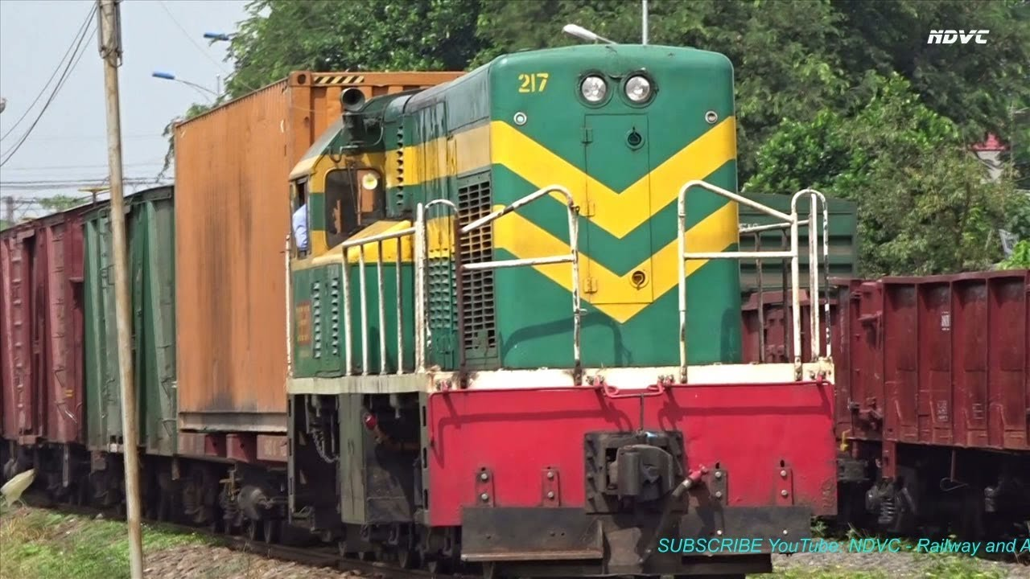
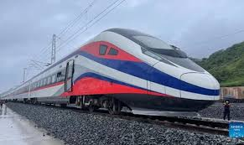
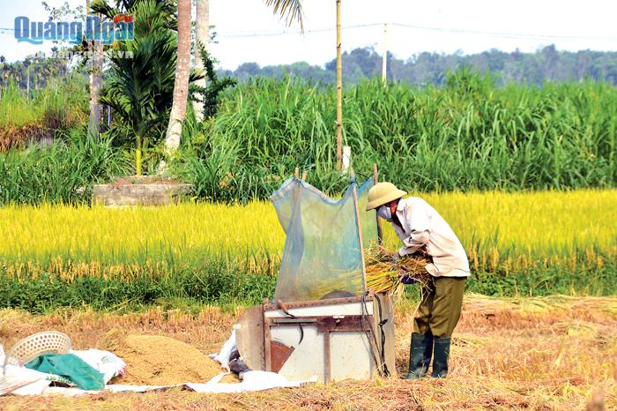
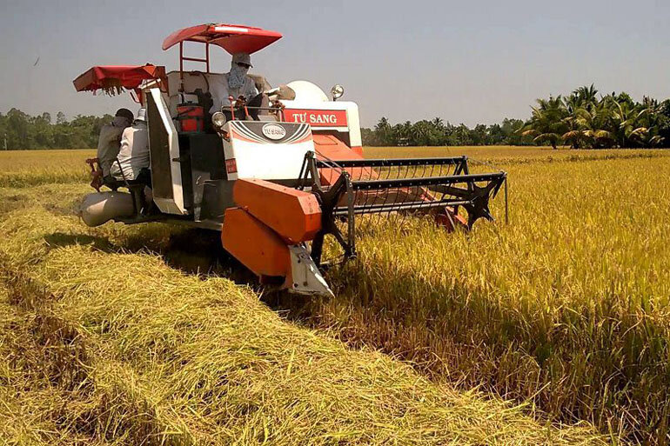
* Warm up
What do you think of these pictures?

Slide 4
→ Talk about the development of science and technology.

Slide 5


Unit
11
SCIENCE AND TECHNOLOGY
LESSON 1: GETTING STARTED
Great news for students
1

Slide 6
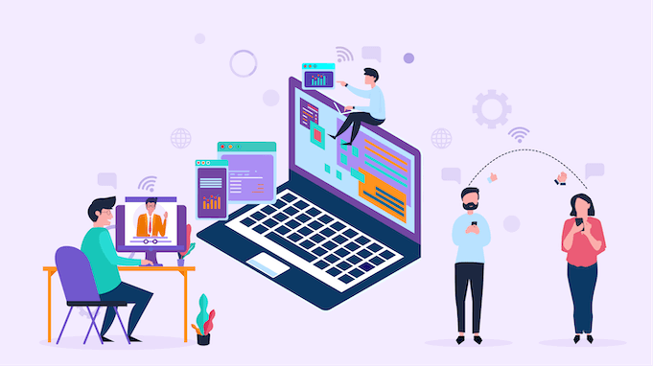

* VOCABULARY
technology (n)
/tekˈnɒlədʒi/
công nghệ

Slide 7

* VOCABULARY
face to face (adj)
/ˌfeɪs tə ˈfeɪs/
Trực tiếp, mặt đối mặt

Slide 8

* VOCABULARY
epidemics (n)
/ˌepɪˈdemɪk/
đại dịch

Slide 9
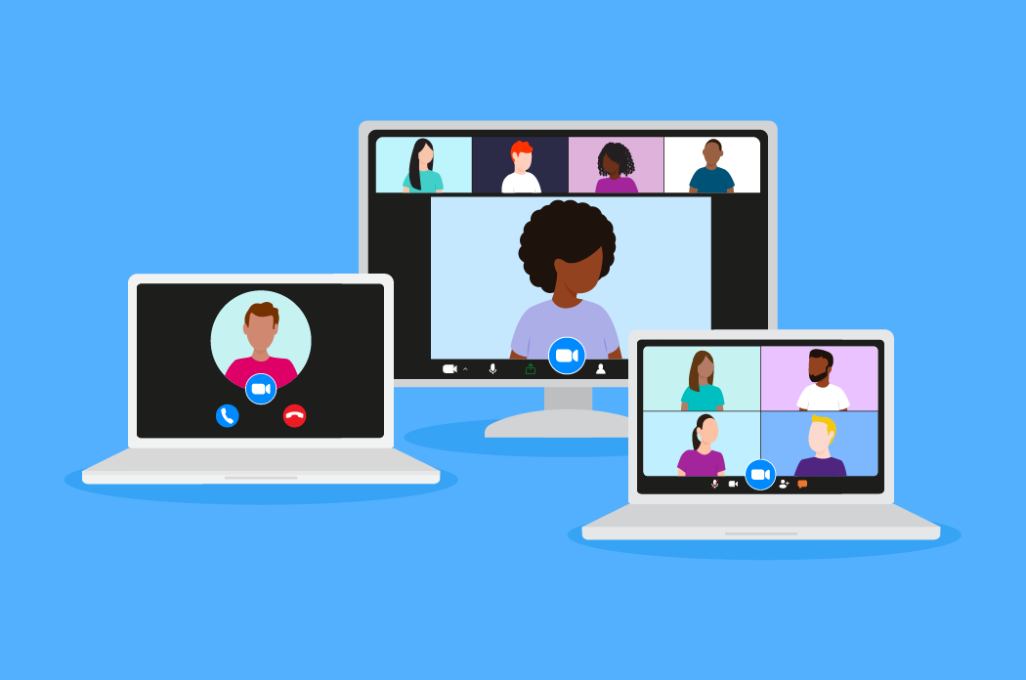
* VOCABULARY
breakout room
/ˈbreɪkaʊt rʊm /
Phòng học chia nhỏ, chia nhóm

Slide 10
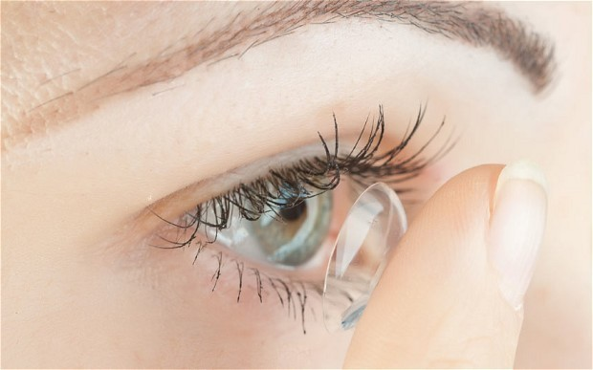
* VOCABULARY
contact lens (n)
/ˈkɒntækt lenz/
Kính áp tròng

Slide 11

* VOCABULARY
invention (n)
/ɪnˈvenʃn/
Phát minh

Slide 12
* VOCABULARY
New words | Pronunciation | Meaning
1. technology (n) | /tekˈnɒlədʒi/ | Công nghệ
2. face-to-face | /ˌfeɪs tə ˈfeɪs/ | Trực tiếp, mặt đối mặt
3. epidemics (n) | /ˌepɪˈdemɪk/ | Đại dịch
4. breakout room (n) | /ˈbreɪkaʊt rʊm / | Phòng học chia nhỏ
5. contact lens (v) | /ˈkɒntækt lenz/ | Kính áp tròng
6. invention (n) | /ɪnˈvenʃn/ | Phát minh

Slide 13
* VOCABULARY
New words | Meaning
1. | Công nghệ
2. | Trực tiếp, mặt đối mặt
3. | Đại dịch
4. | Phòng học chia nhỏ
5. | Kính áp tròng
6. | Phát minh
technology (n)
face-to-face
epidemics (n)
breakout room (n)
contact lens (v)
invention (n)

Slide 14
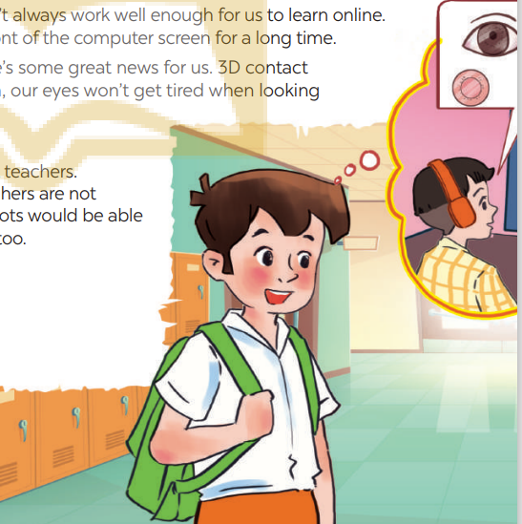
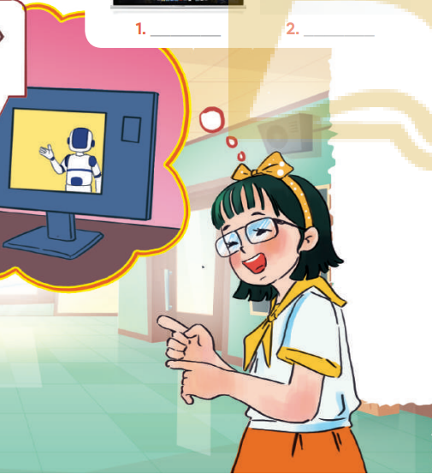
* CHATTING
* Answer the questions:
1. Who are the girl and the boy?
2. Where do you think they are?
3. What might they be talking about?
4. What can you see in the bubble?
They are Minh and Ann.
They are at school.
They are discussing their online class / robot teacher.
A boy, a computer, an eye …

Slide 15
* PRACTICE
1
Listen and read.
Minh: I really liked yesterday’s online lesson. What about you, Ann?
Ann: I prefer having face-to-face classes. I like to interact with my classmates during the lessons.
Minh: I think online classes are convenient during bad weather or epidemics. Also, students can still interact when they are in breakout rooms.
Ann: But the Internet connection doesn’t always work well enough to learn online. And my eyes get tired when I work in front of the computer screen for a long time.
Minh: I know what you mean. But there’s some great news for us. 3D contact lenses will soon be available. With them, our eyes won’t get tired when looking at a computer screen all day long.
Ann: Wow, that’s brilliant!
Minh: Another helpful invention is robot teachers. They will teach us when our human teachers are not available or get ill. My uncle said the robots would be able to mark our work and give us feedback too.
Ann: Fantastic! I can’t wait.

Slide 16

2
Read the conversation again and tick T (True) or F (False).
STATEMENTS | T | F
1. Ann and Minh had a face-to-face class yesterday.
2. Ann likes face-to-face classes because she can interact with her classmates.
3. Minh finds online classes inconvenient.
4. When students use 3D contact lenses, their eyes will not get tired.
5. Robot teachers will be able to mark papers and comment on students’ work.

Slide 17
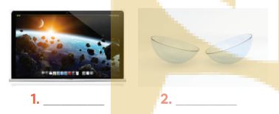
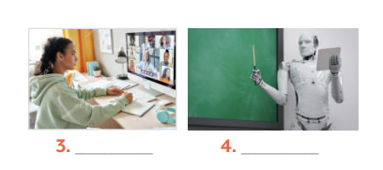
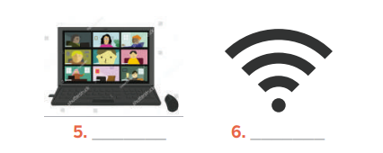
3
Label each picture with a phrase from the box.
3D contact lenses
computer screen
robot teacher
breakout rooms
online class
Internet connection

Slide 18
4
Complete the sentences, using the phrases in 3
3D contact lenses
computer screen
robot teacher
breakout rooms
online class
Internet connection
I can’t see the documents on the computer very clearly. I need a larger ______________.
During our lessons, our teacher puts us into ______________ for group discussions.
A____________ in Korea teaches English to primary students.
We had a(n)____________ yesterday with a teacher in the US.
Can I wear ________________ and watch a movie too?

Slide 19
* PRODUCTION
5
Do you know what things were invented in these years? Work in pairs and find out.
1822: Charles Babbage invented it. Students use it to type essays and to learn online.
1876: Alexander Graham Bell invented it. We use it to communicate with our friends and families.
1928: Sir Alexander Fleming discovered it. It was the world’s first antibiotic.
1989: Tim Berner-Lee invented it. It links information sources so everyone can access them.
2000: Honda developed it. It can run, jump, and work as a bartender.
Game
QUIZ

Slide 20



Gift box secret game

Slide 21











Gift box secret game

Slide 22








Do you know what things were invented in these years?
1. 1822: Charles Babbage invented it. Students use it to type essays and to learn online.
The computer
9 mark
GO HOME

Slide 23
Do you know what things were invented in these years?
2. 1876: Alexander Graham Bell invented it. We use it to communicate with our friends and families.
The telephone
5 k
GO HOME

Slide 24
Do you know what things were invented in these years?
3. 1928: Sir Alexander Fleming discovered it.
It was the world’s first antibiotic.
Penicillin
10 mark
GO HOME

Slide 25
Do you know what things were invented in these years?
4. 1989: Tim Berner-Lee invented it. It links information sources so everyone can access them.
WWW
9 mark
GO HOME

Slide 26
Do you know what things were invented in these years?
5. 2000: Honda developed it. It can run, jump, and work as a bartender.
A walking robot
5k
GO HOME

Slide 27
* PRODUCTION
5
QUIZ: Do you know what things were invented in these years? Work in pairs and find out.
1822: Charles Babbage invented it. Students use it to type essays and to learn online.
1876: Alexander Graham Bell invented it. We use it to communicate with our friends and families.
1928: Sir Alexander Fleming discovered it. It was the world’s first antibiotic.
1989: Tim Berner-Lee invented it. It links information sources so everyone can access them.
2000: Honda developed it. It can run, jump, and work as a bartender.
The computer
The telephone
Penicillin
WWW
A walking robot

Slide 28

* CONSOLIDATION
* What have we learnt in this lesson?
identify the topic of the unit
use lexical items related to science and technology
identify the language features that are covered in the unit

Slide 29

* Homework
Learn the new words and phrases by heart.
Do Exercise Unit 11 in the Workbook
Prepair lesson 2( A closer look 1)

Slide 30




Slide 31
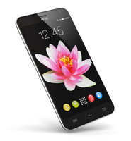
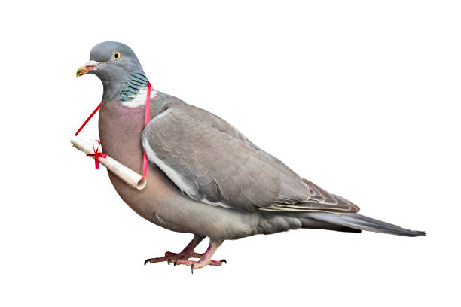
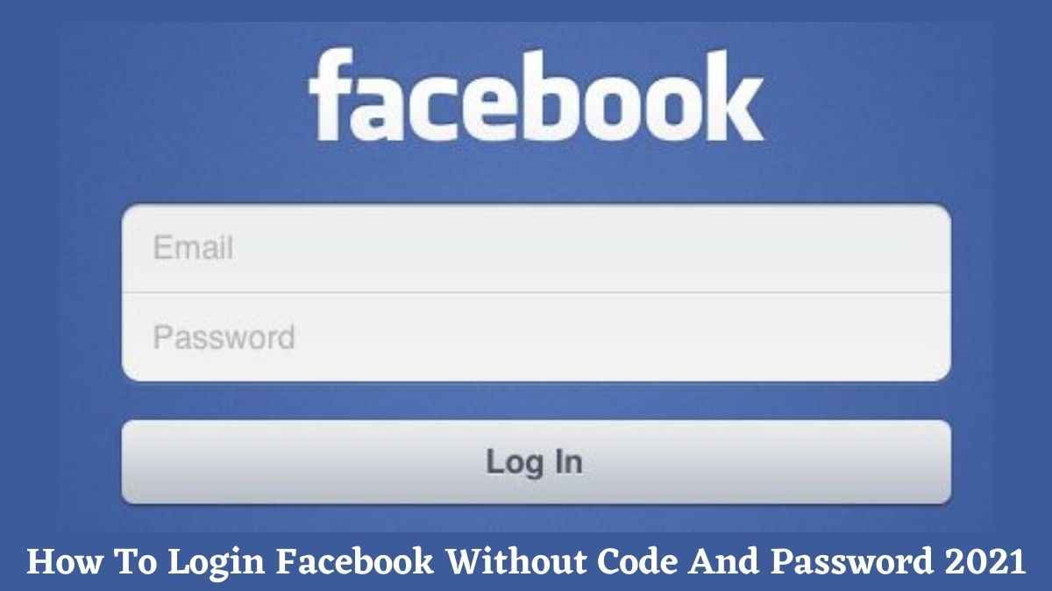
WARM-UP
1. What is this?
The hidden word:
SEIENCC
SMARTPHONE
_ _ _ _ _ _ _ _ _ _
PIGEON
2. My favourite bird is _ _ _ _ _ _ .
ACCOUNT
3. I don't have a Facebook _ _ _ _ _ _ _ .”

Slide 32
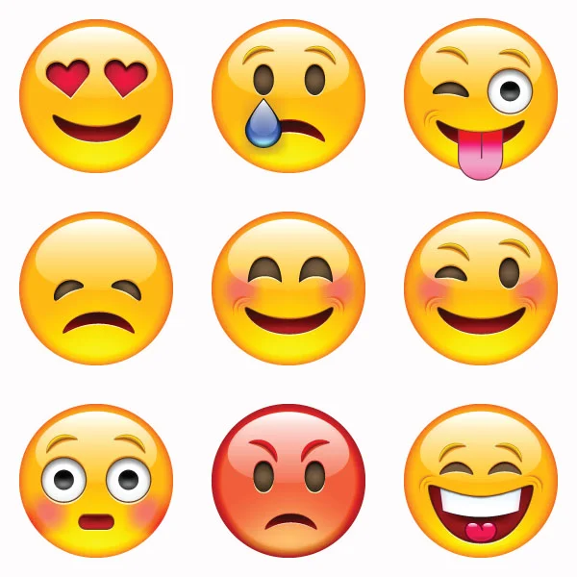
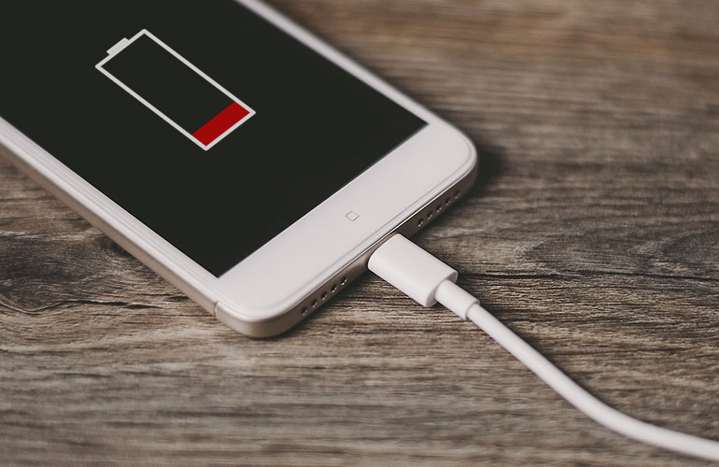
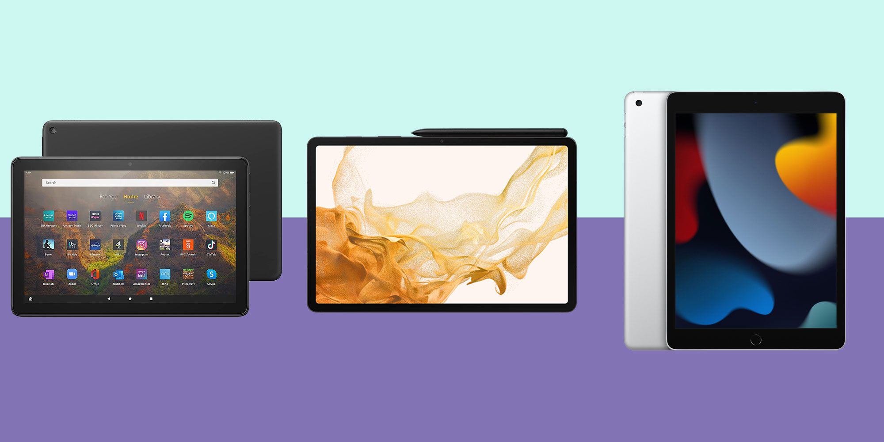
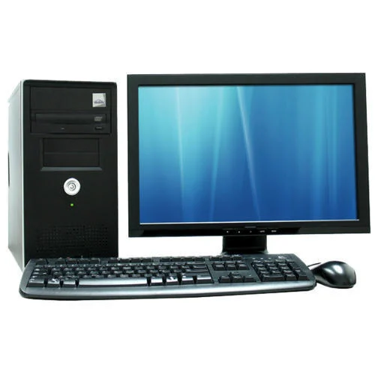
WARM-UP
The hidden word:
EOTLHYGNCO
4. What are they?
7. Don't unplug my phone.
It's _ _ _ _ _ _ _ _ .
CHARGING
EMOJIS
_ _ _ _ _ _
TABLETS
5. I prefer using _ _ _ _ _ _ _ to smartphones .
8. What is this?
It's a _ _ _ _ _ _ _ _ .
TELEPATHY
COMPUTER
6. _ _ _ _ _ _ _ _ _ the direct communication of thoughts or feelings from one person to another without using speech, writing, or any other normal method.

Slide 33
WARM-UP
The hidden words:
SEIENCC
EOTLHYGNCO
SCIENCE
TECHNOLOGY
_ _ _ _ _ _ _
_ _ _ _ _ _ _ _ _ _

Slide 34
* VOCABULARY
New words | Pronunciation | Meaning
1. technology (n) | /tekˈnɒlədʒi/ | Công nghệ
2. face-to-face | /ˌfeɪs tə ˈfeɪs/ | Trực tiếp, mặt đối mặt
3. epidemics (n) | /ˌepɪˈdemɪk/ | Đại dịch
4. breakout room (n) | /ˈbreɪkaʊt rʊm / | Phòng học chia nhỏ
5. contact lens (v) | /ˈkɒntækt lenz/ | Kính áp tròng
6. invention (n) | /ɪnˈvenʃn/ | Phát minh

