Slide 1
Unit 11:
Travel in Future
Lesson 5: Skills 1

Slide 2
OBJECTIVES
read for general and specific information about a future car.
talk about why a means of transport will / won’t be popular
reading
speaking

Slide 3
BOARD RACING:
Work in teams of 6 to guess the words base on the hints.
3 hints/word
Take turn to write the words into the boards then say BINGO.
The fastest to guess the word correctly gets 1 point.
Notes:
Teacher prepare small black boards and markers

Slide 4

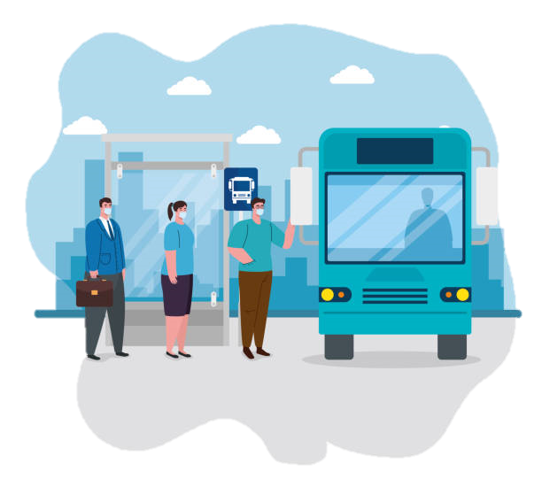
passenger (n)
1. A noun starts with P
2. a person who is travelling in a vehicle but is not driving it, flying it, or working on it
/ˈpæs.ən.dʒər/

Slide 5
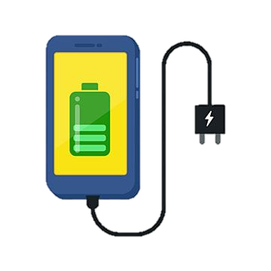
charge
1. A verb starts with C
2. to put electricity into an electrical device such as a battery.
/tʃɑːdʒ/

Slide 6
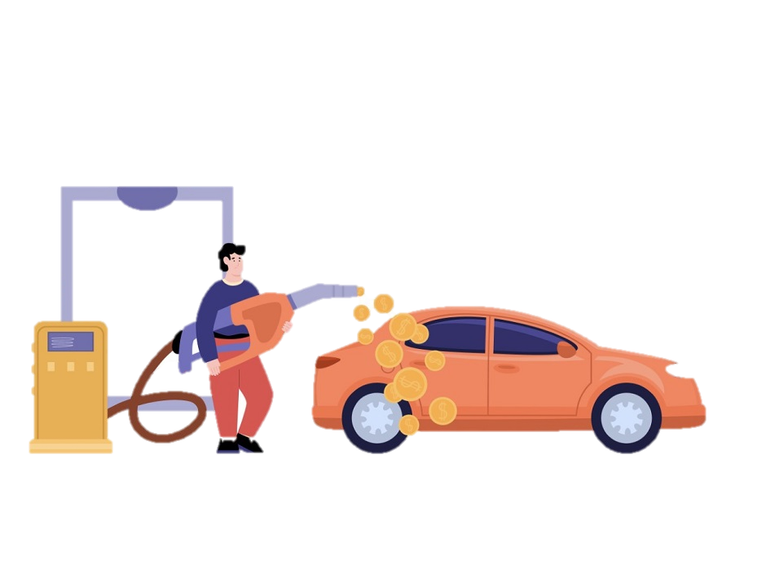
economical
1. An adj starts with E
2. not using a lot of fuel, money, etc
/ˌiː.kəˈnɒm.ɪ.kəl/

Slide 7
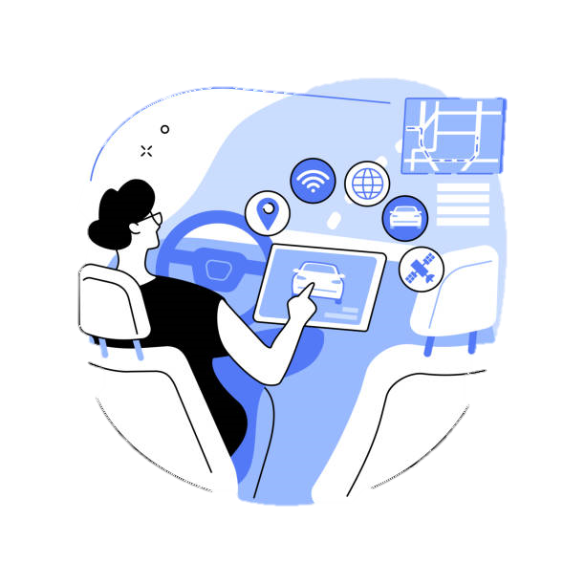
autopilot (adj/n)
1. An adj/n starts with A
2. Be driven itself
/ˈɔː.təʊˌpaɪ.lət/

Slide 8

function (n)
1. A n starts with F
2. the natural purpose (of something) or the duty (of a person)
/ˈfʌŋk.ʃən/

Slide 9
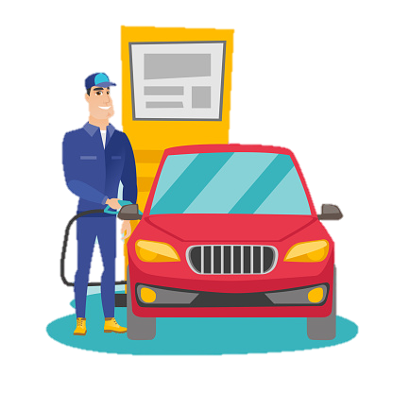
Run on (phr)
1. A phrasal verb starts with R and O
2. Be powered by sth
/rʌn ɒn/

Slide 10
VOCABULARY
Form | Meaning | Pronunciation | Vietnamese equivalent
1. (to) charge | to put electricity into an electrical device such as a battery. | /tʃɑːdʒ/ | sạc pin
2. passenger (n) | a person who is travelling in a vehicle but is not driving it, flying it, or working on it | /ˈpæs.ən.dʒər/ | hành khách
3. economical (a) | not using a lot of fuel, money, etc. | /ˌiː.kəˈnɒm.ɪ.kəl/ | tiết kiệm nhiên liệu
4. autopilot (adj, n) | a device that keeps aircraft, spacecraft, and ships moving in a particular direction without human involvement | /ˈɔː.təʊˌpaɪ.lət/ | lái tự động
5. function (n) | the natural purpose (of something) or the duty (of a person) | /ˈfʌŋk.ʃən/ | chức năng
6. (to) run on | If a machine runs on a particular type or supply of power, it uses that power to work | /rʌn ɒn/ | chạy bằng (nhiên liệu nào)

Slide 11
01
reading
read for general and specific information aboaut a future car.

Slide 12

Read the passage and answer the question
What is its main idea?
A. Roadrunner is a success.
B. Roadrunner is a car company.
C. Roadrunner’s cars have an autopilot function.
Roadrunner
Roadrunner is a car company that makes electric cars. The company introduced the first model in 2015 and they named it Speed. Speed soon became a success.
Notes:
Bài khóa
Roadrunner là một công ty sản xuất ô tô điện. Công ty đã giới thiệu mô hình đầu tiên vào năm 2015 và họ đặt tên cho nó là Speed (Tốc độ). Speed sớm thành công. Speed an toàn, nhanh chóng, thoải mái và không tốn kém nhiều. Nó có bốn chỗ ngồi. Xe có thể di chuyển trên 350 km /h. Bạn chỉ phải sạc pin sau mỗi 700 km. Nó thậm chí còn có một màn hình chơi game bên trong xe.
Công ty sẽ giới thiệu một mô hình mới vào năm tới có tên là Safety (An toàn). Mẫu xe này sẽ trở thành chiếc xe điện lớn nhất và an toàn nhất mà bạn có thể mua. Nó sẽ có thể chở bảy hành khách. Mô hình mới cũng sẽ tiết kiệm hơn.
Cả hai mô hình đều có chức năng lái tự động, vì vậy chúng không cần người lái. Hành khách có thể đọc, chơi trò chơi hoặc thậm chí ngủ trong khi đi du lịch.

Slide 13
2. Read the passage again and complete the fact file with no more than two words or a number (p120)
Name of the company | Roadrunner
Speed was introduced in | (1) ____________
Safety will be the | (2) ________ and (3)________ electric car
Both models have | a gaming screen and an (4) ___________
Both models run on | (5) ________________
Passengers can | read, sleep, play games

Slide 14
2. Read the passage again and complete the fact file with no more than two words or a number (p120)
Name of the company | Roadrunner
Speed was introduced in | (1) ____________
Safety will be the | (2) ________ and (3)________ electric car
Both models have | a gaming screen and an (4) ___________
Both models run on | (5) ________________
Passengers can | read, sleep, play games
2015
The company introduced the first model in 2015 and they named it Speed.

Slide 15
2. Read the passage again and complete the fact file with no more than two words or a number (p120)
Name of the company | Roadrunner
Speed was introduced in | (1) ____________
Safety will be the | (2) ________ and (3)________ electric car
Both models have | a gaming screen and an (4) ___________
Both models run on | (5) ________________
Passengers can | read, sleep, play games
2015
largest
safest
The company will introduce a new model next year called Safety. This model will become the largest and safest electric car you can buy.

Slide 16
2. Read the passage again and complete the fact file with no more than two words or a number (p120)
Name of the company | Roadrunner
Speed was introduced in | (1) ____________
Safety will be the | (2) ________ and (3)________ electric car
Both models have | a gaming screen and an (4) ___________
Both models run on | (5) ________________
Passengers can | read, sleep, play games
2015
Both models have an autopilot function, so they are driverless.
largest
safest
autopilot function

Slide 17
2. Read the passage again and complete the fact file with no more than two words or a number (p120)
Name of the company | Roadrunner
Speed was introduced in | (1) ____________
Safety will be the | (2) ________ and (3)________ electric car
Both models have | a gaming screen and an (4) ___________
Both models run on | (5) ________________
Passengers can | read, sleep, play games
2015
Roadrunner is a car company that makes electric cars.
largest
safest
autopilot function
electricity

Slide 18
3. Retelling
Close your book and just look at the table in task 2 to retell what you have read about “Roadrunner”.

Slide 19
GAME TIME!
READING SUMMARY
Work in teams of 6
Raise your hands to answer the questions
The fastest to guess the word correctly gets 1 point.

Slide 20
Reading summary
01
02
03
04
What did we read about?
Name the car model were introduce?
Roadrunner – an electric car company
Speed and safety
Which one has a gaming screen inside
Which one is more economical
Speed
Safety

Slide 21
02
speaking
talk about why a means of transport will / won’t be popular

Slide 22
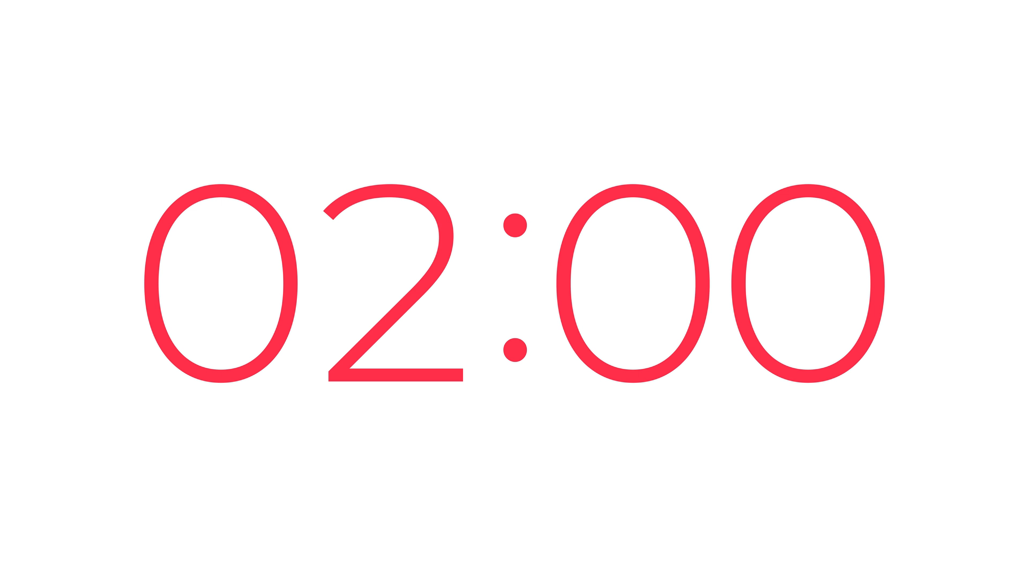
4. Work in pairs. Look at the fact file in 3 then ask and answer questions about it.
(P.102)
Example:
A: What is the name of the company?
B: Roadrunner.
A: When did the company introduce its first model?
B: In 2015.
Notes:
Sample:
A: What will Safety be?
B: It will be the largest and safest electric car.
A: What will both models have?
B: They will have a gaming screen and an autopilot function.
A: What will both models run on?
B: Electricity.
A: What can passengers do?
B: read, sleep, play games

Slide 23
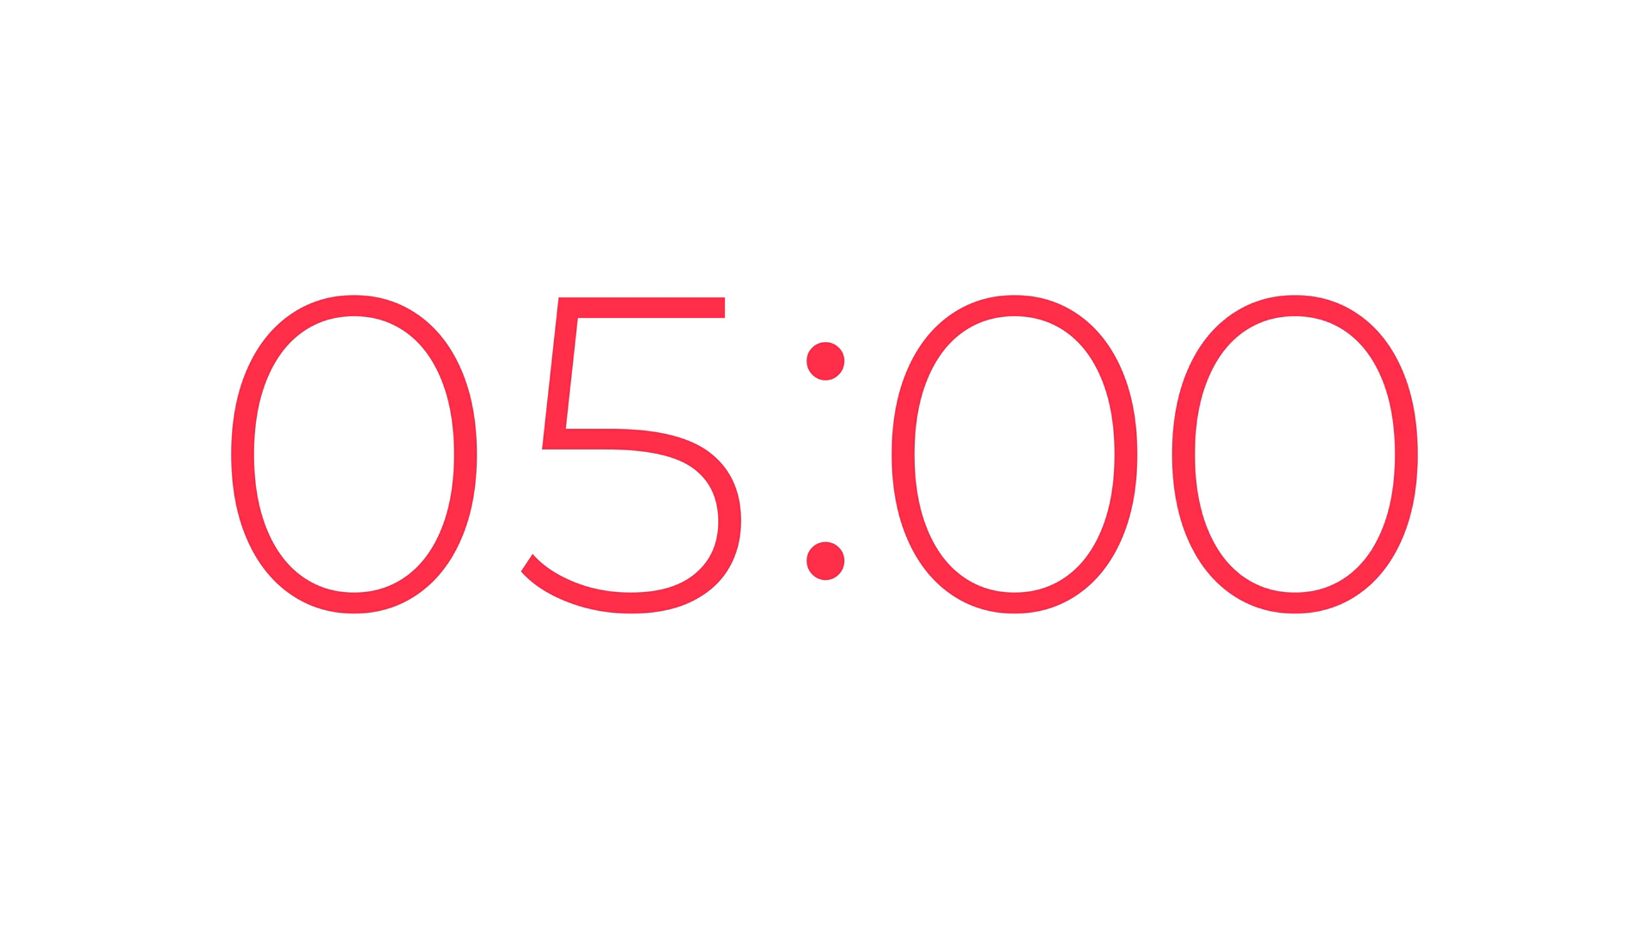
5. Work in groups. Discuss why Roadrunner's cars will or won't become popular in the near future. Report your reasons to the class.
Example:
- We think Roadrunner's cars will become popular in the near future because they are fast...
- We think Roadrunner's cars won't become popular in the near future because they might be dangerous / expensive...
Notes:
Sample:
- We think Roadrunner’s car will become popular in the near future because they are eco-friendly.
- We think Roadrunner’s car won’t become popular in the near future because they might be dependent on battery.
- We think Roadrunner’s car will become popular in the near future because they allow passengers read, sleep, play games.

Slide 24
REPORT TIME!

Slide 25
Let’s recap!
What have we learnt today?

Slide 26
HOMEWORK
PREPARE FOR THE NEXT LESSON

Slide 27
Thanks for listening!

