Slide 1

WELCOME  TO  OUR  CLASS
ENGLISH 6

Slide 2
Miêu tả hình dáng bên ngoài :
S + Is/ am/ are + adj ( Hình dáng , đặc điểm bên ngoài / tính cách )
S + has / have + (a/ an) + adj + N ( từ chỉ bộ phận trên cơ thể )

Slide 3
* Warm-up
* Brainstorming:
kind
slim
APPEARANCE
PERSONALITIES
Appearance: tall, short, beautiful, smart, …
Personalities: confident, careful, clever, funny, …

Slide 4


UNIT 3: MY FRIENDS
Period 22:

Slide 5

* Vocabulary
Choose the correct answer A, B, or C.
1.
Nick is very . He makes everyone laugh!
A.
confident
B.
funny
C.
active
2.
My sister always does her homework before class.
She’s very .
A.
hard-working
B.
creative
C.
careful
3.
Mi is . She helps me with my homework.
B.
C.
kind
A.
hard-working
friendly
4.
He is a person. He cares about everybody.
A.
B.
friendly
C.
clever
caring
5.
My best friend is very . She likes doing activities.
A.
B.
clever
C.
active
creative

Slide 6
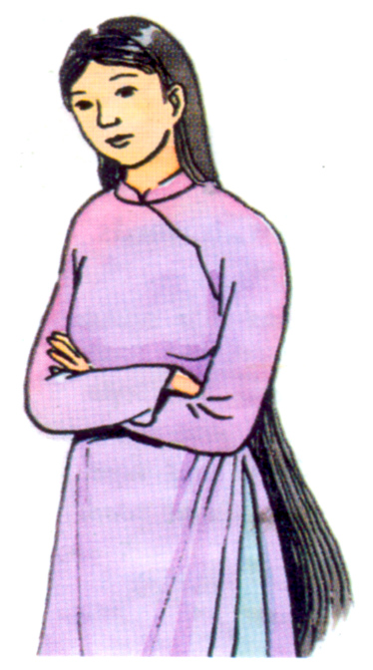
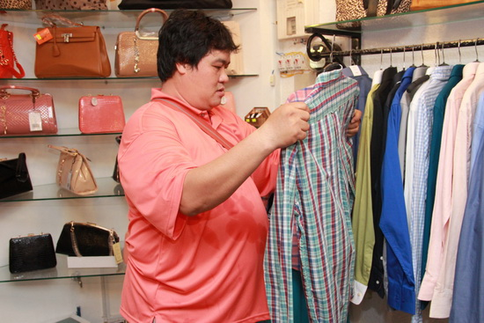
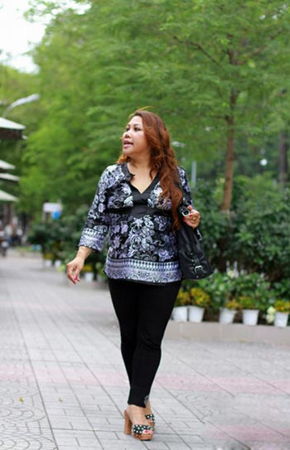
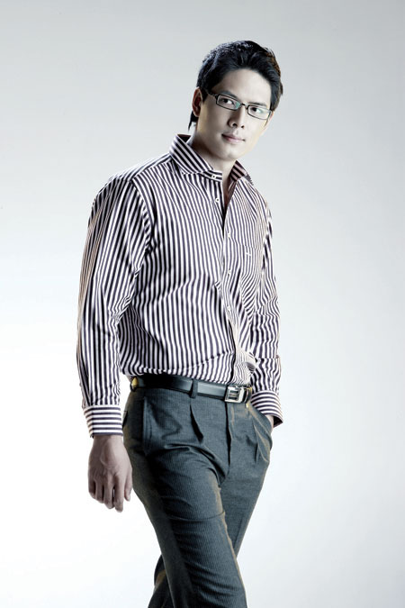
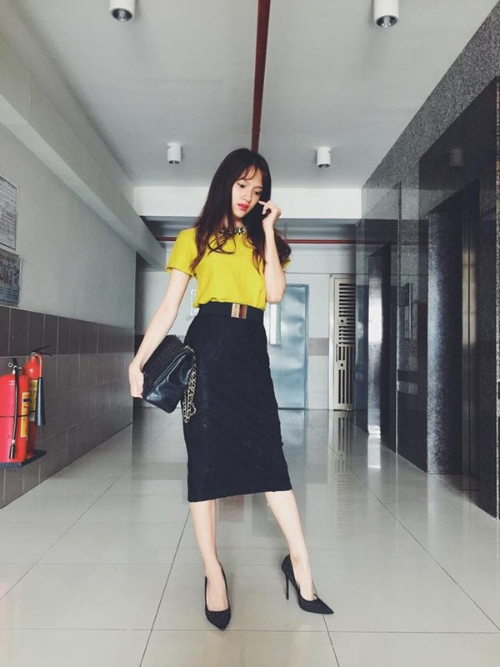
Look at the picture and answer the question
What does she/he look like?
- She is tall.
- She has a long black hair.
- She has a round face with a small nose
- She is very beautiful
He is tall.
He has short hair.
He has an oval face
He is very handsome.
- She is slim.
- She has a long black hair.
- She has an oval face.
- She is beautiful.
- She is short and fat.
She has a long brown hair.
She has a big face.
- He is tall and fat .
- He has a short black hair.
- He has a big face

Slide 7

Answer questions about your classmates.
1.
Who has long hair in your class?
2.
Who has a small nose?
3.
Who has a round face?
4.
Does the classmate next to you have long hair?
5.
Does the classmate next to you have big eyes?

Slide 8


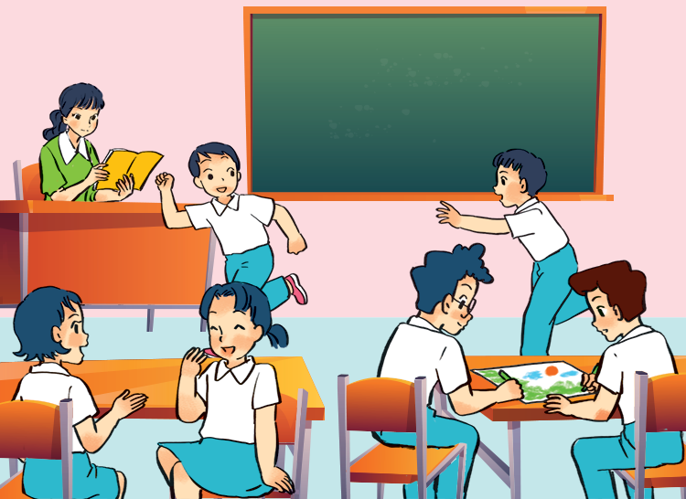
* Grammar
Put the verbs in brackets in the present continuous.
This is my class during break time. Some boys
(1. run) _______ around the class. Mi and Mai
(2. talk) _______ . Nam and Phong (3. not talk) _______ . They (4.draw) _______ something.
My teacher is in the classroom too. She (5. not teach) _______ . She’s reading a book.
are running
are talking
are
not talking / aren’t talking
are drawing
is not teaching / isn’t teaching

Slide 9
The present simple
S + Is/ am/ are + N/ adj / adv /..
S + V ( infinitive / s/es)
I/ we/ you/ they + V infinitive
She / He/ It/ + V (s/ es )
S + Don’t / Doesn’t + V infinitive
Do/ Does + S + Vinfinitive ?
Yes, S + do/ does
No, S + don’t/ doesn’t .

Slide 10
Grammar
The present continous tense
S + is/ am/ are + V ing
S + is/ am/ are + not + Ving
Is/ Are / Am + S + Ving ? Yes, S + is/ am/ are
No, S + is/ am/ are + not .
Dấu hiệu : Now, at the moment, right now, look ! ….
It’s + time , ……

Slide 11

Put the verbs in brackets in the present simple or present continuous.
1.
are
doing
A: What
you (do) ?
B: I (write)
am writing / ‘m writing
an email to my friend.
2.
cycles
A: Mai usually (cycle) to school.
B: Really? I (not cycle)
I (walk) everyday.
don’t cycle.
.
walk
3.
A: Where is Phong?
he (do) his homework?
Is
doing
B: No, he (read)
is reading/ ‘s reading
a book in the living room.

Slide 12


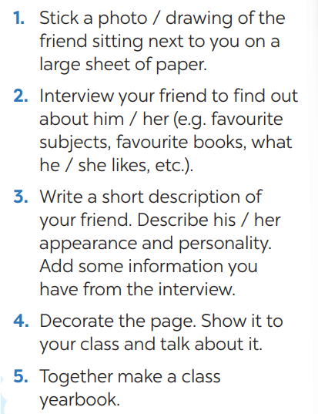
My class
yearbook
How to make
a class yearbook

Slide 13



Homework
Do exercise in workbook..
Prepare : Review 1.
Good bye !

Slide 14


Thank you for your attention!

