Slide 1
love

Slide 2
Warm up:
Game:Pelmanism
KIND
FRIENDLY
FUNNY
CLEVER
1
2
3
4
ACTIVE
6
7
CREATIVE
Vui vẻ
Năng động
5
8
9
10
11
12
Thân thiện
Sáng tạo
Tốt bụng
Thông minh

Slide 3
UNIT 3: MY FRIENDS
Period 19:
Asking about appearance and personality

Slide 4
Listen and read the dialogue between Linda and Mi. Pay attention to the highlighted.
…
Linda: What does your best friend look like?
Mi: She’s short with long black hair.
She has bright brown eyes.
Linda: What’s she like?
Mi: She’s very kind and creative.
…
Notes:
Slide này không đúng.

Slide 5
Structure
1. Ask and answer about appearance ( hỏi và trả lời về hình dáng bên ngoài của ai đó)
What + do/does + S + look like ?
S + have/has + (a/an) + adj + N
(trong đó adj là các tính từ chỉ đặc điểm miêu tả các bộ phận trên cơ thể : small, big, short, long, black, straight, curry, ....
N là danh từ chỉ các bộ phận trên cơ thể : face, hair, nose, head, ……………………………… )
S+ is/ am/ are + adj ( chỉ hình dáng bên bên ngoài )
2. Ask and answer about personality ( hỏi và trả lời về tính cách của một ai đó )
What is/are + S + like ?
S + is/ are + adj
(trong đó adj là các tính từ chỉ tính cách : creative, funny, kind, clever, careful, …………………………

Slide 6
Work with a classmate. Ask him / her about his / her best friend. Remember to use the two questions highlighted in 1.
Tuan: What does your best friend look like?
Hoa : She’s (He’s adj ( miêu tả đăch điểm bên ngoài của ai đó : short, tall, fat, thin, slim, big, small,…
She(he) has a/an +adj + N ( miêu tả đăch điểm của các bộ phận trên cơ thể ( a short black hair/ a round face/ big brown eyes/ ……
Tuan: What’s she /he like?
Hoa : She’s( He’s adj ( tính cách : funny, kind, hard working, creative, careful, caring, clever,…

Slide 7
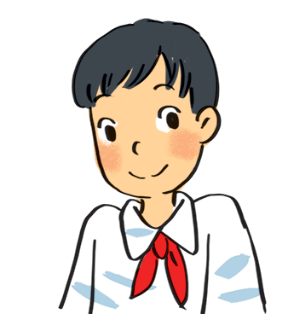
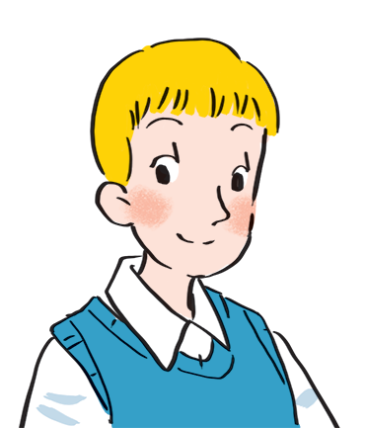
Read about these students in 4Teen magazine. Use one or two adjectives to describe them.
clever
I live in Da Nang. At home, I can do my homework without my parents’ help. At school, I like speaking English. I’m going to an English club now.
hard-working
I come from Cambridge. In my free time, I draw pictures and play the piano. I also help some old people near my house. I usually read to them at the weekend. Now I’m drawing in my garden.
creative
kind
Notes:
City landmarks phải ở trên mục 3

Slide 8
We may have different personalities because we have different birthdays.
Read the descriptions below. Do you think they match the friends in 3?
21/3 – 19/4 | confident, active
20/4 – 20/5 | loving, hard-working
21/5 – 21/6 | active, friendly
22/6 – 22/7 | caring, clever
23/7 – 22/8 | confident, creative
23/8 – 22/9 | careful, hard-working
23/9 – 23/10 | creative, friendly
24/10 – 21/11 | careful, funny
22/11 – 21/12 | clever, confident
22/12 – 19/1 | careful, hard-working
20/1 – 18/2 | friendly, clever
19/2 – 20/3 | kind, creative

Slide 9
Read the descriptions in 4.
Share your opinion with the class.
Example:
My birthday is …
It’s true that …
It isn’t true that …

Slide 10
homework
- Practice speaking about your best friend.
- prepare next lesson

Slide 11
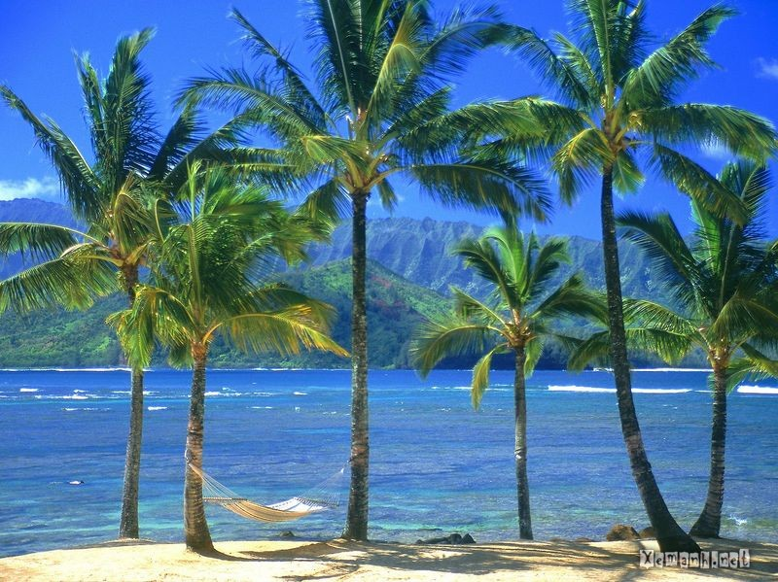
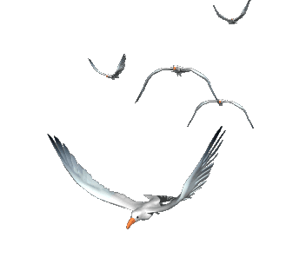
Goodbye!
See you again!

