Slide 2
UNIT 3: MY FRIENDS
Period 18 : A closer look 2

Slide 3
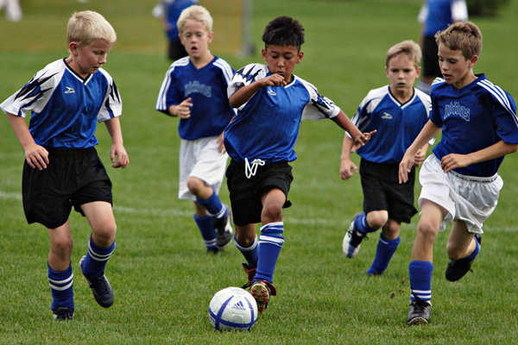
They are playing football.
What are they doing?

Slide 4
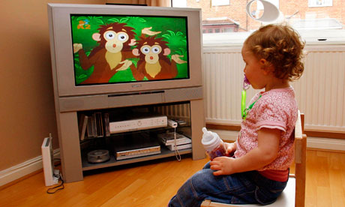
He is watching T.V

Slide 5
They are riding a bike

Slide 6
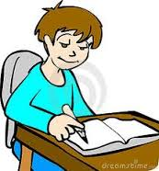
Is he writing ?
Yes. he is writing

Slide 7
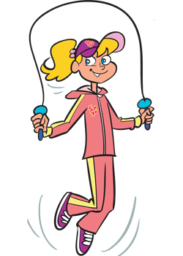
Is she dancing?
No,she isn’t. She is skipping

Slide 8
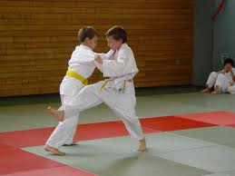
Actions now
THE PRESENT
CONTINUOUS
TENSE

Slide 9
I. Grammar:
The present continuous
(Thì hiện tại tiếp diễn)
1. Using( Cách sử dụng) : We use the present continuous for actions happening now.
Example: - She’s talking.
- They’re not talking.
2. Signal ( dấu hiệu) We can use the present continuous with now, at present, or at the moment.
Example: - I’m doing my homework at present.
- A: Are you reading now?
B: Yes, I am.

Slide 10
3.Form( Cấu trúc): Present continuous
 | Form | Example
Khẳng định | S + is/am/are + V-ing | Lan is reading I am watching TV They are playing soccer
Phủ định | S + is/am/are not + V-ing | Lan is not reading
Nghi vấn | Is/Am/Are/ + S + V-ing? Yes, S + is/am/are No, S + is/am/are not | Are you listening to music? Yes, I am No, I amnot
Câu hỏi | Wh + is/am/are + S + V-ing? S + is/ am/are + V-ing | What are you doing now? I am studying English.

Slide 11
4. Các quy tắc thêm –ing vào sau động từ
Các quy tắc | Ví dụ
Động từ kết thúc bởi “e”, ta bỏ “e” thêm “ing” | Have- having | Make- making
 | Write – writing | Come- coming
Động từ kết thúc bởi “ee”, ta thêm “ing” mà không bỏ “e” | See- seeing | Agree - agreeing
Động từ kết thúc bởi “ie”, ta đổi “ie” thành “y” rồi thêm đuổi “ing” | Lie – lying | Die- dying
Động từ kết thúc bởi 1 nguyên âm (u,e,o,a,i) + 1 phụ âm, ta gấp đôi phụ âm cuối rồi thêm –ing. | Run- running | Stop - stopping
 | Get – getting | Travel - travelling

Slide 12
II. Practice
1.Put the verbs in brackets in the present continuous.
1.
Nam (read)
is reading
a book now.
2.
They (play)
are playing
football at the moment.
3.
My sister (not make)
isn’t making
a sandwich at present.
am going
4.
I (go) to the supermarket at the moment.
5.
Are
talking
they (talk) about their new friends?

Slide 13
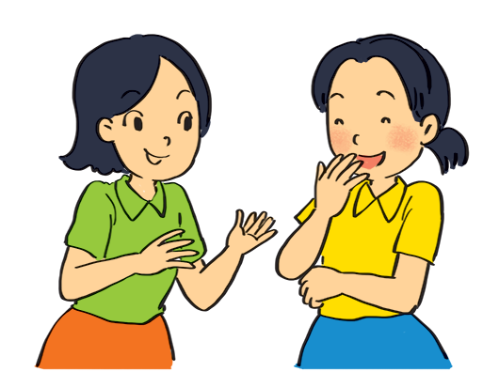
Look at the pictures. Write sentences like the example. Use positive or negative present continuous verbs.
Example:
She’s talking to Mai. (talk)

Slide 14
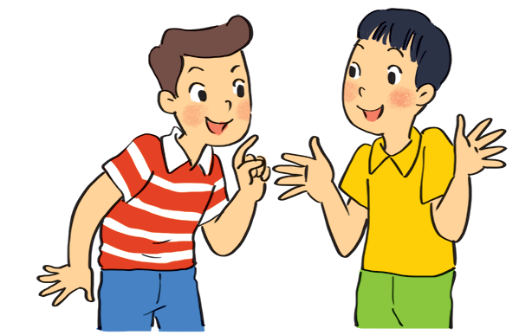
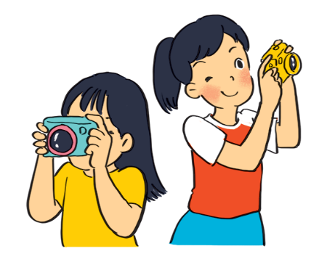
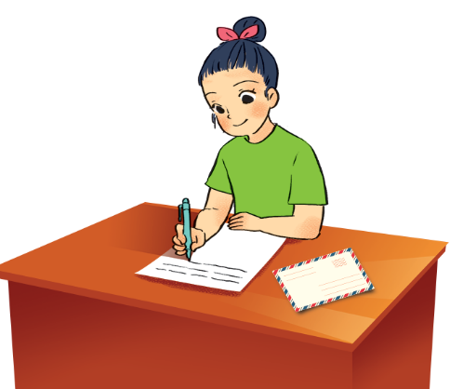
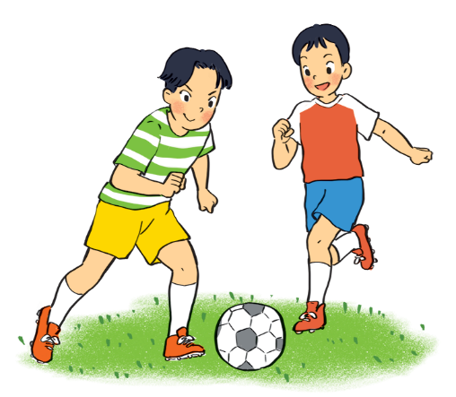
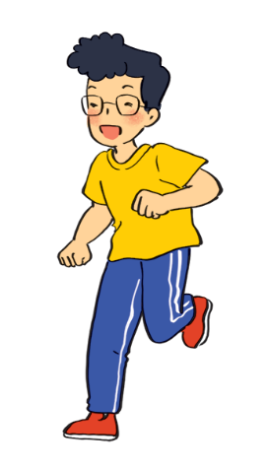
.
1.
Nam and Ba
(eat ice cream)
are not / aren’t eating ice cream.
2.
are taking photos.
Lan and Trang
(take photos)
.
3.
Ha
(write a letter)
is / Ha’s writing a letter.
.
4.
Duong and Hung
(play badminton)
are not / aren’t playing badminton.
.
is not / isn’t drawing a picture.
5.
.
Phong
(draw a picture)

Slide 15
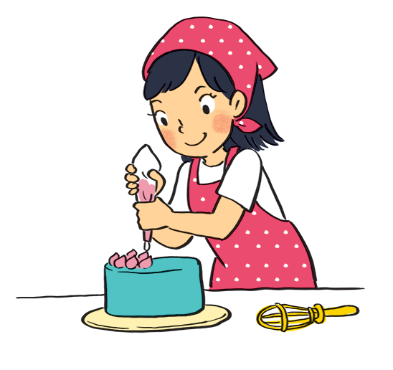
Work in pairs. Look at the pictures. Ask and answer.
Example:
A: your sister / make a cake?
Is your sister making a cake?
B: Yes, she is.

Slide 16
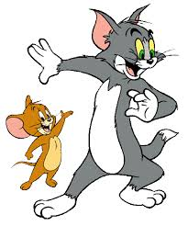
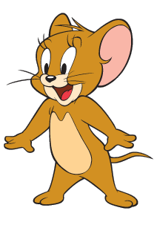
Game: Lucky numbers
1
2
3
4
5
6
7
8

Slide 17
LUCKY NUMBER!

Slide 18
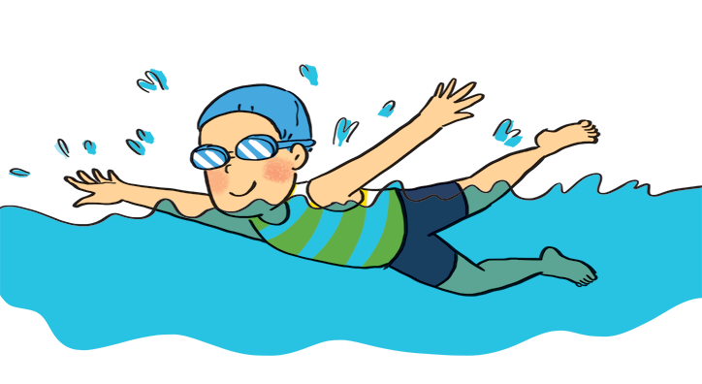
1
A: your friend / swim?
B:
Is your friend swimming?
Yes, he is.

Slide 19
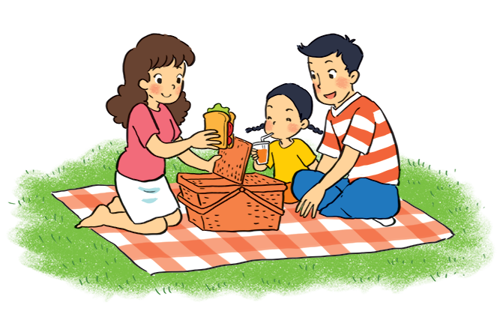
2
A: they / listen to music?
B:
Are they listening to music?
No, they aren’t.
(They’re / They are having a picnic.)

Slide 20
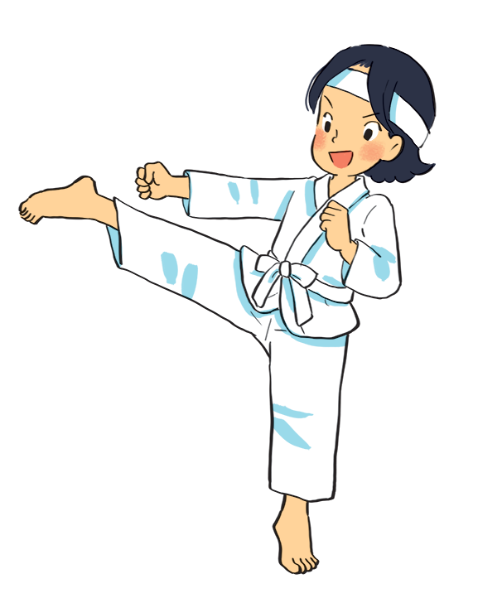
3
A: Mi / play the piano?
B:
Is Mi playing the piano?
No, she isn’t.
(She’s / She is doing karate.)

Slide 21
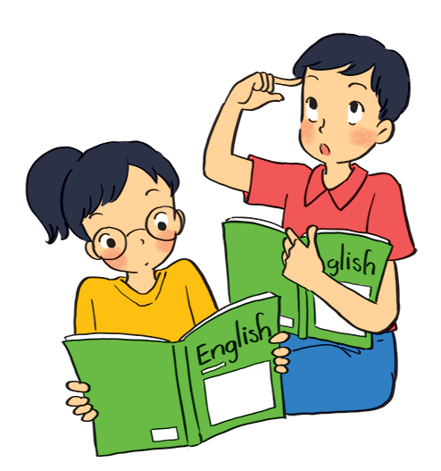
4
A: they / learn English?
B:
Are they learning English?
Yes, they are.

Slide 22
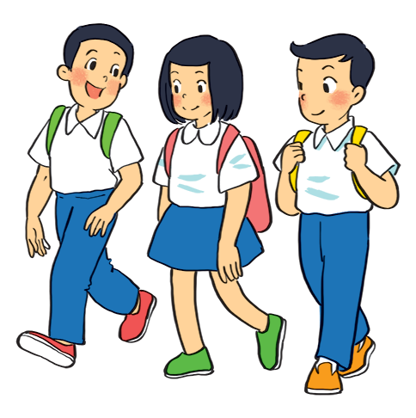
5
A: your friends / cycle to school?
B:
Are your friends cycling to school?
No, they aren’t.
(They’re / They are walking to school.)

Slide 23
LUCKY NUMBER!

Slide 24
LUCKY NUMBER!

Slide 25
Grammar
The present continuous
When something often happens or is fixed, we use the present simple.
When something is happening now, we use the present continuous.
+ Khi một điều gì đó thường xảy ra hoặc đã được xác định( chắc chắn), chúng ta sử dụng thì hiện tại đơn.
+ Khi một điều gì đó đang xảy ra ở hiện tại, chúng ta sử dụng thì hiện tại tiếp diễn.

Slide 26
Put the verbs in brackets in the present simple or present continuous.
My best friend (not walk)
Sometimes she (cycle) .
1.
doesnot / doesn’t walk
to school every day.
cycles
2.
he (play) ?
is
playing
Look! What
your friends (study)
every afternoon?
3.
Do
study
in the library
4.
I (write)
am / ‘m writing
an email to my friend now.
5.
He (not do)
He (read)
is not / isn‘t doing.
his homework now.
is / ‘s reading
.

Slide 27
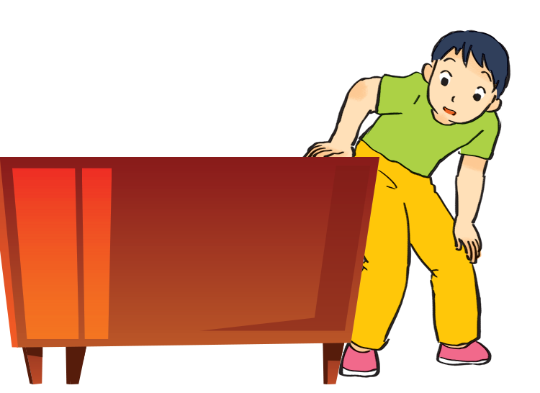
Charades
Take turns to mime different actions.
Others guess what you are doing.
Example:
A: Are you dancing?
B: No, I’m not.
C: Are you looking for something?
B: Yes, I am.

Slide 28
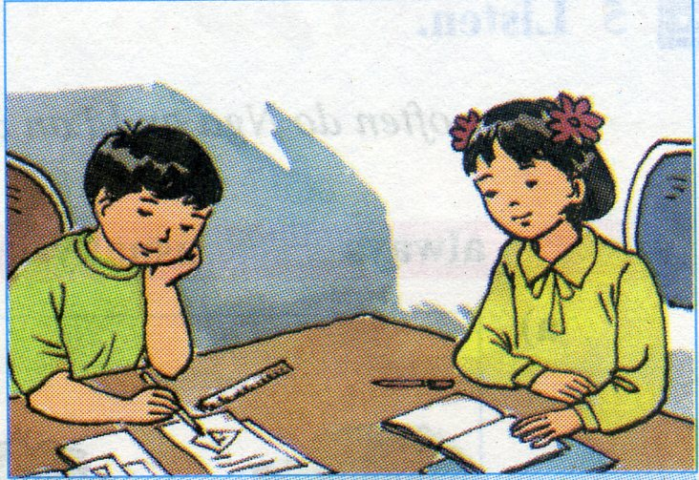
* Home work
Learn by heart grammar.
Do exercise in workbook.
Prepare new lesson:
Unit 3. Lesson 4. Communication

Slide 29
Goodbye – See you again.

