Slide 1

WELCOME  TO  OUR  CLASS
ENGLISH 6

Slide 2

LISTEN A SONG AND FILL WORDS IN THE BLANKS
K
1. wardrobe
2. friends
3. often
4. eat
5. fun
Inside my beautiful room. I have a bed and a (1)………
And a mirror. I have many (2)……… .
And they (3)………come. We(4)………, we play, we have(5)……...
In my room, In my room.
Me and my friend in my room.

Slide 3

Do you have a lot of friends?

Slide 4

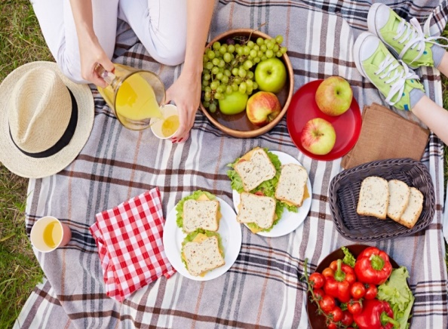
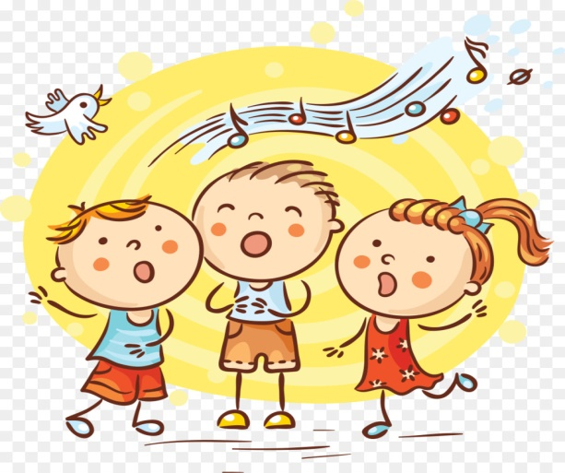

What can you do with your friends?
…………….
We can eat and drink together
We can play some games
we sing some songs

Slide 5

UNIT 3: MY FRIENDS
Period 16 : Getting started

Slide 6
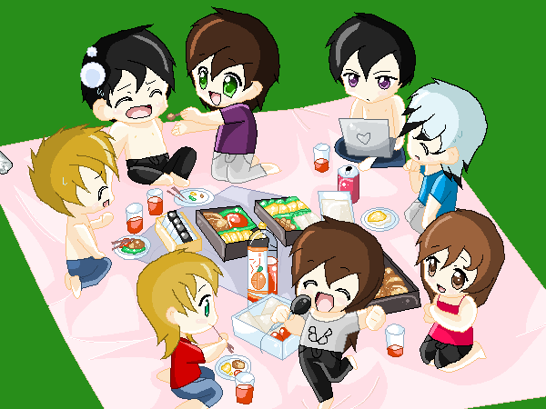
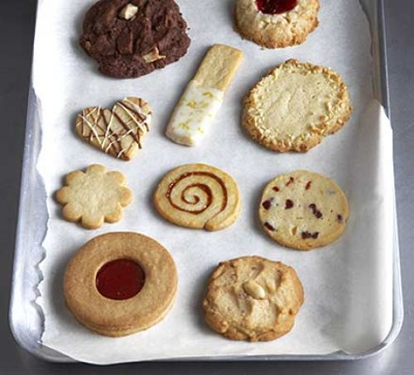



UNIT 3: MY FRIENDS
LESSON 1: Gettingstarted
I. Vocabulary:
- Picnic /ˈpɪk.nɪk/ (n):
dã ngoại
- Biscuit /ˈbɪs.kɪt/ (n):
bánh quy
pass /pɑːs/ (v)
chuyển qua, đưa qua
Glasses /ɡlæs·əz/ (n ) :
mắt kính
Magazine /ˌmæɡ.əˈziːn/(n):
tạp chí
-surprise/səˈpraɪz(a):
bất ngờ, ngạc nhiên

Slide 7
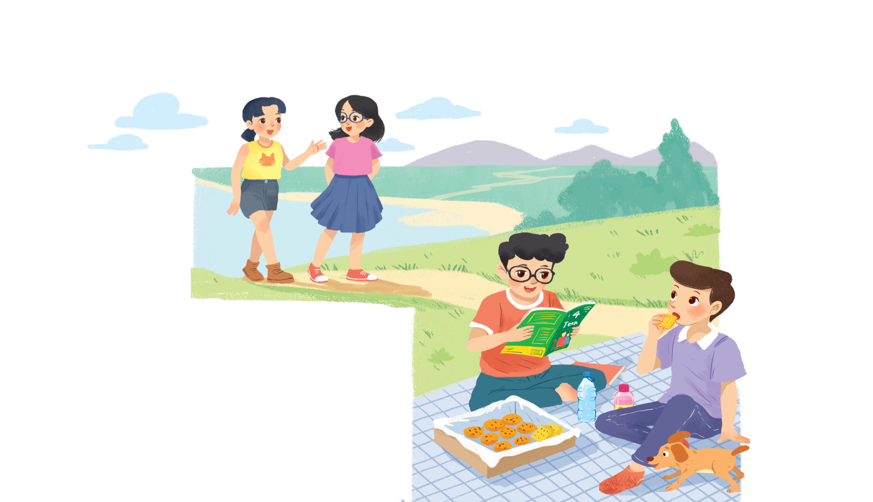
II. Listen and read.
A surprise guest
1. Practice the dialogue
Notes:
Thiếu tên bài đọc.

Slide 8

A surprise guest
Phong: That was a great idea, Nam.
I love picnics!
Nam: Please pass me the biscuits.
Phong: Sure. Here you are.
Nam: Thanks. What are you reading, Phong?
Phong: 4Teen. It’s my favourite magazine!
Nam: Look! It’s Mai. And she is with someone.
Phong: Oh, who’s that? She has glasses and long black hair.
Nam: I don’t know. They’re coming over.
Mai: Hi there. This is my friend Chau.
Phong & Nam: Hi, Chau. Nice to meet you.
Chau: Nice to meet you, too.
Nam: Would you like to sit down? We have lots of food.
Mai: Oh, sorry, we can’t. We’re going to the bookshop.
Chau: Bye for now.
Phong & Nam : Bye bye.

Slide 9

Fill the blanks with the words from the conversation.
1.
Phong and Nam are having a .
picnic
2.
4Teen is Phong’s
favorite magazine.
3.
Mai
Chau.
Phong and Nam see and
.
4.
Chau has and
long black hair.
glasses
5.
are going to
Mai and Chau
the bookshop.
the bookshop.

Slide 10

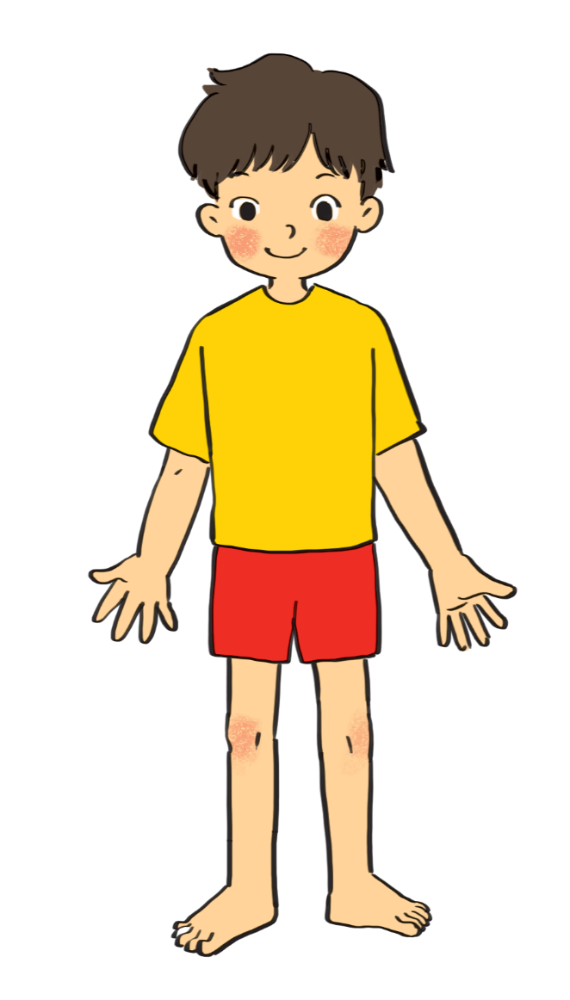
Label the body parts with the words in the box.
1.
10.
9.
2.
8.
3.
7.
4.
5.
6.
Do you know any other words for body parts?

Slide 11
Match the word with it’s meaning
cheek
Mắt
eye
Cánh tay
hand
Gò má
arm
Bàn tay
mouth
chân
leg
mũi
nose
Miệng
hair
tóc
shoulder
Bàn chân
foot
vai

Slide 12

cheek
eye
hand
arm
mouth
cheek
eye
hand
arm
mouth
leg
shoulder
leg
nose
hair
foot
nose
hair
shoulder
foot
eye
hair
1.
10.
cheek
nose
9.
2.
mouth
shoulder
8.
3.
arm
7.
hand
4.
6.
foot
leg
5.

Slide 13
Do you know any other words for body parts?
finger
ears
elbow
knee
head
face
finger

Slide 14

Work in groups. Complete the word webs.
Example:
arms
hair
nose
eyes
long / short
big / small
blonde
curly
hair

Slide 15
Work in groups. Complete the word webs.
Example:
arms
hair
long / short
leg

Slide 16
Work in groups. Complete the word webs.
Example:
nose
eyes
head
big / small
feet
hand
ears

Slide 17
Work in groups. Complete the word webs.
Example:
Xoăn, quắn
blonde
curly
long/short
black
hair
Gợn sóng
wavy
straight
fair

Slide 18
Example:
Lan has a long hair
S have/has adj N
Lan’s hair is long.
S be adj
To describe the people , S use the structure
S + have/has + (a/an) + adj + N
OR
S + be + adj

Slide 19


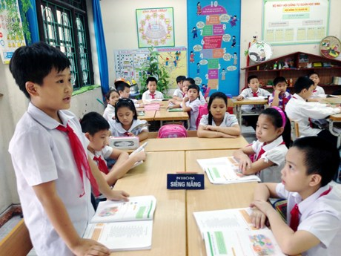
Guessing
Work in groups. Take turns to describe a classmate. Other group members guess who he / she is.
Example:
A: She has long hair and big eyes.
B: Is that Lan?
A: That’s right.

Slide 20
6. Homework
- Learn by heart all the new words.
- Prepare lesson 2 ( A closer look 1).

Slide 21

Goodbye
See you again!!!

Slide 22
Qúy thầy cô có nhu cầu thì kết bạn qua fb ( Côi Nguyễn) hoặc số đt : 0837939997.
(150k/ 1hk)

