Slide 1
Teacher : Nguyễn Thị Lanh
School : Đồng Quang secondary shool
Class : 7
Book : Global susess
Period : 87

Slide 2


Slide 3



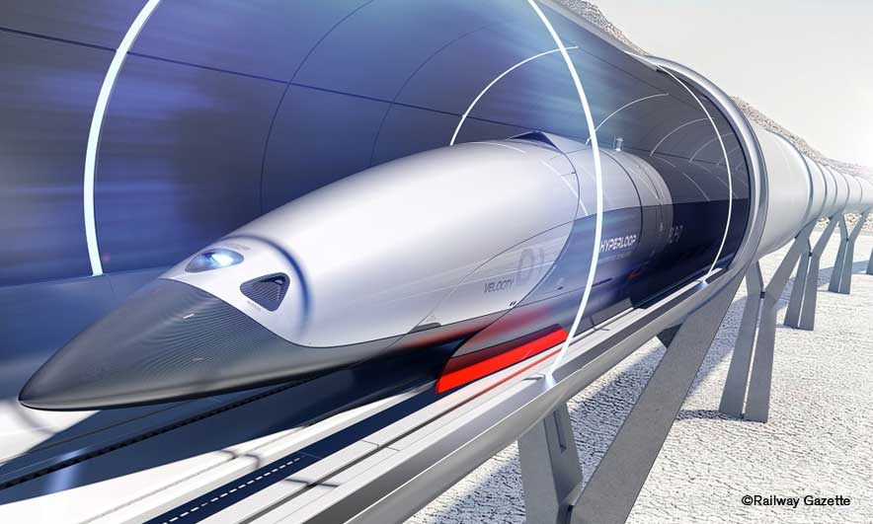
Unit
11
TRAVELLING IN THE FUTURE
Period 87
LESSON 1: GETTING STARTED
I hope we will have a hyperloop soon!
Unit
HOBBIES

Slide 4

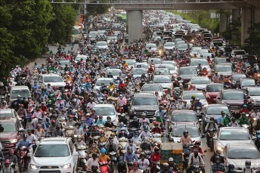
Warm - up
* chatting
+ How do you people travel every day?
+ What do you think about the traffic in the picture?
→ People travel by different means of transport such as cars, motorbikes, bicycles, buses or on foot
→ There's too much traffic on the road. This can easily cause traffic congestion ( traffic jam)

Slide 5
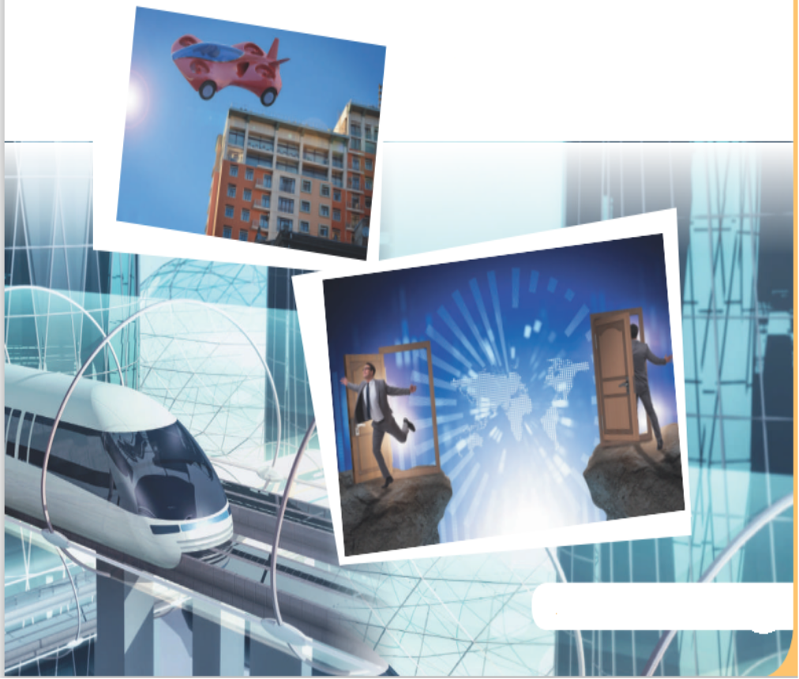
+ How about traffic in the future?
→ I think there will be many modern means of transport that will save energy and protect the environment.

Slide 6
Unit
11
TRAVELLING IN THE FUTURE
LESSON 1: GETTING STARTED
I hope we will have a hyperloop soon!
HOBBIES

Slide 7


* Vocabulary
- eco – friendly (a):
thân thiện với môi trường
/ˈiː.kəʊˌfrend.li/

Slide 8

* Vocabulary
- fume (n):
khói
/fjuːm/

Slide 9

* Vocabulary
- hyperloop (n):
hệ thống giao thông tốc độ cao
/ˈhaɪ.pərluːp/

Slide 10

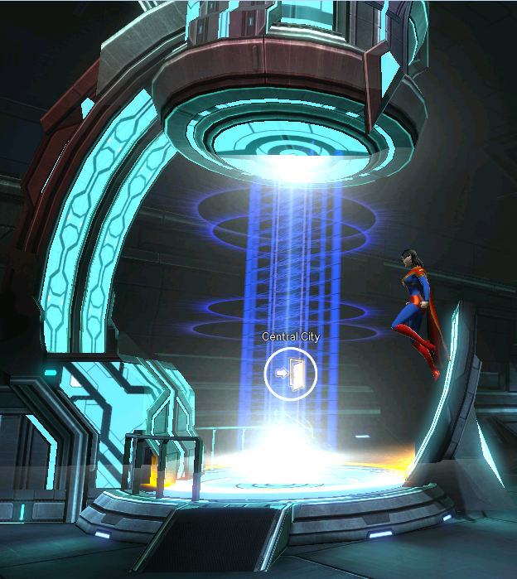
* Vocabulary
- teleporter (n):
phương tiện di chuyển tức thời
/ˈtel.ɪ.pɔː.tər/

Slide 11

* Vocabulary
- campsite (n):
địa điểm cắm trại
/ˈkæmp.saɪt/

Slide 12
PRESENTATION
New words | Pronunciation | Meaning
1. eco-friendly (adj) | /ˈiːkəʊˌfrendli/ | thân thiện với môi trường
2. fume (n) | /fjuːm/ | khói
3. hyperloop (n) | /ˈhaɪpərluːp/ | hệ thống giao thông tốc độ cao
4. teleporter (n) | /ˈtelɪpɔːtər/ | phương tiện di chuyển tức thời
5. campsite (n) | /ˈkæmpsaɪt/ | địa điểm cắm trại

Slide 13
1. LISTEN AND READ
+ Who are they in the conversation ?
→They are Minh and Ann.
+ What are they talking about?
→They are talking about means of transport in the future.

Slide 14
PRACTICE
1
Listen and read. What are Ann and Minh talking about?
Minh: Oh, another traffic jam.
Ann: How will we get to the campsite on time now?
Minh: I don’t know. It’s a pity that we don’t have a hyperloop now!
Ann: What’s a hyperloop?
Minh: It’s a system of tubes. You can go from one place to another in just minutes.
Ann: Amazing! Even faster than a flying car!
Minh: Yes, and there are no traffic jams.
Ann: Will it pollute the environment?
Minh: No. There will be no fumes, and it’s totally safe.
Ann: Like a teleporter?
Minh: A teleporter is also fast, safe and eco-friendly. But it’s a different mode of travel.
Ann: So when we travel in hyperloops, we won’t have to worry about bad weather, right?
Minh: Right.
Ann: Sounds great! I hope we’ll have them soon.

Slide 15
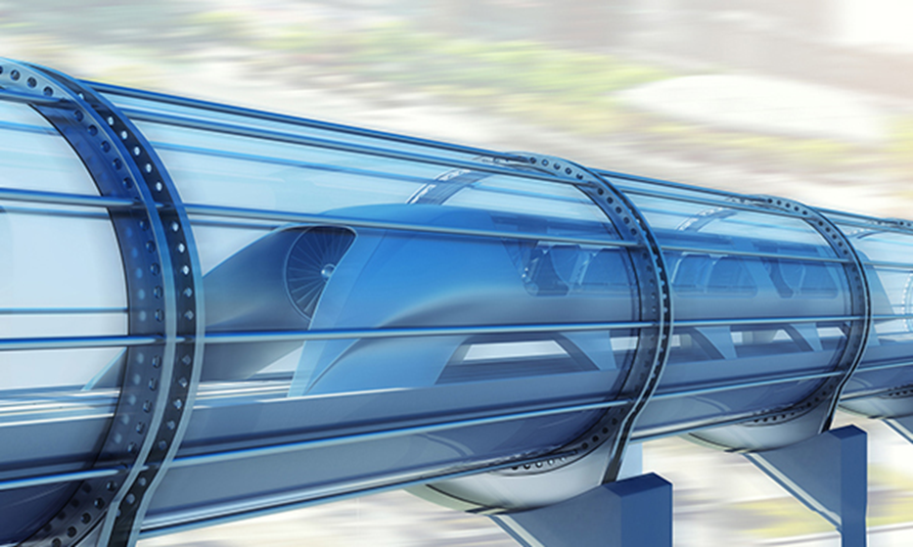
PRACTICE
1
Listen and read. What are Ann and Minh talking about?
A. Travelling by teleporter
B. Future modes of travel
C. Being in a traffic jam

Slide 16
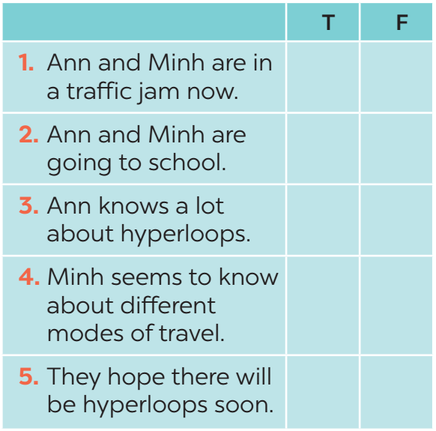

PRACTICE
2
Read the conversation again and tick T (True) or F (False).
→ Ann: How will we get to the campsite on time now?
→ Ann: What’s a hyperloop?

Slide 17
PRACTICE
3
Find the words and phrases that describe the means of transport in the conversation and write them in the correct columns.
Hyperloop | Teleporter
a system of tubes
fast
faster than a flying car
safe
no traffic jams
eco-friendly
no fumes
safe

Slide 18


4
Quiz

Slide 19

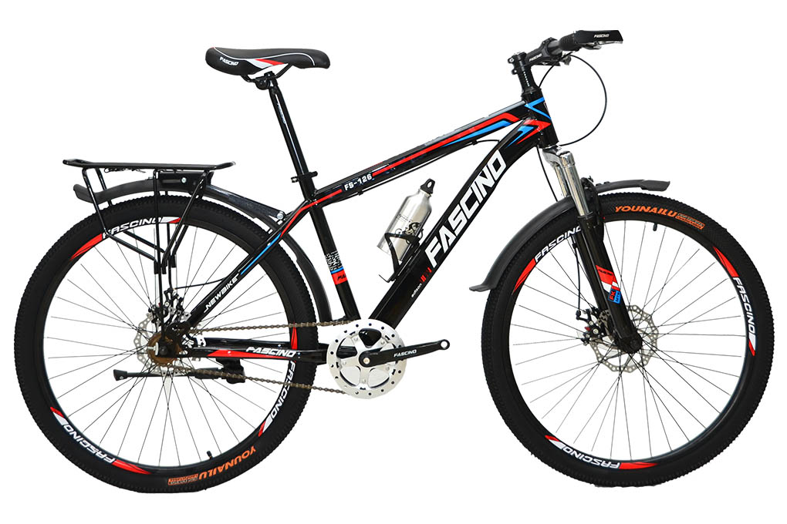
4
Quiz
What vehicle is this?
1. It has two wheels and you pedal it.
→bicycle / bike

Slide 20
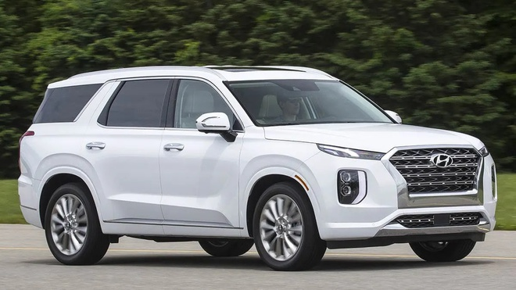
4
Quiz
What vehicle is this?
2. It has four wheels. It runs on petrol or electricity, and can carry up to eight passengers.
→ It’s a car

Slide 21
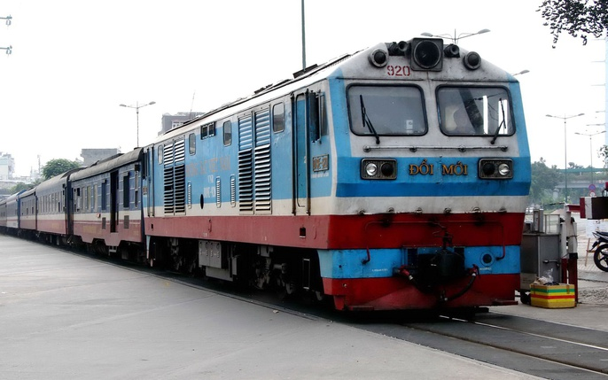
4
Quiz
What vehicle is this?
3. It carries many passengers and runs on tracks.
→ It’s a train

Slide 22
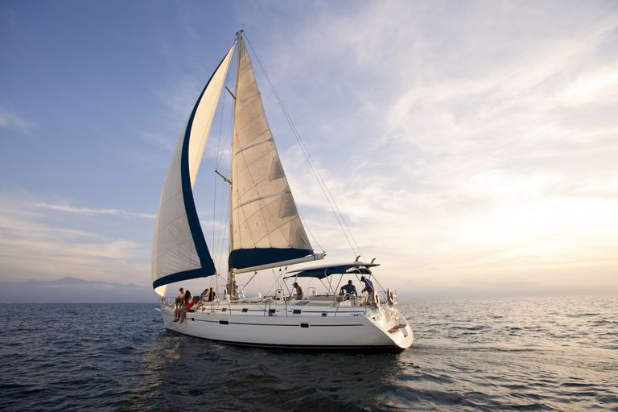
4
Quiz
What vehicle is this?
4. It sails on the sea. It needs wind to sail.
→ Sailing boat

Slide 23
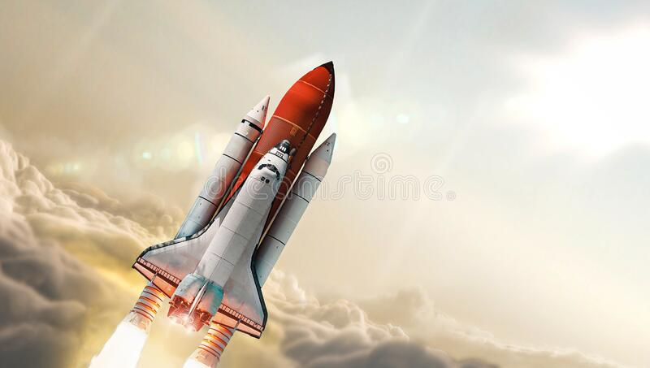
4
Quiz
What vehicle is this?
5. It travels in space. It can even carry people to the moon.
→ It’s a rocket / spaceship

Slide 24
PRACTICE
4
Quiz. What vehicle is this?
1. It has two wheels and you pedal it.
2. It has four wheels. It runs on petrol or electricity, and can carry up to eight passengers.
3. It carries many passengers and runs on tracks.
4. It sails on the sea. It needs wind to sail.
5. It travels in space. It can even carry people to the moon.
→ bicycle / bike
→ car
→ train
→ sailing boat
→ rocket / spaceship

Slide 25
PRODUCTION
5
Discussion: What do you think these vehicles will be like in 50 years?
I think people will use some of these vehicles in 50 years. They will be innovated to save more energy and save the environment.(Tôi nghĩ mọi người sẽ sử dụng một số phương tiện này trong 50 năm nữa. Chúng sẽ được cải tiến để tiết kiệm năng lượng hơn và tiết kiệm môi trường

Slide 26

CONSOLIDATION
2
HOMEWORK
Prepare the vocabulary for the next lesson: A closer look 1.
Do the exercise in the Workbook.

Slide 27

Website: hoclieu.vn
Fanpage: facebook.com/www.tienganhglobalsuccess.vn/

