Slide 1
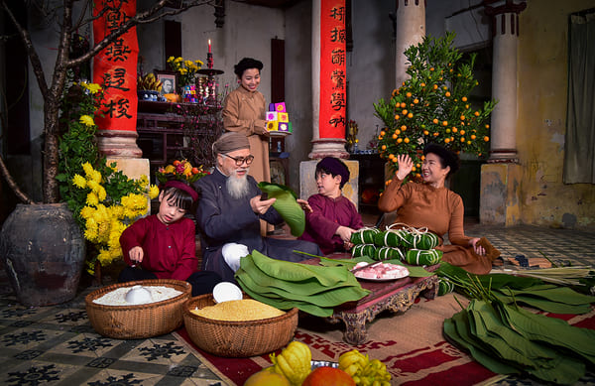
Period 35
Unit
5
OUR CUSTOMS AND TRADITIONS
LESSON 1: GETTING STARTED

Slide 2
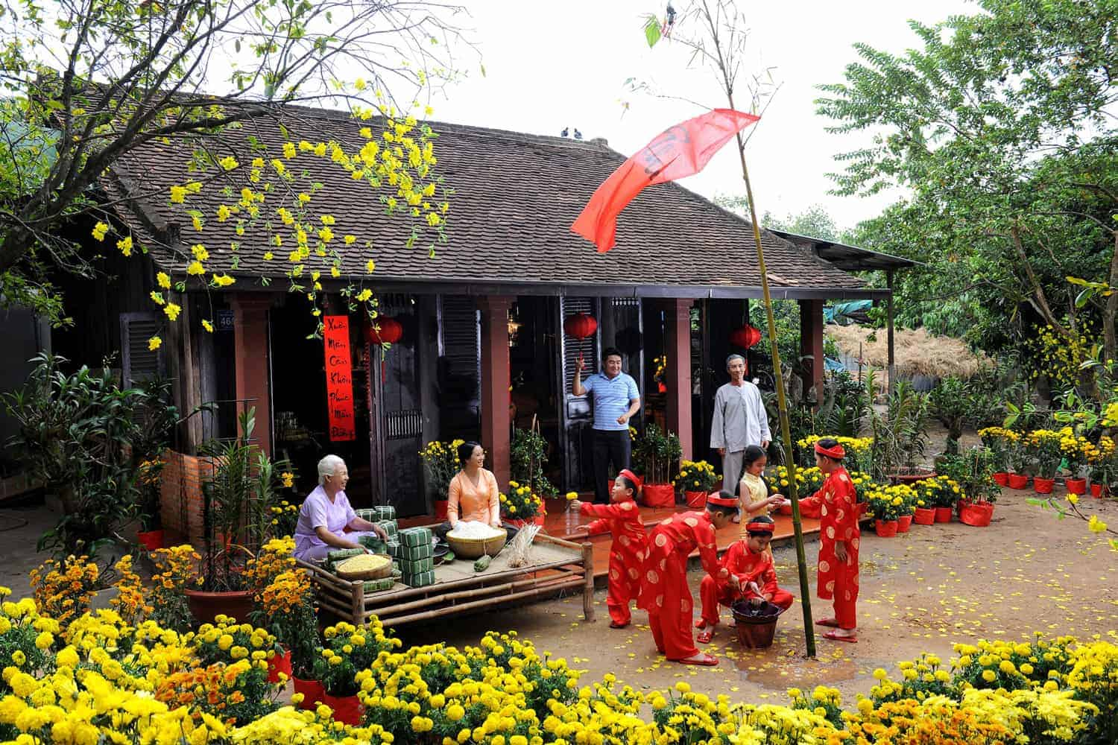
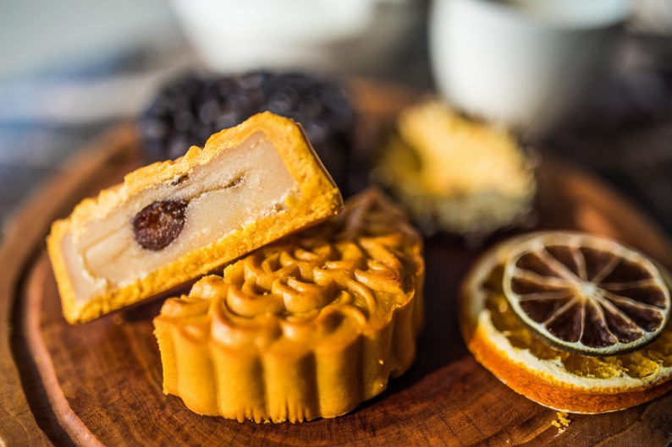
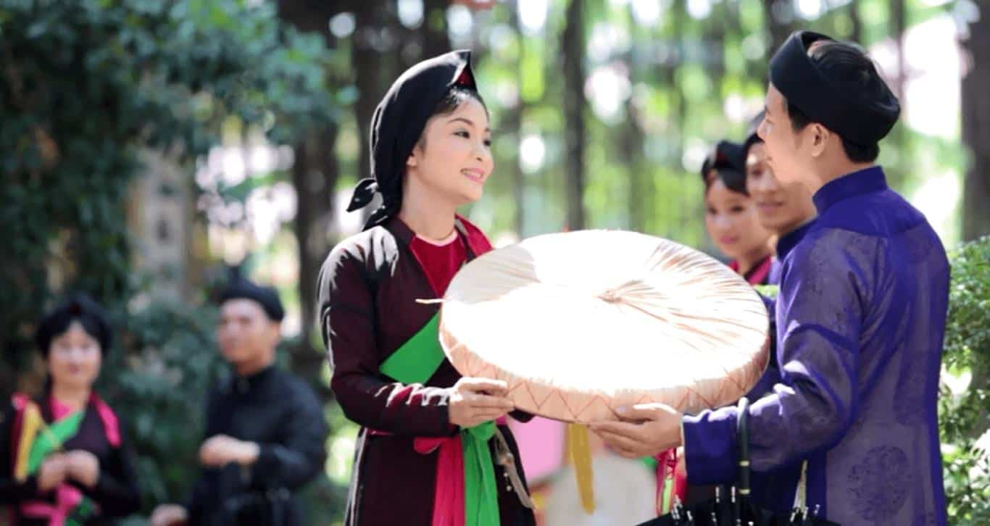
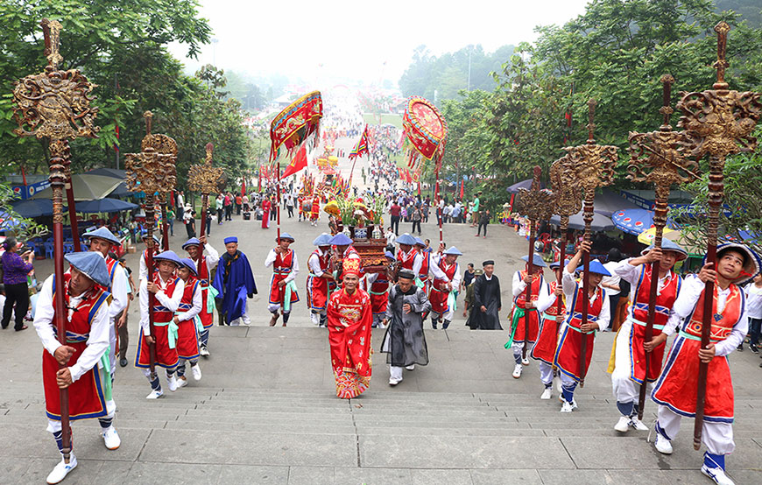
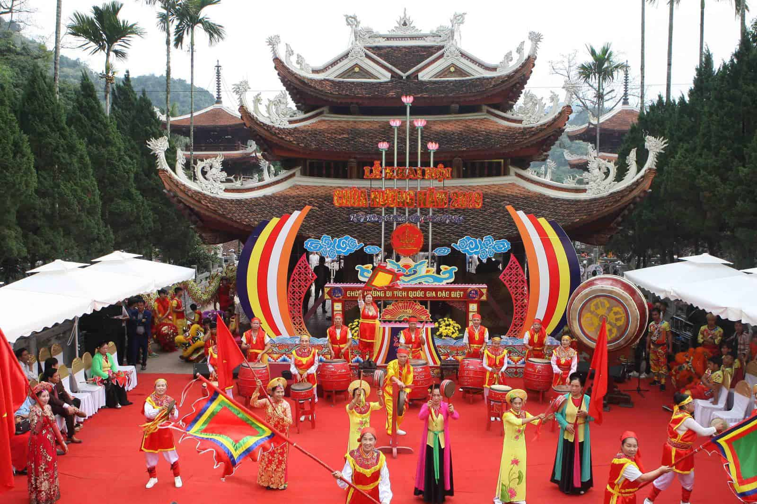
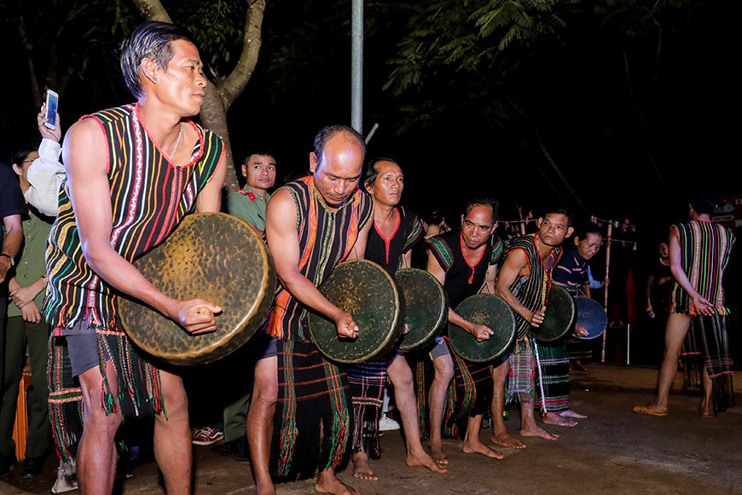
Hùng Kings Temple Festival
Perfume Pagoda Festival
Lunar New Year
Lim Festival
Mid-Autumn Festival
Gong Festival

Slide 3
PRESENTATION
Tet is coming!

Slide 4
VOCABULARY
admire (v)
/ədˈmaɪər/
khâm phục, ngưỡng mộ/ ngắm (hoa, trăng…)

Slide 5
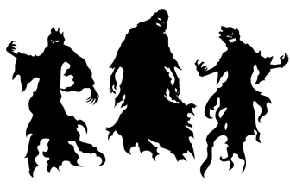
VOCABULARY
bad spirit (n)
/bæd ˈspɪr.ɪt/
điều xấu xa, tà ma

Slide 6
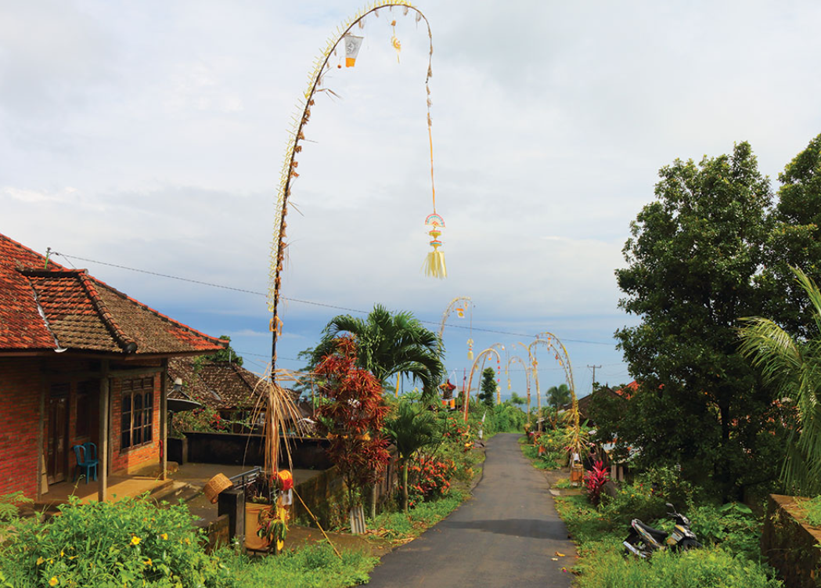
VOCABULARY
bamboo pole (n)
/bæmˈbuː pəʊl/
cây nêu

Slide 7
VOCABULARY
chase away (phr. v)
/tʃeɪs əˈweɪ/
xua đuổi

Slide 8
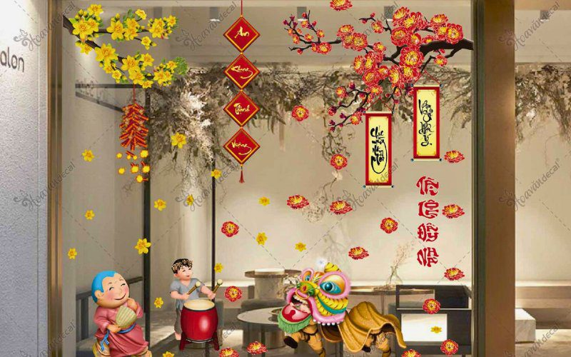
VOCABULARY
decoration (n)
/ˌdek.əˈreɪ.ʃən/
sự trang trí/ đồ trang trí
decorative (adj)
/ˈdek.ər.ə.tɪv/
để trang trí

Slide 9
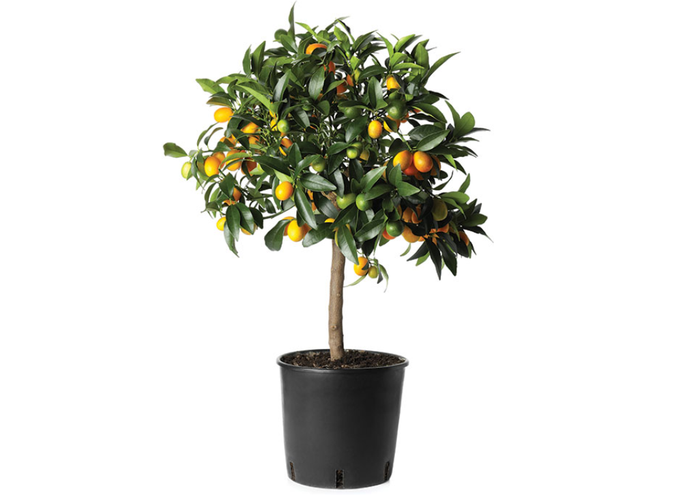
VOCABULARY
kumquat tree (n)
/ˈkʌm.kwɒt triː/
cây quất

Slide 10
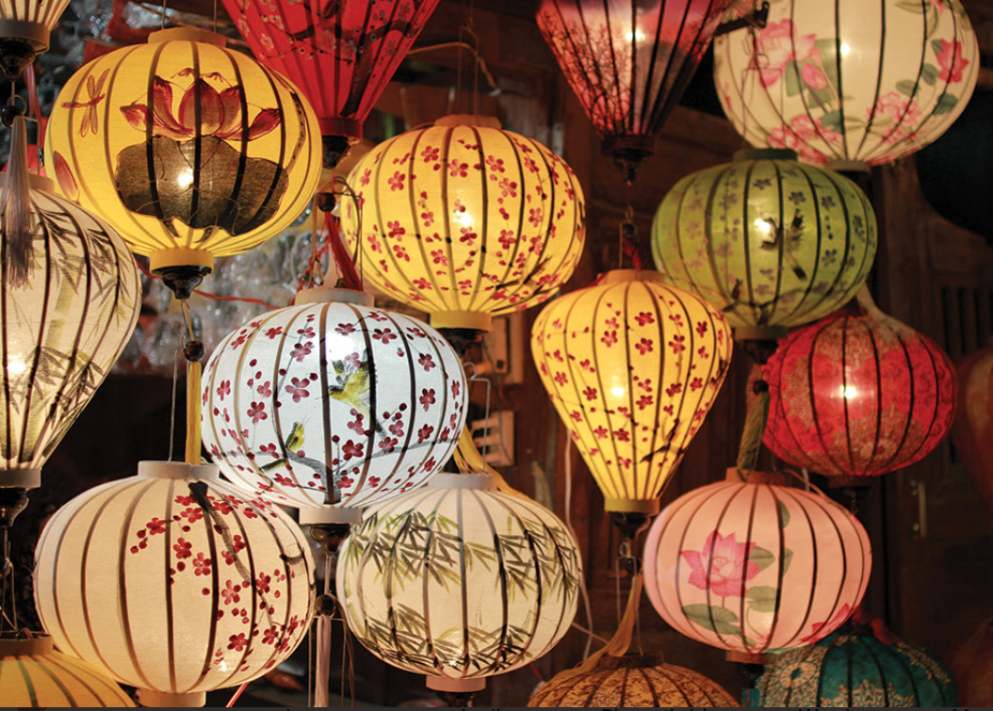
VOCABULARY
lantern (n)
/ˈlæn.tən/
đèn lồng

Slide 11
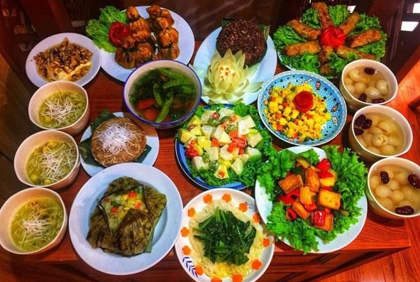
VOCABULARY
offering (n)
/ˈɒfərɪŋ/
đồ thờ cúng

Slide 12
VOCABULARY
ornamental tree (n)
/ɔːnəˈmentl triː/
cây cảnh

Slide 13
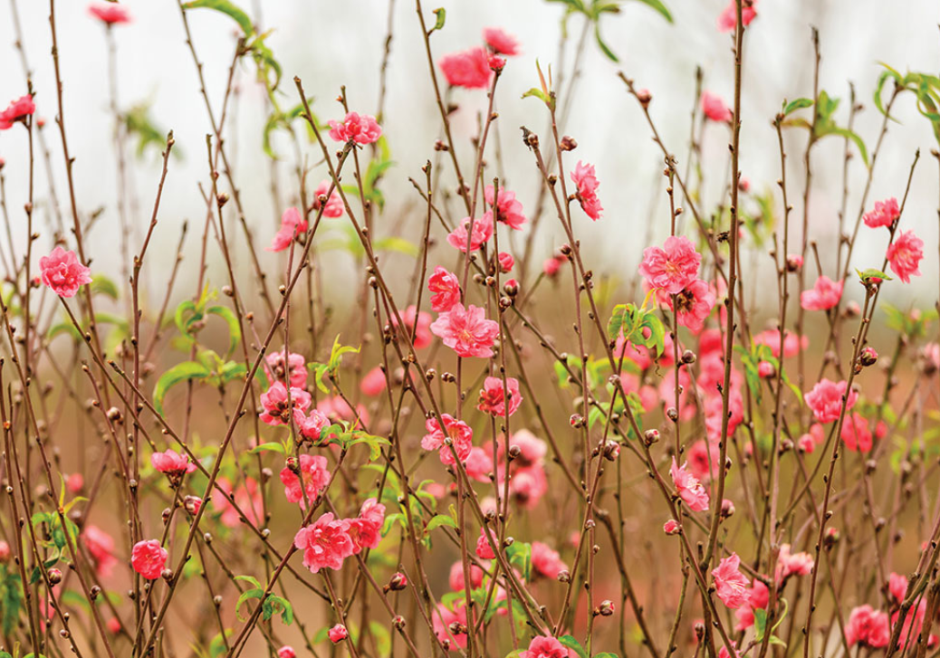
VOCABULARY
peach blossom (n)
/piːtʃ ˈblɒs.əm/
hoa đào

Slide 14
VOCABULARY
pray (+ for) (v)
/preɪ/
cầu nguyện

Slide 15
PRESENTATION
New words | Pronunciation | Meaning
1. admire (v) | /ədˈmaɪər/ | khâm phục, ngưỡng mộ/ ngắm
2. bad spirit (n) | /bæd ˈspɪr.ɪt/ | điều xấu xa, tà ma
3. bamboo pole (n) | /bæmˈbuː pəʊl/ | cây nêu
4. chase away (phr. v) | /tʃeɪs əˈweɪ/ | xua đuổi
5. decoration (n) | /ˌdek.əˈreɪ.ʃən/ | sự trang trí, đồ trang trí
6. decorative (adj) | /ˈdek.ər.ə.tɪv/ | để trang trí
7. kumquat tree (n) | /ˈkʌm.kwɒt triː/ | cây quất

Slide 16
PRESENTATION
New words | Pronunciation | Meaning
8. lantern (n) | /ˈlæn.tən/ | đèn lồng
9. offering (n) | /ˈɒfərɪŋ/ | đồ thờ cúng
10. ornamental tree (n) | /ɔːnəˈmentl triː/ | cây cảnh
11. peach blossom (n) | /piːtʃ ˈblɒs.əm/ | hoa đào
12. pray (v) | /preɪ/ | cầu nguyện

Slide 17
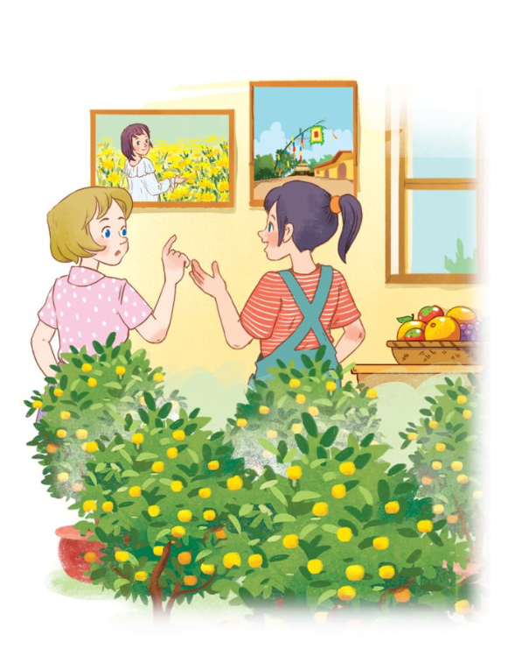
PRACTICE
Task 1, p. 50: Listen and read.
What can you see in the picture?
- Can you guess what they are talking about?

Slide 18
PRACTICE
Task 1, p. 50: Listen and read.
Elena: Wow, this girl looks so cute.
Trang: Yeah ... She’s my cousin. She’s at Sa Dec Flower Village. Tet is coming soon, so many people visit flower villages to take pictures with the blooming flowers.
Elena: Oh, I’m fond of admiring the flowers. Does your family visit places like this too?
Trang: Yes, we do. We usually visit Nhat Tan Village to buy kumquat trees and peach blossoms.
Elena: I see flowers and ornamental trees everywhere these days. What are they for?
Trang: We, Vietnamese, use plants and flowers for decorations and for oﬀerings. They are an important part of our Tet tradition.
Elena: And what’s that tall tree in the photo?
Trang: Well, it’s actually a bamboo pole. People place it in the yard of the communal house. They hang decorative items like small bells and lanterns on it. They want to chase away bad luck and pray for a lucky new year.
Elena: Interesting! I didn’t know that.

Slide 19
Task 2, p. 51: Read the conversation again and tick T (True) or F (False).
PRACTICE
Sentences | T | F
1. Elena and Trang are at Sa Dec Flower Village.
2. Many people visit ﬂower villages to take photos.
3. Trang’s family usually buys kumquat trees and peach blossoms at Nhat Tan Village.
4. Flowers are not part of any Vietnamese traditions.
5. People decorate bamboo poles with small bells and lanterns for New Years.

Slide 20
Task 2, p. 51: Read the conversation again and tick T (True) or F (False).
PRACTICE
Sentences | T | F
1. Elena and Trang are at Sa Dec Flower Village.
2. Many people visit ﬂower villages to take photos.
3. Trang’s family usually buys kumquat trees and peach blossoms at Nhat Tan Village.
4. Flowers are not part of any Vietnamese traditions.
5. People decorate bamboo poles with small bells and lanterns for New Years.
Trang’s cousin is at Sa Dec Flower Village.
Flowers are an important part of Tet.

Slide 21
PRACTICE
Task 3, p. 51: Match the phrases with the correct pictures.

Slide 22
PRACTICE
Task 4, p. 51: Complete the sentences with the verbs from the box.
1. The British decorate their Christmas trees and ______ presents under them.
2. Tom likes to ______ the view from the hill.
3. In many cultures, knocking on wood is a way to ______ away bad spirits.
4. Many Asians go to Buddhist temples to ______ for good luck.
place
admire
chase
pray

Slide 23
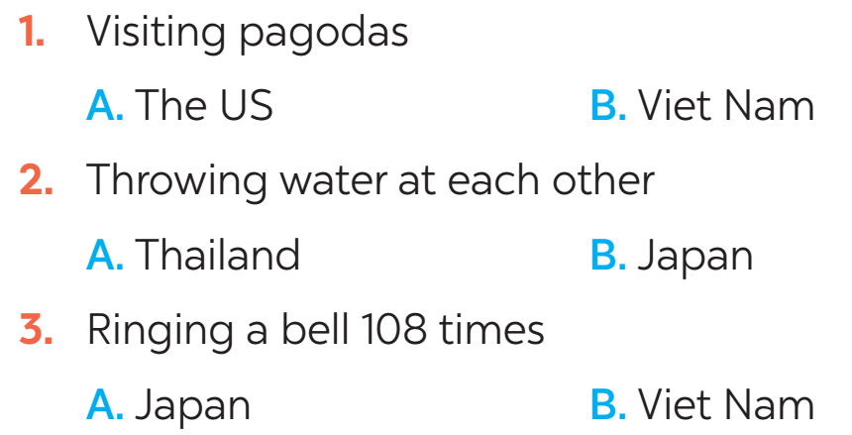
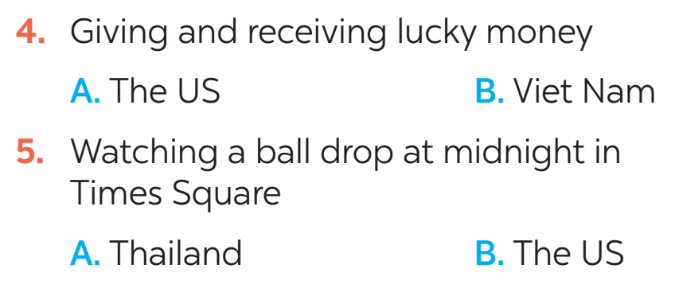
FURTHER PRACTICE
New Years around the world.
Task 5, p. 51: People around the world celebrate New Years differently. Choose the tradition below.

Slide 24
CONSOLIDATION
1
Wrap-up
What have we learnt in this lesson?
identify the topic of the unit
use lexical items related to Tet holiday

Slide 25
CONSOLIDATION
2
Homework
- Learn the new words by heart.
- Practise talking about Tet Holiday.

