Slide 2
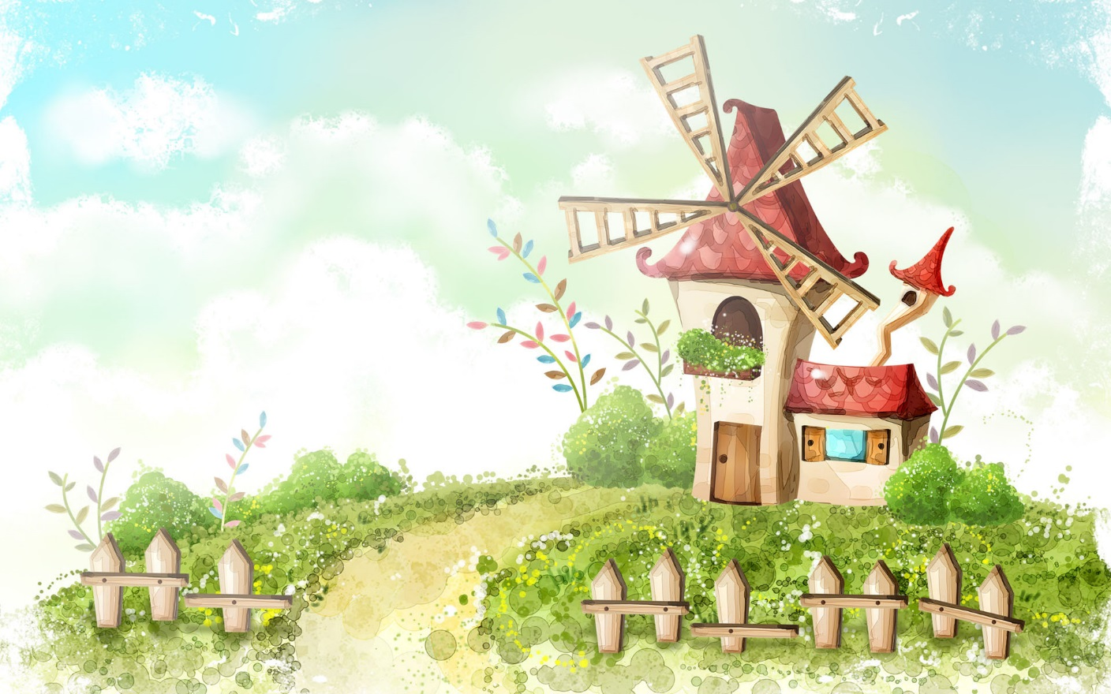
Welcome to our class 7E
TEACHER :NGUYỄN THỊ LANH

Slide 3
Period : 94
Unit 12
ENGLISH-SPEAKING COUNTRIES
Lesson 1: GETTING STARTED
A holiday in Australia

Slide 4
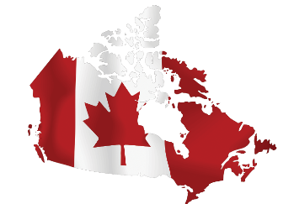
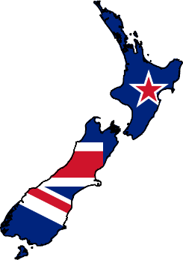
WARM-UP
FLAGS MATCHING
1
2
3
The USA
Canada
The UK
4
5
New Zealand
Australia

Slide 5
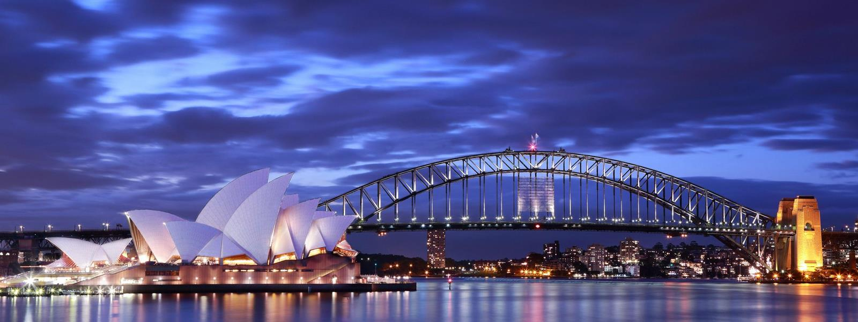
Period : 94
Unit 12
ENGLISH-SPEAKING COUNTRIES
Lesson 1: GETTING STARTED
A holiday in Australia

Slide 6
PRESENTATION
* Vocabulary:
island (n)
/ˈaɪlənd/
hòn đảo

Slide 7
PRESENTATION
* Vocabulary:
sunset (n)
/ˈsʌnset/
mặt trời lặn, hoàng hôn

Slide 8
PRESENTATION
* Vocabulary:
landscape (n)
/ˈlændskeɪp/
phong cảnh

Slide 9
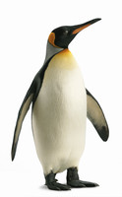
PRESENTATION
* Vocabulary:
penguin (n)
/ˈpeŋɡwɪn/
chim cánh cụt

Slide 10
PRESENTATION
* Vocabulary:
New words | Pronunciation | Meaning
1. island (n) | /ˈaɪlənd/ | hòn đảo
2. sunset (n) | /ˈsʌnset/ | mặt trời lặn, hoàng hôn
3. landscape (n) | /ˈlændskeɪp/ | phong cảnh
4. penguin (n) | /ˈpeŋɡwɪn/ | chim cánh cụt

Slide 11
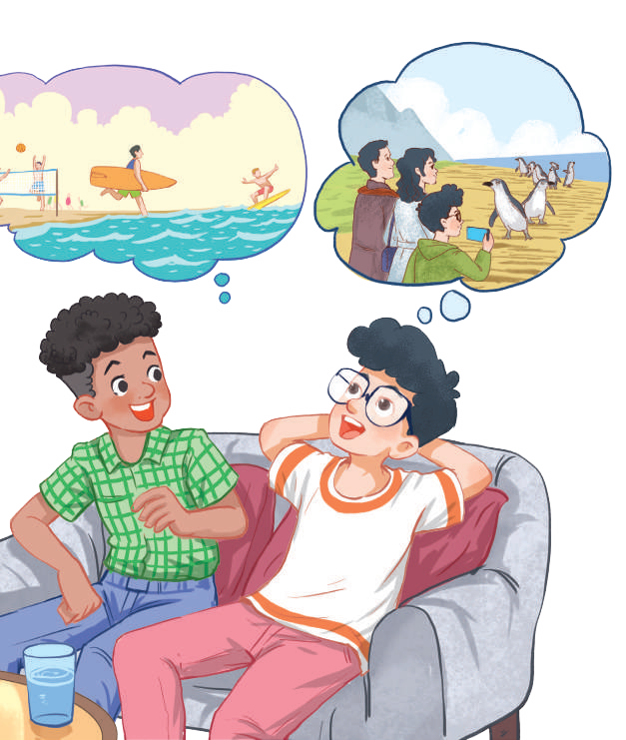
PRESENTATION
* Set the scene:
1. Who are these boys?
2. What do you think they will
mention in the conversation ?

Slide 12
PRESENTATION
1
Listen and read.
Mark: How was your holiday in Australia, Phong?
Phong: It was fantastic! I got to use my English in real life: asking for directions, reading maps, talking to local people, ...
Mark: Oh … Your English is much better.
Phong: Thanks.
Mark: Did you travel a lot?
Phong: Just around Melbourne, the city with four seasons in a day.
Mark: Wow ... I didn’t know that. How was it?
Phong: It was great! We took a tour to Phillip Island.
Mark: What did you see?
Phong: We went penguin watching.
Mark: It sounds pretty exciting.
Phong: It was. Australia has amazing landscapes.
Mark: Yes, and Australians love outdoor activities.
Phong: Right. There were plenty of people enjoying the parks and beaches.
Mark: I’m glad that you had a wonderful time there.
Phong: Thanks, Mark.

Slide 13
PRESENTATION
* Set the scene:
1. Who are these boys?
1. They are Phong and Mark
2. What do you think they will
mention in the conversation ?
2. They mention Phong’s use of English in real life, his travels and Australia’s people and landscapes.

Slide 14
PRACTICE
1
Listen and read.
Mark: How was your holiday in Australia, Phong?
Phong: It was fantastic! I got to use my English in real life: asking for directions, reading maps, talking to local people, ...
Mark: Oh … Your English is much better.
Phong: Thanks.
Mark: Did you travel a lot?
Phong: Just around Melbourne, the city with four seasons in a day.
Mark: Wow ... I didn’t know that. How was it?
Phong: It was great! We took a tour to Phillip Island.
Mark: What did you see?
Phong: We went penguin watching.
Mark: It sounds pretty exciting.
Phong: It was. Australia has amazing landscapes.
Mark: Yes, and Australians love outdoor activities.
Phong: Right. There were plenty of people enjoying the parks and beaches.
Mark: I’m glad that you had a wonderful time there.
Phong: Thanks, Mark.

Slide 15
PRACTICE
2
What are Phong and Mark talking about?
A. Phong’s holiday in Australia B. English-speaking countries C. The tour to Phillip Island

Slide 16
PRACTICE
3
Read again and tick the information you can find in the conversation.
1. In Australia, Phong used English in real life. 2. Phong visited some museums. 3. Phillip Island is far from Melbourne. 4. Australia is beautiful. 5. Australians love outdoor activities.
Yes, and Australians love outdoor activities.
It was fantastic! I got to use my English in real life
It was. Australia has amazing landscapes.

Slide 17
PRACTICE
4
Complete the sentences with the words and phrases from the box.
island sunset landscape
Australians penguin watching
1. This is a picture of the ______________ in my village. 2. – Where did you go ___________________? – On the beach. 3. – Is Phu Quoc a(n) ____________? – Yes, it is. 4. We had dinner on the beach after ____________. 5. Most _____________ like outdoor sports and games.
landscape
penguin watching
island
sunset
Australians

Slide 18
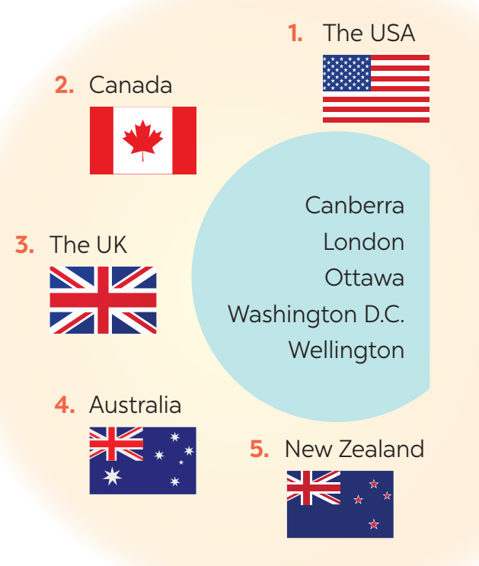
PRACTICE
5
MATCHING GAME: What’s its capital city?
1. Washington D.C.
2. Ottawa
3. London
4. Canberra
5. Wellington

Slide 19
PRACTICE
5
DISCUSSION
What do you know about the countries?

Slide 20
HOMEWORK
➢Learn by heart vocabulary.
➢ Practice the conversation again.
Do exercises in your workbooks.
Search for more English- speaking countries.
➢ Prepare: Lesson 2: A Closer look 1 on P.126-127.

Slide 21
Thanks for
your attention!
Goodbye!
Thanks for
your attention!

