Slide 2
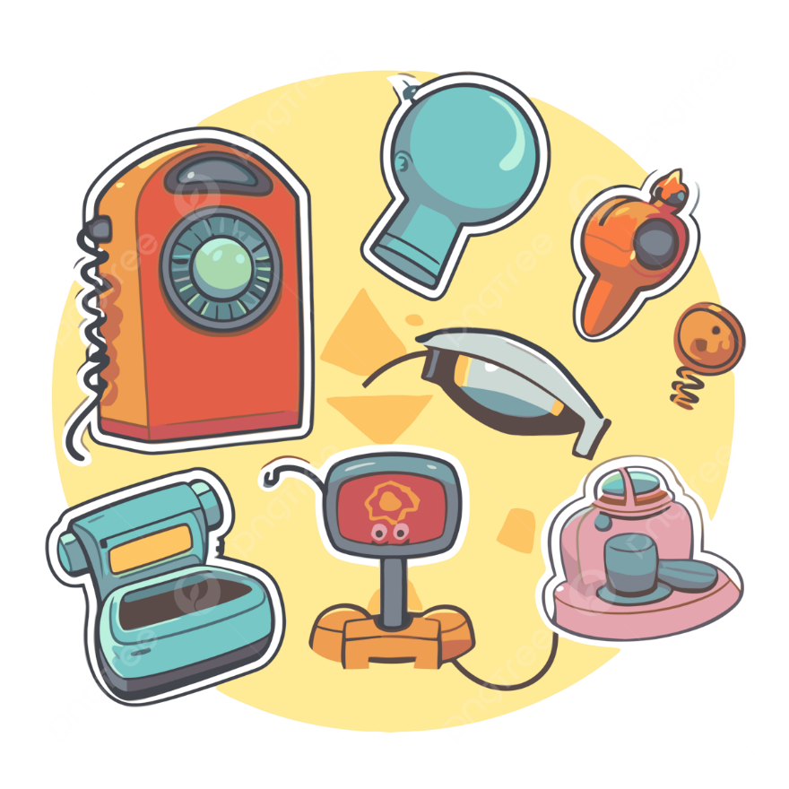
Unit
11
ELECTRONIC DEVICES
LESSON 2: A CLOSER LOOK 1
1

Slide 3
LESSON 2: A CLOSER LOOK 1
LESSON 1: GETTING STARTED
WARM-UP
Brainstorming
Vocabulary
Task 1: Match the electronic devices with the correct pictures.
Task 2: Complete the sentences with the material words from the box.
Task 3: Circle the correct words or phrases to complete the following sentences.
VOCABULARY
Task 4: Listen and repeat the sentences. Pay attention to the stress pattern of each sentence.
Task 5: Write each sentence in the suitable box. Then listen, check, and repeat.
PRONUNCIATION
CONSOLIDATION
Wrap-up
Homework

Slide 4
WARM-UP
BRAINSTORMING

Slide 5
VOCABULARY
robotic vacuum cleaner (n)
/rəʊˈbɒtɪk ˈvækjuːm ˈkliːnər/
robot hút bụi tự động

Slide 6
VOCABULARY
camcorder (n)
/ˈkæmkɔːrdər/
máy quay phim xách tay

Slide 7
VOCABULARY
copper (n)
/ˈkuːpər/
đồng

Slide 8
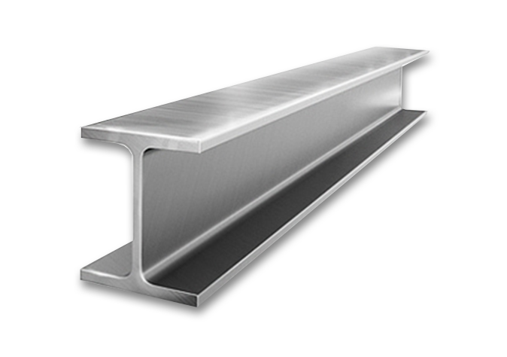
VOCABULARY
steel (n)
/stiːl/
thép

Slide 9
VOCABULARY
New words | Pronunciation | Meaning
1. robotic vacuum cleaner (n) | /rəʊˈbɒtɪk ˈvækjuːm ˈkliːnər/ | robot hút bụi tự động
2. camcorder (n) | /ˈkæmkɔːrdər/ | máy quay phim xách tay
3. copper (n) | /ˈkuːpər/ | đồng
4. steel (n) | /stiːl/ | thép

Slide 10
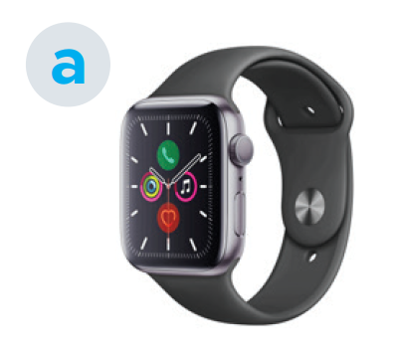
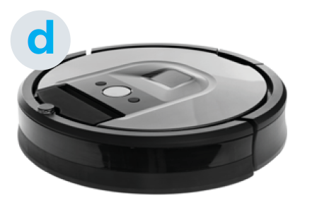
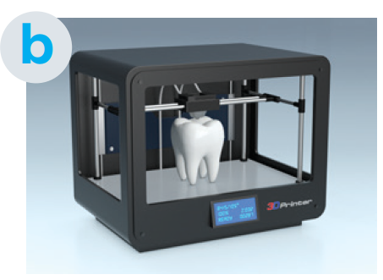
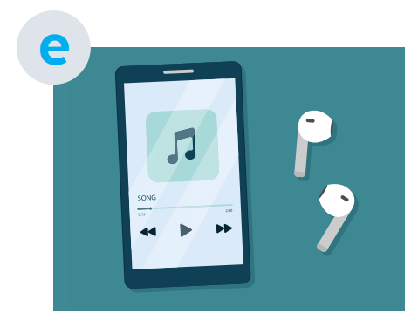
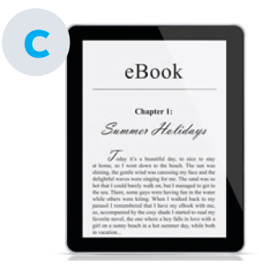
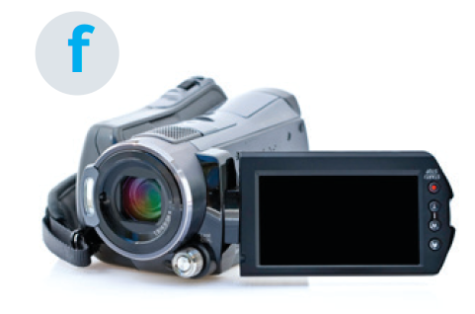
VOCABULARY
1
Match the electronic devices with the correct pictures.
1. robotic vacuum cleaner
1. d
2. c
3. a
4. e
5. b
6. f
2. e-reader
3. smartwatch
4. portable music player
5. 3D printer
6. camcorder

Slide 11
PRACTICE
2
Complete the sentences with the material words from the box.
rubber cardboard steel plastic copper
1. We often use ________, which is a soft reddish-brown metal, to make
electric wire, pipes, and coins. 2. Today, ________ is often used to make cases of electric devices because
it doesn’t conduct electricity and it is light, and easily be shaped into many
different forms. 3. We often use ______ in the construction industry because it is a strong
and hard metal. 4. We use ________, which comes from rubber trees, for making tyres,
boots, etc. 5. The kids need a piece of __________ to easily cut shapes and make toys.
cooper
plastic
steel
rubber
cardboard

Slide 12
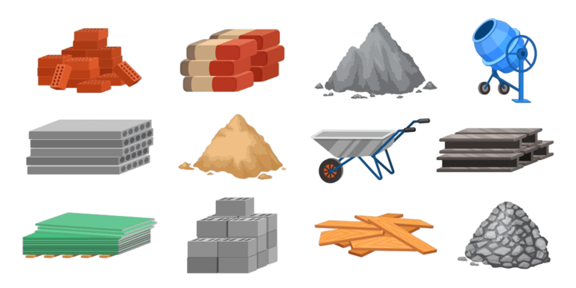
PRACTICE
What do you call these materials in Vietnamese?

Slide 13
PRACTICE
3
Circle the correct words or phrases to complete the following sentences.
1. The most common use for rubber / iron is for producing tyres for cars, motorbikes, bicycles, etc. 2. The most popular material for the construction of buildings and bridges is plastic / steel because it is strong enough to support heavy loads. 3. Today 3D printers / photocopiers allow us to create three-dimensional objects, e.g. medical implants, clothes, cars, etc. 4. We use copper / cardboard to make food packaging such as cereal and pasta boxes, as it is food-safe and not harmful to the environment. 5. They use camcorders / portable music players for live-streaming video content such as concerts, live events, and webinars.

Slide 14
PRONUNCIATION
4
Listen and repeat the sentences. Pay attention to the stress pattern of each sentence.
Don’t talk!
Don’t worry!
Keep silent!
Look out!

Slide 15
PRONUNCIATION
5
Write each sentence in the suitable box. Then listen, check, and repeat.
1. I see!
2. Be quiet! 3. Say sorry!
4. Watch out! 5. That long?
6. Speak louder!
1. I see!
2. Be quiet!
4. Watch out!
3. Say sorry!
6. Speak louder!
5. That long?

Slide 16
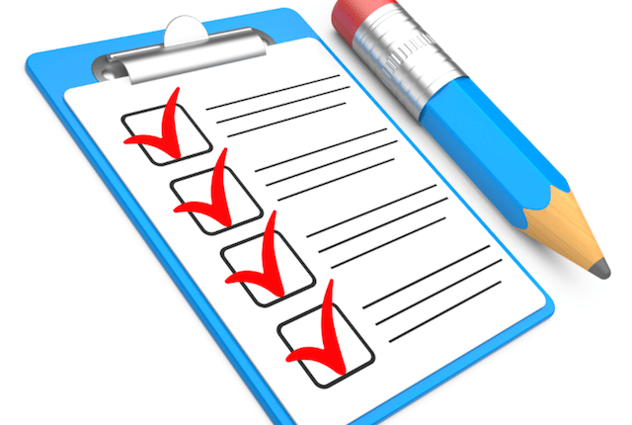
CONSOLIDATION
1
Wrap-up
What have we learnt in this lesson?
Use the lexical items related to the topic Electronic devices.
Say the sentences with all word having stress correctly.

Slide 17
CONSOLIDATION
2
Homework
- Do exercises in the Workbook.

Slide 18
Website: hoclieu.vn
Fanpage: www.facebook.com/tienganhglobalsuccess.vn/

