Slide 2
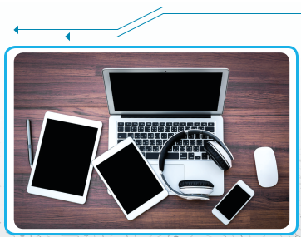
Unit
11
ELECTRONIC DEVICES
LESSON 6: SKILLS 2
1

Slide 3
LESSON 6: SKILLS 2
LESSON 1: GETTING STARTED
WARM-UP
Brainstorming
Task 1: Work in pairs. Discuss the following questions.
Task 2: You will hear Trang talking about her favourite electronic device. Listen and choose the correct answer A, B, or C.
Task 3: Listen again and fill in each blank with ONE word that you hear.
LISTENING
Task 4: Think of one of your favourite electronic devices. Make notes of your answers to the following questions.
Task 5: Write a paragraph (100 – 120 words) about what your favourite electronic device can do now and what it will be able to do in the future. Use the ideas in 4 or of your own.
WRITING
CONSOLIDATION
Wrap-up
Homework

Slide 4
WARM-UP
What can a smartphone do
- NOW?
BRAINSTORMING
- IN THE FUTURE?

Slide 5
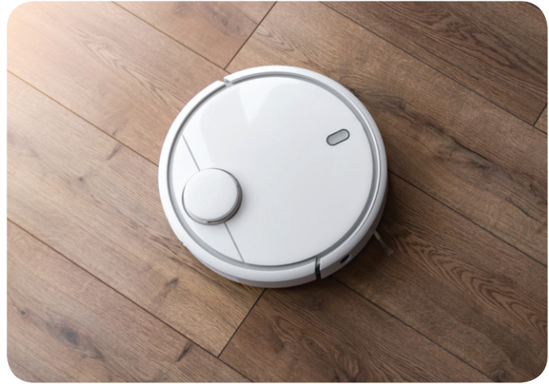
LISTENING
1
Work in pairs. Discuss the following questions.
1. What is this electronic device?
2. Do you want to have one in
your home? Why / Why not?
It’s a robotic vacuum cleaner .

Slide 6
LISTENING
2
You will hear Trang talking about her favourite electronic device. Listen and choose the correct answer A, B, or C.
1. In Trang’s opinion, cleaning the floor ______.
A. is an easy and interesting task
B. is boring and takes a lot of time
C. can only be done by housekeepers
2. Trang’s current robotic vacuum cleaner can clean ______.
A. almost every dust, spot, and dirty mark in her house
B. only dust, spots, and dirty marks that we can see
C. dust, spots, and dirty marks under human control

Slide 7
LISTENING
2
You will hear Trang talking about her favourite electronic device. Listen and choose the correct answer A, B, or C.
3. If you drop crumbs to the floor, robotic vacuum cleaners of the future will come by and ______.
A. wipe all of them with a rubber
B. suck them all up
C. remind you to clean them
4. In the future, laser technology will enable robot vacuum cleaners to ______.
A. get to any floor or room in our houses
B. climb stairs and open doors or drawers
C. see everything on the ground

Slide 8
LISTENING
3
Listen again and fill in each blank with ONE word that you hear.
1. Trang can control her current robotic vacuum cleaner with an app on her ___________. 2. Trang’s current robotic vacuum cleaner is easy to store and ______. 3. Robotic vacuum cleaners of the future will be able to recognize patterns and then take _______. 4. Trang thinks robotic vacuum cleaners will be more _______ to us in the future.
smartphone
carry
action
helpful

Slide 9
WRITING
4
Think of one of your favourite electronic devices. Make notes of your answers to the following questions.
– What is your favourite electronic device?
– What can it do for you now?
– What will it be able to do for you in the future?

Slide 10
WRITING
5
Write a paragraph (100 – 120 words) about what your favourite electronic device can do now and what it will be able to do in the future. Use the ideas in 4 or of your own.
My favourite electronic device is _________________________ ________________________________________________________________________________________________________ ___________________________________________________.

Slide 11
WRITING
5
Write a paragraph (100 – 120 words) about what your favourite electronic device can do now and what it will be able to do in the future. Use the ideas in 4 or of your own.
My favourite electronic device is a smartwatch. Currently, it helps me stay connected and track my fitness. It also allows me to receive notifications, answer calls, and play music right from my wrist. With its built-in fitness tracking features, it monitors my steps, heart rate, and sleep patterns, helping me maintain a healthy lifestyle. In the future, I think my smartwatch will become even more advanced.
It will likely incorporate advanced health monitoring technologies, providing real-time analysis of vital signs and even detecting early signs of potential health issues. Additionally, it will be able to seamlessly integrate with other smart devices, allowing me to control home automation, make secure payments, and navigate augmented realities. As technology continues to evolve, smartwatches like mine hold the potential to become one of our indispensable companions.

Slide 12
CONSOLIDATION
1
Wrap-up
What have we learnt in this lesson?
Listen for information about electronic devices.
Write a paragraph about electronic devices.

Slide 13
CONSOLIDATION
2
Homework
- Do exercises in the Workbook.

Slide 14
Website: hoclieu.vn
Fanpage: www.facebook.com/tienganhglobalsuccess.vn/

