Slide 1
Unit 11: OUR GREENER WORLD lesson 4: communication
Grade 6

Slide 2
Objectives
By the end of the lesson, students can be able to:
learn how to give warnings;
practise using some grammar points and vocabulary related to the topic.

Slide 3


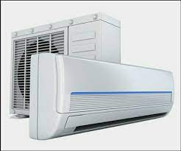



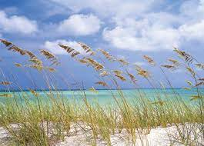
Vocabulary
1. Warning (n) /ˈwɔː.nɪŋ/
2. Breeze (n) /briːz/
3. Air conditioner (n)
/ˈeə kənˌdɪʃ.ən.ər/
4. Throw away (v)
5. Decorate (v)
6. Turn on (v)
Lời cảnh báo
Làn gió nhẹ lướt qua
Điều hòa
Vứt đi , quẳng đi
Trang trí
Bật lên

Slide 4
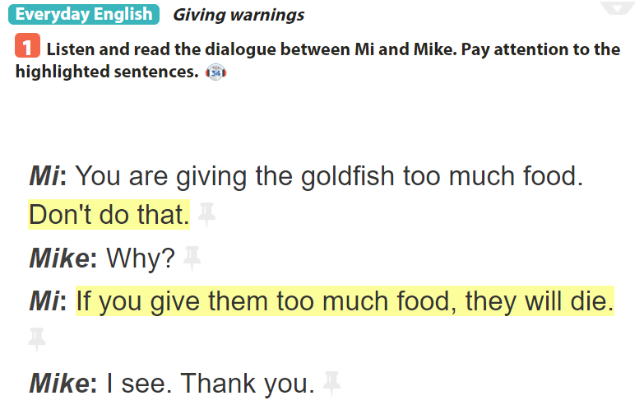

Slide 5
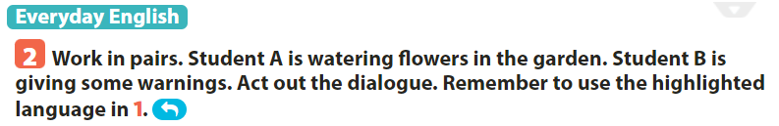
Example:
A: Don’t water these flowers too much.
B: Why?
C: If you water them too much, they will die.

Slide 6
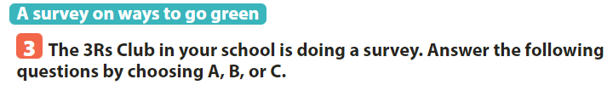
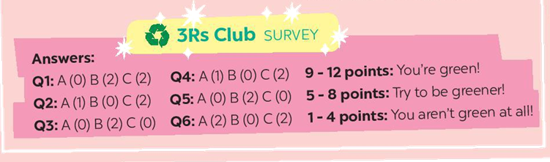
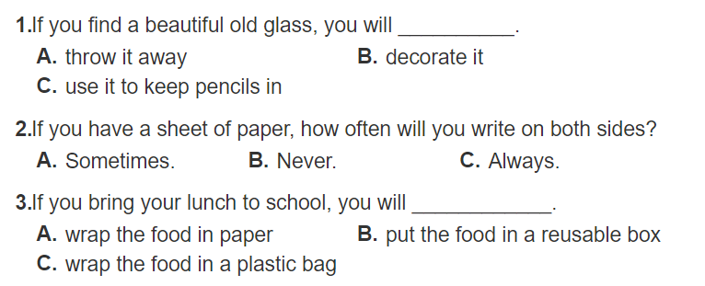

Slide 7
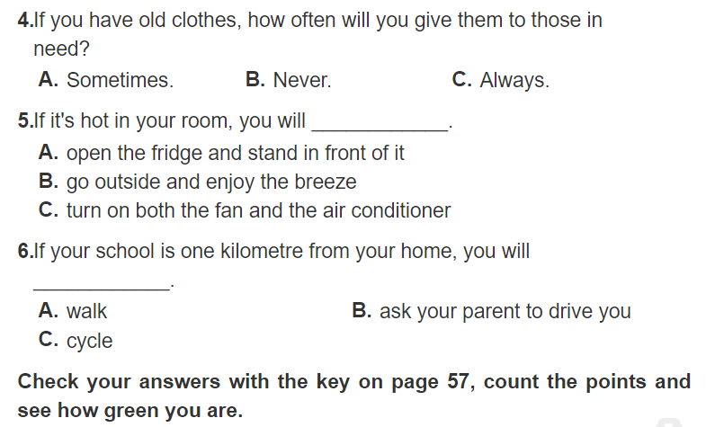

Slide 9
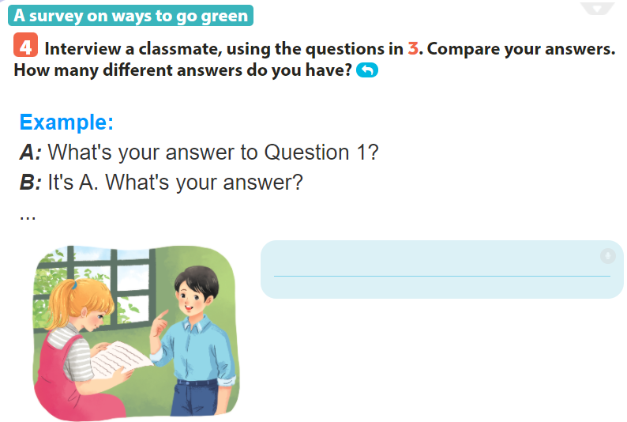
A: What’s your answer to question 2?
B: It’s C. How about you?
A: I choose B.

Slide 10
SUM UP
By the end of the lesson, students can be able to:
- learn how to give warnings;
- practise using some grammar points and vocabulary related to the topic.
- Do exercise page ……

